Slide 1
MICROBIAL FOOD SAFETY A FOOD SYSTEMS APPROACH
Charlene Wolf-Hall and William Nganje

Slide 2
Chapter 9: Viruses and Prions

Slide 3
Key Questions
What is a virus?
What is a prion?
What viruses and prions are of most concern for microbial food safety?
What controls can prevent foodborne illness due to viruses and prions?

Slide 4
Viruses and Prions
Not Alive?
Require a host biochemical machinery to replicate
Border between chemistry and life
Infectious agents

Slide 5
Hepatitis A
Virus
Infects humans and primates

Slide 6
Noroviruses
Virus
Viral Infection
Fecal-oral transmission
Low infectious dose - ~18 particles
Vomiting and diarrhea

Slide 7
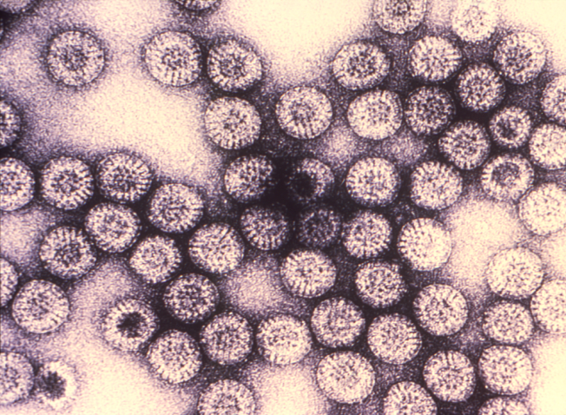
Rotavirus
Virus
Viral Infection
Fecal-oral transmission
Low infectious dose - ~10 particles
Vomiting and diarrhea

Slide 8
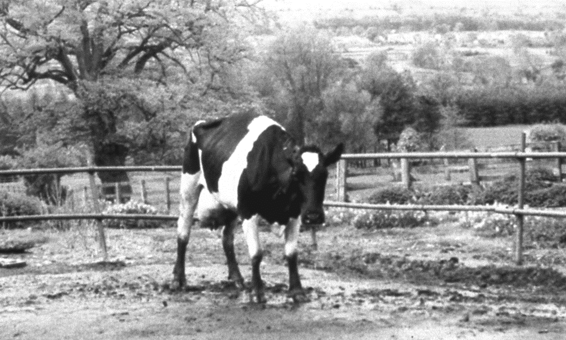
Prions
Proteinaceous, infectious particles
Infection - transmissible spongiform encephalopathies
Proteins that can remain biologically active through varying environmental and processing conditions
Deadly neurodegenerative disease
Scrapie in sheep
Chronic wasting disease (CWD) in deer
Bovine spongiform encephalopathy (BSE) in cattle; also known as mad cow disease
Creutzfeldt-Jakob disease (vCJD) in humans

Slide 9
THANK YOU
Name: Charlene Wolf-Hall & William Nganje
Email: charlene.hall@ndsu.edu & William.Nganje@ndsu.edu

