Slide 1
MICROBIAL FOOD SAFETY A FOOD SYSTEMS APPROACH
Charlene Wolf-Hall and William Nganje

Slide 2
Chapter 8: Eukaryotic Microorganisms of Concern in Food - Parasites and Molds

Slide 3
Key Questions
What is a eukaryotic microorganism?
What eukaryotic microorganisms are of most concern for microbial food safety?
What are the mechanisms by which these microorganisms cause illness?
What are the hazards these microorganisms present to consumers?
What controls can prevent foodborne illness due to these microorganisms?

Slide 4
Eukaryotic Microorganisms of Concern in Foods
Eukaryotes - Cells of the higher organisms, containing a true nucleus bounded by a nuclear membrane.
Prokaryotes - Cells, such as those of bacteria and blue green algae, which lack a nuclear membrane so that the nuclear material is either scattered in the cytoplasm or collected in a nucleoid region.
Eukaryotes of concerns in microbial food safety:
Parasitic worms and protozoa
Fungi - Mycotoxins

Slide 5
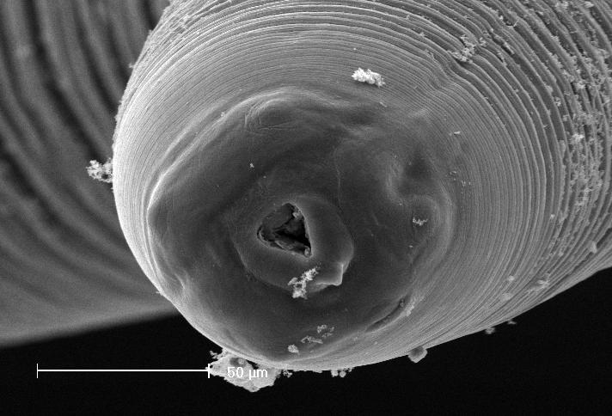
Anisakis Simplex
Helminth – Roundworm
Parasite of marine mammals; transmitted to humans by undercooked seafood

Slide 6
Taenia
Helminth – Flatworms
Host-adapted to swine, beef and humans

Slide 7
Trichinella spiralis
Helminth – Roundworm
Found in warm blooded animals, more common in pigs and bear

Slide 8
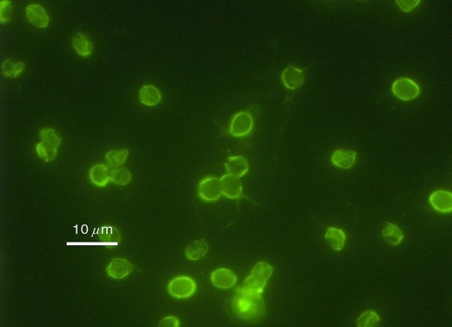
Cryptosporidium
Protozoan
Intracellular parasites transmitted through feces
Contaminated water is the main source

Slide 9
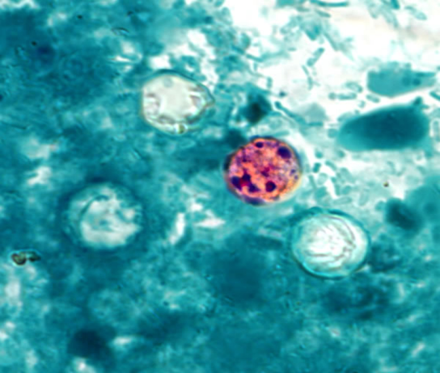
Cyclospora cayetanensis
Protozoan
Humans are the only source
Contaminated water is the main source
Parasitic Infection – Cyclosporiasis
Diarrhea
US stats
Cause 44,407 illnesses, 11 hospitalizations, and zero deaths per year
Average cost per case - $1,483
Controls
Use of safe, potable water for food preparation and cleaning
Sensitive to heating and boiling of water
Good hygiene

Slide 10
Giardia
Protozoan
Warm blooded animals and humans
Contaminated water is the main source

Slide 11
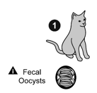
Toxoplasma gondii
Protozoan
Felines and humans
Contaminated water is the main source

Slide 12
Mycotoxins
Mold - A fungus with visible downy mycelium upon which powdery conidia can be seenl.
Mycotoxins – Toxic compounds produced by fungi.
Field Fungi - Fungi that invade food crops in the field. These fungi can damage grain as the seeds develop.
Storage Fungi - Fungi that grow in stored grain, spoiling quality and possibly safety.
Genera of most concern in food:
Aspergillus
Fusarium
Penicillium

Slide 13
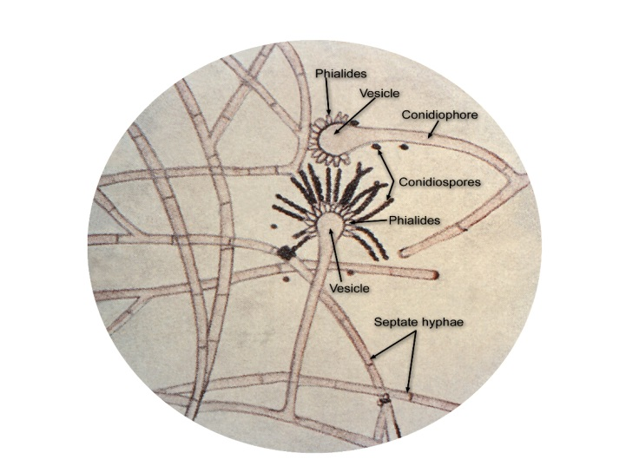
Aspergillus
Mold
Can be problems in field and storage
Higher risk in drought harvest years

Slide 14
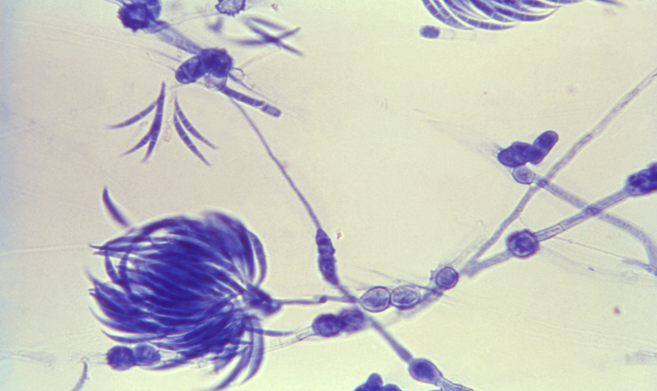
Fusarium
Mold
Field fungus
Higher risk in wet harvest years

Slide 15
Penicillium
Mold
Storage fungus; many psychrotrophs

Slide 16
THANK YOU
Name: Charlene Wolf-Hall & William Nganje
Email: charlene.hall@ndsu.edu & William.Nganje@ndsu.edu

