Slide 1
MICROBIAL FOOD SAFETY A FOOD SYSTEMS APPROACH
Charlene Wolf-Hall and William Nganje

Slide 2
Chapter 7: Gram-Negative Bacteria

Slide 3
Key Questions
What Gram-negative bacteria are of most concern for microbial food safety?
What are the mechanisms by which these Gram-negative bacteria cause illness?
What are the hazards that these Gram-negative bacteria present to consumers?
What controls to prevent foodborne illness due to these Gram-negative bacteria?

Slide 4
Gram Negative Bacteria of Concern in Food Safety
Of most concern in foods
Campylobacter
Escherichia coli
Salmonella
Shigella
Vibrio
Yersinia

Slide 5
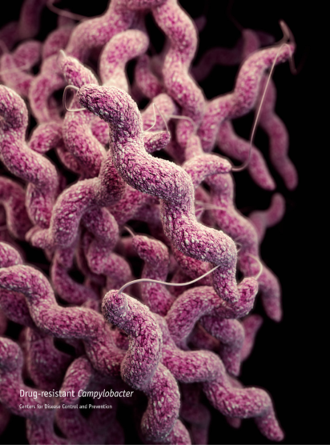
Campylobacter
Campylobacter jejuni and Campylobacter coli
Gram-negative spirally curved rods
Common in digestive tracts of animals, most common in poultry

Slide 6
Escherichia coli
Gram-negative very short rods
Common in digestive tracts of animals

Slide 7
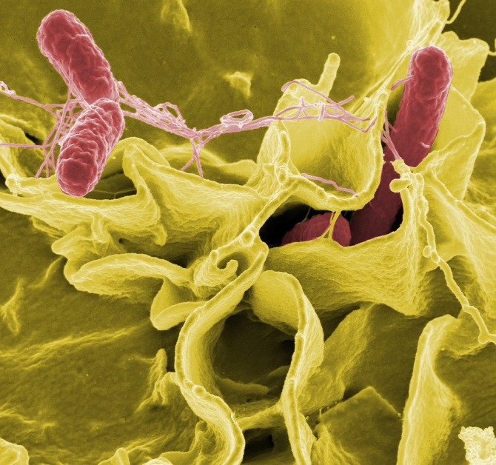
Salmonella
Gram-negative rods
Common in digestive tracts of animals

Slide 8
Shigella
S. dysenteriae, S. flexneri, S. boydii, and S. sonnei
Gram-negative rods
Found in digestive tracts of primates, including humans
Food contamination from human fecal material

Slide 9
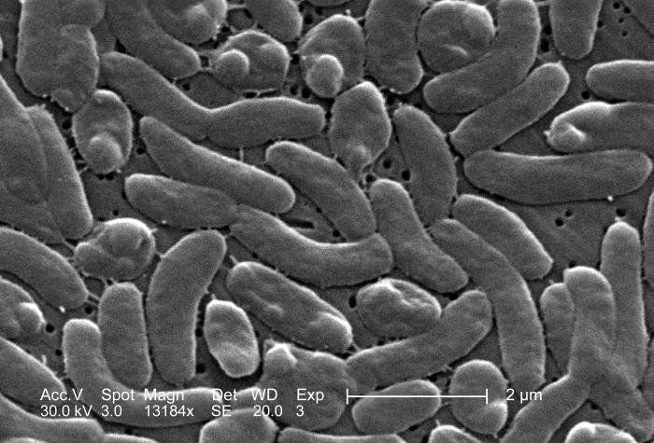
Vibrio
Eight species of concern in foods
Gram-negative rods, straight or curved
Inhabit aquatic environments, found in seafood

Slide 10
Yersinia
Y. enterocolitica, Y. pseudotuberculosis, Y. pestis
Gram-negative short rods
Common in environment and digestive tracts of animals, common in swine

Slide 11
THANK YOU
Name: Charlene Wolf-Hall & William Nganje
Email: charlene.hall@ndsu.edu & William.Nganje@ndsu.edu

