Slide 1
MICROBIAL FOOD SAFETY A FOOD SYSTEMS APPROACH
Charlene Wolf-Hall and William Nganje

Slide 2
Chapter 5: Foodborne Infections, Intoxications, and Etiology

Slide 3
Key Questions
What is a foodborne infection?
What is a foodborne intoxication?
What is the etiology of foodborne disease?
What are the basics of testing foods for foodborne microorganisms?

Slide 4
Foodborne Illness
Any human injury or disease state induced as a consequence of consuming a particular food or beverage.
Foodborne Hazards
Chemical
Physical
Biological

Slide 5
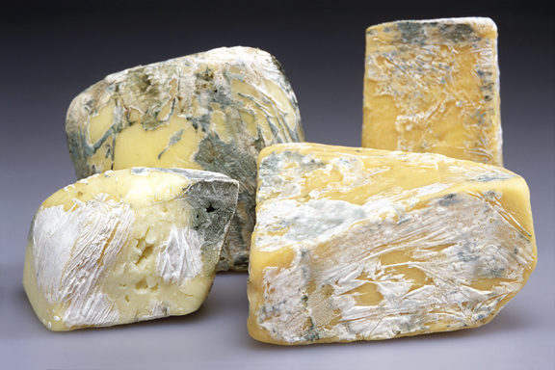
Microbial Hazards
Food is not sterile
Beneficial
Pathogens
Spoilers

Slide 6
Foodborne Illness
Immunocompromised humans at higher risk
The very old, for whom immune systems are failing to function as well.
The very young, for whom immune systems are not yet fully developed.
Those with chronic diseases such as cancer or diabetes.
People with organ transplants who take medications to prevent tissue rejections.
Pregnant women whose immune systems are taxed due to the biological burden of pregnancy.
Nutrient deprived people.

Slide 7
Foodborne Infections
Foodborne infections are a form of disease that results from eating food containing living pathogens.
An infection involves the invasion by living microorganisms of tissue in the host, causing damage.
Microorganisms in a non-harmful state within the host are not considered to be an infection.

Slide 8
Foodborne Infections
Virulence - The degree of pathogenicity within a group or species of microorganisms or viruses as indicated by case fatality rates and/or the ability of the organism to invade the tissues of the host. The pathogenic capacity of an organism is determined by its virulence factors.
Infective Dose - The number of pathogenic microorganisms necessary to cause infection in a host.

Slide 9
Foodborne Intoxications
A foodborne intoxication is a state where there is damage to a consumer (host) from a chemical consumed.
Microbial toxins tend to be secondary metabolites.
Most common bacterial
Clostridium botulinum
Staphylococcus aureus
Bacillus cereus
Most common fungal
Aspergillus
Penicillium
Fusarium

Slide 10
Toxin-Mediated Infections
Toxin-mediated infections, also referred to as toxicoinfections, involve ingestion of large numbers of live pathogens, which then produce or release toxin in the gastrointestinal tract.
Most common
Bacillus cereus
Clostridium perfringens
Enterotoxigenic and enterohemorrhagic Escherichia coli
Some strains of Campylobacter jejuni
Vibrio cholerae

Slide 11
Etiology and Epidemiology of Foodborne Illnesses
Etiology – The branch of science concerned with the causes and origins of diseases.
Epidemiology - The study of the various factors influencing the occurrence, distribution, prevention, and control of disease, injury, and other health-related events in a defined population.

Slide 12
Etiology and Epidemiology of Foodborne Illnesses
In the United States
38% of outbreaks of unknown etiology
31 pathogens are most commonly identified
PulseNet - The labs that are in the PulseNet use standardized testing methods that allow the DNA fingerprint of the microbe to be taken and compared to other cases

Slide 13
Testing Methods for Pathogens in Foods
Microbiological methods range from traditional culturing techniques to more modern molecular based and rapid methods.
Methodology selection depends on needs for sensitivity, selectivity, accuracy, precision, rapidity, ruggedness, usability, and cost.
“Ideal methods would identity and quantify multiple targets from any matrix in real time under non-laboratory conditions, and cost little” (Ryu and Wolf-Hall, 2014).
Most testing labs are shifting from traditional culturing methods to rapid methods to save on labor costs and turnaround time.

Slide 14
Testing Methods for Pathogens in Foods
No method is perfect
Limitations of what test indicates
Potential for errors:
Type I - false positive
Type II - false negative
Use of standardized methods for consistency and appropriateness for food being tested

Slide 15
THANK YOU
Name: Charlene Wolf-Hall & William Nganje
Email: charlene.hall@ndsu.edu & William.Nganje@ndsu.edu

