Slide 1
MICROBIAL FOOD SAFETY A FOOD SYSTEMS APPROACH
Charlene Wolf-Hall and William Nganje

Slide 2
Chapter 4: Humans and Microbes – Risk Analysis

Slide 3
Key Questions
What is risk analysis?
How do microbial hazards become risks
to humans?
How do lapses in policies result in type I
and type II food risks?
How do microbial foodborne disease outbreaks impact food systems?

Slide 4
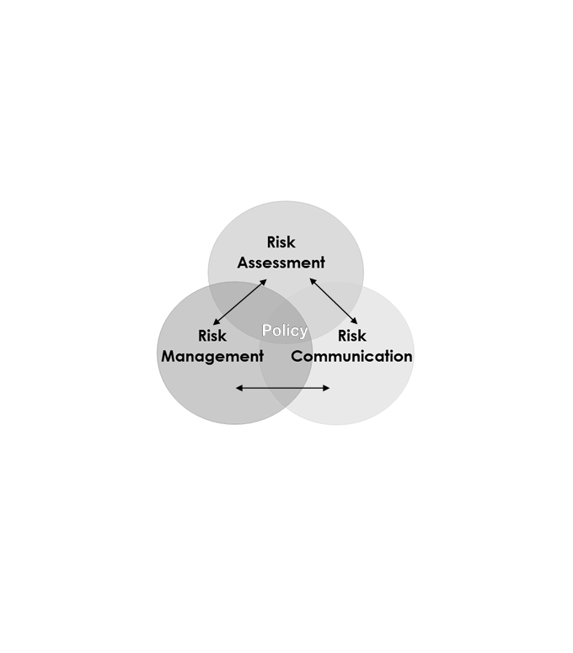
Introduction to the Risk Analysis Model
Used to examine why food safety problems could occur and how to control food risk.
Figure 4.1 is a Schematic Presentation of the Interface Model.

Slide 5
Risk Assessment and Responsibilities for Food Safety Risks
What is the probability that hazardous foods will become food safety risks to humans?
Hazard identification;
Hazard assessment;
Dose-response;
Exposure analysis;
Economic outcome assessment and risk measurement.

Slide 6
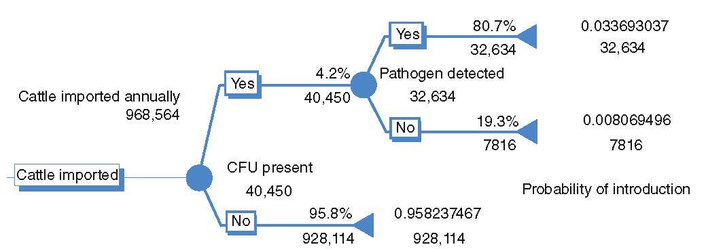
Figure 4.2 shows a summary of the risk assessment for a hypothetical hazardous food.
The risk assessment process has transition from the traditional qualitative inspection system to a quantitative process.

Slide 7
Risk Management and Responsibilities for Food Safety Risks
For determining what action to take to reduce or eliminate food safety risks
Avoid or eliminate risk
Decrease or modify the risky activity
Decrease the magnitude or frequency of risk
Decrease vulnerability of exposed people or property

Slide 8
Risk Communication and Responsibilities for Food Safety Risks
Exchange of information, between concerned parties, about levels of health or environmental risk, the significance and meaning of those risks, and the decisions
Risk = Hazard + Outrage
When hazard is high and outrage is low; scientists are concerned.
When hazard is low and outrage is high; the public is concerned.

Slide 9
Risk Communication and Responsibilities for Food Safety Risks
1. Use simple, graphical material;
2. Provide opportunity for learning;
3. Put risks into perspective;
4. Relate on a personal level;
5. Understand qualitative concerns;
6. Recognize impacts of subtle changes in problem formulation;
7. Identify specific target audiences;
8. Generate involvement;
9. Avoid high threat campaigns;
10. Use multiple channels and media;
11. Use peer and social relationships; and
12. Be inventive.

Slide 10
Information Sharing and Policies Response in Mitigating Type I and Type II Risks
Reasons for an effective tool to mitigate food risks:
Complexity of food supply networks;
Limitations with information sharing among stakeholders and agencies;
Limitations with adequate resources;
Ineffective policy response, that is timely and targeted.

Slide 11
Policy Response to Minimize Error Based Disruptions
To assist policy makers design systems to detect, prevent, and respond to food safety/defense risks in the food supply networks it is critical to understand control oriented systems.
We proposed that control oriented systems differ fundamentally from systems designed to respond to protect against disruptions caused by uncontrollable rare events such as hurricanes, strikes or quakes.
This type of problem is thus qualitatively distinct and it is further complicated by the complexity of the supply network system.

Slide 12
Voids in Control Measures in the United States
In 1996, the Food Safety Inspection Service (FSIS) introduced new mandatory food safety regulations following repeated discoveries of E. coli and Salmonella in the US food supply in the 1980s and early 1990s.
By 2000 these regulations had been adopted by meat and poultry processors. Pathogen levels have decreased after the adoption of mandatory PR/HACCP in meat and poultry processing (CDC FoodNet 2010; reported by Marler).

Slide 13
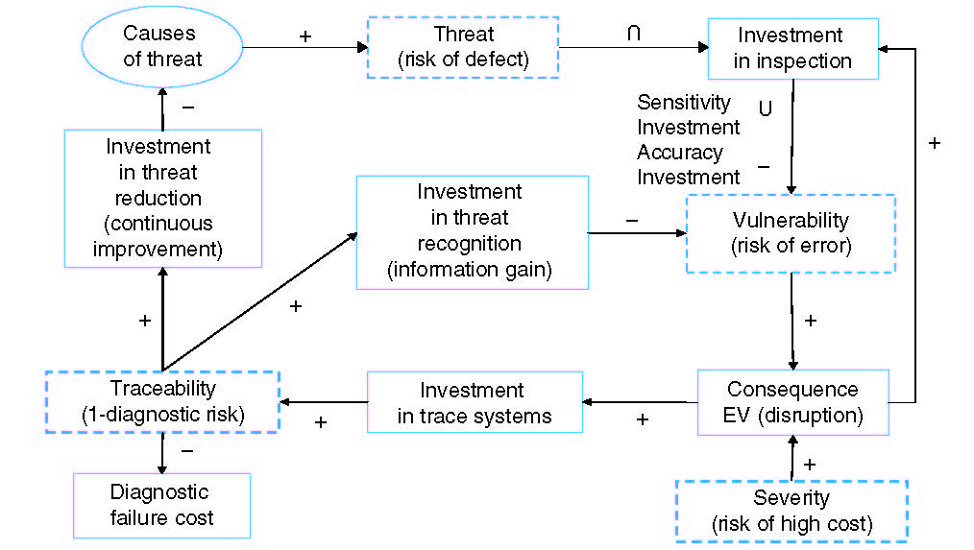
Figure 4.3 presents a control oriented process map of shipment, inspection, detection, trace, and prevention in the food supply, including error based disruption points and subsequent opportunities for improvement with the interface model. Product is shipped and inspected, as shown in the central horizontal axis of the figure.

Slide 14
Microbial Outbreaks and Impact on the Food Systems
Because more encompassing, more accurate and timelier inspections presumably increase costs, managers will assess the risk of these disruptions relative to those costs.
Because the cost of a false positive may be low (no illness or deaths) relative to other types of disruptions, managers may accept the cost of these disruptions rather than improving the inspection system to prevent food risks.

Slide 15
These food risks are characterized by class I, II, and III recalls by the Food and Drug Administration (FDA):
Class I recall is food product will cause serious adverse health consequences or death.
Class II recall is food product may cause temporary or medically reversible adverse health consequences.
Class III recall is food product is not likely to cause adverse health consequences (FDA, 2009).

Slide 16
Control Oriented Framework and Response to Food Risks
This framework has four major components:
To identify the role and synergies from multiple stakeholders (governmental agencies and private entities);
To establish procedures to detect threats and vulnerability along the food supply chain;
To identify incentives for management to adopt and implement control oriented risk mitigation plans;
To develop a feedback system for response and continuous improvement. These components are discussed in detail on the next slide.

Slide 17
Synergies from Multiple Stakeholders
Mitigating food risks is a very complex task involving several agencies and stakeholders, especially for a cross-border food supply chain.
For example, imported foods require the intervention of several agencies to control for food safety problems. These include:
USDA initiates inspections to comply with quality and grading standards at the farms in foreign countries and at their packing and processing facilities.
The Food and Drug Administration (FDA) conducts pathogen testing at the POE.
Custom Border Protection (CBP) and USDA work together to implement the 24-hour e-manifest rule (US Department of Homeland Security, 2003).
Animal and Plant Health Inspection Service (APHIS) focus on pest control.

Slide 18
A major challenge with having multiple Agencies and stakeholders is how to identify synergies.
Figure 4.3 proposes a conceptual model which provides a systemic view of costs and risks and the relationships between them.

Slide 19
Summary
The risk analysis model provides a framework for stakeholders to channel information to policy makers, to design efficient control, and to minimize food risks.
The interphase model could be used to explain how microbes become risks to humans, with type II disruptions that have consequences like making people sick or killing them. Private and public partnerships and information sharing are important ways to mitigate foodborne illness risks and costs.

Slide 20
THANK YOU
Name: Charlene Wolf-Hall & William Nganje
Email: charlene.hall@ndsu.edu & William.Nganje@ndsu.edu

