Slide 1
MICROBIAL FOOD SAFETY A FOOD SYSTEMS APPROACH
Charlene Wolf-Hall and William Nganje

Slide 2
Chapter 2: Ecological Concepts of Foods and Definitions of Pre- and Post-Harvest

Slide 3
Key Questions
What is ecology, and how are these concepts applied to foods?
How are microorganisms affected by the environmental factors in foods?
What is hurdle technology?
What do pre- and post-harvest mean?

Slide 4
Ecological Terms
Ecology - The branch of biology that deals with the relations of organisms to one another and to their physical surroundings.
Ecosystem – A functional system which includes the organisms of a natural community together with their environment.
Microbiome - The full collection of microbes (bacteria, fungi, virus, etc.) that naturally exist within a particular biological niche such as an organism, soil, a body of water, etc.

Slide 5
Microbiomes of Food
Food is not sterile
The majority of microorganisms in food microbiomes are harmless

Slide 6
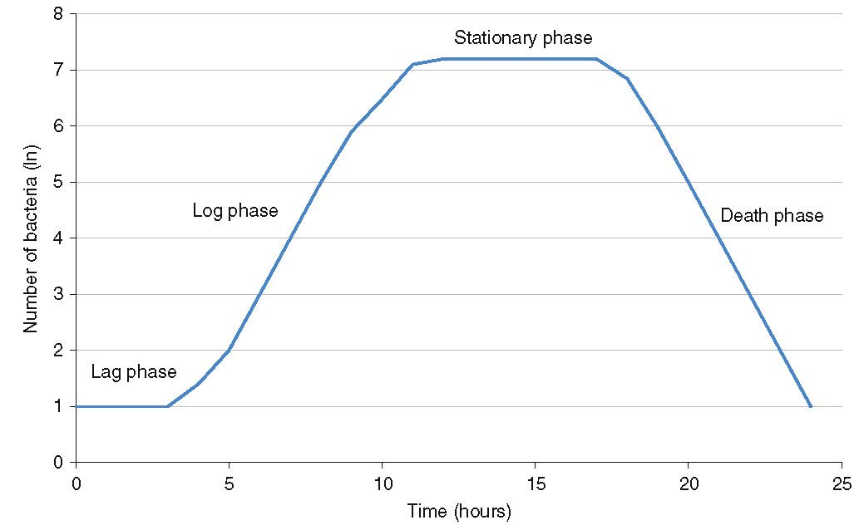
Bacterial Growth Curve

Slide 7
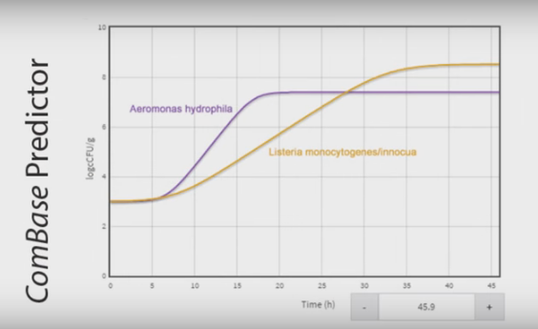
Modeling Microbial Growth and Survival
www.combase.cc

Slide 8
Microbial Food Safety Terminology
Infective Dose - The number of pathogenic microorganisms necessary to cause infection in a host.
Secondary Metabolites - Chemicals synthesized by organisms that do not appear to have a direct role in the organism's growth. Antibiotics and mycotoxins are examples of secondary metabolites.
Toxin - A substance that has toxicity.

Slide 9
FAT TOM
F = Food
A = Acidity
T = Time
T = Temperature
O = Oxygen
M = Moisture
National Restaurant Association Educational Foundation (2012) ServSafe CourseBook, 6th edition.

Slide 10
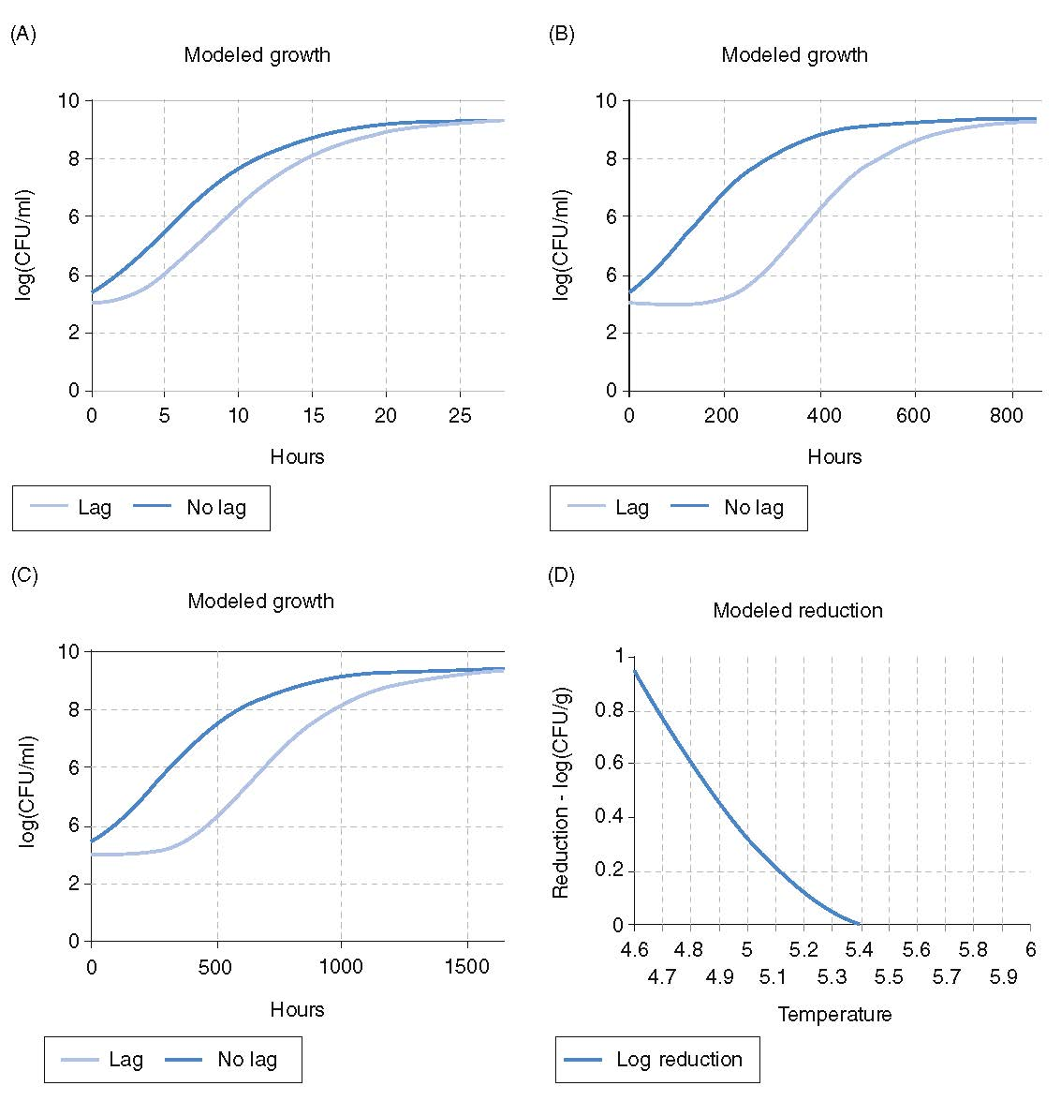
Hurdle Technology - The strategic manipulation of environmental factors to control microorganisms in foods, allowing for better quality food production
Bacterial growth and reduction curves depicting Escherichia coli O157:H7 (USDA, 2003). (A) Under aerobic conditions in broth culture at 25°C, pH 7, 0.5% sodium chloride and initial concentration of 3 colony forming units (CFU)/ml (time is the hurdle). (B) The same conditions except for a temperature of 5°C (time and temperature are hurdles). (C) The same conditions as (B), but with a lower pH of 4.5 (time, temperature and pH as hurdles). (D) Survival during fermentation of Soujouk-style fermented sausage (time, temperature, pH, oxygen content, additives, and competing microflora as hurdles).

Slide 11
Changes to Environmental Conditions
Pre-Harvest - Occurring before a crop or livestock for food are harvested. Post-Harvest - The handling of food crops or animals immediately after the harvest step.

Slide 12
THANK YOU
Name: Charlene Wolf-Hall & William Nganje
Email: charlene.hall@ndsu.edu & William.Nganje@ndsu.edu

