Slide 1
MICROBIAL FOOD SAFETY A FOOD SYSTEMS APPROACH
Charlene Wolf-Hall and William Nganje

Slide 2
Chapter 12: Cost of Microbial Foodborne
Outbreaks to Society

Slide 3
Key Questions
What are the categories of food safety costs to society?
How do we quantify the cost to society of foodborne illness and death?
How do we estimate the net loss to all sectors?
How do food safety risks and perception of food risks affect the cost to society?
How food policy can have unintended consequences and increase the cost to society?

Slide 4
Cost to Society of Foodborne Illness and Death
The United States Department of Agriculture’s Economic Research Service (ERS) provides estimates of the benefits or reductions in illness caused by four foodborne pathogens: Salmonella, Escherichia coli O157:H7, Campylobacter jejuni or C. coli, and Listeria monocytogenes.
Four reasons suggested why a range should be used.
The incidence of foodborne illness (and death) and the proportion of cases caused by contaminated meat and poultry were uncertain.
The efficacy of the HACCP program in reducing foodborne illness was also uncertain.
The benefit estimates vary because two different discount rates were used.
There was use of two different methods to assign economic value to improvements in health and longevity resulting from reductions in foodborne illness.

Slide 5
Estimating Net Loss to All Sectors
Costs of foodborne illness to society are more complex than the value of illness or death or costs to the firm.
To estimate the cost of foodborne illness we therefore need to estimate costs to individuals and firms and benefits to other industries and sectors. One approach to estimate cost to society is to use the social accounting matrix (SAM). SAM could also be used to estimate cost-effectiveness of cost mitigation strategies like HACCP.
A detailed explanation of SAM composition can be accessed at http://ageconsearch.umn.edu/bitstream/34023/1/ae000791.pdf.

Slide 6
The Categorization of the Risk Perceptions and Risk Attitudes Index
 |  | Risk attitude
 |  | Low | High
Risk perception (of food safety risk) | Low | Accountable Young adults / brand familiarity | Conservative Older families / brand familiarity
 | High | Concerned Older adults / brand familiarity | Alarmist Young families / brand familiarity Pensioners / brand familiarity

Slide 7
Length of Food Scare and Economic Loss
The length of the scare considered in this case study was determined by the concentration and duration of the U.K. newspaper coverage immediately following the avian flu outbreak announcement of February 3, 2007.
Figure 12.1 shows the total number of articles from these publications that were published each day of the scare.

Slide 8
Figure 12.1 Number of newspaper articles regarding avian flu scare by date of publication. Adapted from Cacciolotti et al., (2007).

Slide 9
As shown in Figure 12.1, the highest level of newspaper coverage occurred in the three weeks following the announcement.
Within three weeks of the announcement, coverage of the outbreak had dwindled from daily reporting of public health concerns to occasional stories regarding the economic effects of the food scare, including the loss of jobs and reduction in sales for Bernard Matthews.

Slide 10
Perception of Food Risks: The Case of Avian Flu
On 1 February 2007, a veterinarian was called to the Bernard Matthews farm in Holton, Suffolk in eastern England to begin an investigation into the deaths of 2,600 turkeys.
On 3 February 2007, the European Commission said tests confirmed that the birds on the Bernard Matthews Holton farm were infected with the lethal H5N1 strain of avian influenza (BBC News, 2008).
Table on following slide shows an alphabetical list of the 48 countries that reported H5N1 avian flu outbreaks affecting domestic poultry from 2003-2008 with an indication in parenthesis of the number of outbreaks recorded during this time.

Slide 11
Countries reporting H5N1 avian flu in domestic poultry 2003-2008. Adapted from World Organization for Animal Health, http://www.oie.int/.
Country | Number of Incidents | Country | Number of Incidents
Afghanistan | 22 | Jordan | 1
Albania | 3 | Kazahkstan | 1
Azerbaijan | 2 | Korea (Republic of) | 59
Bangladesh | 285 | Kuwait | 20
Benin | 5 | Laos | 10
Burkina Faso | 4 | Malaysia | 16
Cambodia | 20 | Myanmar | 93
Cameroon | 1 | Niger | 2
China | 93 | Nigeria | 61
Côte d'Ivoire | 4 | Pakistan | 50
Czech Republic | 4 | Palestinian Autonomous Territories | 8
Denmark | 1 | Poland | 10
Djibouti | 1 | Romania | 163
Egypt | 1065 | Russia | 147
France | 1 | Saudi Arabia | 29
Germany | 7 | Serbia and Montenegro | 1
Ghana | 6 | Sudan | 18
Hungary | 9 | Sweden | 1
India | 48 | Thailand | 1139
Indonesia | 261 | Togo | 3
Iran | 1 | Turkey | 219
Iraq | 3 | Ukraine | 42
Israel | 10 | United Kingdom | 3
Japan | 9 | Vietnam | 2475
* Hong Kong reported H5N1 in domestic and wild birds in January, 2003 though these outbreaks are generally considered distinct from the outbreaks beginning in late 2003 and are not included in this total.

Slide 12
The outbreak of February 2007 became the largest European avian flu event, with nearly 160,000 birds culled.
Figure 12.2 shows the impact in both sales volume (units sold) and sales value (in GBP) when looking at all Bernard Matthews brand products in the weeks preceding and following the avian flu outbreak announcement.

Slide 13
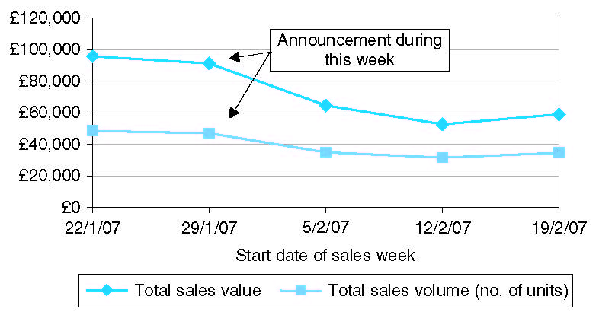
Figure 12.2 Weekly sales volume and sales value of Bernard Matthews brand products at the time of February 2007 avian flu outbreak.

Slide 14
While, overall, Bernard Matthews brand products saw a decline in sales value and sales volume, this trend was not shared by all turkey products.

Slide 15
Costs Associated with Ineffective Policy Design
Ineffective policy design could increase cost and harm related to foodborne pathogens.
Safety and health policies are adopted to reduce harm to potential victims from accidents and other harmful events.
Figure 12.3 presents the potential relationship between perceptions of risk, the actual degree of hazard, information, and demand for the risky commodity.

Slide 16
Figure 12.3 Interaction between Perceived Risk, Hazard, Positive Information, and Demand.

Slide 17
Food Safety Policies and Offsetting Behavior
CCPs are usually practices/procedures that, when not done correctly, are the leading causes of foodborne illness outbreaks.
Consequently, consumers often view PR/HACCPs as more extensive than they actually are, creating imperfect information and mistaken reliance on positive food-safety information from the media and/or federal agencies.

Slide 18
As shown in Figure 12.4, outbreaks of foodborne illnesses peaked in 2000.
Nationwide, the number of (single-state and multi-state outbreaks combined) foodborne illness outbreaks per year almost tripled following implementation of PR/HACCP.

Slide 19
Figure 12.4 Number of Outbreaks Nationwide: Foodborne Disease Outbreak Surveillance System (Centers for Disease Control).

Slide 20
Summary
Cost of foodborne illness extends beyond individual illness and deaths. It affects firms and society as a whole.
To understand this a SAM framework was developed by USDA-ERS for HACCP. The reduction in losses of benefits from reduced illness and deaths were felt at all levels in society.
The use of HACCP SAM also shows that appropriate mitigation strategies to reduce illness and deaths will generate more benefit to society. SAM model analyzes the economic transactions and traces them for an individual firm or industry, government, households and rest of the economy which makes it easier to identify if a mitigation strategy like HACCP is beneficial. The level and distribution of the costs and benefits of the HACCP regulatory program for meat and poultry changed dramatically with economy wide effects.
SAM analysis provides policy makers useful information about who ultimately benefits from reduced foodborne illnesses and who ultimately pays the costs of food safety regulations.
Costs related to food scare and infective policy design could be significant and should be included in the cost of foodborne pathogens to society.

Slide 21
THANK YOU
Name: Charlene Wolf-Hall & William Nganje
Email: charlene.hall@ndsu.edu & William.Nganje@ndsu.edu

