Slide 1
MICROBIAL FOOD SAFETY
A FOOD SYSTEMS APPROACH
Charlene Wolf-Hall and William Nganje

Slide 2
Chapter 11: Cost of Microbial Foodborne Outbreaks

Slide 3
Key Questions
Why do we need to estimate the cost of foodborne illness outbreaks and cost-effectiveness for firms to implement control measures?
How do we quantify the economic cost of foodborne illness outbreak to a firm?
How firm investment costs compare to benefits of reduced illness and deaths?

Slide 4
Introduction to Understanding Costs and Why?
The United States Food and Drug Administration (FDA) finds that implementing control measures to reduce foodborne illness costs constitutes a major rule under both the Executive Order 12991 and the Regulatory Flexibility Act (P.L. 96-354).
Costs-mitigation measures must meet the cost-effectiveness or cost–benefit criteria.

Slide 5
Firm-Level Cost of Foodborne Illness Outbreak
Firm-level costs are correlated with the type of recall. There are three classes of recall in the United States:
Class I recalls are those that will cause serious adverse health consequences and deaths.
Class II recalls are those that cause temporary or medically reversible health effects.
Class III recalls are likely to not cause any health problems. These are usually product quality issues with mislabeling.

Slide 6
Federal Agency Guidelines for a Recall
A recall policy;
Evaluation of class for the recall;
Adopt a recall strategy;
Explain the role of the firm(s) involved and discuss guidelines to terminate recall.

Slide 7
Industry guidelines for a Recall
A written recall plan;
A product code system which can trace all products to facilitate a recall;
Maintain records of all products distributed and sold.

Slide 8
Cost Concepts
Depreciation
Fixed (implementation) costs
Operating (variable) costs

Slide 9
Depreciation
It is important to understand the economics concept of depreciation when estimating costs.
Straight line method of depreciation could be calculated from the relationship:
Depreciation = (OC−SV)/N
Where OC is the original cost of an item; SV is the salvage or junk value at the end of the lifespan of the item, and N is the lifespan of the item.

Slide 10
Double declining balance method could be
computed from the relationship
Depreciation = (2/N)*(R)
Where R is the remaining book value of the asset at the beginning of the period (e.g. year).
Sum of year digit method is computed as:
D = {(N – t + 1) / [N * (N+1) / 2]} * (OC – SV)
Where t is the current period (e.g. depreciation for the first year is calculated using t = 1).

Slide 11
Fixed (implementation) Costs
These are costs that do not vary with production levels.
Generally, these are expenses on equipment or material that have a lifespan greater than 1 year.
Examples include the costs associated with buildings, machinery, and computers.

Slide 12
Operating (variable) Costs
Costs that vary with the level of production.
Generally considered expenses on equipment or material that have a lifespan equal to or less than 1 year.
Examples include electricity, paper wraps, boxes, and labor.

Slide 13
Practice Problem
A new piece of laboratory equipment costs US$12,000 and has a life span of 4 years. The salvage value of the equipment is US$1,500. Using each of the three depreciation methods, calculate the annual depreciation of the new equipment.
1. Which method of depreciation most accelerates expenses?
2. What is the tax advantage of accelerating expenses?

Slide 14
At this point calculate the depreciation using each of the three methods and answer the questions.
 | Straight line method | Double declining balance method | Sum of year digit method
Year 1 | US$2,625 | US$6,000 | US$4,200
Year 2 | US$2,625 | US$3,000 | US$3,150
Year 3 | US$2,625 | US$1,500 | US$2,100
Year 4 | US$2,625 | US$750 | US$1,050

Slide 15
Cost Structure for Firms
The quality cost index (QCI), a common cost structure used by firms to measure investments or costs of foodborne risks to a firm and compare these costs to the performance of the firm.
Quality cost index = total quality costs/net sales x 100
QCI is defined as the ratio of total costs to net sales.
It is a function of three major costs components (prevention–appraisal–failure; PAF) weighted by net sales.

Slide 16
Estimated Failure Costs Linked to the 2006 E. coli O157:H7 Outbreak and Recall
Recall related costs
Retail value of Dole Baby Spinach (per unit of 3 lbs) | US$3.89
Approximate number of units recalled | 42,000
TOTAL RECALL RELATED COSTS | US$163,380
Lost productivity expenses
Lost productivity due to E. coli O157:H7 (per case) | US$1,871.96
Approximate number of E. coli O157:H7 cases linked to outbreak | 204
TOTAL LOST PRODUCTIVITY EXPENSES | US$381,879.84
Medical and loss of life calculations
Did not visit physician and survived (per case) | US$28
Estimated unreported cases | 6,000
TOTAL | US$168,000
Visited physician and survived (per case) | US$495
Approximate number of cases | 100
TOTAL | US$49,500
Did not have HUS and survived (per case) | US$6,550
Approximate number of cases | 70
TOTAL | US$458,500
Had HUS and survived (per case) | US$36,525
Approximate number of cases | 31
TOTAL | US$1,132,275
Had HUS and did not survive (per case) | US$6,766,498
Approximate number of cases | 3
TOTAL | US$20,299,494
TOTAL MEDICAL AND LOSS OF LIFE COST | US$22,107,769
Industry lost sales following outbreak and recall | US$80,000,000
Federal funding (within Iraq Bill) to compensate "innocent" farmers | US$25,000,000
USDA grant funding to identify source of outbreak | US$1,200,000
Total estimated failure costs (2006 E. coli outbreak) | US$128,853,028.84
Approximate vol. of contaminated product (pounds) | 15,750

Slide 17
From this single outbreak we estimate the failure costs associated with the 2006 E. coli O157:H7 outbreak based on the US-spinach industry losses and the total costs.
Annual failure costs for multiple outbreaks in the United States could be in the billions of dollars.

Slide 18
Comparing Firm Costs and Benefits of Reduced Illness and Deaths
We use the case of the meat industry’s compliance with regulatory requirements for pathogen reduction (PR) / hazard analysis and critical control points (HACCP) (see Chapter 10) for this comparison and introduce other methods and techniques used in empirical analysis to compare cost and benefits when factors are stochastic.
A stochastic factor could also be referred to as a random variable. Probability functions are used to measure stochastic outcomes.

Slide 19
Control Measures
Currently, food service and retail facilities are implementing various forms of pathogen reduction interventions including voluntary PR/HACCP. These interventions fall into three broad strategy categories:
USDA–FDA verification;
Contracting with an external firm to perform food safety audits;
Voluntary PR/HACCP. It should be noted that all strategies require standard operating procedures for hygiene.

Slide 20
MICMAC Scenario Methods
The MICMAC scenario method is used to help determine which variables will have a strong influence and strong dependence on the perceived outcome.
Table below shows sample factors that could be used in PR/HACCP analysis.
Figure 11.1 shows the variables that will have a direct influence on the adoption of PR/HACCP by retail firms.

Slide 21
Table 11.2 Abbreviations for variables affecting the effectiveness of PR/HACCP at the retail level.
Variable | Abbreviation
Cost of labor to train employees | LabCos
Cost of restructuring operations | Restruc
Cost of microbial testing | CosMT
Firm’s probability of having a foodborne illness outbreak | ProbOut
The number of firms adopting HACCP plans | #adopt
The price of meat products | Price
The demand for meat products | DemMeat
The supply of meat products | SupMeat
The number of foodborne illness outbreak occurring nationally | #OutNation
The public demand for food policy changes | PublicDem
Consumer education about safe food practices | ConsEd
Diet trends in the United States | Diet

Slide 22
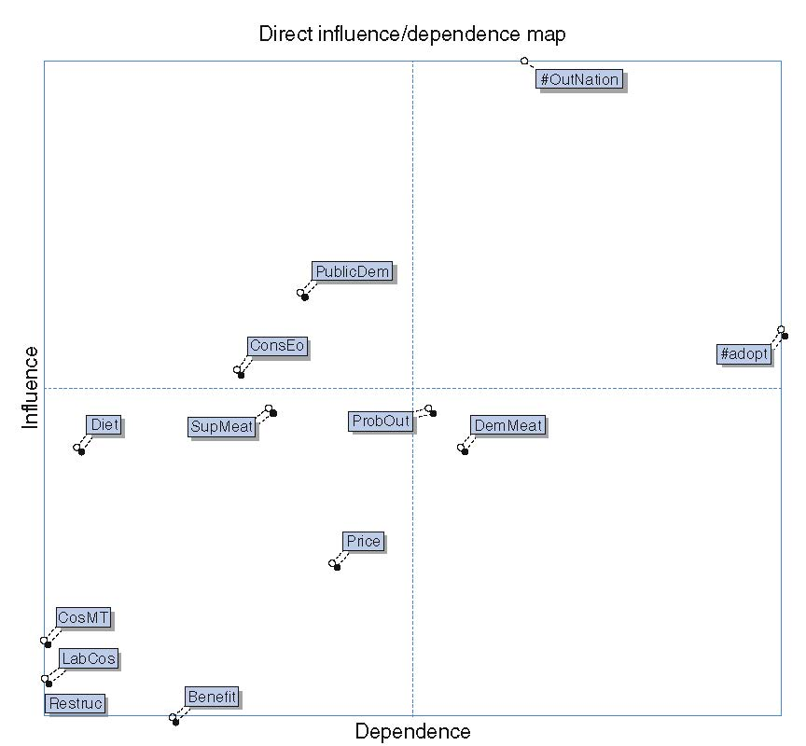
Figure 11.1 Direct influence/dependence map for retail PR/HACCP implementation.

Slide 23
Quality Loss
The loss function is defined as
L= (A_{o}/Δ_{o}²)σ²
where L is the quality loss, A_{o} is the welfare loss when the tolerance limit is violated, Δ_{o} is the tolerance limit, and σ² measures the variance of the quality of the product.

Slide 24
Summary
Scenario analysis is a statistical procedure used to determine what factors or variables would be instrumental in implementing a desired outcome. Instead of forecasting what a particular outcome will be scenario analysis allows you to envision the desired outcome and then determine what factors will lead to that outcome.
Stochastic dominance analysis suggests a need to extend the PR/HACCP performance standard to more retail facilities and other pathogens.
Currently, Salmonella is the only performance standard for PR/HACCP. The assumption is that if Salmonella levels decrease then other levels of pathogens will follow. This might not be true with food retail.

Slide 25
THANK YOU
Name: Charlene Wolf-Hall & William Nganje
Email: charlene.hall@ndsu.edu & William.Nganje@ndsu.edu

