Slide 1
MICROBIAL FOOD SAFETY
A FOOD SYSTEMS APPROACH
Charlene Wolf-Hall and William Nganje

Slide 2
Chapter 10: Control Measures: The Case of PR/HACCP

Slide 3
Key Questions
What is HACCP and how has this food safety policy evolved?
What are the principles of a HACCP plan?
How was mandatory PR/HACCP policy formulated and implemented?
What are the cost challenges with PR/HACCP and how were these reduced?
Is continuous improvement possible with mandatory regulation?

Slide 4
Background on PR/HACCP
The concept of HACCP was developed in the 1960s through a collaboration between the Pillsbury Company, the United States Army Laboratories and the United States National Aeronautics and Space Administration (NASA), where foods for astronauts being developed needed to be as safe as possible (imagine having a foodborne illness in space).

Slide 5
Timeline for the Final PR/HACCP Rule
1970s – HACCP principles were being voluntarily implemented by firms that produced low-acid canned foods.
1995 – The Food and Drug Administration (FDA) issued HACCP regulations for fish and seafood.
1998 – The United States Department of Agriculture’s Food Safety and Inspection Service (USDA-FSIS) mandated HACCP for raw meat and poultry plants.

Slide 6
2001 - The Food and Drug Administration issued HACCP regulations for juice processing and packaging. Other pilot and voluntary initiatives started in the dairy and other sectors.
2010 – The Food Safety Modernization Act will result in more mandatory HACCP-like programs under the FDA and USDA-FSIS.

Slide 7
Three Major Components
  A requirement for sanitation standard operating procedure (sanitation SOP’s);
  Development of a HACCP Plan with critical control points and critical limits;
  Microbiological performance criteria and standard, with a major emphasis on Salmonella reduction and the use of E. coli testing for process verification.

Slide 8
HACCP Principles and Design
HACCP implementation is based on a good understanding of the seven HACCP principles.
Five preliminary steps should be completed before outlining the seven principles of HACCP.

Slide 9
Five Preliminary Steps
Develop a HACCP team;
Describe the food and its method of distribution;
Identify the intended use and target consumers;
Develop a flow diagram which describe the process;
Verify the flow diagram.

Slide 10
HACCP Principles
Conduct a Hazard analysis.
Identify the critical control points (CCP).
Establish critical limits for each CCP.
Establish procedures to monitor CCPs.
Establish corrective actions when CCP limits are exceeded.
Establish verification procedures.
Record keeping.

Slide 11
PR/HACCP Policy Formulation and Implementation
FSIS outline eight policy formulation and implementation procedures.
FSIS regulatory and inspection reform plan for PR/HACCP.
Changes within FSIS.
Coordination between food safety agencies to incorporate farm-to-table strategy.
Establishing firm-level performance standard.
FSIS verification.
Process control verification.
Enforcement and due process.
FSIS enforcement strategy.
Reassessment.

Slide 12
Implementation Issues for Small Firms
The FSIS recognizes that many smaller establishments lack the familiarity with HACCP that existed in many larger establishments.
FSIS developed 13 generic HACCP models for the major process categories. The generic models were developed specifically to assist small and very small establishments in preparing their HACCP plans.

Slide 13
Comparison of Cost
Regulatory component | Proposal | Final
I. Sanitation SOPs | 175.9ª | 171.9
II. Time–temperature requirements | 45.5 | 0.0
III. Antimicrobial treatments | 51.7 | 0.0
IV. Micro testing | 1,396.3^{b} | 174.1
V. Compliance with Salmonella standards | Not separately estimated^{c} | 55.5–243.5
VI. Compliance with generic E. coli criteria | Not applicable | Not separately estimated
HACCP
Plan development | 35.7 | 54.8
Annual plan reassessment | 0.0 | 8.9
Record keeping (recording, reviewing and storing data) | 456.4 | 440.5^{d}
Initial training | 24.2 | 22.7^{d}
Recurring training | 0.0 | 22.1e
VII. Additional overtime | 20.9 | 17.5^{d}
Subtotal—industry costs | 2,206.6 | 968.0–1,156.0
VIII. FSIS costs | 28.6^{f} | 56.5
Total | 2,235.2 | 1,024.5–1,212.5
Source: Federal Register, Vol. 61, No. 144.
ª The preliminary analysis included a higher cost estimate for sanitation SOPs ($267.8 million) that resulted because of a programming error. The cost estimate of $175.9 million is based on an effective date of 90 days after publication.
^{b} The preliminary analysis was based on the premise that microbial testing would be expanded to cover all meat and poultry processing after the HACCP implementation. The proposed rule only required sampling for carcasses and raw ground product. Thus, the cost estimate of $1,396.3 million was higher than the actual cost of the proposed sampling requirements.
^{c} The preliminary analysis accounted for some of the cost of complying with the new standards under the regulatory components of micro testing, antimicrobial treatments and time and temperature requirements.
^{d} These costs are slightly different from the proposal because of changes in the implementation schedule.
^{e} FSIS added the cost for recurring training based on the review of public comments.
^{f} Based on current estimates for the cost of training, inspector upgrades and $0.5 million for annual HACCP verification testing.

Slide 14
PR/HACCP and Continuous Improvement
In the United States, the Foodborne Diseases Active Surveillance Network (FoodNet) is the principal foodborne disease component of the Centers for Disease Control’s (CDC) Emerging Infections Program (EIP).
The CDC lists the objectives of FoodNet as: 1) To determine the frequency and severity of foodborne diseases; 2) To determine the association of common foodborne diseases with eating specific foods; 3) To describe the epidemiology of new and emerging bacterial, parasitic, and viral foodborne pathogens.

Slide 15
Infections caused by specific bacterial pathogens by State (United States of America)
Pathogen | CA | CO | CT | GA | MD | MN | NY | OR | TN | Total
Campylobacter | 999 | 343 | 495 | 614 | 300 | 954 | 248 | 586 | 212 | 4751
Escherichia coli O157 | 36 | 37 | 39 | 50 | 16 | 232 | 31 | 77 | 42 | 560
Non-O157 STEC | 0 | 4 | 24 | 4 | 0 | 24 | 0 | 5 | 0 | 61
Listeria | 16 | 5 | 15 | 16 | 14 | 4 | 7 | 12 | 5 | 94
Salmonella | 480 | 317 | 454 | 1,675 | 622 | 693 | 271 | 290 | 438 | 5,240
Shigella | 427 | 144 | 60 | 714 | 141 | 493 | 28 | 112 | 100 | 2,219
Vibrio | 16 | 5 | 9 | 24 | 13 | 3 | 2 | 5 | 2 | 79
Yersinia | 17 | 9 | 9 | 50 | 12 | 19 | 6 | 12 | 10 | 144
Total | 2,051 | 878 | 1,126 | 3,334 | 1,147 | 2,620 | 608 | 1,155 | 836 | 13,755

Slide 16
FoodNet is used to monitor foodborne diseases and infections caused by bacteria. The data also provides infection by age group.
The FoodNet data shows a high incidence of foodborne diseases in infants and young children, and this constitutes a major concern in public health issues.
FoodNet is involved with active disease tracking to facilitate continuous improvement of strategies and procedures that could help reduce food safety risks.

Slide 17
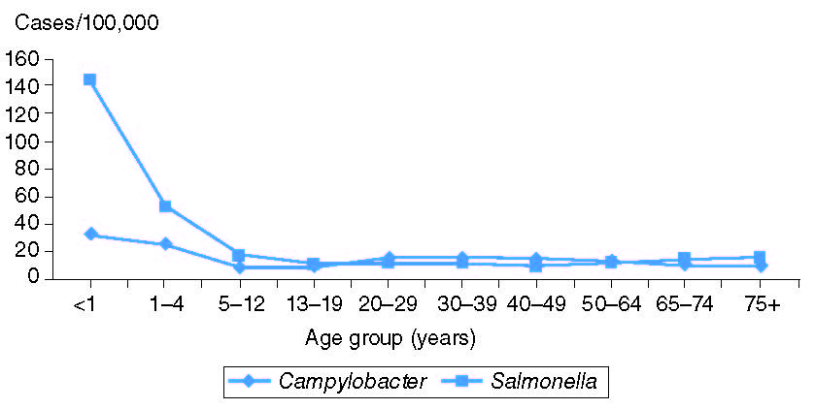
Figure 10.1 Incidence of Campylobacter and Salmonella infections by age group, FoodNet sites, 2001.

Slide 18
Summary
In this chapter we provide information about PR/HACCP, from agencies charged with reducing food safety risks. Information from FDA provides details on the principles of PR/HACCP.
We also discuss the procedure used to formulate mandatory HACCP regulation for the meat and poultry industry. PR/HACCP is an improvement over traditional organoleptic methods in the pre PR/HACCP era. It is a performance based regulation based on continuous improvement. Provisions have been made in the United States to facilitate PR/HAACP implementation costs for smaller firms by developing generic HACCP models.
The major role of the regulatory agency is to verify that a processor's HACCP system is effective and working as intended. Tracking with data from FoodNet suggests that there are links between PR/HACCP and public health improvements.

Slide 19
THANK YOU
Name: Charlene Wolf-Hall & William Nganje
Email: charlene.hall@ndsu.edu & William.Nganje@ndsu.edu

