Slide 1
MICROBIAL FOOD SAFETY
A FOOD SYSTEMS APPROACH
Charlene Wolf-Hall and William Nganje

Slide 2
Chapter 1: Food

Slide 3
Key Questions
What are some of the major food groups consumed globally?
What are some examples of unusual or exotic foods?
What are food supply networks?

Slide 4
Who is eating who?
All living things consume food. Living things include:
  Animals
  Plants
  Fungi
  Protozoa
  Bacteria
Each of the kingdoms includes organisms that can consume organisms from other kingdoms.
We are all food for something else.

Slide 5
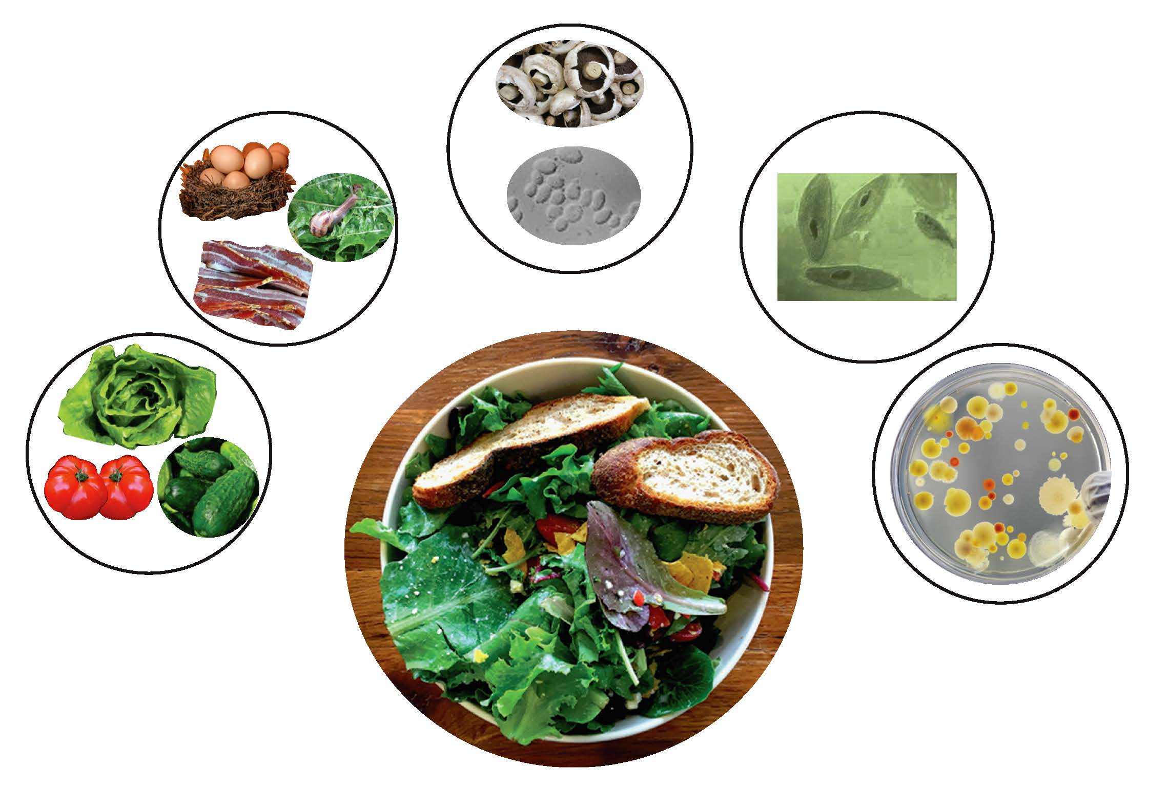
What’s in that fresh salad?

Slide 6
Human Food Categories for Global Consumption Trends
Cereals
Meat
Eggs, milk and dairy products
Fish
Vegetables
Energy providers: vegetable oils, animals fats and sugar

Slide 7
Animal Based Foods
Terrestrial Mammals
  Goats
  Sheep
  Pigs
  Cattle
Birds
  Chickens
  Ducks
  Geese

Slide 8
Animal Based Foods
Freshwater and Seafood
  White fish
  Oily fish
  Invertebrates
    Crabs
    Clams
    Oysters
Insects, Annelids and Reptiles
Dairy Products and Eggs

Slide 9
Plant Based Foods
Fruits
Vegetables
Nuts
Grains
Legumes
Oilseeds

Slide 10
Microbial Based Foods
Mushrooms and Other Fungi
Single Cell Protein
Fermented Foods

Slide 11
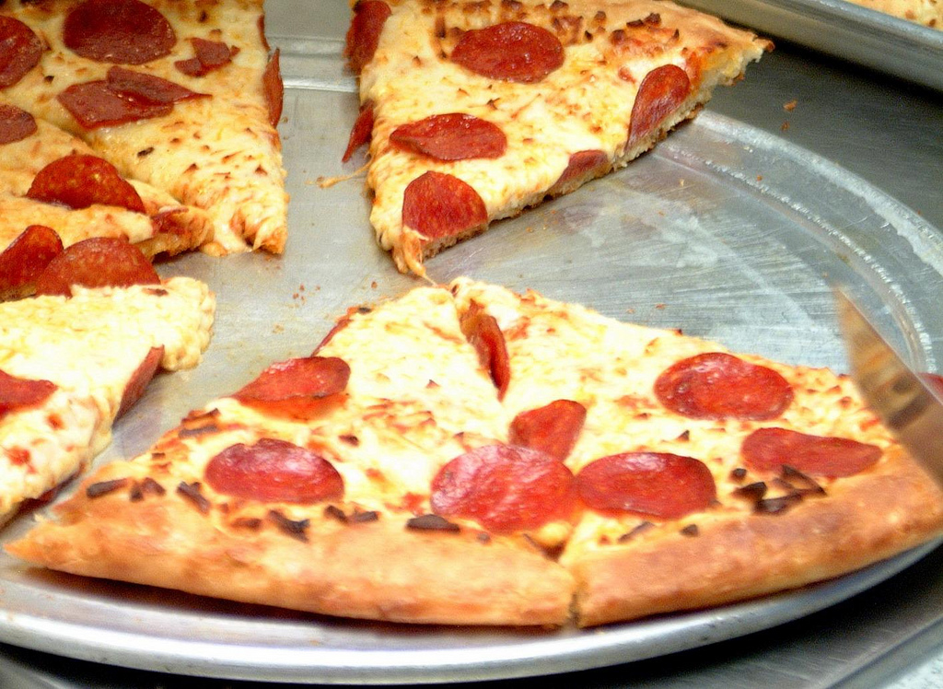
Multi-Ingredient Processed Foods

Slide 12
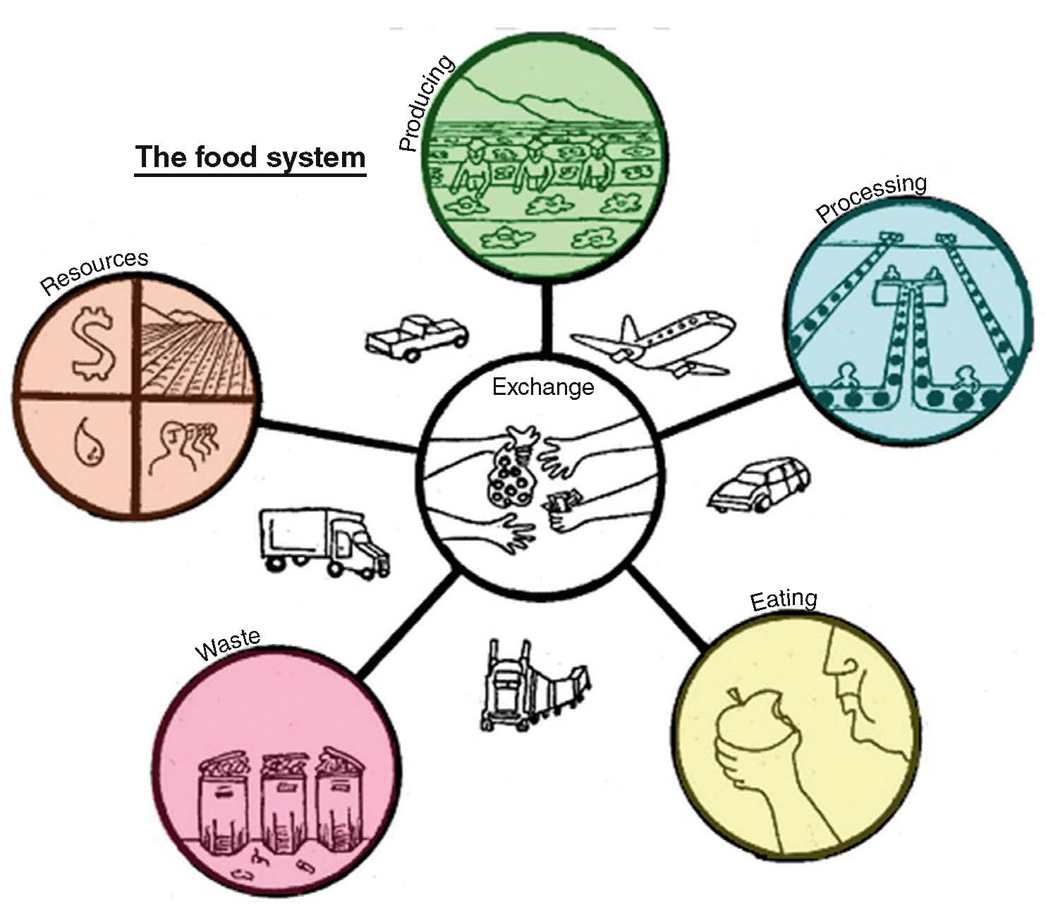
Food Supply Networks, Spread of Foodborne Hazards, and Traceability
Tight coupling | Fresh bagged leafy greens (easy trace) | Unpopulated region Branded processed food products (Mixed trace)
Loose coupling | Farmer’s Market Ontario: raw milk, cheese event (medium to easy trace) | Tomatoes/peppers event (difficult trace)
 | Linear network | Complex network

Slide 13
Food Supply Chains
Mitigation of Risks
  Food Safety = Food System Reliability
  Reduce exposure to natural hazards, errors, and failures
Errors
  Type I Disruption = False Positive
  Type II Disruption = False Negative

Slide 14

Economic Consequences
Outbreaks can cost society hundreds of millions of dollars
The longer tracing takes, the higher the cost

Slide 15
THANK YOU
Name: Charlene Wolf-Hall & William Nganje
Email: charlene.hall@ndsu.edu & William.Nganje@ndsu.edu

