Slide 1
Farm Business Management: The Fundamentals of Good Practice
Peter L. Nuthall

Slide 2
Chapter 2
A Synopsis of Production Economics

Slide 3
Discover the theory behind optimal farm decision making.
Learn about the basic questions that farmers must answer in operating their farms.
Explore the nature of a production function and its critical importance to farm decision making.
Based on the logic of production economics, learn about the decision rules that should be followed to ensure efficient and optimal production.
Appreciate the one-to-one relationship between an equation and a graph.
Understand that production economics theory cannot be used on its own to solve practical farm decision problems.

Slide 4
Studying Production Economics
Production economics provides the core rules for optimization.
Usual objective is profit, but it can be anything provided it can be measured.
Production economics provides decision principles and rules.
It does not provide practical analytical methods for determining the best decisions, except in relatively simple decision problems.
A simple problem would be when there is only one product produced with little risk and uncertainty.

Slide 5
Core Decision Problems
The three basic decision problems are:
• What combination of products should be produced?
• At what level of output should each be produced?
• What combination of inputs should be used to produce each product?
The objective is to maximize profit within the restrictions of available resources.
Where resources are limited, solving each problem must relate to the other problems. Each problem is not independent.

Slide 6

The Production Function (1)
Virtually all production follows a sigmoid curve relationship. This is referred to as a production function: it relates input to output.
Production economics is largely based on this sigmoid production curve.
Its form is:

Slide 7
The Production Function (2)
This is a two-dimensional graph that shows one input only.
Reality is a multi-dimensional situation with many inputs.
The graph can be considered a multi-input system in which all but one input is held constant.
Algebraically, there is a one-to-one correspondence between a graph and an equation.
Thus, the production function is:
Y = f(X1, X2, X3, … Xn / Xn + 1, Xn + 2 …)
where Y = output, X = inputs.

Slide 8
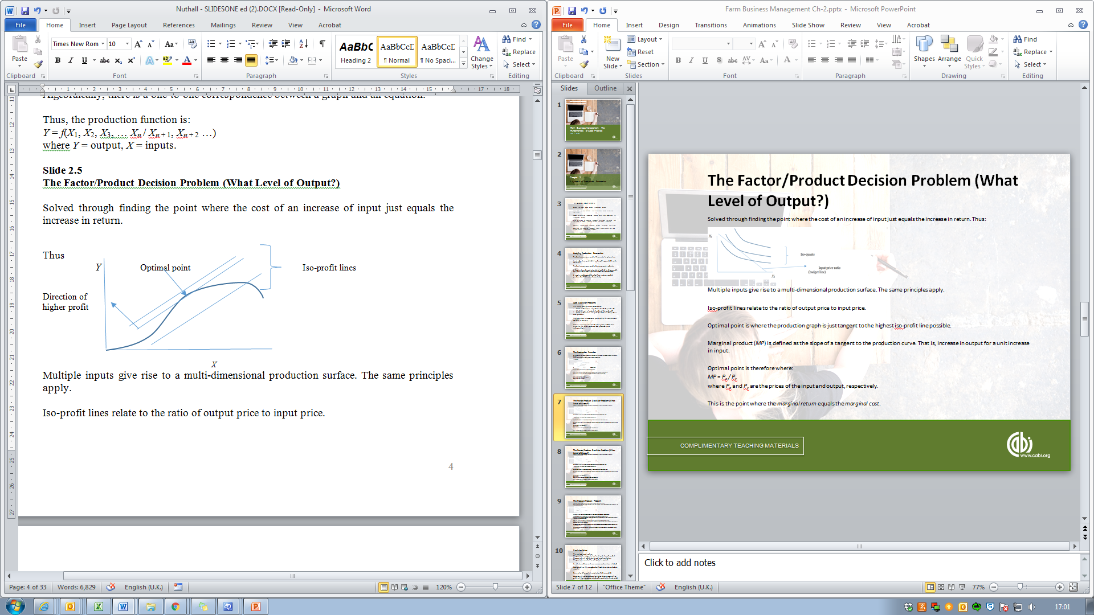
The Factor/Product Decision Problem (What Level of Output?)
Solved through finding the point where the cost of an increase of input just equals the increase in return. Thus:
Multiple inputs give rise to a multi-dimensional production surface. The same principles apply.

Slide 9
The Factor/Product Problem (2)
Iso-profit lines relate to the ratio of output price to input price.
Optimal point is where the production graph is just tangent to the highest iso-profit line possible.
Marginal product (MP) is defined as the slope of a tangent to the production curve. That is, increase in output for a unit increase in input.
Optimal point is therefore where:
MP = P_{x} / P_{y}
where P_{x} and P_{y} are the prices of the input and output, respectively.
This is the point where the marginal return equals the marginal cost.

Slide 10
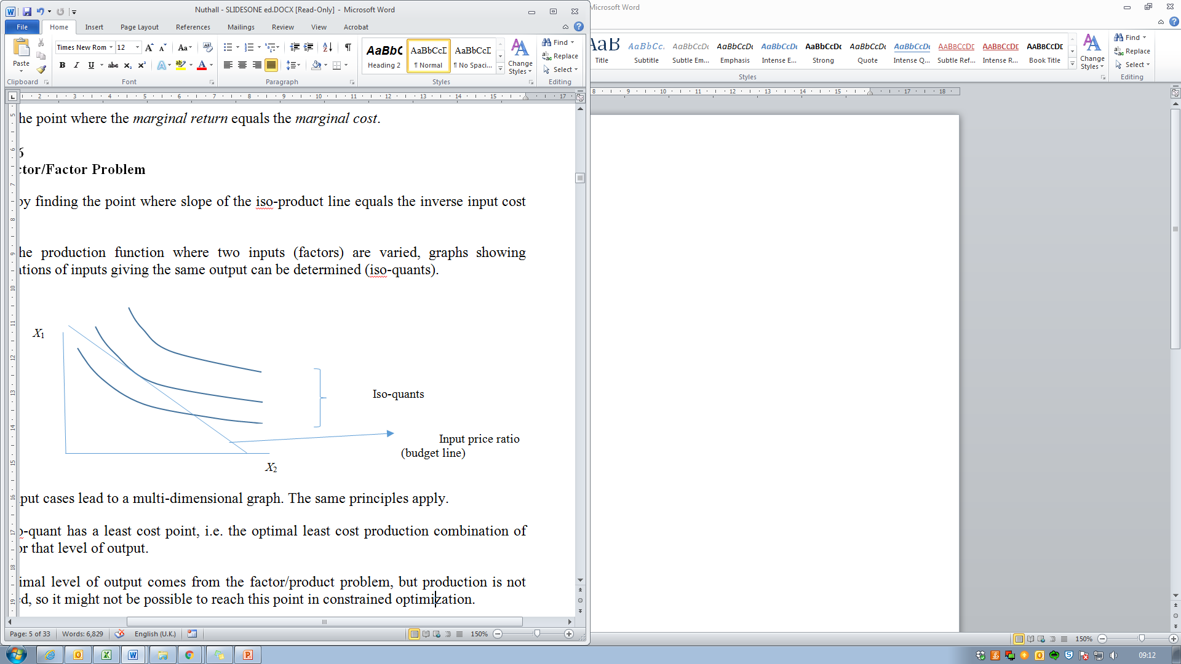
The Factor/Factor Problem (1)
Solved by finding the point where slope of the iso-product line equals the inverse input cost ratio.
Using the production function where two inputs (factors) are varied, graphs showing combinations of inputs giving the same output can be determined (iso-quants).
Multi-input cases lead to a multi-dimensional graph. The same principles apply.

Slide 11
The Factor/Factor Problem (2)
Each iso-quant has a least cost point, i.e. the optimal least cost production combination of inputs for that level of output.
The optimal level of output comes from the factor/product problem, but production is not unlimited, so it might not be possible to reach this point in constrained optimization.
The optimal least cost production point on each isoquant is where the line representing the ratio of the input costs is at a tangent to the isoquant: this is where the slopes are equal.
The slope of the isoquant is what is called the marginal rate of substitution (MRS).
The optimal point is therefore where the MRS = P_{x2} / P_{x1}
where P = price (or cost).

Slide 12
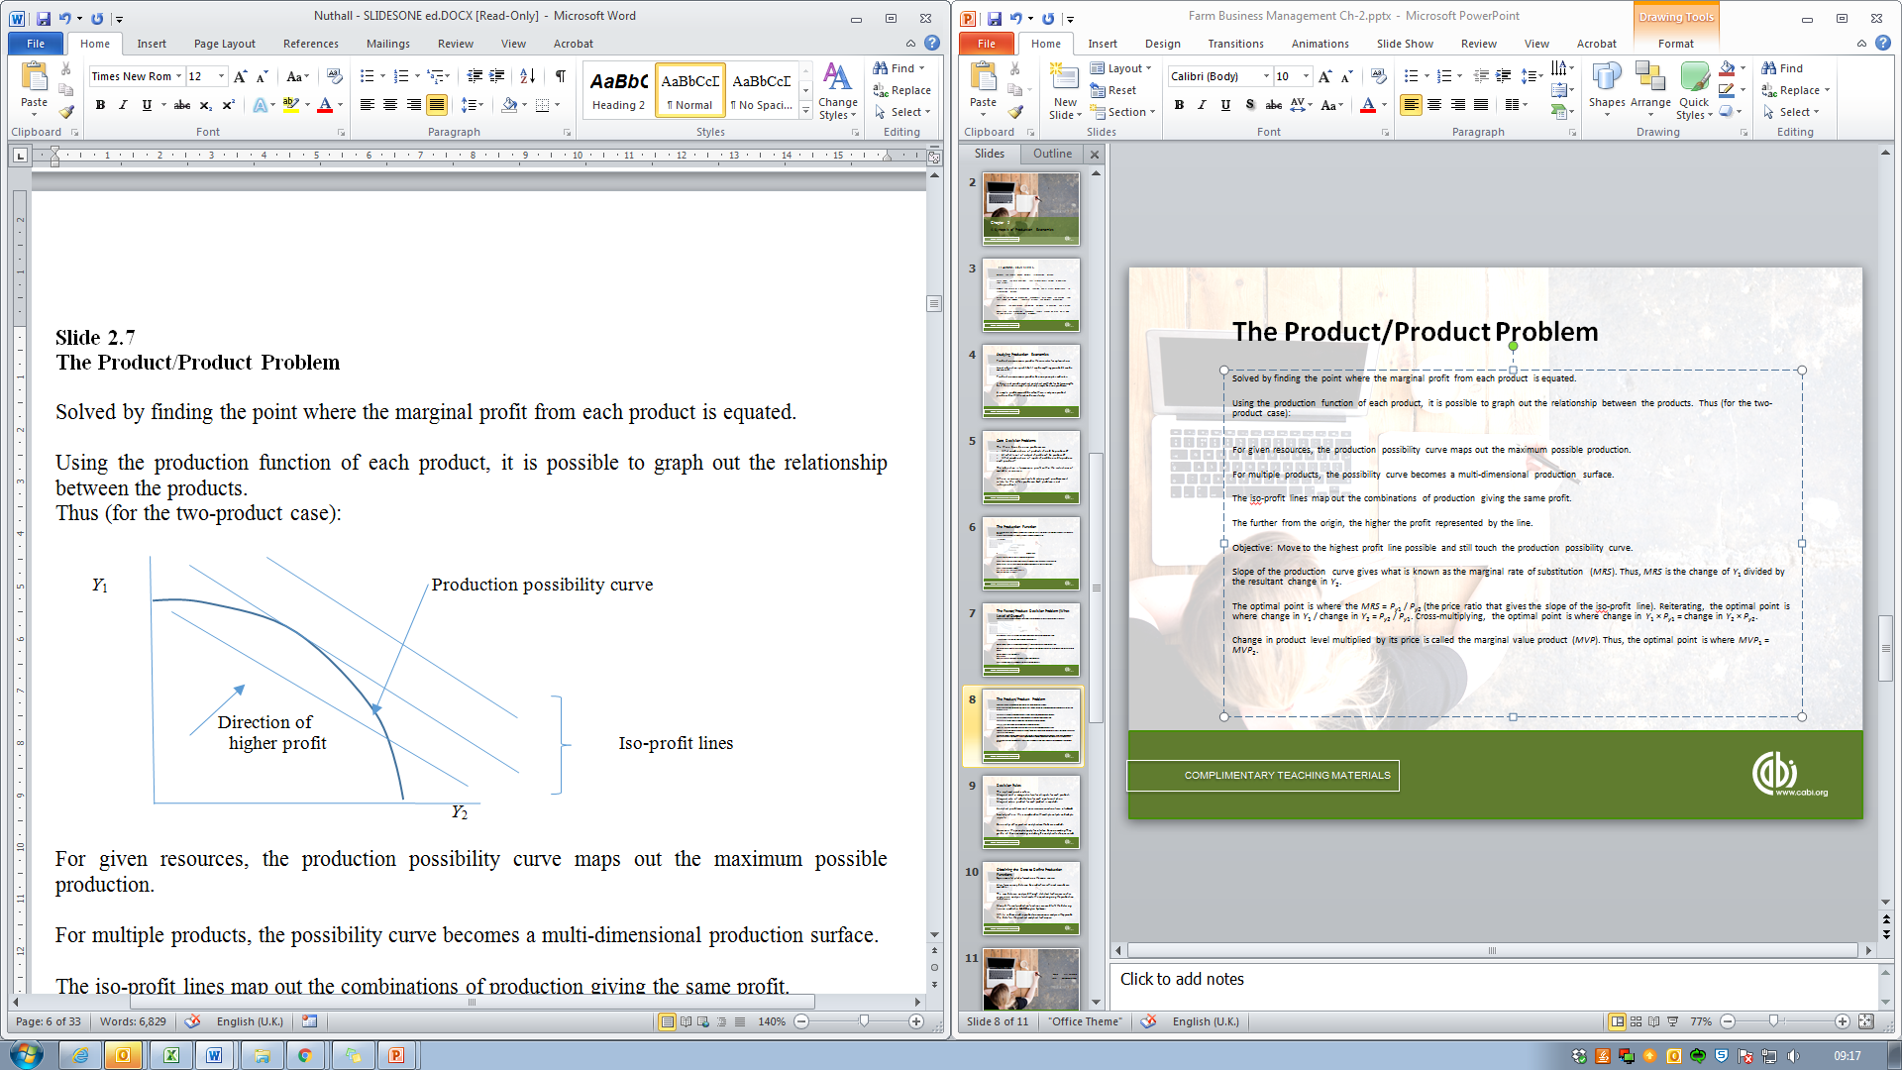
The Product/Product Problem (1)
Solved by finding the point where the marginal profit from each product is equated.
Using the production function of each product, it is possible to graph out the relationship between the products. Thus (for the two-product case):
For given resources, the production possibility curve maps out the maximum possible production.
For multiple products, the possibility curve becomes a multi-dimensional production surface.

Slide 13
The Product/Product Problem (2)
The iso-profit lines map out the combinations of production giving the same profit. The further from the origin, the higher the profit represented by the line.
Objective: Move to the highest profit line possible and still touch the production possibility curve.
Slope of the production curve gives what is known as the marginal rate of substitution (MRS). Thus, MRS is the change of Y₁ divided by the resultant change in Y₂.
The optimal point is where the MRS = P_{y1} / P_{y2} (the price ratio that gives the slope of the iso-profit line).
Reiterating, the optimal point is where change in Y₁ / change in Y₂ = P_{y2} / P_{y1}.
Cross-multiplying, the optimal point is where change in Y₁ × P_{y1} = change in Y₂ × P_{y2}.
Change in product level multiplied by its price is called the marginal value product (MVP).
Thus, the optimal point is where MVP₁ = MVP₂.

Slide 14
Decision Rules
The optimal point is where:
Marginal cost = marginal return for all inputs for each product.
Marginal rate of substitution for each input = cost ratios.
Marginal value product for each product is equated.
Analytical problems exist once resource constraints are introduced.
Similarly where this is combined with multiple outputs and multiple inputs.
Generally, other practical analytical methods are needed.
However, the principles apply for intuitive decision making. They guide all decision making, including the analytical techniques used.

Slide 15
Obtaining the Data to Define Production Functions
Experimental plot information is the main source.
Also farm survey data can be used where sufficient records are available.
The raw data are analysed through statistical techniques such as regression analysis to estimate the equation giving the production functions.
Many different production functions are used to fit the data, e.g. linear, quadratic, Cobb-Douglas, Spillman.
While seldom used in production economics analyses, they provide the data for the practical analytical techniques.

Slide 16
Thank You
Name: First Surname
Email: email@email.com

