Slide 1
Farm Business Management: The Fundamentals of Good Practice
Peter L. Nuthall

Slide 2
Chapter 12
Understanding the Human Factor in Management

Slide 3
Learn about the attributes exhibited by experts.
Better understand the process known as ‘pattern matching’.
Discover the importance of ‘informed intuition’ and the concept of ‘decision constructs’.
Appreciate the critical aspects of a manager’s psyche that determine their abilities.
Understand the concept of a farmer’s locus of control.
Realize people have distinct and definable approaches to learning ideas, concepts and information.
Appreciate the structure and components of a farmer’s personality and intelligence, and how they relate to management.
Consider the question of motivation.
Become aware of the relationships leading to managerial skill, and the importance of each relationship.

Slide 4
The Importance and Significance of Management
Management ability is critical for success: it is the fourth factor of production.
Manager must be good at the core skills (Chapter 9), but also planning and implementation.
But managers are human and don’t respond like machines.
Managers must aspire to being an expert. Characteristics include:
excellence in defining problems, observation of cues;
perceiving patterns, solutions, superior memories;
quickly solving with pattern matching, or sorting with analysis.

Slide 5
The Structure of Managers
Ability comes from genes (parents) and practice (the environment).
People are defined by their personality and intelligence, and possibly their motivation.
Improvement comes from personality change and training, and learning from experience.
If not a perfect manager, the manager will have biases. A bias exists when something is not perfect with the decision process and implementation. Emotions and humanity are prominent. Identify and improve.

Slide 6
Defining Management Skill (1)
Management involves very many skills and much knowledge: primary production is mainly a practical occupation.
Personality research shows there are five factors (besides intelligence) defining a person. These are openness, conscientiousness, extroversion, agreeableness and neuroticism (really anxiety): OCEAN.
Management style: personality expressed in terms of management factors (six factors that encompass OCEAN).
Tests to determine a farmer’s management style are available (see Appendix A1, this volume).
Other personality theories exist, but not as much evidence.
Risk attitude may relate to personality. Tests exist to assess a farmer’s attitude to risk (see Appendix A5, this volume).

Slide 7
Defining Management Skill (2)
Intelligence is also important to a certain extent and has many aspects (e.g. logical, visual).
Intelligence is broadly classed into fluid (broad reasoning) and crystallized. Fluid intelligence is expressed in a particular culture.
Intelligence impacts on:
memory,
observation,
anticipation,
imagination,
creativity, and
a farmer’s ‘constructs’ and intuition (constructs = decision rules of thumb).
Intelligence is assessed by tests in many cases, but debate exists over the tests’ efficacy.

Slide 8
Motivation Relative to Managerial Ability
Many theories on motivation exist: is it the drive to achieve in project management and control?
What are the drivers: the farmer’s and family’s needs; the level of self-control; emotional impacts?
Tests: not many successful tests exist, so use observation.
Many believe ‘motivation’ is an expression of personality and is highly correlated with it.

Slide 9
Learning Style
Learning influences managerial ability, so appropriate learning is important.
We all learn in different ways: some by seeing, some by hearing, some by doing, and some by reading.
Most people learn by a mixture, with the dominant aspects varying between individuals.
Learning process: experience something;
observe and reflect;
relevant abstract concepts acquired.
Repetition is needed by many people.
Tests available for working out an individual’s learning style: farmers are often ‘concrete’ in style.

Slide 10
Locus of Control
Farmers have varying beliefs in the factors they can control and manage.
The term locus of control is used to define this belief. Measured as a %.
Tests are used to measure the locus of control (see Appendix A3, this volume).
Answers to tests enable classifying types, e.g. careful and determined planner, beyond control approach.
Types summarized into ‘internals’ (strong control) and ‘externals’ (little control).
Internals tend to make greater profit and are more adventurous.
But locus of control tends to be correlated with personality measures.

Slide 11
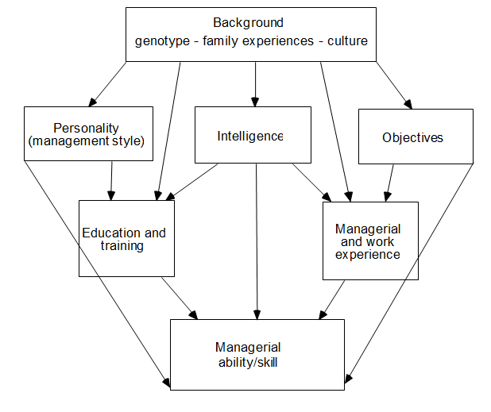
Modelling the Origins of Managerial Ability: Find Values for Arrows

Slide 12
Research Results on the Origins of Managerial Ability
Can ask farmers to answer questions to define each box in the diagram. Includes tests for management style, intelligence, education, experience and objectives.
Objectives do not define management ability per se, but impact on measuring success. Output levels relative to objectives determine ability, equations relate factors to output via ability.
Results show managerial ability is explained by:
74% experience;
18% management style;
8% intelligence.
Farmers with poorer ability exhibit a high level of anxiety, low conscientiousness, low community spirit, low levels of consultation with colleagues, and a benign outlook, as well as many other characteristics.

Slide 13
Thank You
Name: First Surname
Email: email@email.com

