Slide 1
Antimicrobial Stewardship for Nursing Practice
Edited by Molly Courtenay and Enrique Castro-Sánchez

Slide 2
Chapter 3 Antimicrobials and Antimicrobial Resistance
Maria Clara Padoveze, Ligia Maria Abraão and Rosely Moralez de Figueiredo

Slide 3
Understand the core knowledge underpinning the concept of antimicrobial resistance
Apply this knowledge to nursing practice to prevent antimicrobial resistance

Slide 4
SECTION 1: Introduction

Slide 5
Antimicrobials: treatment of infections
reduce mortality
increase life expectancy
Multidrug resistant bacteria: limitations for therapeutic options

Slide 7
Human contribution factors to antimicrobial resistance as public health problem
Overuse of antibiotics in:
Medicine
Livestock farming
Agriculture
Poultry production
Lack of development of new antibiotics

Slide 8
SECTION 2: Infection

Slide 9
Infection
Balance between host response and micro-organisms’ mechanisms to overcome them
Host
Response to prevent aggression
Micro-organisms
Ability to overcome host defences
Number, ability to invade, produce toxins
Infection

Slide 10
Colonization versus Infection
Colonization: process by which micro-organisms are present in the host,with a certain level of multiplication, but without producing clinical disease.
Infection: involves the invasion of micro-organisms in the host’s body tissues, with the generation of an inflamatory and immunological response, leading to clinical disease and resulting in signs and symptoms.

Slide 11
Signs and symptoms of infection
Not all colonization results in infection
Colonization => temporarily or permanently colonized OR development of infection
Colonization is a complex process:
Sometimes involves changes in the colonizing species
Sometimes quick progress to infection

Slide 12
Signs and symptoms of infection
Important: awareness to identify early signs and symptoms of infection
Nurses: have a pivotal role in the early identification of infection
Clinical presentation:
may be restricted to certain anatomical site (local infection)
OR
general signs (indicate system infection)

Slide 13
Signs and symptoms of infection
Major infection sites | Main signs and symptoms
Bloodstream | Fever, tachycardia, tachypnea, hypotension, mental confusion, oliguria
Digestive tract | Nausea, vomiting, diarrhea, abdominal pain
Respiratory tract | Tachypnea, presence or change of secretion (changes in amount, colour, appearance)
Skin | Erythema, heat, pain, pus, macules, papules, vesicles
Urinary tract | Dysuria, polyuria, low abdominal pain
Wound | Erythema, heat, pain, pus, necrosis

Slide 14
Signs and symptoms of infection
Opportunities for nurse to contribute to early identification of infection (examples):
Measurement of vital signs
Physical examination
Administration of medication: observation of catheter site
Wound care: observation of characteristics of secretion or necrosis
Bathing patients: observation of erythema, heat or macules and papules in the skin
Emptying a urinary catheter bag: observation of changes in urine characteristics.

Slide 15
Specimen collection
Importance of adequate specimen collection during relevant stages of infection
Ideally before antibiotics administration
The optimal time for specimen collection varies according to the type of infection
Early stages of an infection is more profitable
Correlate the signs and symptoms of infection and the optimal time for specimen collection.
Adequate conservation of samples and timely delivery to laboratory

Slide 16
SECTION 3: How Antimicrobials work

Slide 17
Main concepts
Antimicrobial: includes any agente (such as antibiotics, antivirals, antifungals, and antimalarials) capable to perform against micro-organisms
Produced biologically by micro-organisms or synthetically by chemists.
Kill micro-organisms: (-cidal)
Inhibit grow of micro-organims (-static)
Antibiotic: is a type of antimicrobial substance active against bacteria

Slide 18
Main concepts
Broad-spectrum drug: has activity against gram-positive as well gram-negatives species
Narrow-spectrum drug: has activity against only one group of micro-organisms or only one species.
Therapeutic index: refers to the level of selective toxicity of a given drug comparing to the blood concentration at which a drug causes a therapeutic effect to the amount of toxicity produced in humans.

Slide 19
Classification of antimicrobials
Inhibitors of cell wall synthesis
Inhibitors of cytoplasmic membrane function
Inhibitors of protein syntheses
Inhibitors of nucleic acid synthesis
Antimetabolites

Slide 20
Classification of antimicrobials
May vary according to:
The targeted micro-organisms: antibiotics, antivirals, antifungals, antimalarials
Their molecular structure
Their antimicrobial mechanisms
Obs.: the examples showed in the following tables are not exhaustive

Slide 21
Inhibitors of cell wall synthesis
Target the bacterial cell wall
Interfer with the building of the peptidoglican chain
Interact with proteins to the synthesis of peptidoglycan chain
Lysis of bacteria occurs due to disruption of the peptidoglycan layer

Slide 22
Inhibitors of cell wall synthesis
Class compound | Antimicrobial drug
Beta-lactams | Penicillins, ampicillin, amoxicillin, carbenicilin, methicilin
Beta-lactams | Cephalosporins (cephalothin, cefamandole, cefotaxime, cefoxitin, cefazolin, cefoperazone, cefixime, cefprozil, cefpodoxime, ceftaroline, ceftolozane-tazobactam, ceftazidime-avibactam
Beta-lactams | Carbapenems (imipenem, meropenem, doripenem, ertapenem)
Glycopeptides | Vancomycin, teicoplanin

Slide 23
Inhibitors of cytoplasmic membrane function
Affinity for lipids bind irreversibly to cytoplasmic membrane sterols
Interfere with lipid byosynthesis
Lead to alterations in permeability, resulting in loss of nutrientes and other essential compounds

Slide 24
Inhibitors of cytoplasmic membrane function
Class compound | Antimicrobial drug
Polyenes | Amphotericin B, nystatin, candicidin, pimaricin, trichomycin, hamycin *
Azoles | Ketoconazole, fluconazole, itraconazole *
Polymixins | Polymixin B, polymixin E (colistin)
* antifungals

Slide 25
Inhibitors of protein synthesis
Binding ribosomes
Cause misreading of messenger RNA, resulting in abnormal proteins or impairment of proteins synthesis
Abnormal proteins will produce pores that enable more antibiotic to enter the bacterial cell

Slide 26
Inhibitors of protein synthesis
Class compound | Antimicrobial drug
Aminoglycosides | Streptomycin, kanamycin, gentamycin, tobramycin, sisomycin, amikacin, neomycin, fortimicin A, netilmicin, 5-episiomicin, spectinomycin
Tetracyclines | Tetracycline, doxycycline, chlorampenicol
Amphenicols | Chloramphenicol
Macrolides | Erythromycin, azithromycin, spiramycin, josamycin, roxithromycin, clarithromycin,
Oxazolidonones | Linezolid
Lincosamides | Lincomycin, clindamycin

Slide 27
Inhibitors of nucleic acid synthesis
Disrupture of DNA synthesis causing lethal DNA breaks during the replication process
Several mechanisms:
Binding to a subunit of RNA polymerase
Inhibition of topoisomerases
Phosphorylation of componentes
Inhibition of viral primary transcription process
Inhibiton of viral replication process
Blocking the pathway for folic acid synthesis

Slide 28
Inhibitors of nucleic acid synthesis
Class compound | Antimicrobial drug
Ansamycins | Rifampicin, Rifamycin B
Quinolones | Nalidixic acid, fluorquinolones (norfloxacin, ciprofloxacin, ofloxacin)
Pyrimidine | Flucytosine
Amines | Amantadine, rimantadine
Virazole | Ribavirin**
Nucleoside analog | Idoxuridine, thymidine, acyclovir, zidovudine (azidothymidine or AZT), vidarabine**
** antivirals

Slide 29
Antimetabolites
Compounds structurally similar to normal cellular metabolites
Compete with cellular metabolites for attachment to enzymes
Similarity of structural analogue of para-aminobenzoic acid, pteridine, nicotinamide
Binding and inhibition of Beta-lactamase ring

Slide 30
Antimetabolites
Class compound | Antimicrobial drug
Sulfonamides | Sulfanilamide, sulfadiazine, sulfamethoxazole, sulfathiazole, sulfasoxazole, sulfapyridine
Sulfones | Dapsone
Nitrofurans | Nitrofurantoin
Aminopyrimidines | Trimethoprim, ormetoprim
 | Isoniazid, ethambutol
 | Para-aminosalicyclic acid

Slide 31
SECTION 4: Appropriate antimicrobial use

Slide 33
Mechanisms of resistance
To impair the action of antimicrobials:
Reduction of bacterial membrane permeability
Increases in expression and activity of efflux pump systems
Synthesis of enzymes able to destroy or modify the drug
Modification, substitution or disruption of antibiotic bacterial targets
Biofilm formation

Slide 34
a) Reduction of bacterial membrane permeability
Bacterial cellular membrane:
intrinsic permeability that allows nutrients intake
acts as a first barrier to external agents
Low permeability on the cell surface:
antibiotic blocking => drugs cannot achieve their targets

Slide 35
b) Synthesis of enzymes to destroy a drug
Enzymes can degrade and modify antibiotics
Enzymes can degrade different antibiotics belonging to the same class:
Examples:
beta-lactamases: destroy beta-lactams (penicillin, cephalosporins, clavams, and monobactams)
carbapenemases: destroy carbapenems

Slide 36
c) Modification of antibiotic targets
Very frequent mechanism
Antibiotics bind to the bacterial target in a specific way, preventing their normal role
Example: penicillin = bind to penicillin binding protein (PBP) = rupture of cell wall
Small mutations on these targets = prevent antibiotic binding
Example: altered PBP (PBPa) will not bind to penicillin
DNA
PBP
penicillin
Bacterial cel
DNA
PBPa
penicillin
Bacterial cel

Slide 37
d) Increases in expression and activity of efflux pump
Efflux pump:
proteins that constitutes all bacterial plasma membrane
mechanism that actively transport antibiotics out of the bacterial cells
Over expression of these proteins:
increase expression and activity of efflux pump system

Slide 38
SECTION 5: Implications for nursing practice

Slide 39
Implications for nursing practice
Nurses should recognize:
the mechanisms that lead to antimicrobial resistance
selective pressure exerted by antimicrobials
how antimicrobials work
Nurses: pro-active attitude regarding antibiotic therapy

Slide 40
Implications for nursing practice
Obtain allergy history from the patient to support optimal prescribing of antimicrobials
Proper choice of catheter according to the therapy and clinical conditions of the patient
Monitor adverse events of antimicrobial therapy
Review daily condition of patients
Actively take part in multidisciplinar team discusssions regarding antibiotic treatment, indication and duration

Slide 41
Implications for nursing practice
Proper and timely specimens collection
Avoid unnecessary specimens collection
Example: avoid urine collection of asymptomatic patients to prevent unnecessary treatment
Timely examination of antibiograms to support therapy adjustment and de-escalation

Slide 42
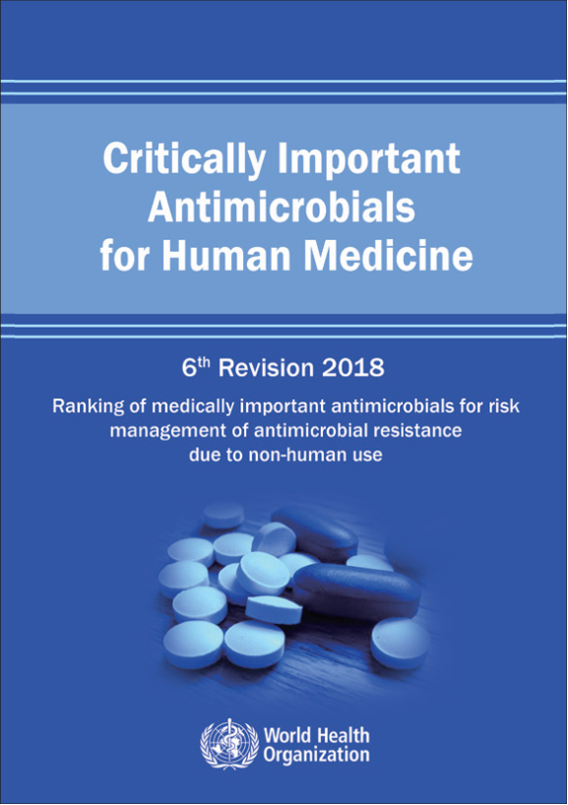
Role of nurses
Awareness: antimicrobials with restricted indication and the need to save them for specific purposes
Example: isoniazid and rifampicin limited to therapy as part of treatment of mycobacterial diseases including tyberculosis.
One Health approach:
Multiple sectors working together to achieve better public outcomes

Slide 43
Nurses are frontline professionals engaged in the fight against antimicrobial resistance

Slide 44
Thank You

