Slide 1
Antimicrobial Stewardship for Nursing Practice
Edited by Molly Courtenay and Enrique Castro-Sánchez

Slide 2
CHAPTER 2 INFECTION PREVENTION AND CONTROL
Briëtte du Toit and Yolanda van Zyl

Slide 3
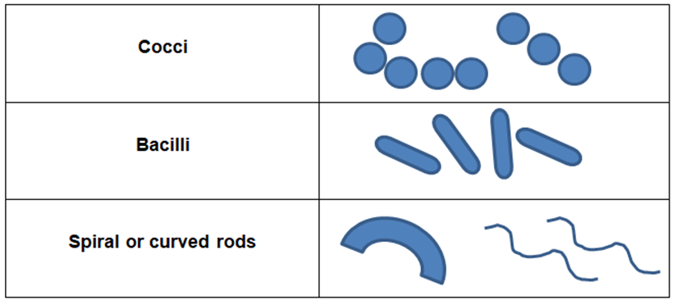
CLASSIFICATION OF MICRO-ORGANISMS
Bacteria
Fungi
Viruses
Parasites
Algae
Bacteria can further be classified in:
Cocci
Bacilli
Spiral or curved rods

Slide 4
REQUIREMENTS FOR THE REPRODUCTION OF MICRO-ORGANISMS
Physical
Temperature
pH
Osmotic pressure
Chemical
Water
Nutrients: Carbon, Nitrogen & Minerals
Oxygen
Organic growth factors

Slide 5
ANTIBIOTIC RESISTANT MICRO-ORGANISMS
Antibiotic resistance develops when micro-organisms adapt and grow in the presence of antibiotics
Resistance Mechanisms
Decrease permeability of the cell wall
Alteration of the drug target
Inactivation of the drug
Active efflux of the drug
Development of alternative metabolic pathways

Slide 6
CHAIN OF INFECTION

Slide 7
ROUTES OF TRANSMISSION
Main Routes | Types | Examples
Contact | Direct, e.g. hands | E.g. Staphylococcus aureus, Antibiotic resistant organisms
 | Indirect, e.g. equipment, environment | E.g. Staphylococcus aureus, Antibiotic resistant organisms
Respiratory | Droplet | Influenza
 | Airborne | Tuberculosis, measles, chickenpox
Ingestion | Water & food | Cholera & salmonella
 | Faecal matter | Hepatitis A
Inoculation | Injection, trauma & surgery | HIV, Hepatitis B & C
 | Insects & vectors | Malaria
Trans-Placental | Mother to child | HIV, syphilis, rubella

Slide 8
SURVEILLANCE
Surveillance is the continuous and systematic collection and analysis of data to detect and monitor public health threats, including the epidemiology of these threats and the
burden of disease.

Slide 9
VACCINES’ ROLE IN THE PREVENTION OF RESISTANCE
Prevent infectious diseases and reduce the use of antimicrobials
Reduce the prevalence of viral infections
Prevent disease and therefore secondary infections
New or improved vaccines can prevent difficult to treat diseases
Reduce infections in animals that are used for food

Slide 10
SPECIMEN COLLECTION
Ensure good-quality specimens
To ensure optimal processing, analysis and interpretation of results
Collect specimen prior to administration of antimicrobials
(But do not delay treatment in critically ill patients)
Prevent contamination of specimens during collection
Ensure adequate volume to ensure accurate analysis,
(e.g. blood cultures)
Label specimen correctly
Provide enough clinical information
Send to the laboratory as soon as possible
Only collect specimens when clinically indicated

Slide 11
Thank You

