Slide 1
The Cat – Behaviour and Welfare 9. The cat as a predator
Bjarne O. Braastad
Professor of Ethology
Department of Animal and Aquacultural Sciences,
Norwegian University of Life Sciences, NMBU, Ås, Norway

Slide 2
Predatory behaviour – the cat as a predator, a threat to populations of small birds?

Slide 3
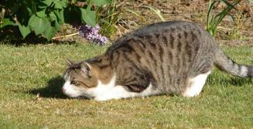
Hunting behaviour of cats – a long sequence of behaviour
Hunting motivation → seek a hunting place
Relevant hunting place → waiting in ambush – patience
Sees potential prey → run closer to prey, new ambush
Prey inattentive → low crawling towards prey, hiding if possible
Prey inattentive, OK distance → runs or jumps onto
prey; seizes it
If the cat is hungry → killing bite and possibly eats prey
If the cat is not hungry, it may release the prey and catch
it again → the cat ‘plays’ with the prey
The longer into the behaviour sequence, the higher the hunting motivation must be to continue hunting. Killing bite needs a particularly high motivation in house cats. (Leyhausen, P., 1979, Cat Behavior, Garland STPM Press, New York)

Slide 4
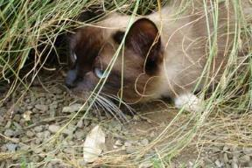
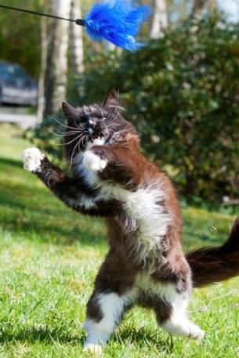
Hunting behaviour in cats – the role of play
Predatory play = object play, important for behavioural development, but also kept in adult cats
Predatory play can use the human as an ‘object’ – should not be encouraged, since the cat gets used to biting humans.
Instead, use other objects like table-tennis balls, paper in a string, feather sticks etc.
Remember the cat’s patience!
This also applies when we
play with the cat.

Slide 5
Hunting in cats – prey species and hunting efficiency
Prey species:
Most common: mice, voles, young rats, birds, young rabbits, squirrels, insects as snacks
Less common: adult rats, adult rabbits, hares, ducks, pheasants, small snakes, lizards
Efficiency:
Small rodents and birds: 2–4 attacks per successful hunt
Rabbits: 5 attacks per successful hunt
(Fitzgerald & Turner, 2000, in: Turner & Bateson (eds) The Domestic Cat, 2nd edn, Cambridge
University Press, Cambridge, UK)
Cats take less prey as they become older.
(Churcher & Lawton, 1987, Journal of Zoology 212, 439–455; Barratt, 1998, Wildlife Research 25,
475–487)

Slide 6
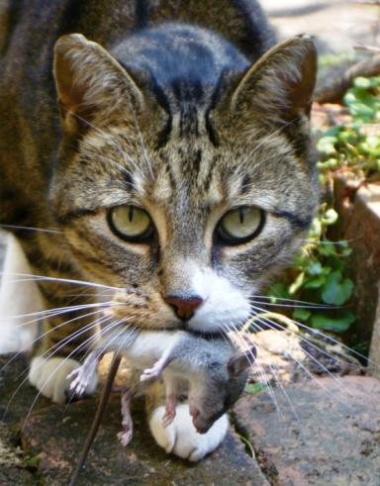
Hunting in cats – favourable effects: pests
Contributes to keeping populations of mice and rats low → important during domestication of cats
May reduce mouse population (hunting young and adult mice)
May counteract increase in rat populations (hunting young rats)
Reducing cat populations may increase rat
populations.
(Fitzgerald & Turner, 2000, in: Turner & Bateson (eds) The Domestic Cat,
2nd edn, Cambridge University Press, Cambridge, UK)
Foto: Lxowle, Wikimedia, CC-BY-SA-3.0)

Slide 7
Hunting in cats – harmful effects: – birds
Ornithologists claim that cats are harmful to populations of small birds. Is it true? Consider this:
Bird hunting occurs during daytime – often seen by humans.
Small-rodent hunting occurs at night – often overlooked.
By keeping rat populations down, the cat may reduce rat predations on ground-nesting birds.
Even if domestic cats take a lot of birds in living areas, those bird species will normally be abundant in forests or other areas.
On some small islands, cats may be at risk to local bird populations.
In Australia, cats, like other imported predatory species, may be harmful to bird populations.

Slide 8
More on cats’ behaviour and welfare is found here (in Norwegian)
www.braastad.info – Braastad’s website on ethology, animal welfare, cats, and human–animal relationship
www.facebook.com/KattenAtferdVelferd – Facebook (Meta) site for the Norwegian cat book
www.etologi.no – website for the Norwegian Association of Ethologists
www.etologi-dyrevelferd.no – website on ethology and animal welfare for secondary schools
www.animalpickings.com – popular scientific website for the Research Group on Ethology and Animal Environment at the Norwegian University of Life Sciences
Notes:
Trykk Visningsfunksjonen så samme bilde er på PC og lerret!
Trykk deretter lenken.

Slide 9
Thank you for listening to Bjarne. He believes that he understands me.
But we have our secrets that no ethologist yet knows about.

