Slide 1
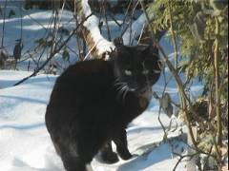
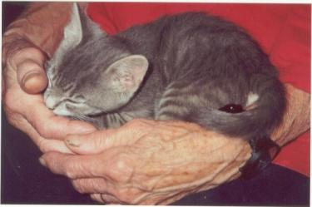
The Cat – Behaviour and Welfare
8. Social behaviour of male cats
Bjarne O. Braastad
Professor of Ethology
Department of Animal and Aquacultural Sciences,
Norwegian University of Life Sciences, NMBU, Ås, Norway

Slide 2
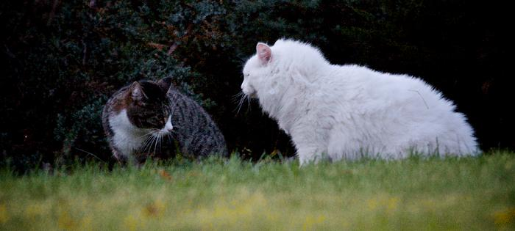
Male cat social behaviour
Male cats are not socially adult before age of c.2 years.
Home ranges in males (200–300 hectares):
  do not defend a territory
  may quarrel with other males during mating season
Castrated males may show social behaviour
similar to females:
  stay closer to home
  may become more territorial
Male cats may also be good friends.
Photo: Audun Braastad
Notes:
Atferdsutvikling – sosialisering – 12 uker
Sosial struktur – hunner og hanner
Eierløse katter – katters atferd i ukjent terreng
Kommunikasjon – akustisk, visuell, berøring, lukt, mennesker (inkl. Lydfiler)
Atferdsproblemer

Slide 3
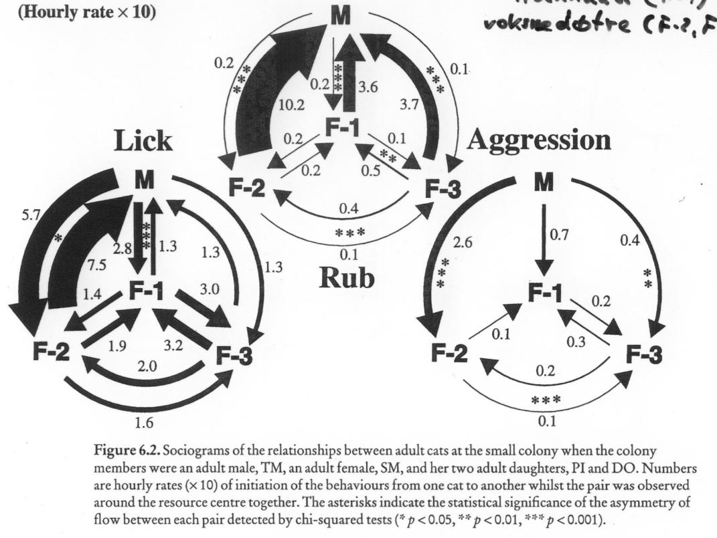
Sociogram:
1 male (M), 1 female (F1) and her two adult daughters (F2, F3)
(Macdonald et al., 2000, in: Turner & Bateson (eds) The Domestic Cat, 2nd edn. Cambridge University Press, Cambridge, UK)
Notes:
Atferdsutvikling – sosialisering – 12 uker
Sosial struktur – hunner og hanner
Eierløse katter – katters atferd i ukjent terreng
Kommunikasjon – akustisk, visuell, berøring, lukt, mennesker (inkl. Lydfiler)
Atferdsproblemer

Slide 4
More on cats’ behaviour and welfare is found here (in Norwegian)
www.braastad.info – Braastad’s website on ethology, animal welfare, cats and human–animal relationship
www.facebook.com/KattenAtferdVelferd – Facebook (Meta) site for the Norwegian cat book
www.etologi.no – website for the Norwegian Association of Ethologists
www.etologi-dyrevelferd.no – website on ethology and animal welfare for secondary schools
www.animalpickings.com – popular scientific website for the Research Group on Ethology and Animal Environment at the Norwegian University of Life Sciences
Notes:
Trykk Visningsfunksjonen så samme bilde er på PC og lerret!
Trykk deretter lenken.

Slide 5
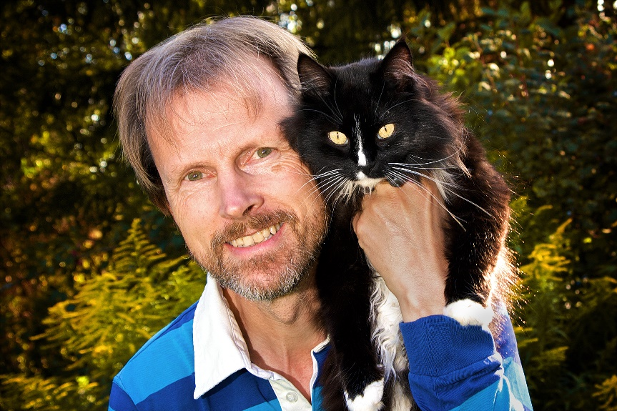
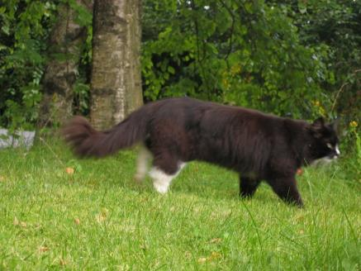
Thank you for listening to Bjarne. He believes that he understands me.
But we have our secrets that no ethologist yet knows about.

