Slide 1
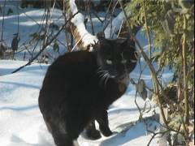
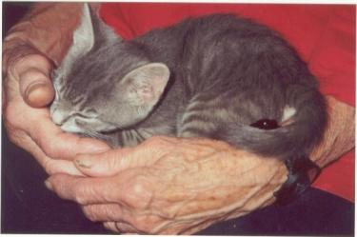
The Cat – Behaviour and Welfare
7. Social behaviour of female cats
Bjarne O. Braastad
Professor of Ethology
Department of Animal and Aquacultural Sciences,
Norwegian University of Life Sciences, NMBU, Ås, Norway

Slide 2
Social behaviour and social structure in adult cats

Slide 3
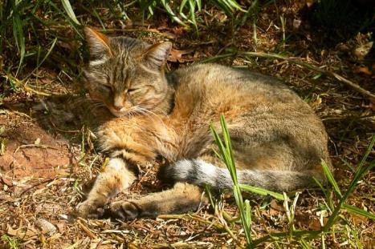
The role of males in African wildcat
The house cat (Felis silvestris catus) is inherited from the African wildcat (Felis silvestris libyca).
The African wildcat may live monogamously in semi-deserts in north-eastern Africa.
In such biotopes, the female cat needs help from the male to provide protection and enough food for the kittens. Remnants of such social skills may be observed in some of today’s house cats.
African wildcat. (Photo: Sonelle, Wikimedia, CC-BY-SA 3.0)
Notes:
Atferdsutvikling – sosialisering – 12 uker
Sosial struktur – hunner og hanner
Eierløse katter – katters atferd i ukjent terreng
Kommunikasjon – akustisk, visuell, berøring, lukt, mennesker (inkl. Lydfiler)
Atferdsproblemer

Slide 4
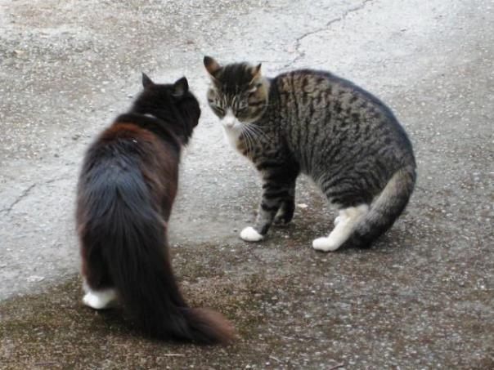
Female cat social behaviour
Population density of outdoor cats: 300m² – 1km² / cat
Female’s territory and home range (0.3–50 hectares)
    – territory is defended (access to prey and a safe nest)
    – passing through home range by other cats is readily accepted.
Photo: Agnethe-Irén Sandem
Notes:
Atferdsutvikling – sosialisering – 12 uker
Sosial struktur – hunner og hanner
Eierløse katter – katters atferd i ukjent terreng
Kommunikasjon – akustisk, visuell, berøring, lukt, mennesker (inkl. Lydfiler)
Atferdsproblemer

Slide 5
Female 2
T
Female 1
T
Female 3
Male
T
T = territory; ellipses = home ranges; blue line = a creek

Slide 6
Female cat social behaviour
Population density of outdoor cats: 300m² – 1km² / cat
Female’s territory and home range (0.3–50 hectares)
    – territory is defended (access to prey and a safe nest)
    – passing through home range by other cats is readily accepted
    Group territories:
      central females → more offspring
        defence against predators
      peripheral females → no territory
Photo: Agnethe-Irén Sandem
Notes:
Atferdsutvikling – sosialisering – 12 uker
Sosial struktur – hunner og hanner
Eierløse katter – katters atferd i ukjent terreng
Kommunikasjon – akustisk, visuell, berøring, lukt, mennesker (inkl. Lydfiler)
Atferdsproblemer

Slide 7
More on cats’ behaviour and welfare is found here (in Norwegian)
www.braastad.info – Braastad’s website on ethology, animal welfare, cats and human–animal relationship
www.facebook.com/KattenAtferdVelferd – Facebook (Meta) site for the Norwegian cat book
www.etologi.no – website for the Norwegian Association of Ethologists
www.etologi-dyrevelferd.no – website on ethology and animal welfare for secondary schools
www.animalpickings.com – popular scientific website for the Research Group on Ethology and Animal Environment at the Norwegian University of Life Sciences
Notes:
Trykk Visningsfunksjonen så samme bilde er på PC og lerret!
Trykk deretter lenken.

Slide 8
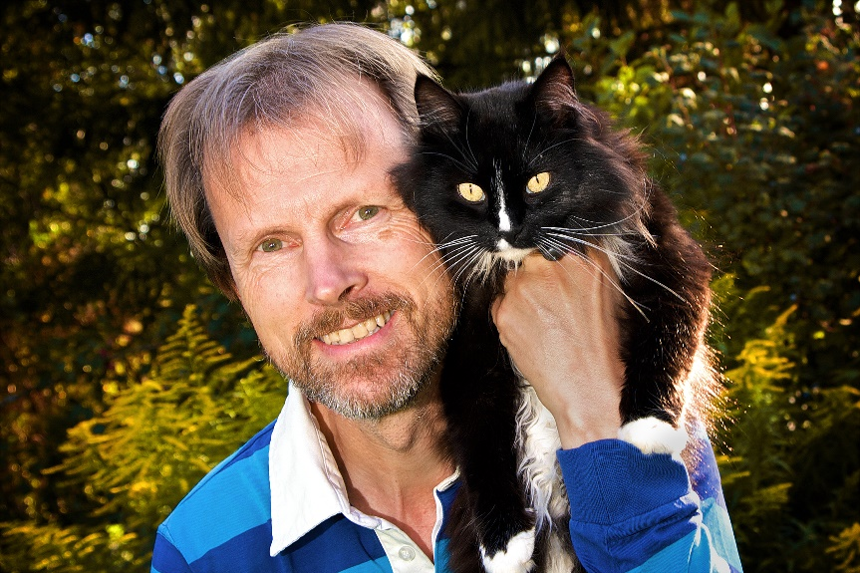
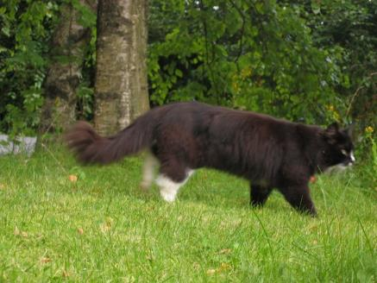
Thank you for listening to Bjarne. He believes that he understands me.
But we have our secrets that no ethologist yet knows about.

