Slide 1
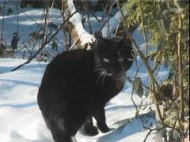
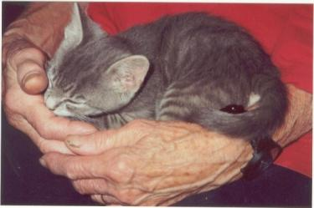
The Cat – Behaviour and Welfare 6. The cat’s body language
Bjarne O. Braastad
Professor of Ethology
Department of Animal and Aquacultural Sciences,
Norwegian University of Life Sciences, NMBU, Ås, Norway

Slide 2
Body language (Visual communication)

Slide 3
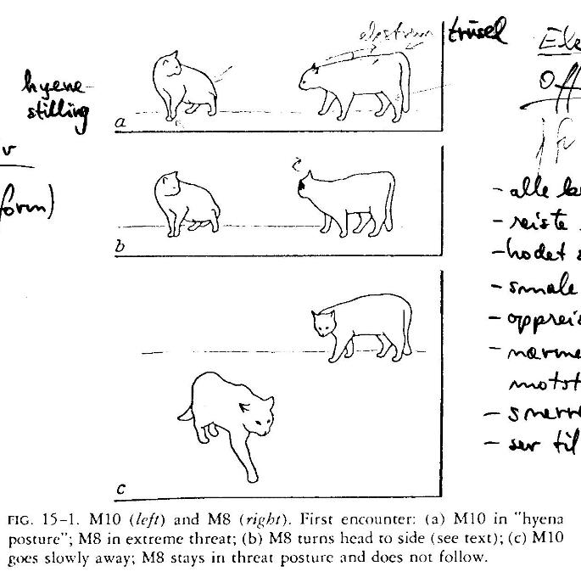
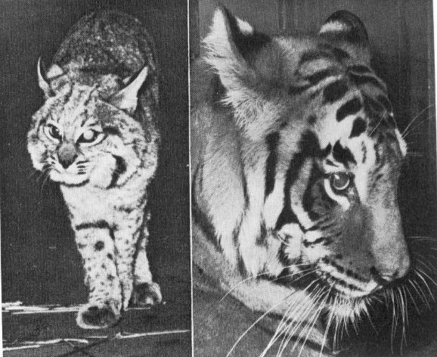
The cat’s body language - I
Lynx and tiger: notice the light spots on the ears → ear signals are more visible during night
Offensive threat: erect legs, tail down, may show the side of head and body
(Figures: Leyhausen, P. (1979) Cat Behavior. Garland, New York)

Slide 4
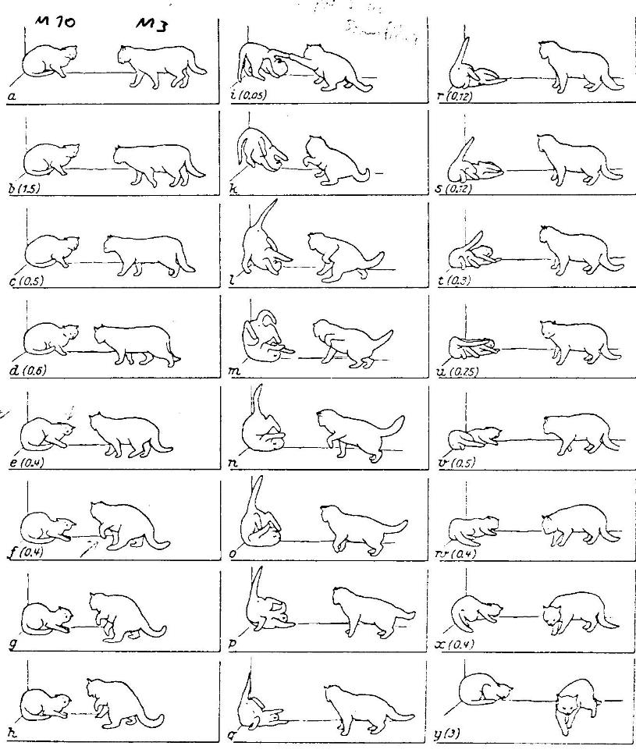
The cat’s body language - II
Defensive threat:
close to ground
retracts head
By stronger signals:
the back towards floor
hits with paws to defend itself
(Leyhausen, P. (1979) Cat Behavior, Garland, New York. (Drawn from a movie clip))

Slide 5
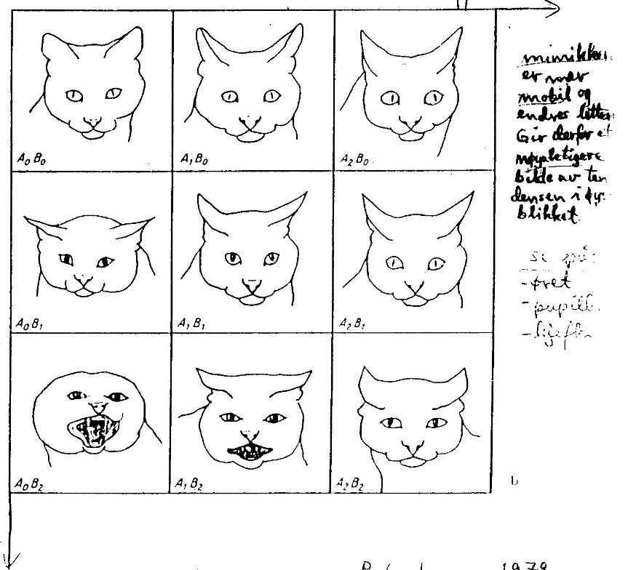
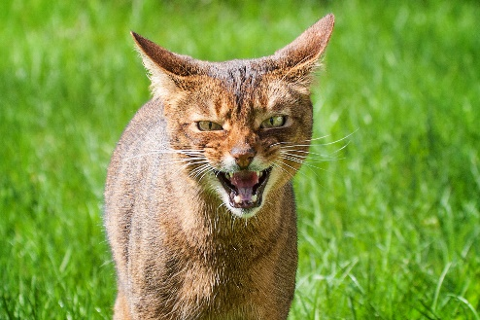
The cat’s facial signals
Offensive tendency,
angry
What does this cat signal?
Defensive
tendency
fear
(Leyhausen, P. (1979) Cat Behavior, Garland, New York)
Photo: Audun Braastad

Slide 6
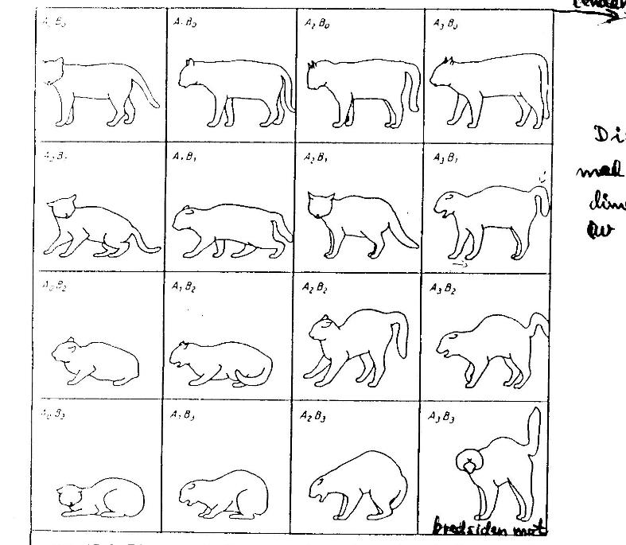
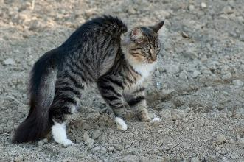
The cat’s body posture
Offensive tendency
angry
Defensive
tendency
Photo: Maria Myrland
fear
(Leyhausen, P. (1979) Cat Behavior, Garland, New York)

Slide 7
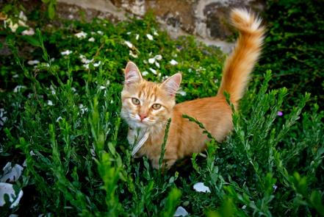
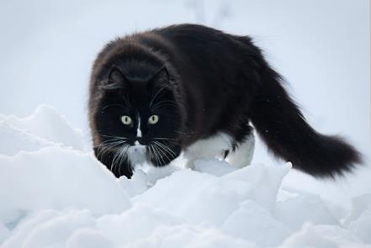
Tail movements
Tail up and down again
‘Hi! ☺’
Lashing tail
‘I warn you!’
(Photos: Audun Braastad)
Notes:
Eks.: hopper ned fra stol og går forbi oss på vei til kjøkkenet
Eks.: Katten ligger og koser seg I fanget vårt. Vi klapper katten…

Slide 8
More on cats’ behaviour and welfare is found here (in Norwegian)
www.braastad.info – Braastad’s website on ethology, animal welfare, cats and human–animal relationship
www.facebook.com/KattenAtferdVelferd – Facebook (Meta) site for the Norwegian cat book
www.etologi.no – website for the Norwegian Association of Ethologists
www.etologi-dyrevelferd.no – website on ethology and animal welfare for secondary schools
www.animalpickings.com – popular scientific website for the Research Group on Ethology and Animal Environment at the Norwegian University of Life Sciences
Notes:
Trykk Visningsfunksjonen så samme bilde er på PC og lerret!
Trykk deretter lenken.

Slide 9
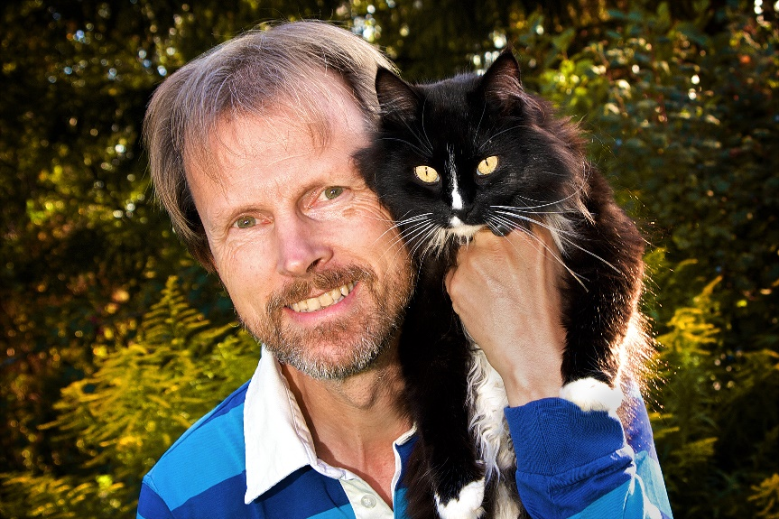
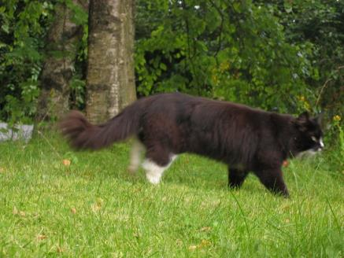
Thank you for listening to Bjarne. He believes that he understands me.
But we have our secrets that no ethologist yet knows about.

