Slide 1
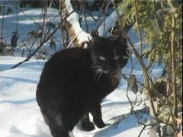
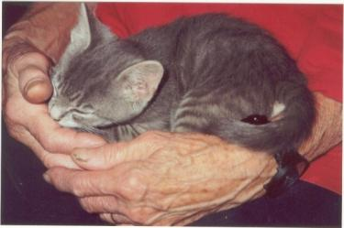
The Cat – Behaviour and Welfare 5. What does the miaow mean?
Bjarne O. Braastad
Professor of Ethology
Department of Animal and Aquacultural Sciences,
Norwegian University of Life Sciences, NMBU, Ås, Norway

Slide 2
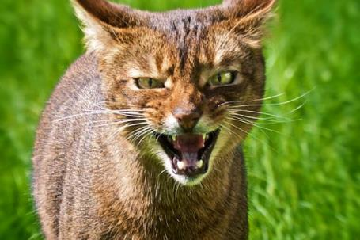
Agonistic behaviour
Agonistic behaviour – behaviour where the animal wishes to increase the distance from other animals
Aggressive behaviour – attacks or threatens to attack
Appeasement signal – signals lower rank, submission
Flight – flees, if possible
Offensive threat – ‘If you don’t leave, I will attack you’
Defensive threat – ‘If you attack me, I will defend myself’
Cats usually do not signal submission, but rather defensive threats!
Norges miljø- og biovitenskapelige universitet
Notes:
12
12
11
11
11
11
11
Dere kjenner begrepene offensiv og defensiv fra fotball ?

Slide 3
Acoustic communication

Slide 4
The cat’s sound language
Which part of the miaow isn’t understandable to you?
Teacher Oscar’s
language lesson
(with permission from Bulls Press)
Wild cat species (lions, tigers, lynx etc.) do not miaow. The miaow is basically a kitten sound that house cats keep using towards humans; also when adult.
Notes:
12
12
11
11
11
11
11

Slide 5
What does the miaow mean?
Listen to the four letters: M – I – A – O. Where is the emphasis?
M - long m-sound: ‘mrrrr’
Contact sound: even ‘mrrrr’ → ‘Hi!’
Call sound: ‘mrr^{rn’} → ‘Hi! Where are you?’
I - long i- or ee-sound: ‘miiiao’
discomfort or pain: → ‘Ouch! That hurts!’
A - long a-sound: ‘miaaao’
claim, desire: → ‘I want ...’
O - long ou-sound: ‘miaoowww’
frustration: → ‘I thought I would get …’

Slide 6
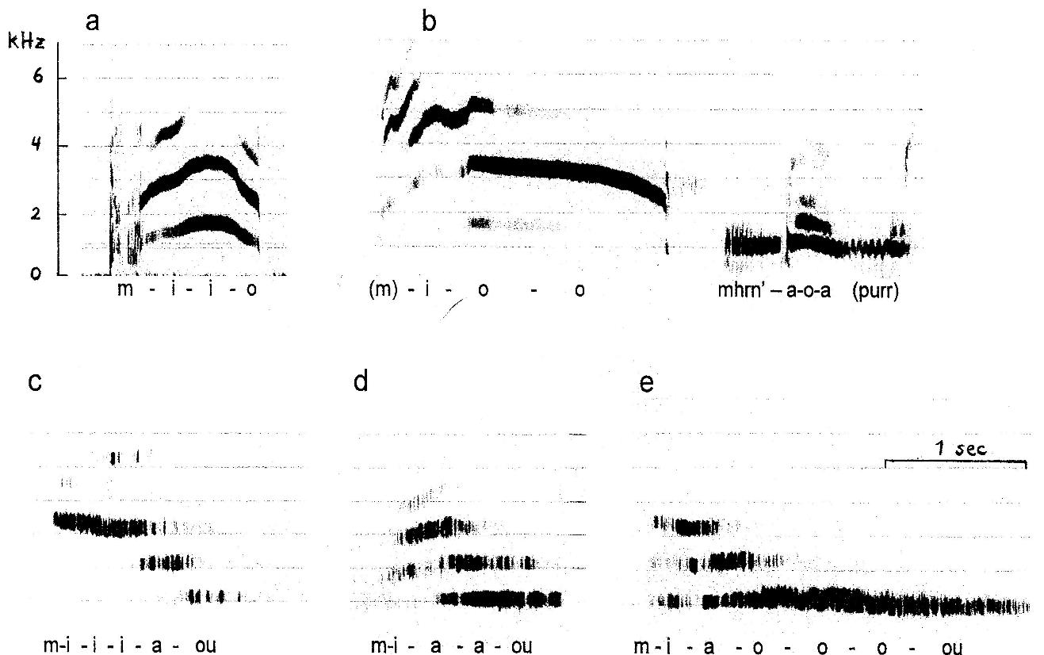
Graphs of the cat’s miaow sounds
The sounds can reach up to 50–60 kHz, ultrasound
‘Hi! I want social contact with you’ [click]

Slide 7
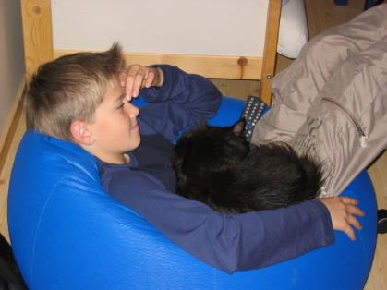
Why does the cat purr?
The purr sound:
Wishes to maintain social contact [click on link and maximize sound level]
By disease or injury: wants help
Can purring vibrations serve as muscle relaxation?
Weak and strong purring:
Weak, normal purring:
Strong purring:
strong solicitation of resources (e.g. food)
(McComb et al., 2009, Current Biology, 19 (13), R507-R508)

Slide 8
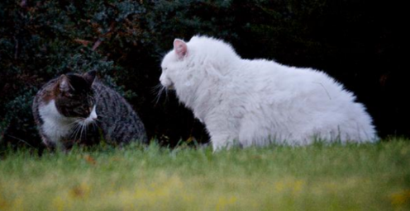
Additional cat sounds
Yowling - offensive aggression
- in fact, a very long miaaaaaaoouu
Hissing - defensive aggression, to signal defence motivation
- virtually only cats and snakes are hissing
Growling - defensive aggression, to defend resources (e.g. food)
‘Mngaou’ - protest!
‘Ke-ke-ke’, ‘A-A-A’ - ‘I want that bird outside the window!’
Note: There is pronounced individual variation in how cats emit and use sound signals. Intonation and modulation of sounds may provide additional information. Different sounds can be combined into more complex signals.

Slide 9
More on cats’ behaviour and welfare is found here (in Norwegian)
www.braastad.info – Braastad’s website on ethology, animal welfare, cats and human–animal relationship
www.facebook.com/KattenAtferdVelferd – Facebook (Meta) site for the Norwegian cat book
www.etologi.no – website for the Norwegian Association of Ethologists
www.etologi-dyrevelferd.no – website on ethology and animal welfare for secondary schools
www.animalpickings.com – popular scientific website for the Research Group on Ethology and Animal Environment at the Norwegian University of Life Sciences
Notes:
Trykk Visningsfunksjonen så samme bilde er på PC og lerret!
Trykk deretter lenken.

Slide 10
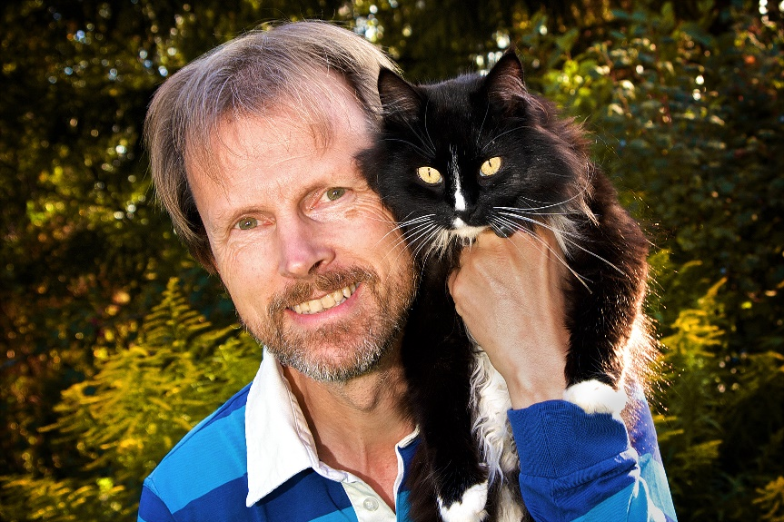
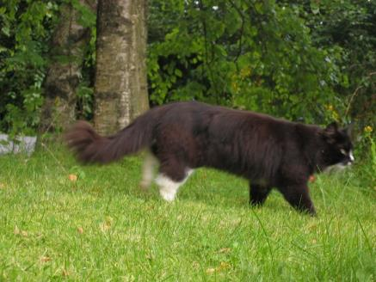
Thank you for listening to Bjarne. He believes that he understands me.
But we have our secrets that no ethologist yet knows about.

