Slide 1
The Cat – Behaviour and Welfare 3. The kitten’s development from 3 to 12 weeks of age
Bjarne O. Braastad
Professor of Ethology
Department of Animal and Aquacultural Sciences,
Norwegian University of Life Sciences, NMBU, Ås, Norway

Slide 2
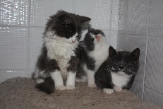
Behavioural development: socialization and play
2–3 weeks: habituation to handling by man
3–21 weeks: socialization and social play:
socialization: 3–12 weeks; most active 3–7 weeks
social play:
– learns effects of signals and social responses
– learns with whom it can have social contact
– humans must be included in socialization or the cat will
remain fearful towards them
– varied human contact is important
– start: weeks 3–9; most active: weeks 9–14
Photo: Janne Helen Lorentzsen
Notes:
Atferdsutvikling – sosialisering – 12 uker
Sosial struktur – hunner og hanner
Eierløse katter – katters atferd i ukjent terreng
Kommunikasjon – akustisk, visuell, berøring, lukt, mennesker (inkl. Lydfiler)
Atferdsproblemer

Slide 3
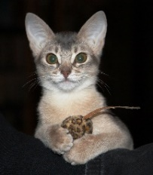
Behavioural development: predatory play and motor skills
Object play/predatory play: learns predatory skills
mother brings dead prey by 4–5 weeks of age; later live small rodent prey
object play: start 9–12 weeks; most active: 18–21 weeks
Motor play: learns co-ordinated movements
To ensure that kittens learn what they need to about social behaviour, they must be together with their mother and siblings until at least 12 weeks of age.
Photo: Heide Kvaløy
Notes:
Atferdsutvikling – sosialisering – 12 uker
Sosial struktur – hunner og hanner
Eierløse katter – katters atferd i ukjent terreng
Kommunikasjon – akustisk, visuell, berøring, lukt, mennesker (inkl. Lydfiler)
Atferdsproblemer

Slide 4
More on cats’ behaviour and welfare is found here (in Norwegian)
www.braastad.info – Braastad’s website on ethology, animal welfare, cats and human–animal relationship
www.facebook.com/KattenAtferdVelferd – Facebook (Meta) site for the Norwegian cat book
www.etologi.no – website for the Norwegian Association of Ethologists
www.etologi-dyrevelferd.no – website on ethology and animal welfare for secondary schools
www.animalpickings.com – popular scientific website for the Research Group on Ethology and Animal Environment at the Norwegian University of Life Sciences
Notes:
Trykk Visningsfunksjonen så samme bilde er på PC og lerret!
Trykk deretter lenken.

Slide 5
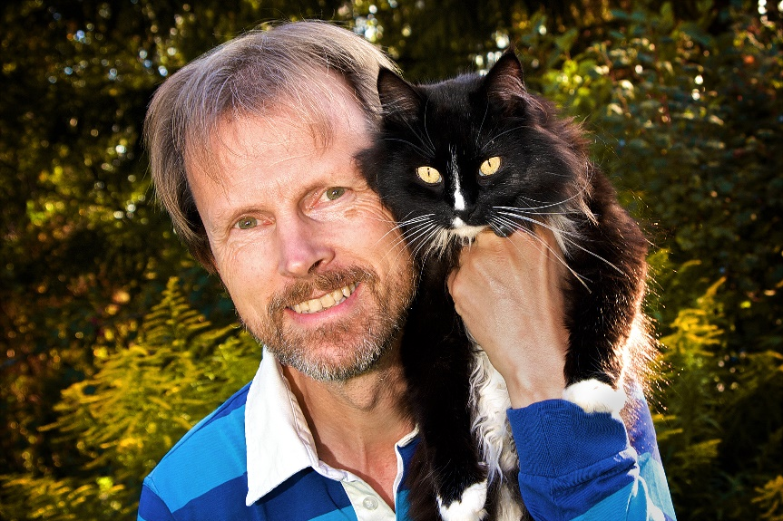
Thank you for listening to Bjarne. He believes that he understands me.
But we have our secrets that no ethologist yet knows about.

