Slide 1
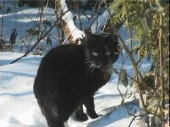
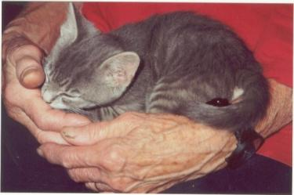
The Cat – Behaviour and Welfare 22. The cat’s environmental needs
Bjarne O. Braastad
Professor of Ethology
Department of Animal and Aquacultural Sciences
Norwegian University of Life Sciences, NMBU, Ås, Norway

Slide 2
The cat’s environmental needs

Slide 3
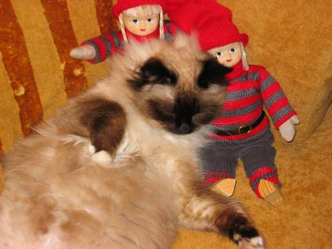
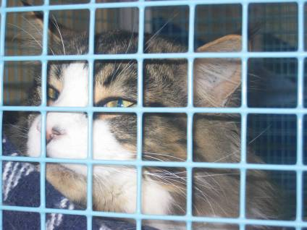
Welfare of cats can vary from very good to very bad

Slide 4
Norwegian Animal Welfare Act – living environment (2010)
§ 23 Animals’ living environment
The animal keeper shall ensure that animals are kept in an environment which is consistent with good welfare, and which meets the animals’ needs which are specific for both the species and the individual. The environment shall give the animals opportunity to carry out stimulating activities, movement, rest and other natural behaviour. The animals’ living environment shall stimulate good health and condition, and contribute to safety and well being.
Animals shall have access to suitable and safe shelter outside the normal grazing periods.

Slide 5
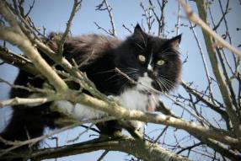
The cat’s normal environment in nature
Biotope, natural habitat
forest terrain, trees, creeks, hides, not open areas
Climate: temperature, humidity, wind
temperate/climate, like in Scandinavia – or somewhat milder
Substrate:
soil and grass substrate – short grass most optimal
cats can rest and sleep in trees
Because animals attempt to optimize their environment, cats tend to prefer it somewhat warmer and softer than nature normally provides, but this is not a welfare requirement.

Slide 6
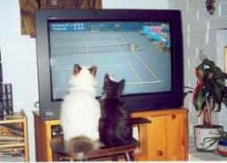
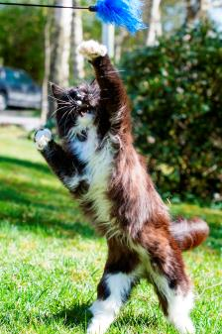
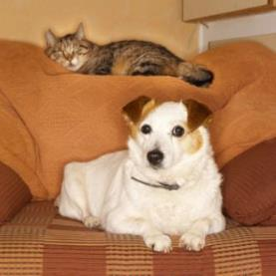
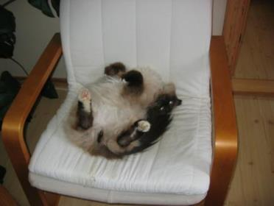
Indoor environment for cats
Cats are very flexible: during domestication they have adapted to human housing conditions.
Most important aspects of indoor environment:
adapted to social structure with regard to space and rooms
has quiet rest and sleeping places
has space for play and activity (indoor cats in particular)
environmental enrichment is important, particularly if the cat is alone a lot.
food automats, play objects → challenge the cat’s intelligence!

Slide 7
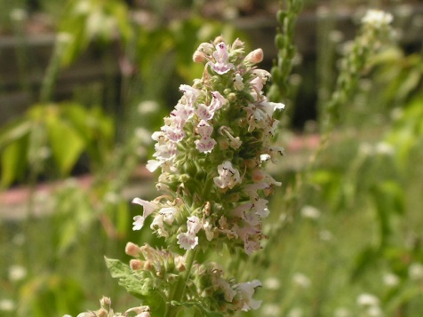
Catnip (Nepeta cataria, environmental enrichment for cats)
Dried leaves or plant oil: increases attention to scratching post or toys
Affects 50–80% of cats, both genders, castrated or intact (the rest passively?)
Does not affect kittens below 2–3 months of age
Individual variation: due to dominant gene
Reactions: sniffs; chews; licks; touches/rubs cheek, chin or body or rolls onto the catnip
More rarely: stretches itself, drools, jumps, runs or becomes aggressive and hyperactive; hallucination or trance
Duration: 5–15 minutes, then non-responsive for 30–60 minutes
Active substance nepetalactone enters via nose to amygdala and hypothalamus
Can react to concentrations as low as 0.01–1.0 x 10⁹
Harmless, no long-term effects or addiction; can be habituated if it is given too frequently.
Pregnant females: can risk uterus contractions → avoid intake

Slide 8
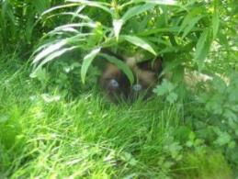
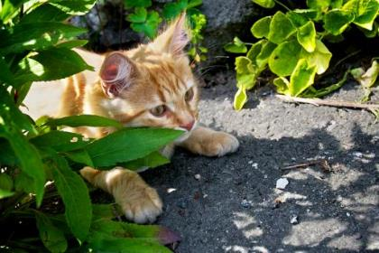
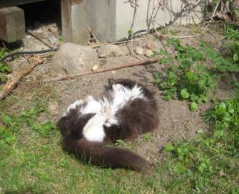
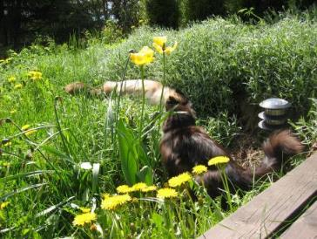
Outdoor environment for cats
The same basic principles apply to both outdoor and indoor environments for cats.
Some factors are easier to satisfy outdoors than indoors –
and vice versa.
Therefore: advantageous to welfare if cats can have access both outdoors and indoors.
The most flexible way is to use a catflap in an exit door.

Slide 9
What do you do with your cat during vacations?
Let a neighbour take care of your cat
Bring the cat on vacation – camping tour, holiday house
Hire a professional cat visitor
Use a boarding cattery
NB: Norwegian regulations on temporary care of animals apply to professional cat visitors and boarding catteries (from 2016).

Slide 10
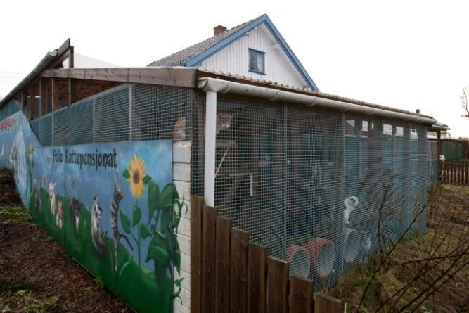
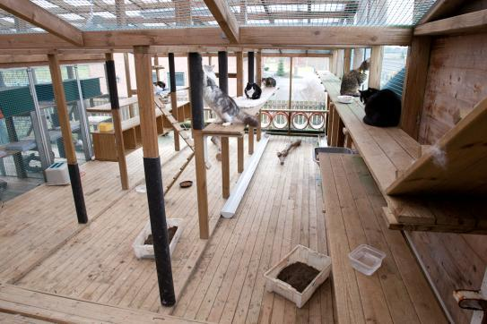
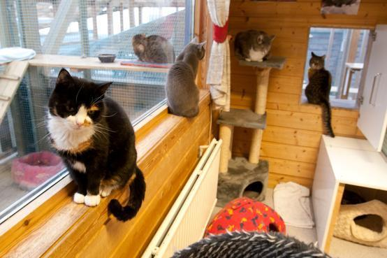
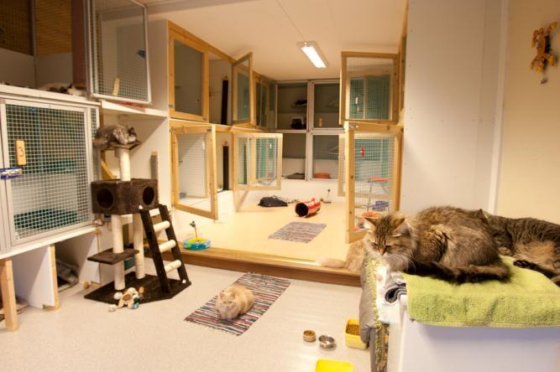
Boarding cattery – housing design

Slide 11
Regulations on trade and temporary care of animals (2016)
Also applies to semi-commercial cat breeders, zoo shops, boarding catteries, animal shelters and professional caretakers of dogs and cats
Dogs and cats are not allowed for sale in zoo shops or markets etc.
New institutions are obliged to report to animal welfare authorities → will be visited by welfare inspectors.
Detailed technical requirements are replaced by functional requirements in line with the Animal Welfare Act, which is also in line with this definition:
‘The environment of an animal is appropriate if it allows the animal to satisfy its needs.’
(Broom & Fraser, 2007, Domestic Animal Behaviour and Welfare, 4th edn. CAB Iinternational, Wallingford, UK)
Competence requirements are enhanced.

Slide 12
Regulations: living environment
§ 9 Living environment
Light conditions, temperature, noise level, quality of air and water, and other aspects of the living environment, shall be adapted to the animal species, population size and age level.
Each animal shall have adequate space. Hostile animals shall be kept separately. Prey species shall be kept separately from predators.
The animals shall have possibilities for free movements, frequent activity and exercise, adapted to the animals’ needs, species and age as well as the duration of the keeping.

Slide 13
Regulations: inspection and care
§ 10 Inspection and care
The animals shall be inspected and cared for at least twice per day.
Animals which are sick, injured, in heat, soon to give birth or newborn, and animals showing abnormal behaviour, shall be given particular attention and if necessary be kept separately from other animals.
Sick and injured animals shall be treated immediately, if necessary by a veterinarian. If staying alive can cause unnecessary suffering, the animal can be euthanized by a skilled person.

Slide 14
Regulations: animals and information
§ 14 The animals
The animals must be suitable for being sold or given away, or being kept temporarily, without unnecessary suffering. Due consideration must be given to the animal’s behaviour, socialization, health and age.
§7 Information to receivers of animals
Animals which are sold or given to people, must be accompanied by written information on the species’ physiological and behavioural needs, including requirements for living environment, feeding and other care. Information on the particular individual must be given, when relevant.

Slide 15
More on cats’ behaviour and welfare is found here (in Norwegian)
www.braastad.info – Braastad’s website on ethology, animal welfare, cats and human–animal relationship
www.facebook.com/KattenAtferdVelferd – Facebook (Meta) site for the Norwegian cat book
www.etologi.no – website for the Norwegian Association of Ethologists
www.etologi-dyrevelferd.no – website on ethology and animal welfare for secondary schools
www.animalpickings.com – popular scientific website for the Research Group on Ethology and Animal Environment at the Norwegian University of Life Sciences
Notes:
Trykk Visningsfunksjonen så samme bilde er på PC og lerret!
Trykk deretter lenken.

Slide 16
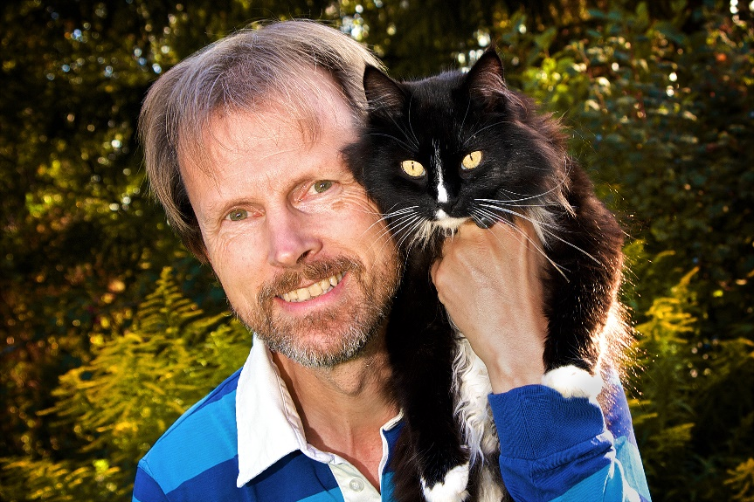
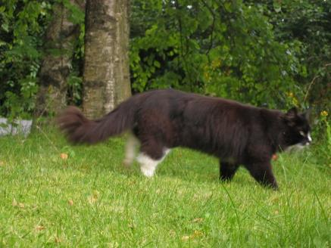
Thank you for listening to Bjarne. He believes that he understands me.
But we have our secrets that no ethologist yet knows about.

