Slide 1
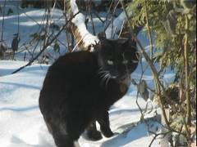
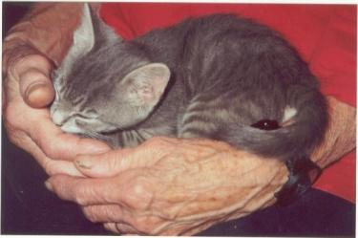
The Cat – Behaviour and Welfare
23. How can the cat benefit human health?
Bjarne O. Braastad
Professor of Ethology
Department of Animal and Aquacultural Sciences
Norwegian University of Life Sciences, NMBU, Ås, Norway

Slide 2
Examples of positive effects of animals on humans, including animal-assisted interventions
Children’s psychological development
A comrade for adult humans
Social contact with elderly in nursing homes
Visiting animals in nursing homes and hospitals
Humans with mental illness, e.g. depression and anxiety
Children with autism
Violent criminals in prison
Occupational therapy for youth with behavioural distrurbances
Green care – farm animals and pets as work training and therapy

Slide 3
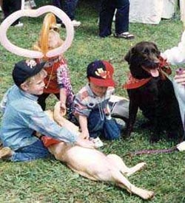
Effects of animals on children
Companion animals are good friends
Gives experience with providing care
Improves non-verbal communication
Children learn self-tolerance and self-control (or the cat will bite). (Review: Endenburg & Baarda, 1995, in: I. Robinson (ed.) The Waltham Book of Human-Animal Interaction: Benefits and Responsibilities of Pet Ownership, Ch. 2, Elsevier, Oxford, UK)
Animals can be an attachment point, a transitional object or can give social support to children.
(McNicholas & Collis, 2006; Melson & Fine, 2006. Both in: A.H. Fine (ed.) Handbook on
Animal-Assisted Therapy, 2nd edn, Academic Press, San Diego, California)
Animals stimulate children to physical acitivity.
75% of children 10–14 years of age turn to the pet when sad or upset. (Rost & Hartmann, 1994, Children and their pets. Anthrozoos 7, 242–254)

Slide 4
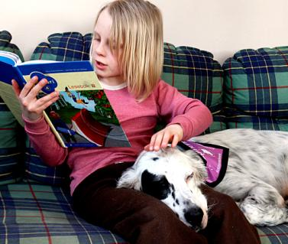
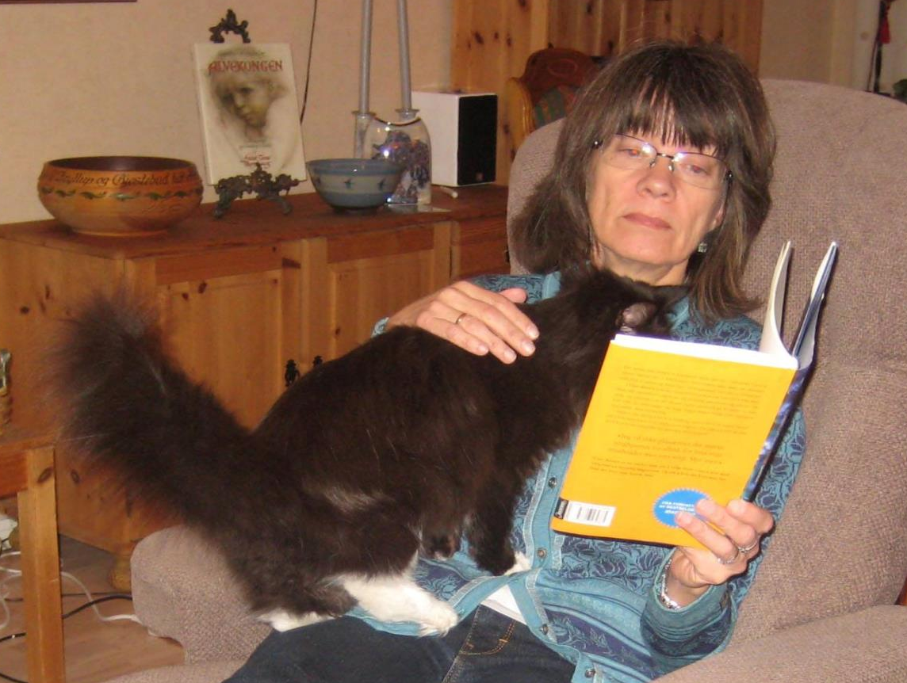
Effects of animals on children – reading dog. Why not a reading cat?
Children 9–16 years of age have lower heart rate and blood pressure when sitting with a dog than when sitting alone.
When the child is asked to read aloud, heart rate and blood pressure increase, but the increase is lower if a dog is present. (Friedmann et al., 1983. Journal of Nervous & Mental Disorders 171, 461–465)
Reading dogs for children having problems with reading or concentration:
‘When the dog lies with its head in the lap, the child will read more concentrated, and the reading skills will markedly increase.’ (Rector at Åsgård primary school in Norway)
An example of Animal-Assisted Pedagogy (AAP)
READ (Reading Education Assistance Dogs) (http://www.readdogsmn.org)
Photo: Anthrozoology Centre, Norway
Photo: Bjarne O. Braastad

Slide 5
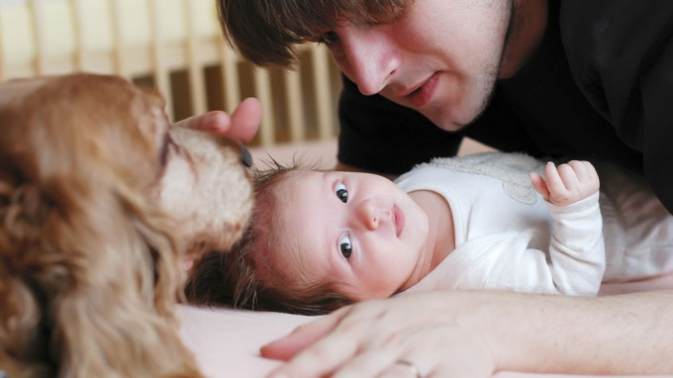
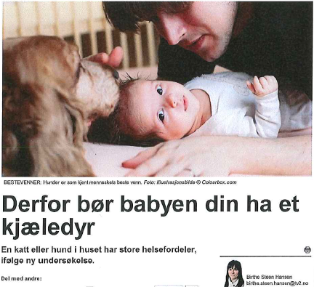
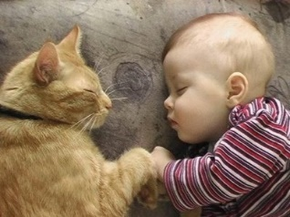
Animals and children → allergy problems?
Several studies in various countries show that:
Children growing up with a dog or cat are less prone to develop respiratory diseases and allergies, and less prone the more contact they have with the animal (dose effect)
  (Ownby et al., 2002, JAMA 288, 963–972; Bufford et al., 2008, Clinical & Experimental Allergy 38, 1635–1643; Bergroth et al., 2012, Pediatrics 130, 211–220)
‘If the immune system is daily exposed to small bacteria, it will keep fit. Then you will avoid many types of allergies.’
(allergy doctor Gregory Lux, to CBS)
This is why your baby needs a pet.
(TV2 News (Norway), 10 July 2012)

Slide 6
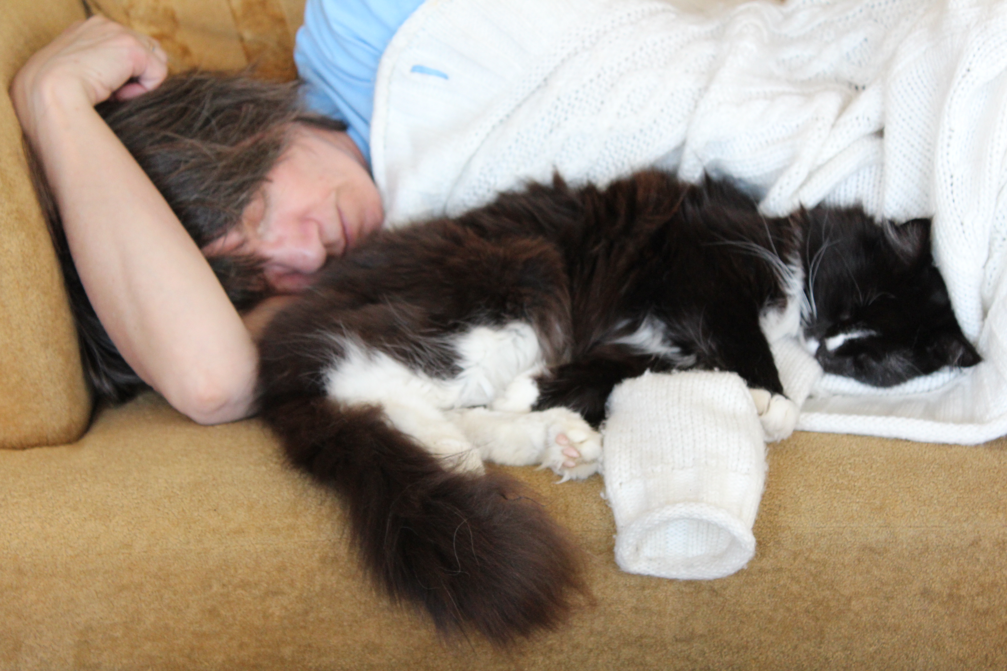
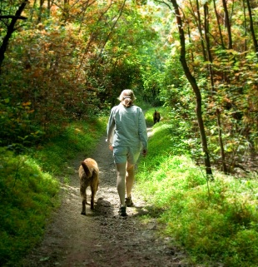
Physical effects of animals
Effects of acquiring a pet on minor health problems:
Reduction in minor problems like headache, common cough, sleeplessness, nervousness, being tired, digestion problems, etc., already one month after acquiring the animal.
(Serpell, 1991, Journal of the Royal Society of Medicine 84, 717–720)

Slide 7
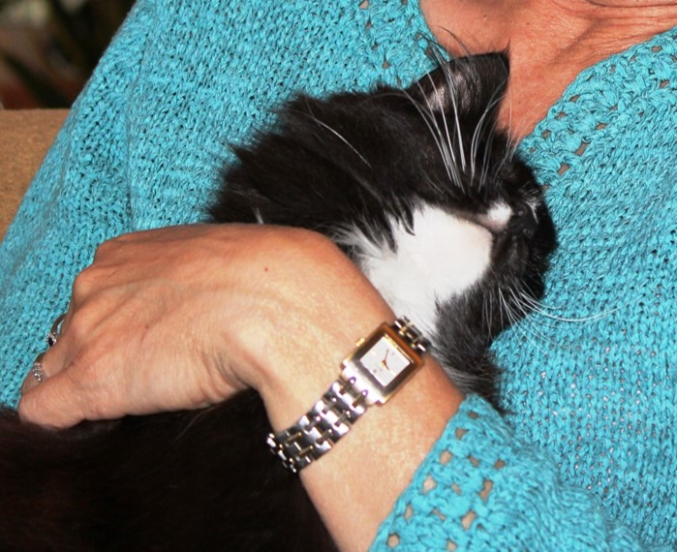
Heart and cardiovascular diseases
The chance of surviving a major heart infarct or severe angina pectoris is considerably better if you have a cat or a dog to pet. (Friedmann et al., 1980, Public Health Reports 95, 307–312)
  Two important factors: pet keeping and social support
  Dog owners had an 8.6 times higher chance of survival one year after an acute myocardial infarction than people without a pet.
  (Friedmann & Thomas, 1995, American Journal of Cardiology 76, 1213–1217)
  While 28% of patients without a pet died
  within a year, only 5.7% of those with a
pet died (p<0.05).

Slide 8
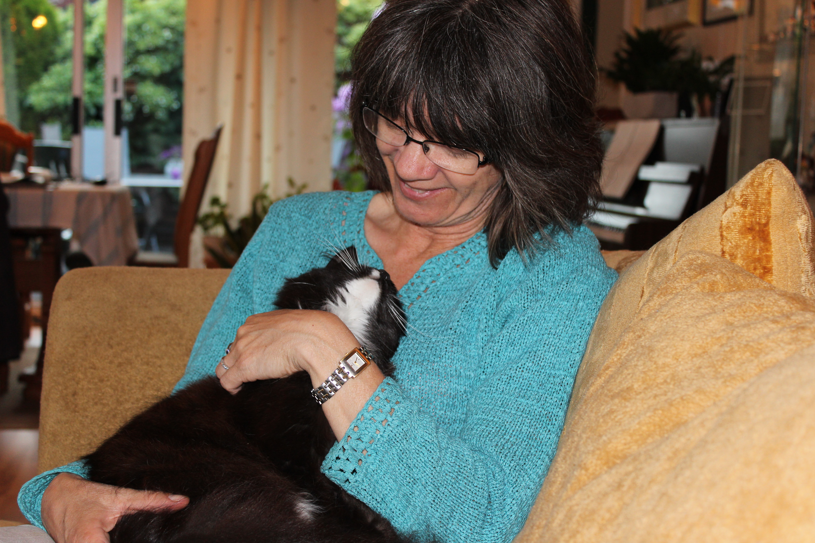
Effects on mental health
Contact with animals can reduce symptoms of:
Depression (Folse et al., 1994, Anthrozoos 7, 188–194)
Anxiety (Berget et al., 2011, Occupational Therapy in Mental Health 27, 50–64)
Joylessness (anhedonia) (Nathans-Barel et al., 2005, Psychotherapy and Psychosomatics
74, 31–35)

Slide 9
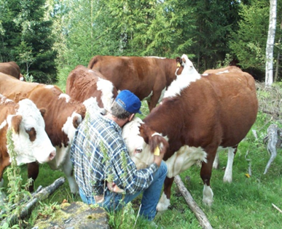
Coping ability and self-esteem
Based on cognitive theories:
  Self-efficacy (Bandura, 1977, Psychological Review 84, 191–215)
    − low degree of self-efficacy is associated with depression and anxiety (Berget et al., 2007, Occupational Therapy and Mental Health 23, 101–117)
  Self-esteem (Nebbe, 1991, School Counselling 38, 362–371)
Farm animals and companion animals depend on humans to get their basic needs satsified.
Working with animals provides possibilities for increased coping ability, self-esteem and a feeling of being significant.
(Burgon, 2003, Anthrozoos 16, 263–276; Bizub et al., 2003,
Psychiatric Rehabilitation Journal 26, 377–383)
(Photo: Bente Berget)

Slide 10
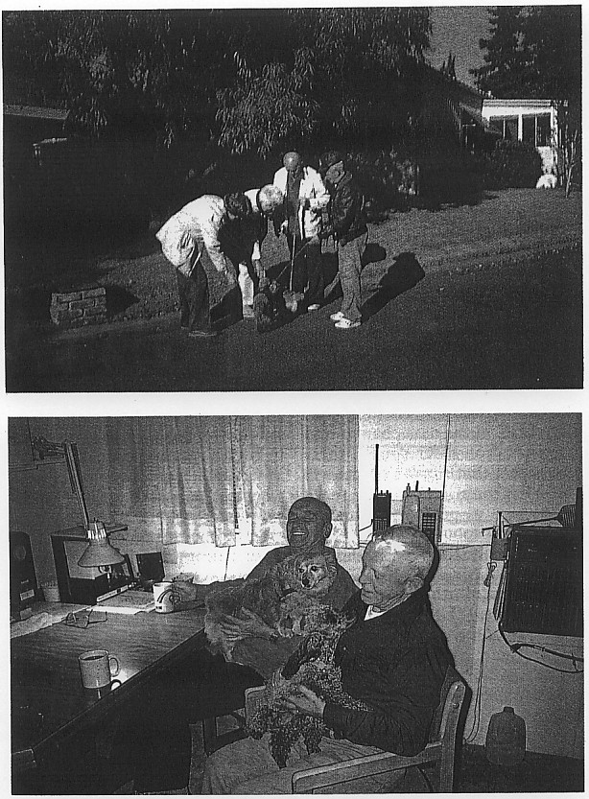
Animals as a social catalyst
Communication through attention to animals can be less intimidating than talking directly to people.
Walking with dogs may lower the threshold for contacting people.
(Messent, 1983, in: Katcher & Beck (eds) New Perspectives on Our Lives with Companion Animals, University of Philadelphia Press)
  (The cat can also be walked with)
Buffer in psychotherapy
(Corson et. al., 1977, Comprehensive Psychiatry 18, 61–72)

Slide 11
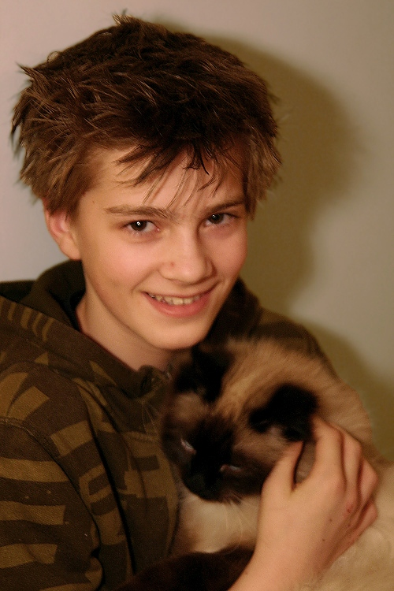
Social interactions
Interacting with animals can contribute to:
longer and richer conversations with people (Bernstein et al., 2000, Anthrozoos 3, 213–224)
development of social contact with other
people
(Barak et al., 2001, American Journal of Geriatric Psychiatry 9,
439–442)

Slide 12
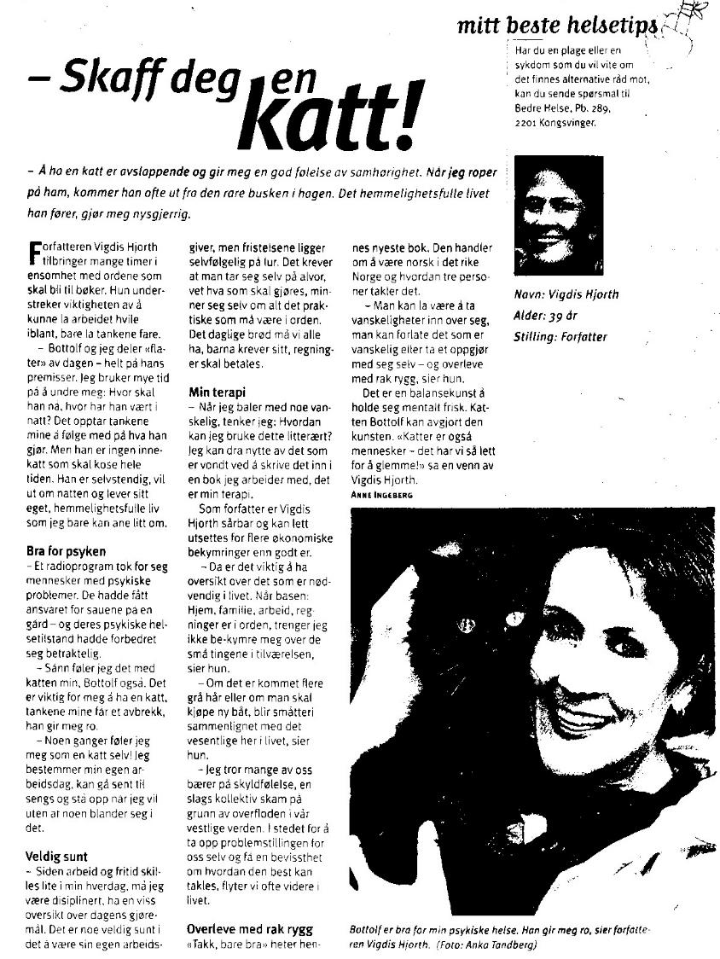
‘Get yourself a cat’! Norwegian author Vigdis Hjorth’s best health care tip.
The magazine Bedre Helse (Better health)

Slide 13
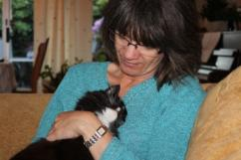
Adults: some identified effects of pet animals on physical health
Reduced risk factors for cardiovascular diseases:
  lower systolic blood pressure
  lower levels of cholesterol and triglycerides in blood
  reduced heart rate (Anderson et al., 1992)
Increased survival one year after a serious heart infarction or angina pectoris (Friedmann and Thomas, 1995; Mootoka et al., 2006)
Increased levels of neurotransmitters: oxytocin, prolactin, ß-endorphin, serotonin, dopamine (Odendaal, 2000; Odendaal and Meintjes, 2003)
Reduced level of the stress hormone cortisol (Odendaal, 2000)
Decrease in minor health problems – probably a psychosomatic effect on the immune system (Serpell, 1991)
Pet owners have fewer visits to a doctor per year than those without animals. (Headey et al., 2002)

Slide 14
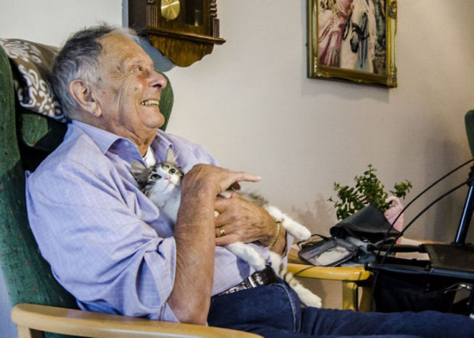
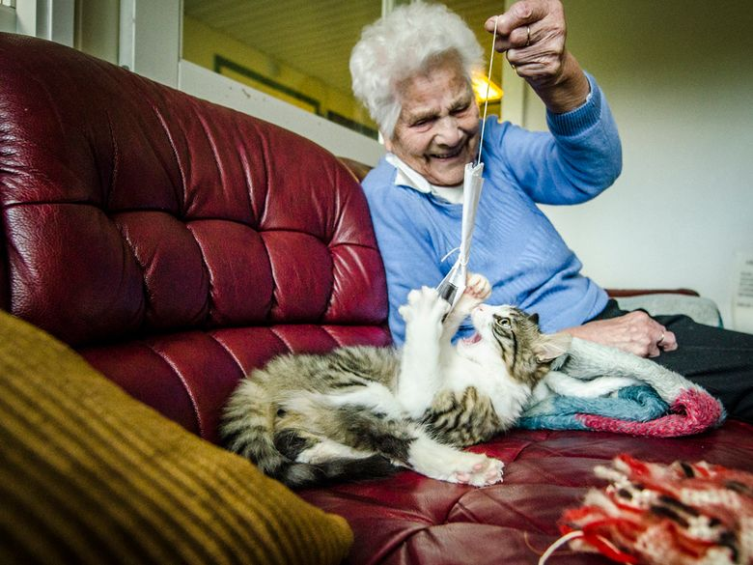
Cats in nursing homes
‘New life with a cat at a nursing home’
(The Norwegian newspaper Sunnmørsposten, 11 October 2012) ,

Slide 15
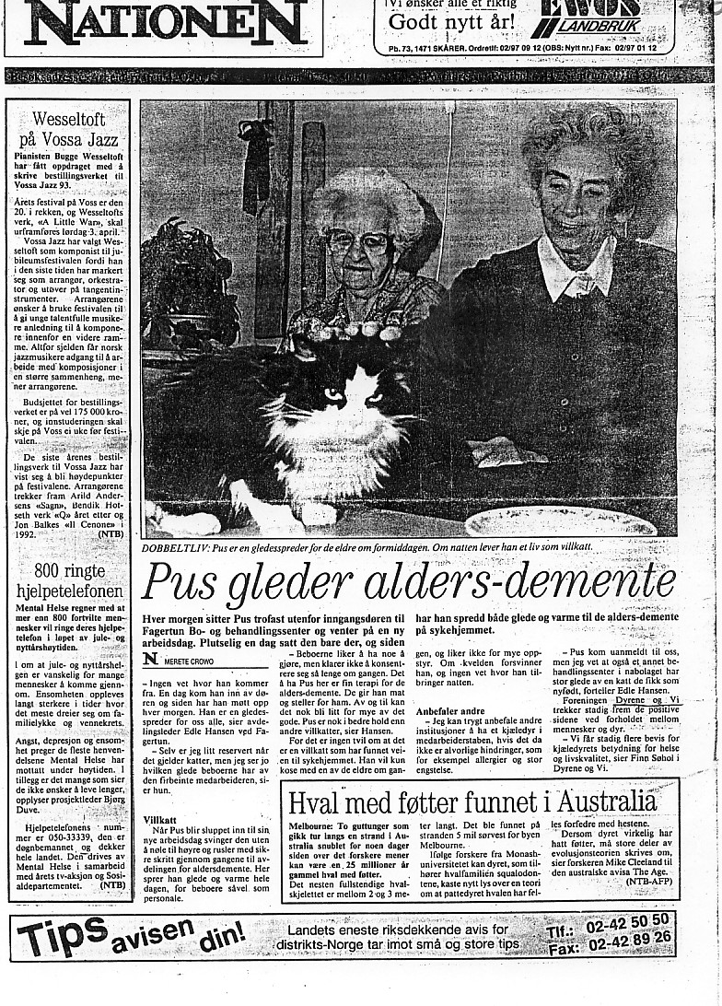
Cat brings joy to demented residents in a nursing home
The Norwegian newspaper Nationen, 1993.
(Siegel, 1993)

Slide 16
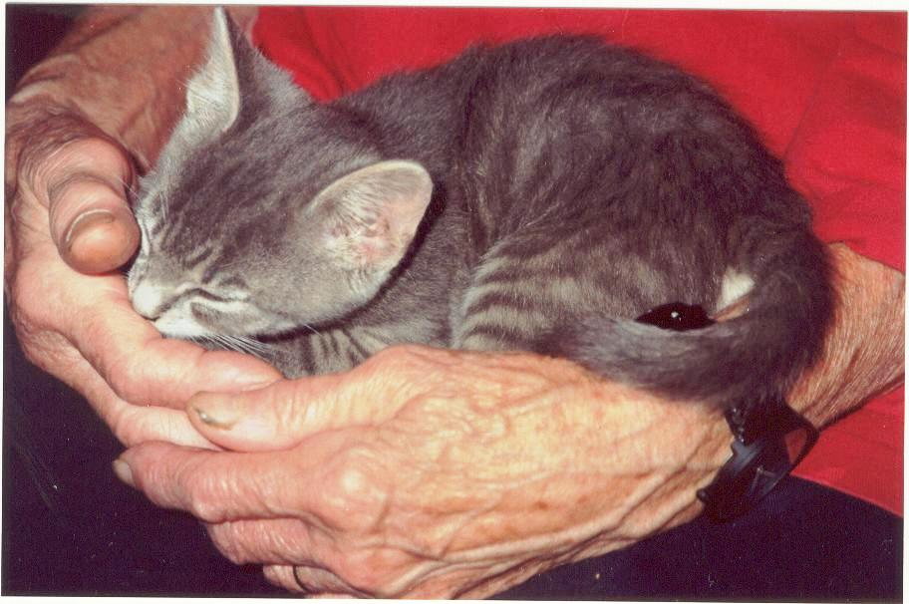
Elderly: some identified effects of pets on physical and mental health
Improved general health (GHQ)
Improved ADL score (Activities of Daily Living)
Fewer doctor visits, fewer receipts, increased attention (Siegel, 1993)
Calmer behaviour and increased social interaction by demented people (Fritz et al., 1995; McCabe et al., 2002; Richeson, 2003)
Stimulates eating among Alzheimer patients (Edwards and Beck, 2001)
Easier medicine administration (Biswas and Ahmedzai, 1992)
Less stress among the health staff in nursng homes (Barker et al., 2005)
Side effects: lower turnover of staff, and visitors stay for a longer time (review: Ormerod, 2007)

Slide 17
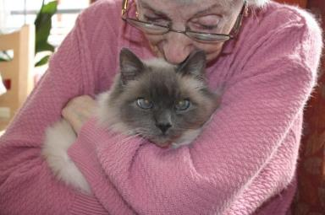
Therapy and companion animals in Norwegian nursing homes
(Ida K. Myren, 2010, Master’s thesis in public health science, NMBU)
Survey of 282 Norwegian nursing homes in all counties
Head nurse answered the questionnaire:
28% of nursing homes had animals.
44% of these had a cat, 23% had a dog.
Animals were most common at a lounge for all.
81% said animals had positive effects on the social environment.
54% said animals increased communication skills.
Those with animals: 17% said animals could cause allergic reactions.
Those without animals: 79% said animals could cause allergic reactions; 50% stated this as a major reason why they didn’t have animals.
56% of nursing homes without animals would consider having them, and all respondents agreed that animals might have positive effects on the residents.
(Myren, Kvaal & Braastad, 2011, Demens & Alderspsykiatri 15(2), 24–26)

Slide 18
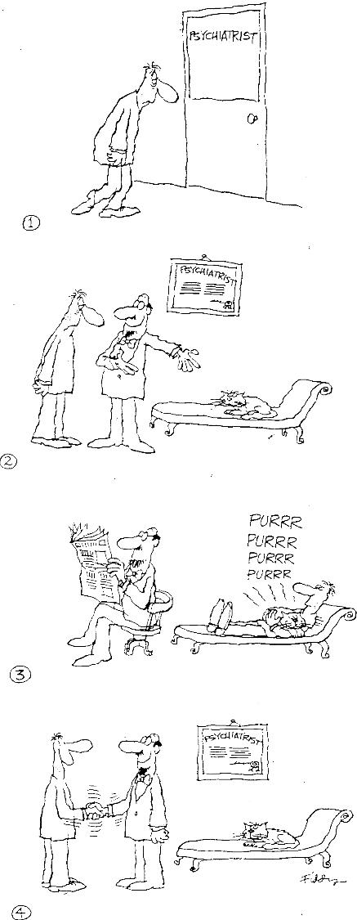
Cats may be excellent therapists

Slide 19
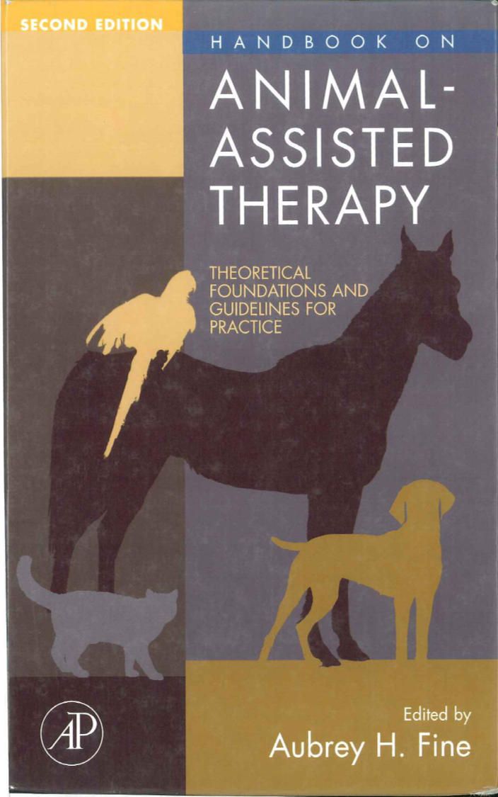
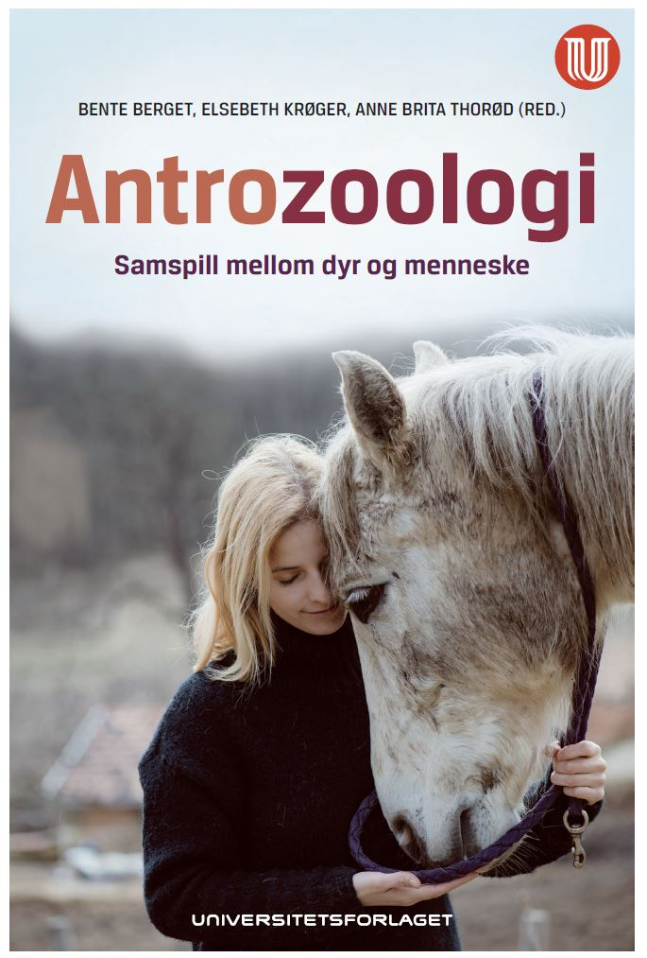
Books on animal-assisted interventions
4th edn in 2015: should be included in education of all health professionals
Norwegian textbook: Berget et al., 2018, Anthrozoology – the relationship between animals and humans, Universitetsforlaget, Oslo

Slide 20
More on cats’ behaviour and welfare is found here (in Norwegian)
www.braastad.info – Braastad’s website on ethology, animal welfare, cats and human–animal relationship
www.facebook.com/KattenAtferdVelferd – Facebook (Meta) site for the Norwegian cat book
www.etologi.no – website for the Norwegian Association of Ethologists
www.etologi-dyrevelferd.no – website on ethology and animal welfare for secondary schools
www.animalpickings.com – popular scientific website for the Research Group on Ethology and Animal Environment at the Norwegian University of Life Sciences
Notes:
Trykk Visningsfunksjonen så samme bilde er på PC og lerret!
Trykk deretter lenken.

Slide 21
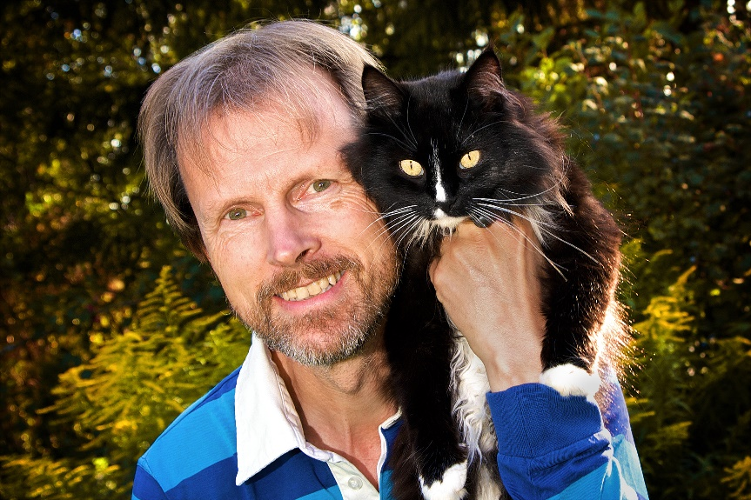
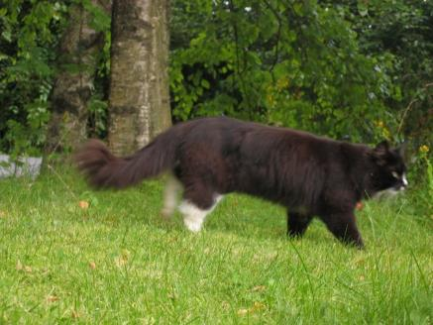
Thank you for listening to Bjarne. He believes that he understands me.
But we have our secrets that no ethologist yet knows about.

