Slide 1
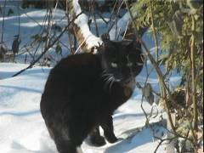
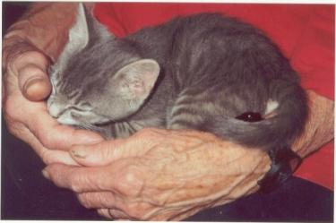
The Cat – Behaviour and Welfare
21. Why are cats so different? Individual variation – breed, age, gender, environment
Bjarne O. Braastad
Professor of Ethology
Department of Animal and Aquacultural Sciences,
Norwegian University of Life Sciences, NMBU, Ås, Norway

Slide 2
Individual variation – breed differences – sex differences

Slide 3
Behaviour traits in cats
(Silja, C.B. Eriksen, 2014, Behavioural characteristics of pedigree cats in Norway. MSc thesis, Norwegian University of Life Sciences)
99 questions to cat owners → factor analysis → 22 behavioural traits (factors) representing 81 behaviour categories
Most prominent behaviour traits in cats (N=1204)
  attention seeking; vocalizing towards owner; predatory behaviour; sociability with people; moderately active and playful
Less common traits
  behaviour problems in general; toilet problems; aggression towards unfamiliar people, dogs or cats in the household; touch sensitivity; reluctant to be held firmly
Cats in large indoor populations are more sociable.
Weak, but significant age effects on behaviour
Pronounced breed differences in behaviour
Cats in this material probably have owners with above-average interest in cats.
Notes:
Det er i denne studien påvist raseforskjeller innenfor de ulike atferdtrekkene som er testet. Til tross for raseforskjellene, er kattene i studien gjennomgående ofte sosiale overfor mennesker. De er ofte lekne og aktive, ofte trenbare og viser ofte predasjonsatferd. Kattene i materialet er generelt sjelden aggressive mot hunder, andre katter eller mot ukjente mennesker. Selv om det finnes tydelige forskjeller mellom katterasene innenfor enkelte atferdstrekk, er det ingen av atferdsegenskapene som er dominerende hos de ulike rasene. Unntaket er rasen perser som gjennomgående vise innaktiv atferd innenfor samtlige atferdsegenskaper. Kattenes miljø er også en betydelig Factor for deres atferdstrekk og man kan derfor ikke ene og alene forklare raseforskjellene kun basert på kattens genetikk. Det er påvist særdeles lite atferdsproblemer blant kattene i studien.

Slide 4
Factor analysis – 22 factors
Factor 1 | Factor 2 | Factor 3 | Factor 4
Sociability with people | Activity/playfulness | Separation-related problems | Aggression towards familiar cats
Questions: 15, 16, 17, 18, 19, 20, 21 | Questions: 1, 4, 5, 6, 7, 8, 9, 10, 12, 14 | Questions: 55, 56, 57, 58, 59, 60 | Questions: 42, 43, 44, 45
Factor 5 | Factor 6 | Factor 7 | Factor 8
Aggression towards unfamiliar humans | Aggression towards dogs | Sociability with non-household cats | Resists restraint
Questions: 30, 31, 32, 33 | Questions: 46, 47, 48, 49, 50 | Questions: 27, 28, 29 | Questions: 38, 39, 40, 41, 92
Factor 9 | Factor 10 | Factor 11 | Factor 12
Touch sensitivity/owner-directed aggression | Attention seeking and purring | Trainability | Predatory behaviour
Questions: 34, 35, 36, 37, | Questions: 25, 26, 85 | Questions: 61, 62, 63 | Questions: 64, 65, 66
Factor 13 | Factor 14 | Factor 15 | Factor 16
Neophobia | Excessive/compulsive self-grooming | Stares, freezes, other compulsory behaviour | Elimination preferences (location, substrate)
Questions: 53, 54, 91 (inverted) | Questions: 72, 73, 74 | Questions: 75, 76, 77 | Questions: 88, 89
Factor 17 | Factor 18 | Factor 19 | Factor 20
Resting place preferences | Directed vocalization (asks for food, door) | Agitated prey interest | Fear of unfamiliar dogs or cats
Questions: 69, 70, 71 | Questions: 23, 24 | Questions: 67, 68 | Questions: 51, 52
Factor 21 | Factor 22
Crepuscular activity | Spraying or urination outside litter box
Questions: 81, 82 | Questions: 78, 84
Cumulative percentage explained: 66.3%
(Eriksen, 2014)
Notes:
Faktoranalysen la grunnlaget for videre atferdsanalyser. Den resulterte i totalt 22 faktorer og reduksjon av atferdsspm fra 99 til 81.
Samlet ga faktorene en forklaringssikkerhet på 66,15 % på materialet.
Hver Factor representerte en atferdsegenskap. For eksempel ser man her at Factor en omhandler atferdsegenskapen sosiabilitet overfor menneske.

Slide 5
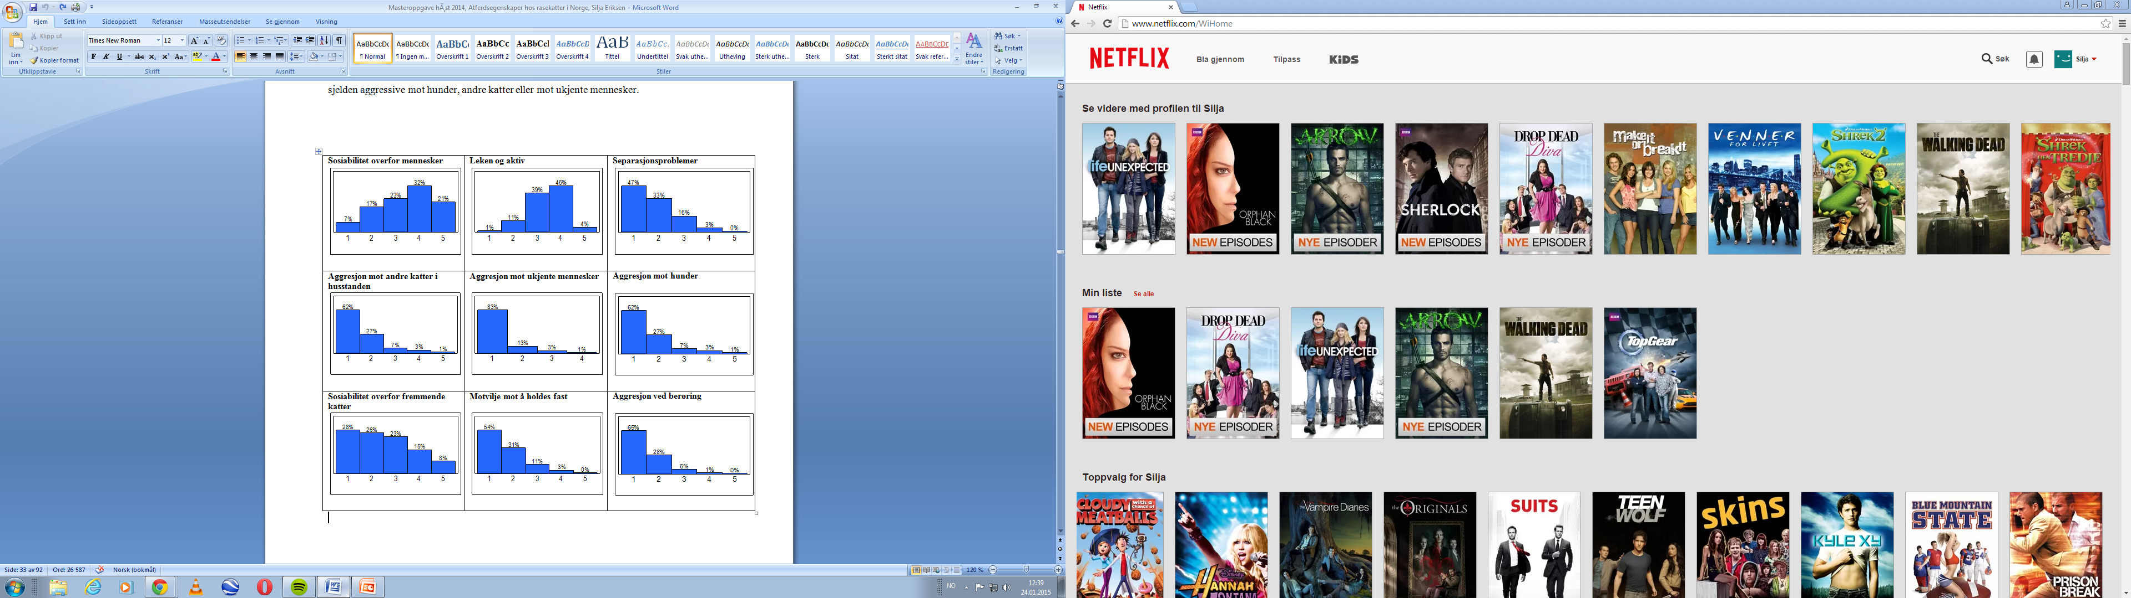
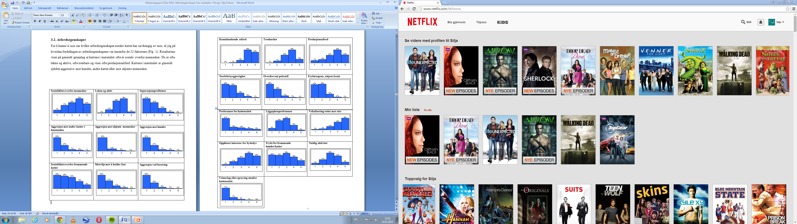
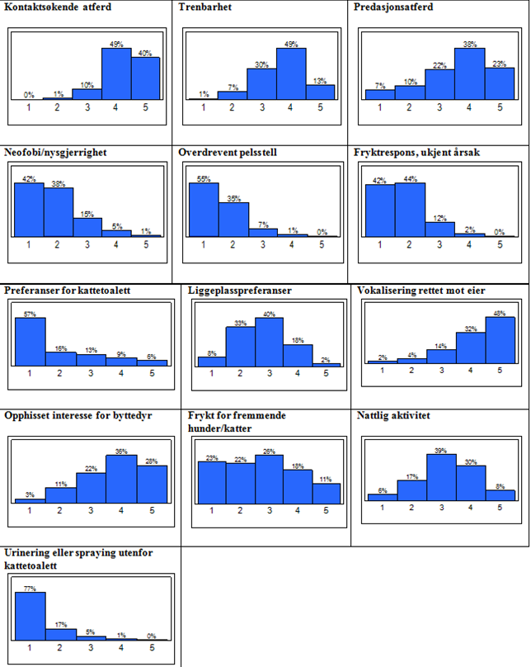
Behavioural traits – frequencies Trait names as in previous slide
1= Never, 2 = Seldom,
3= Sometimes, 4 = Usually,
5 = Always. N=1204 cats
(Eriksen, 2014)
Notes:
Resultatene viser på generelt grunnlag at kattene i materialet ofte er sosiale overfor mennesker.
De er ofte lekne og aktive, ofte trenbare og viser ofte predasjonsatferd.
Kattene i materialet er generelt sjelden aggressive mot hunder, andre katter eller mot ukjente mennesker.
Dette er positivt med tanke på hvilke kvaliteter vi som oftest er ute etter hos våre katter. Resultatet er heller ikke uventet med tanke på de atferdskvaliteter hos katten vi mennesker har satt pris på helt tilbake til kattens domestisering (Driscoll et al., 2007).

Slide 6
What is meant by individuality or personality?
Behaviour categories Behavioural styles Individuality
Object play
Exploring a new stimulus
Appeasement signalling
Lying in a human’s lap
Seek contact with unfamilar people
Lying immobilized (rarely)
Reaction to strong noise (low)
Active
Curious
Sociable towards cats
Sociable towards humans
Fear of humans (low)
Tense (low)
Calm, harmonious
Alert
Social
Calm

Slide 7
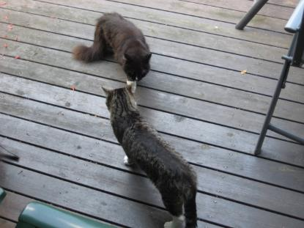
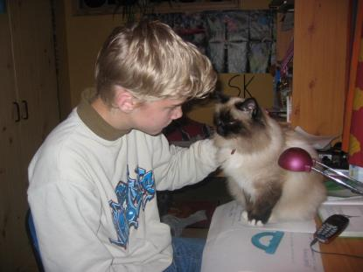
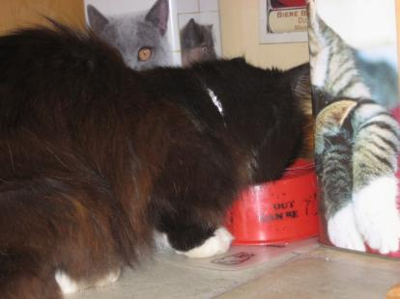
Personality of indoor cats
Four personality axes of indoor cats (Kotrschal et al., 2014, in: Turner & Bateson (eds) The Domestic Cat, 3rd edn, Cambridge University Press, Cambridge, UK)
Active/playful – active, excited, playing, curious, most typical of male cats
Anxious/tense
Sociable – social, vocal, attentive by visits, curious of newcomers
Feeding style – eats fast (typical: male cat) or thoroughly investigates the food (typical: female cat)

Slide 8
Owner’s personality may affect the cat’s personality
Neurotic owners* have more intense social interactions with the cat (cuddling, kissing, heavy focus on cat food), but do less object play than outgoing owners.
  The cat is mainly a social support
Owners with a high degree of openness* do more object play with their cats. Their cats have lower fearfulness and tenseness, and they are less interested in exploring novel objects.
  The cat is mainly a playmate.
  Such cats become more self-secure and safe.
  (Kotrschal et al., 2014, in: Turner & Bateson (eds) The Domestic Cat, 3rd edn, Cambridge University Press, Cambridge)
  * Measured with NEO-FFI personality test (manual: Costa & McCrae, 1992)

Slide 9
Reasons for individual variation in behaviour
Owner personality
Genes, breed differences, sex and age differences
Colour genetics and behaviour
Environment, experience
Development over time:
  alternative developmental paths to same result
  different fathers in a litter
  consistency in behaviour over time
Stability in different situations?

Slide 10
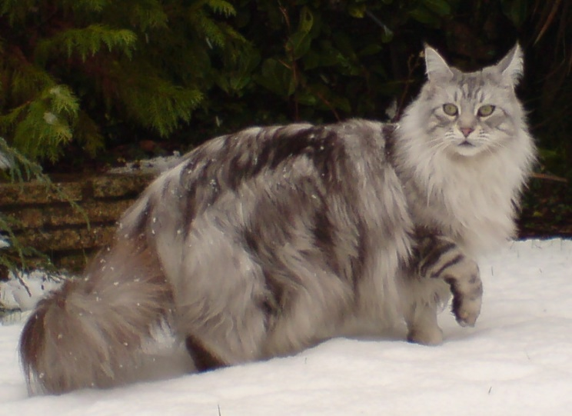
Changes in choice of cat breed
Old breeds like Siamese and Persian become less popular.
New breeds increase in popularity, like Maine coon, Ragdoll, Bengal and Siberian
Maine coon is now the most popular breed in Norway.
Newly registered cats in 2016*
Maine coon 26%
Siberian 14%
Ragdoll 13%
Sacred birman 10%
Norwegian forest cat 7.5%
British shorthair 7.0%
Persian 5.9%
Bengal 3.1%
Devon Rex 2.1%
Abyssinian 1.6%
* NRR, Norwegian Association of Cat Fancier Clubs
Photo: Maine coon cat, Barry Wom, CC-BY-SA 3.0
Notes:
Hvorfor studere katter? Jo katter er et populært kjæledyr og det er om lag 400 000 hustander i Norge som har katt.
I 2010 var det om lag 747 000 katter i Norge.
Hva er det som tiltrekker oss ved katter. jo Deres selvstendighet, intelligens og deres evne til å styre sine eiere for å oppnå sine ønsker.

Slide 11
Breed variation in behaviour (Eriksen, 2014)
Which breeds are reported to have highest scores for these behavioural traits?
Sociability with people - Burmese, Cornish Rex
Activity/playfulness - Bengal, Abyssinian, Oriental, Burmese, Siamese
Separation-related problems - Bengal, Burmese
Aggression towards familiar cats - Abyssinian, house cats
Aggression towards unfamiliar people - Devon Rex, Abyssinian, Egyptian Mau
Aggression towards dogs - Burmese, Abyssinian, Egyptisk Mau
Sociability with non-household cats - Persian, Norwegian forest cat, Egyptian Mau
Resists restraint - House cat, Siberian
Touch-sensitivity - House cat, Maine coon, Siberian
Attention-seeking and purring - Burmese, Cornish Rex, Oriental
Neophobia - Bengal
Directed vocalization (e.g. asks for food) - Burmese, house cat, Maine coon
Fear of unfamiliar dogs or cats - House cat, Devon Rex
Crepuscular activity - Egyptian Mau, Burmese, Abyssinian, Norwegian forest cat

Slide 12
Heritability of behaviour traits based on paternal half-sibs in Siamese and Persian cats
Behaviour trait Heritability (h²)
The cat is active and playful. 0.37
The cats seeks contact with unfamiliar humans. 0.31
The cat seeks contact with unfamiliar children. 0.25
The cat shows fear towards unfamiliar humans. 0.25
The cat shows fear of strong noise. 0.22
The cat is sociable towards unfamiliar humans. 0.17
(Westbye, 1998, Behavioural differences between three cat breeds: heritability of some behaviour patterns, and the human–cat relationship. MSc thesis, Norwegian University of Life Sciences)
Norwegian University of Life Sciences
Notes:
13
13
12
12
12
12
12
Other behaviour traits, including aggressions, showed very low or no heritability in this study. We don’t know to what extent this was due to the owners’ imprecise knowledge of these traits in their cat.
(Explanation of adult paternal half-sibs:
Heritability estimates were based on about 100 litters, the offspring of at least 20 males, each being paired with 3-5 females.
Heritability software: Harvey. )

Slide 13
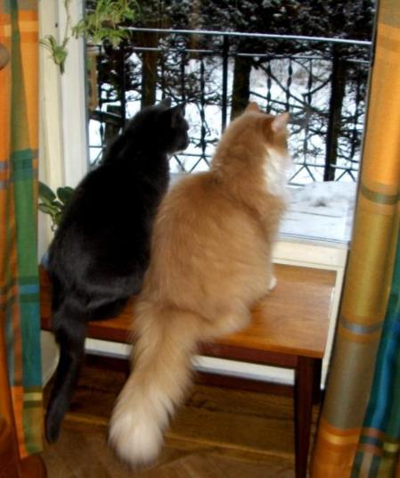
Reasons for individual variation in behaviour
Owner’s personality
Genes, breed differences, sex and age differences
Colour genetics and behaviour: black (non-agouti) and orange
Black or tabby: may reproduce best in high-density populations
Orange: may reproduce best in low-density populations
(Pontier et al., 1995, Oikos 73, 299–308)
Photo: Leif Aslaksen

Slide 14
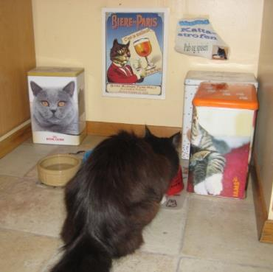
Sex differences in cat behaviour I
12–16 weeks of age: male kittens become more active than females.
Study of feeding situations in homes of cats in Vienna:
Males are more expressive than females and are more successful in attracting owner’s attention:
Tail and body rubbing
Rolling, circling
Eyes wide open, ears erect
Trill purring
Sitting
(Kotrschal et al., 2014, in: Turner & Bateson (eds) The Domestic Cat, 3rd edn, Cambridge University Press, Cambridge, UK)

Slide 15
Sex differences in cat behaviour II
Behaviour traits with strongest sex differences (N=1204)
  scale from 1 (never) to 5 (always)
*** P<0.001, **** P<0.0001
(Eriksen, 2014, Behavioural characteristics of pedigree cats in Norway. MSc thesis, Norwegian University of Life Sciences)
Behaviour trait | F test | Male Mean±SD | Female Mean±SD
Sociability with non-household cats | 29.2**** | 2.7±1.2 | 2.2±1.2
Aggression towards familiar cats | 17.5**** | 1.4±0.7 | 1.6±0.8
Resting place preferences | 16.7**** | 2.6±0.9 | 2.8±0.9
Attention-seeking or purring | 12.0*** | 4.4±0.6 | 4.2±0.7
Resists restraint | 11.8*** | 1.6±0.7 | 1.7±0.8
Notes:
Antall katter i husstanden var den andre miljøpåvirkning jeg valgte å se nærmere på, da katteeiere, ikke minst katteoppdrettere gjerne har flere katter .
Atferdsegenskaper som ble analysert for å se nærmere på effekten av antall katter var; sosiabilitet overfor mennesker, leken og aktiv, aggresjon mot andre katter i husstanden, og sosiabilitet overfor fremmende katter.
Katter i husstander med 8 eller flere katter er signifikant mer sosiale overfor mennesker enn katter som lever alene eller er to i en husstand (p <0,0001). Gjennomgående er katter i hustander med opptil flere katter signifikant mer sosiale overfor mennesker enn katter i husstander med færre individer
Katter som lever i husstander med 8 eller flere katter viser signifikant mer sosiabilitet overfor fremmende katter, enn katter som lever i sammen med en annen katt (p = 0,0001). Det samme gjelder også hvor det er kun en katt i husstanden (p <0,0001).
Ingen signifikant effekt av antall katter i husstaden på atferdegenskapen ”Aggresjon mot andre katter i husstanden”
Som vi da ser, så viser disse resultatene at miljø er også en viktig Factor for katters atferd.

Slide 16
Changes in behaviour by age

Slide 17
Age effects on behavioural traits
11 out of 22 behavioural traits showed significant age effects, yet with low correlations with age.
5 highest correlations with age:
Increases with age:
  aggression towards household cats, directed vocalization
Decreases with age:
  activity/playfulness, sociability with non-household cats, sociability with people
(Eriksen, 2014)
Factor | Behaviour trait | Spearman’s rho | P
2 | Activity/playfulness | - 0.18 | 0.0001
7 | Sociability with non-household cats | - 0.14 | 0.0001
4 | Aggression towards familiar cats | 0.13 | 0.0001
18 | Directed vocalization (asks for food, door) | 0.12 | 0.0002
1 | Sociability with people | - 0.11 | 0.0012
Notes:
Antall katter i husstanden var den andre miljøpåvirkning jeg valgte å se nærmere på, da katteeiere, ikke minst katteoppdrettere gjerne har flere katter .
Atferdsegenskaper som ble analysert for å se nærmere på effekten av antall katter var; sosiabilitet overfor mennesker, leken og aktiv, aggresjon mot andre katter i husstanden, og sosiabilitet overfor fremmende katter.
Katter i husstander med 8 eller flere katter er signifikant mer sosiale overfor mennesker enn katter som lever alene eller er to i en husstand (p <0,0001). Gjennomgående er katter i hustander med opptil flere katter signifikant mer sosiale overfor mennesker enn katter i husstander med færre individer
Katter som lever i husstander med 8 eller flere katter viser signifikant mer sosiabilitet overfor fremmende katter, enn katter som lever i sammen med en annen katt (p = 0,0001). Det samme gjelder også hvor det er kun en katt i husstanden (p <0,0001).
Ingen signifikant effekt av antall katter i husstaden på atferdegenskapen ”Aggresjon mot andre katter i husstanden”
Som vi da ser, så viser disse resultatene at miljø er også en viktig Factor for katters atferd.

Slide 18
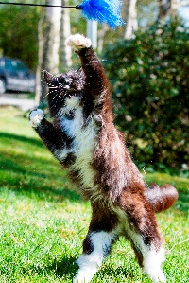
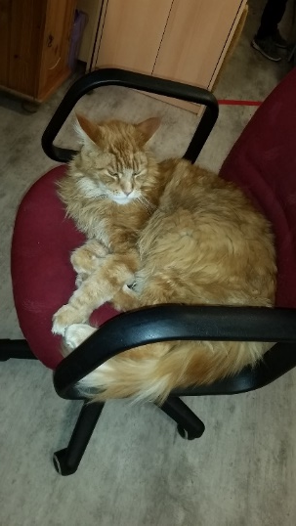
Activity and playfulness
Owner scores from 1 (never) to 5 (always).
1204 Norwegian cats! Statistically significant results are shown.
Activity and playfulness decreases somewhat with age.
Score
16 - 18
Age (years)

Slide 19
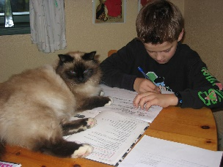
Sociability with people
Decreases somewhat with age, but may increase in older cats.
Score
16 - 18
Age (years)
(Eriksen, 2014)

Slide 20
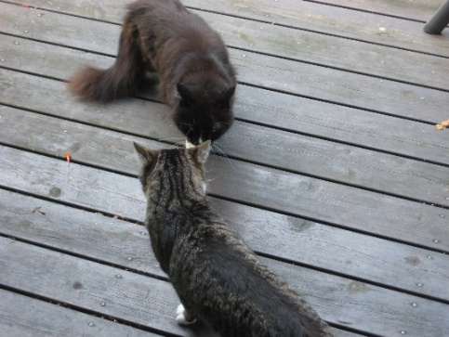
Aggression towards household cats
Increases somewhat with age, but is reduced in old cats.
Score
16 - 18
Age (years)
(Eriksen, 2014)

Slide 21
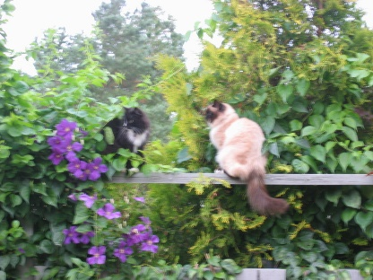
Sociability with non-household cats
Decreases somewhat with age, but increases in older cats.
Score
16 - 18
Age (years)
(Eriksen, 2014)

Slide 22
Resists restraint
Increases somewhat with age.
Score
16 - 18
Age (years)
(Eriksen, 2014)

Slide 23
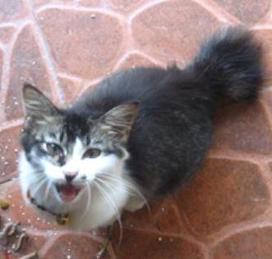
Directed vocalizations – begging
Increases somewhat with age.
Score
16 - 18
Age (years)
(Eriksen, 2014)

Slide 24
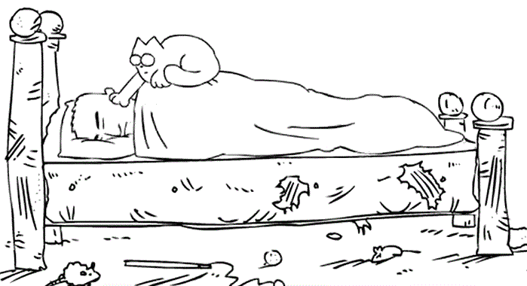
Increase in behavioural problems with age
Generally, older cats do not have more behaviour problems than younger cats, but some can develop new problems as they age:
  wake up owners during night
  increased vocalization during daytime
  anxiety
  inappropriate elimination
  disoriented – wandering, staring, restless
  stereotyped behaviour (simple, repeated behaviour)
But, as many owners appreciate:
Cats take less prey as they become older.
(Churcher & Lawton, 1987, Journal of Zoology 212, 439–455; Barratt, 1998, Wildlife Research 25, 475–487)
Simon’s Cat

Slide 25
Behavioural changes with age
– medical problems
Some behavioural changes are related to medical problems.
The chance increases with age, e.g.:
  hyperthyreosis
  kidney disease
  diabetes
  joint problems
  cardiovascular (e.g. heart) diseases
  hypertension (high blood pressure)
  weakened senses, like vision or hearing
If behavioural changes develop in an old cat:
→ first, let a veterinarian check health condition.

Slide 26
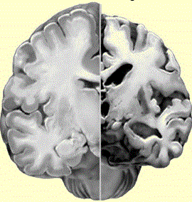
Behavioural changes with age
– cognitive dysfunction
Some behaviour changes are related to cognitive deficits:
  dementia, similar to Alzheimer’s disease in in humans
      same changes in the brain
  can appear by 10 years of age, usually later
  one study: 11–14 years of age: 28% of cats; >15 years: 50%
  (Landsberg et al., 2010, Journal of Feline Medical Surgery 12, 837–848)
  If the vet can exclude that behaviour changes in old cats are due to physical diseases or injury, or environmental conditions, dementia can be the reason.
  But, demented cats can also have physical diseases!

Slide 27
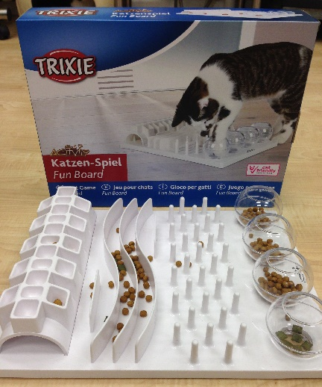

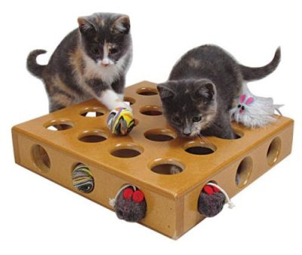
How can we counteract dementia?
Cognitive dysfunction is difficult to treat; must be prevented.
A few drugs exist and can somewhat reduce cognitive failure, e.g. by increasing oxygenation of the brain.
Other measures are particularly important in earlier stages:
Cognitive stimulation and environmental enrichment may delay development of dementia (like in humans).
  give the cat exercises!
  puzzles
  environmental enrichment:
    play objects can activate the cat
    stable environment gives predictability –
    do not introduce too many changes.
  (Landsberg et al., 2010, Journal of Feline Medical Surgery
  12, 837–848)

Slide 28
Environmental factors

Slide 29
Reasons for individual variation in behaviour
Owner’s personality
Genes, breed differences, sex and age differences
Colour genetics and behaviour
Environment, experience
Development over time:
  alternative developmental paths to same result
  different fathers in a litter
  consistency in behaviour over time
Stability in different situations?

Slide 30
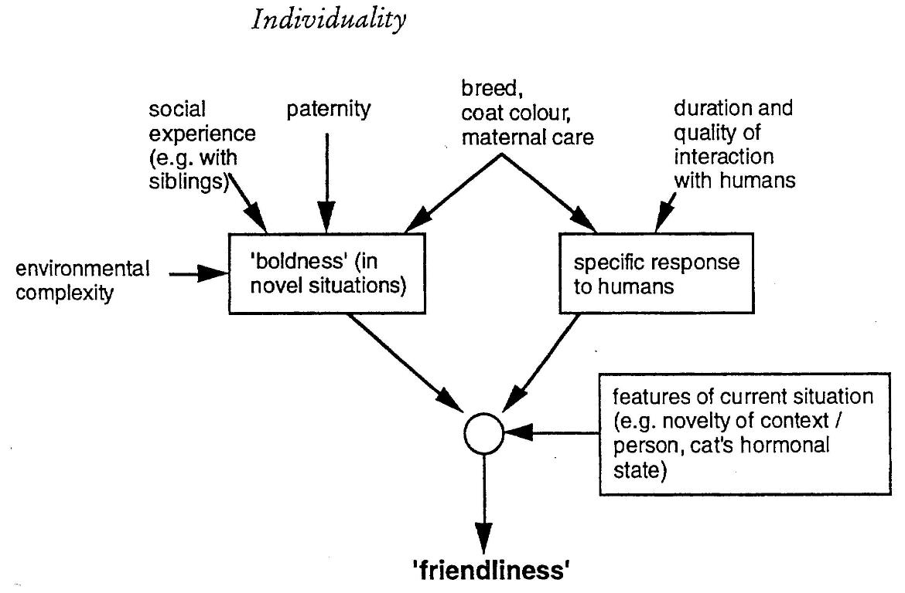
Factors that affect friendliness to humans
(Mendl & Harcourt, 2000, in: Turner & Bateson (eds) The Domestic Cat, 2nd edn, Cambridge University Press, Cambridge, UK )

Slide 31
More on cats’ behaviour and welfare is found here (in Norwegian)
www.braastad.info – Braastad’s website on ethology, animal welfare, cats and human–animal relationship
www.facebook.com/KattenAtferdVelferd – Facebook (Meta) site for the Norwegian cat book
www.etologi.no – website for the Norwegian Association of Ethologists
www.etologi-dyrevelferd.no – website on ethology and animal welfare for secondary schools
www.animalpickings.com – popular scientific website for the Research Group on Ethology and Animal Environment at the Norwegian University of Life Sciences
Notes:
Trykk Visningsfunksjonen så samme bilde er på PC og lerret!
Trykk deretter lenken.

Slide 32
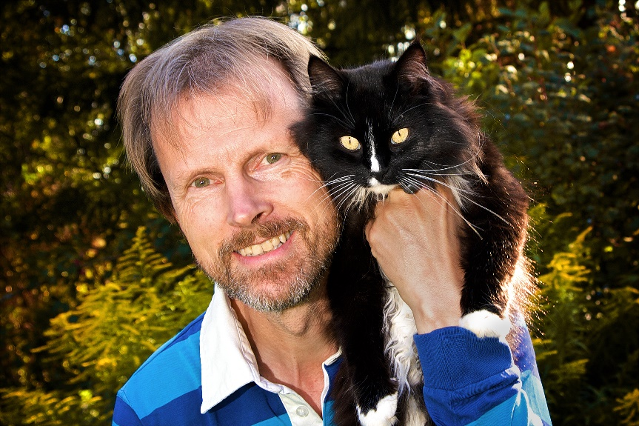
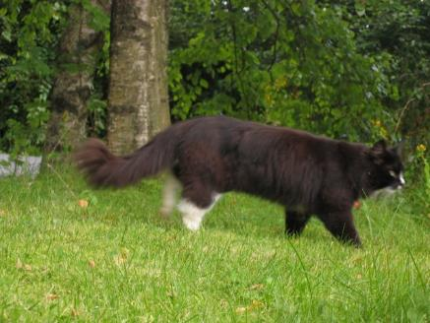
Thank you for listening to Bjarne. He believes that he understands me.
But we have our secrets that no ethologist yet knows about.

