Slide 1
The Cat – Behaviour and Welfare 20. How can you develop kittens into well-functioning adult cats?
Bjarne O. Braastad
Professor of Ethology
Department of Animal and Aquacultural Sciences,
Norwegian University of Life Sciences, NMBU, Ås, Norway

Slide 2
How can you develop kittens into well-functioning adult cats?

Slide 3
Heritability of behaviour traits based on paternal half-sibs
Behaviour trait Heritability (h²)
The cat is active and playful. 0.37
The cats seeks contact with unfamiliar humans. 0.31
The cat seeks contact with unfamiliar children. 0.25
The cat shows fear towards unfamiliar humans. 0.25
The cat shows fear of loud noise. 0.22
The cat is sociable towards unfamiliar humans. 0.17
(Westbye, 1998, MSc thesis, Norwegian University of Life Sciences, Ås)
Norwegian University of Life Sciences
Notes:
13
13
12
12
12
12
12
Other behaviour traits, including aggressions, showed very low or no heritability in this study. We don’t know to what extent this was due to the owners’ imprecise knowledge of these traits in their cat.
(Explanation of adult paternal half-sibs:
Heritability estimates were based on about 100 litters, the offspring of at least 20 males, each being paired with 3-5 females.
Heritability software: Harvey. )

Slide 4
How to get a well-functioning adult cat – I
Behaviour and mental and physical health are a function of genes and environment/experience.
Breeding:
In pedigree cats, choice of breeding animals is essential:
– breed on individuals with low fearfulness towards humans and environment and with a high degree of sociability towards humans.
– In addition, avoid aggressive behavioural traits as the temperament in parents may influence the temperament in offspring. (Westbye, 1998; Bakken & Vangen, 1996, Turner et al., 1986; McCune, 1995)
Environment:
Early experience in kittens before being sold or given to new owners will further develop the behaviour – the same with experience after rehoming.

Slide 5
How to get a well-functioning adult cat – II
Behavioural development:
Behavioural development in kittens starts already prenatally. If a pregnant female mammal experiences severe stress (prenatal stress), the offspring may develop hypersensitive stress mechanisms → low stress-coping ability.
(Braastad, 1998, Effects of prenatal stress on behaviour of offspring of laboratory and farmed mammals. Applied Animal Behaviour Science 61,
159–180)
To ensure that kittens learn what they need to about social behaviour, they must be kept with their mother and litter until 12 weeks of age.
Both before and after weaning and separation, the kitten must experience challenges it can learn to cope with.
Every time a kitten succeeds, self-confidence will increase and make it more robust when facing later challenges.

Slide 6
More on cats’ behaviour and welfare is found here (in Norwegian)
www.braastad.info – Braastad’s website on ethology, animal welfare, cats and human–animal relationship
www.facebook.com/KattenAtferdVelferd – Facebook (Meta) site for the Norwegian cat book
www.etologi.no – website for the Norwegian Association of Ethologists
www.etologi-dyrevelferd.no – website on ethology and animal welfare for secondary schools
www.animalpickings.com – popular scientific website for the Research Group on Ethology and Animal Environment at the Norwegian University of Life Sciences
Notes:
Trykk Visningsfunksjonen så samme bilde er på PC og lerret!
Trykk deretter lenken.

Slide 7
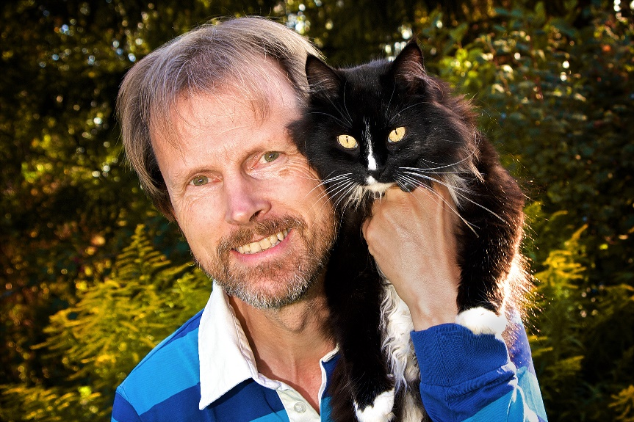
Thank you for listening to Bjarne. He believes that he understands me.
But we have our secrets that no ethologist yet knows about.

