Slide 1
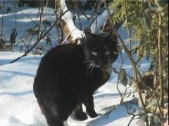
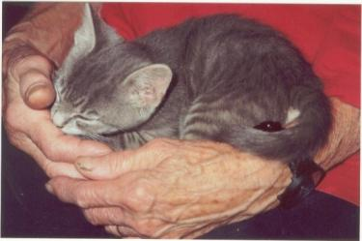
The Cat – Behaviour and Welfare 2. Birth and the kitten–mother relationship
Bjarne O. Braastad
Professor of Ethology
Department of Animal and Aquacultural Sciences,
Norwegian University of Life Sciences, NMBU, Ås, Norway

Slide 2
Behavioural development
Skin sense (tactile sense) and smell (olfactory sense) are ready at birth.
Ears are open by 5 days, eyes by 9 days (with variation).
Relationship to mother is most important for the first weeks.
The kitten becomes more active by 3 weeks.
3–21 weeks: socialization and social play:
socialization: 3–12 weeks; most active 3–7 weeks
social play: learns effect of signals and social responses
learns with whom it can have social contact
humans must be included in socialization or the cat will remain fearful towards them
– varied human contact important
start: weeks 3–9; most active: weeks 9–14
Notes:
Atferdsutvikling – sosialisering – 12 uker
Sosial struktur – hunner og hanner
Eierløse katter – katters atferd i ukjent terreng
Kommunikasjon – akustisk, visuell, berøring, lukt, mennesker (inkl. Lydfiler)
Atferdsproblemer

Slide 3
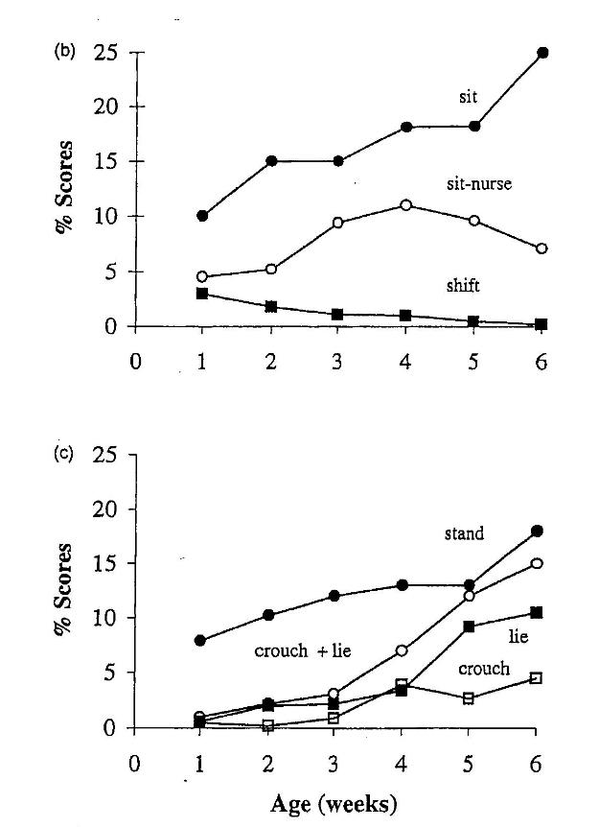
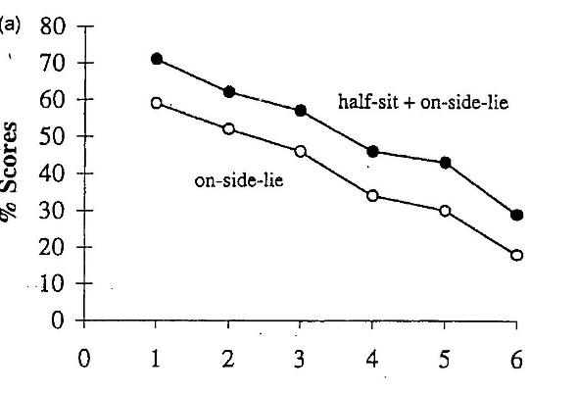
Relationship to mother – mother’s body posture
(Lawrence, 1981)
Notes:
Atferdsutvikling – sosialisering – 12 uker
Sosial struktur – hunner og hanner
Eierløse katter – katters atferd i ukjent terreng
Kommunikasjon – akustisk, visuell, berøring, lukt, mennesker (inkl. Lydfiler)
Atferdsproblemer

Slide 4
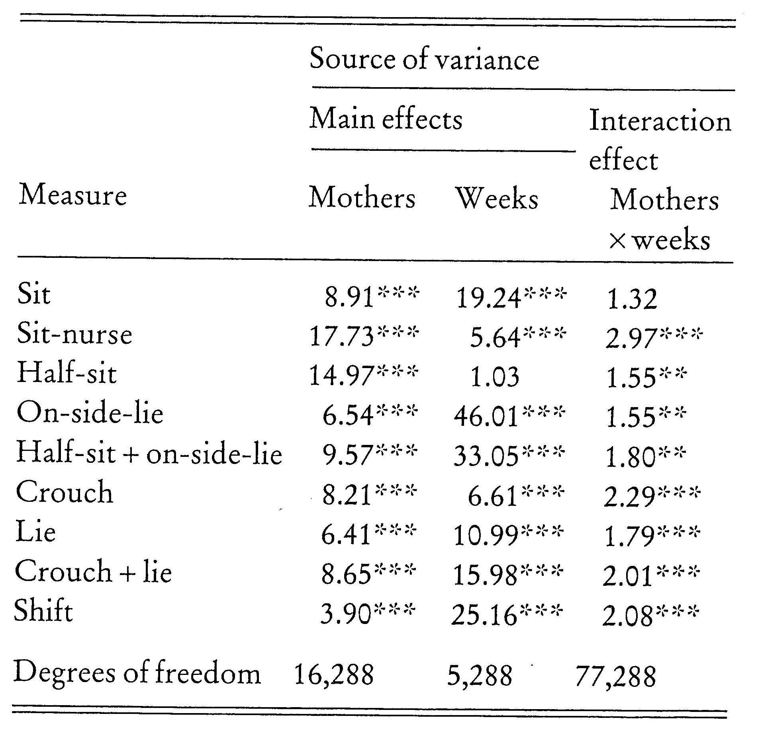
Mother’s body posture – individual variation and age of kittens
(Lawrence, 1981)
Notes:
Atferdsutvikling – sosialisering – 12 uker
Sosial struktur – hunner og hanner
Eierløse katter – katters atferd i ukjent terreng
Kommunikasjon – akustisk, visuell, berøring, lukt, mennesker (inkl. Lydfiler)
Atferdsproblemer

Slide 5
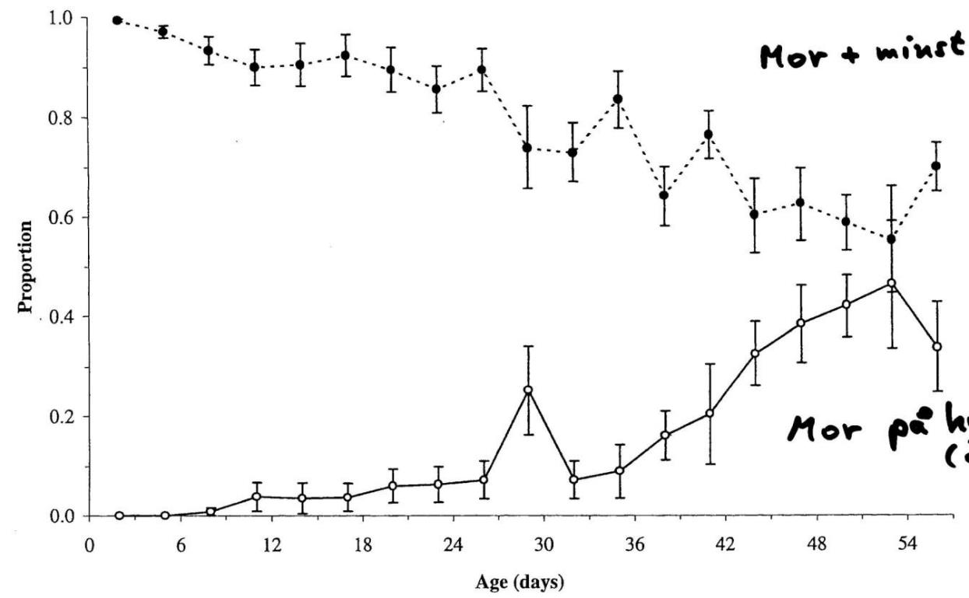
The mother – together with kittens or alone
Mother with at least one kitten
By 1 month, the mother needs a resting place away from the kittens.
Mother alone on a shelf, 0.5 m above floor level
(Deag et al., 1987)
Notes:
Atferdsutvikling – sosialisering – 12 uker
Sosial struktur – hunner og hanner
Eierløse katter – katters atferd i ukjent terreng
Kommunikasjon – akustisk, visuell, berøring, lukt, mennesker (inkl. Lydfiler)
Atferdsproblemer

Slide 6
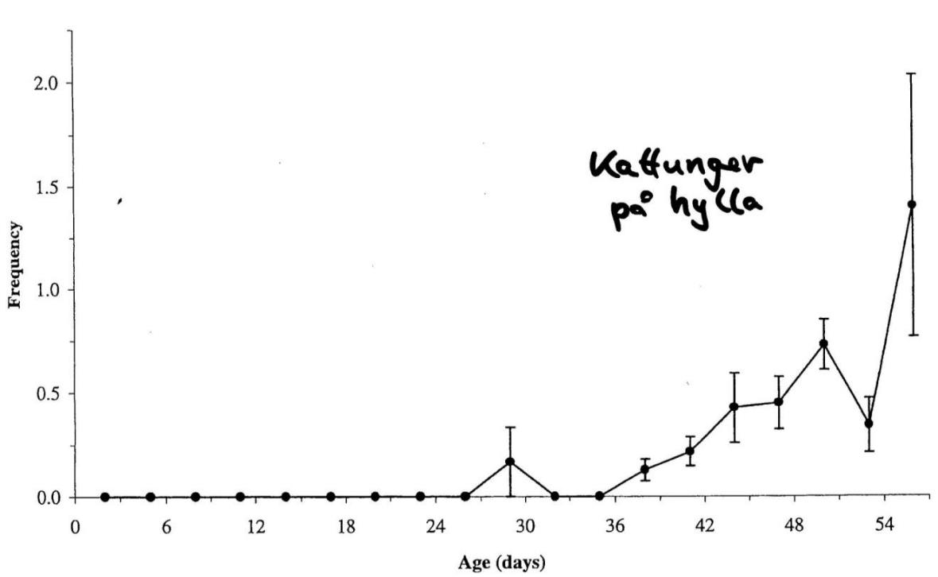
The kitten – frequency on the shelf (0.5 m above floor level)
Antall ganger
pr. 30 minutter
(Deag et al., 1987)
Notes:
Atferdsutvikling – sosialisering – 12 uker
Sosial struktur – hunner og hanner
Eierløse katter – katters atferd i ukjent terreng
Kommunikasjon – akustisk, visuell, berøring, lukt, mennesker (inkl. Lydfiler)
Atferdsproblemer

Slide 7
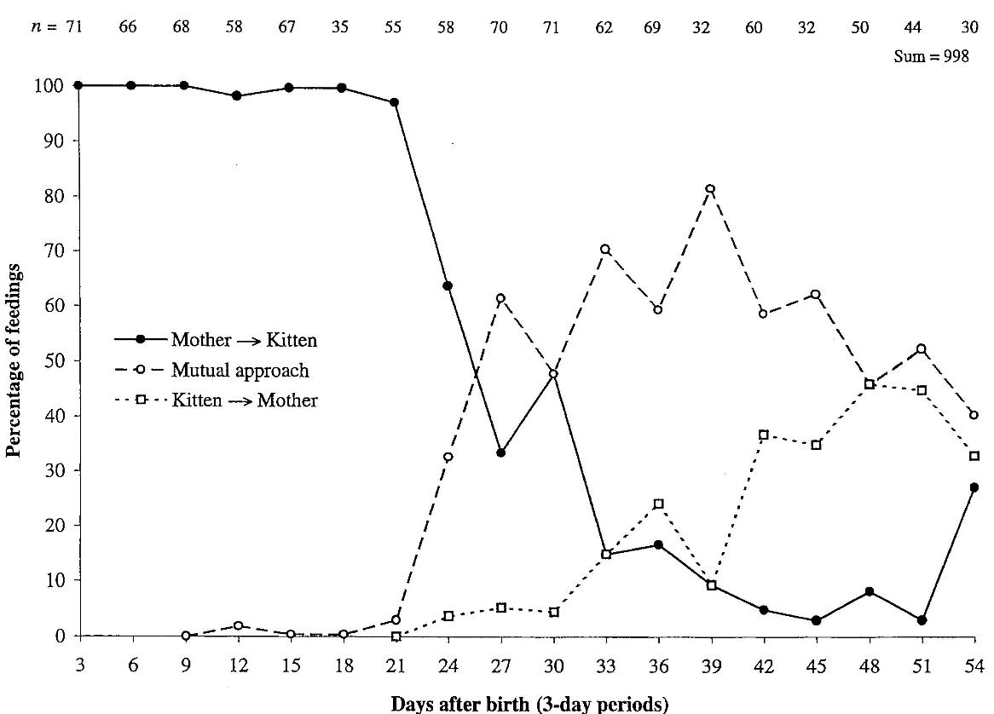
Nursing – Who takes the initiative?
Antall ganger pr. 30 minutter
(Schneirla & Rosenblatt, 1961)
Notes:
Atferdsutvikling – sosialisering – 12 uker
Sosial struktur – hunner og hanner
Eierløse katter – katters atferd i ukjent terreng
Kommunikasjon – akustisk, visuell, berøring, lukt, mennesker (inkl. Lydfiler)
Atferdsproblemer

Slide 8
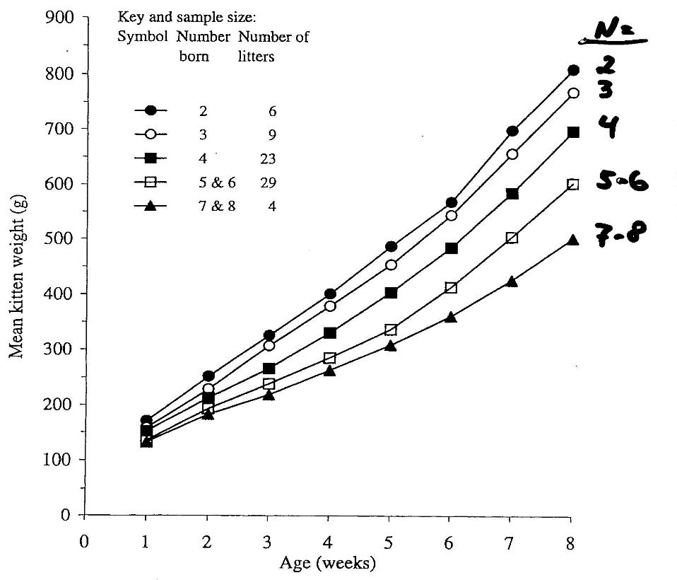
Growth in relation to litter size
(Deag et al., 1987)
Notes:
Atferdsutvikling – sosialisering – 12 uker
Sosial struktur – hunner og hanner
Eierløse katter – katters atferd i ukjent terreng
Kommunikasjon – akustisk, visuell, berøring, lukt, mennesker (inkl. Lydfiler)
Atferdsproblemer

Slide 9
More on cats’ behaviour and welfare is found here (in Norwegian)
www.braastad.info – Braastad’s website on ethology, animal welfare, cats and human–animal relationship
www.facebook.com/KattenAtferdVelferd – Facebook (Meta) site for the Norwegian cat book
www.etologi.no – website for the Norwegian Association of Ethologists
www.etologi-dyrevelferd.no – website on ethology and animal welfare for secondary schools
www.animalpickings.com – popular scientific website for the Research Group on Ethology and Animal Environment at the Norwegian University of Life Sciences
Notes:
Trykk Visningsfunksjonen så samme bilde er på PC og lerret!
Trykk deretter lenken.

Slide 10
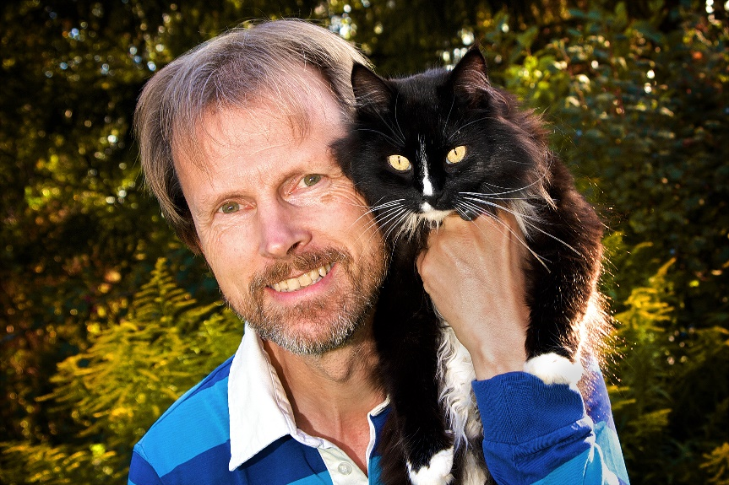
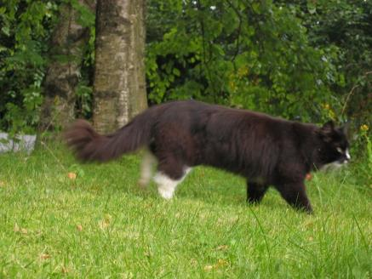
Thank you for listening to Bjarne. He believes that he understands me.
But we have our secrets that no ethologist yet knows about.

