Slide 1
The Cat – Behaviour and Welfare 19. Keeping cats in housing co-operatives
Bjarne O. Braastad
Professor of Ethology
Department of Animal and Aquacultural Sciences,
Norwegian University of Life Sciences, NMBU, Ås, Norway

Slide 2
Problems with keeping cats in housing co-operatives
83% of those without a pet would like to have one.
43% of these were not allowed by the landlord to keep a pet. (Hart et al., 1992, 6th International Conference on Animals & Us, Montreal)
In housing co-operatives, keeping dogs and cats is often prohibited.
In housing co-operatives, keeping an indoor cat cannot be forbidden, unless problems caused to other people can be documented.
(The Emmeline case, Norwegian Supreme Court, 1993)

Slide 3
Cats in housing co-operatives, indoors and outdoors I
‘House rules which forbid cat keeping are void if the cat is only kept indoors.’ (The Emmeline case, Norwegian Supreme Court, 1993)
Consequence: many co-operatives forbid keeping of cats outdoors, but allow indoor keeping.
Keeping cats solely indoors if they are used to walking outdoors is contrary to the Norwegian Animal Welfare Act.
Housing co-operatives must accept that cats used to walking outdoors are allowed to continue outdoor stays.
It is OK to make rules requiring ID-tagging and reproduction control of cats living in housing co-operatives.

Slide 4
Cats in housing co-operatives, indoors and outdoors II
Rules requiring outdoor cats to stay on a leash
The cat needs to explore and be active in all three dimensions. The cat will explore rough terrain, places difficult to access and other places where mice and rats may be found.
If exploration is restricted, animals become frustrated and behavioural disturbances may develop, e.g. stereotypies, low threshold for aggression or even depression. Staying on a leash may be harmful as the cat’s movements gradually may reduce
the free wire length.
Animal owners must show responsibility, and dog and cat owners must co-operate to uphold the rights of those wanting to keep a pet. (Norwegian Association of House Cat Owners, http://norskhuskattforening.net)

Slide 5
More on cats’ behaviour and welfare is found here (in Norwegian)
www.braastad.info – Braastad’s website on ethology, animal welfare, cats and human–animal relationship.
www.facebook.com/KattenAtferdVelferd – Facebook (Meta) site for the Norwegian cat book
www.etologi.no – website for the Norwegian Association of Ethologists
www.etologi-dyrevelferd.no – website on ethology and animal welfare for secondary schools
www.animalpickings.com – popular scientific website for the Research Group on Ethology and Animal Environment at the Norwegian University of Life Sciences
Notes:
Trykk Visningsfunksjonen så samme bilde er på PC og lerret!
Trykk deretter lenken.

Slide 6
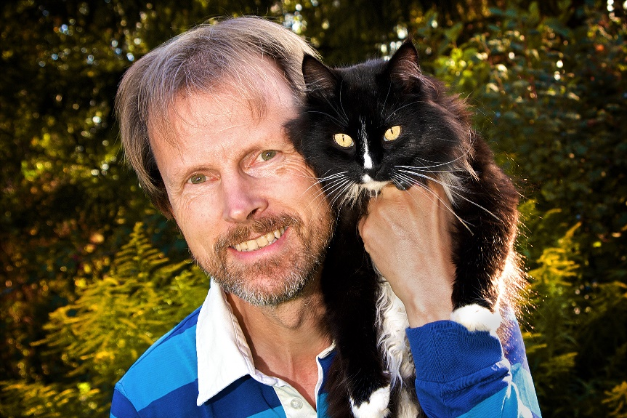
Thank you for listening to Bjarne. He believes that he understands me.
But we have our secrets that no ethologist yet knows about.

