Slide 1
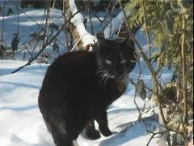
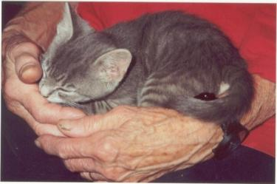
The Cat – Behaviour and Welfare 18. Relationship between cats and humans
Bjarne O. Braastad
Professor of Ethology
Department of Animal and Aquacultural Sciences,
Norwegian University of Life Sciences, NMBU, Ås, Norway

Slide 2
The relationship between cats and humans

Slide 3
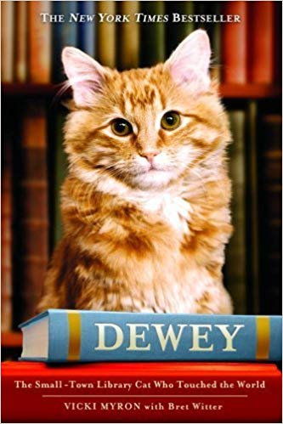
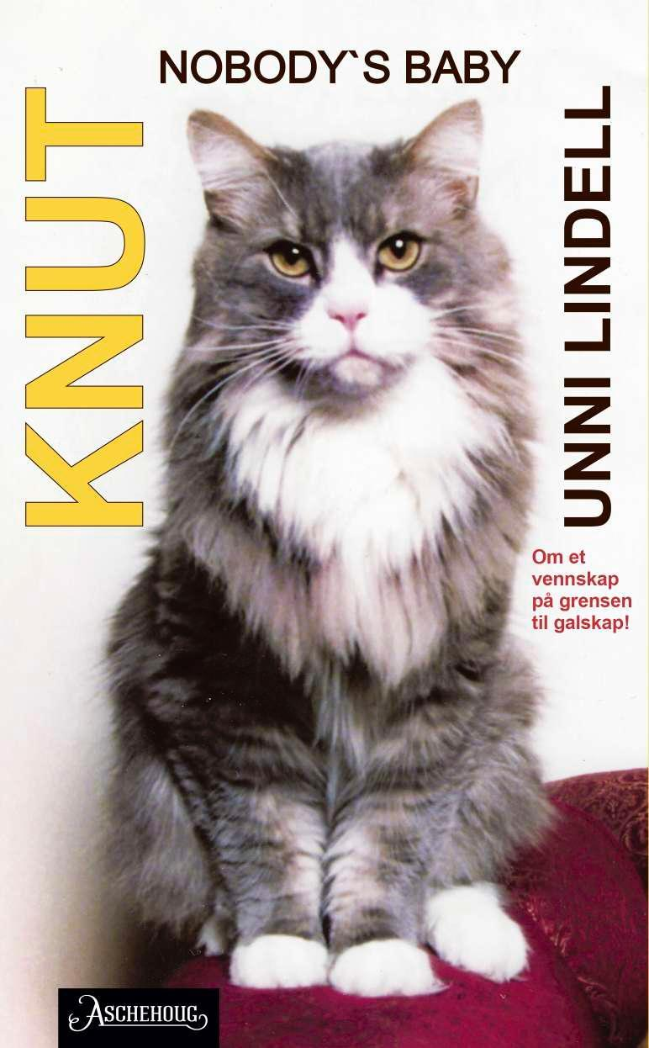
Books on the relationship between cats and humans

Slide 4
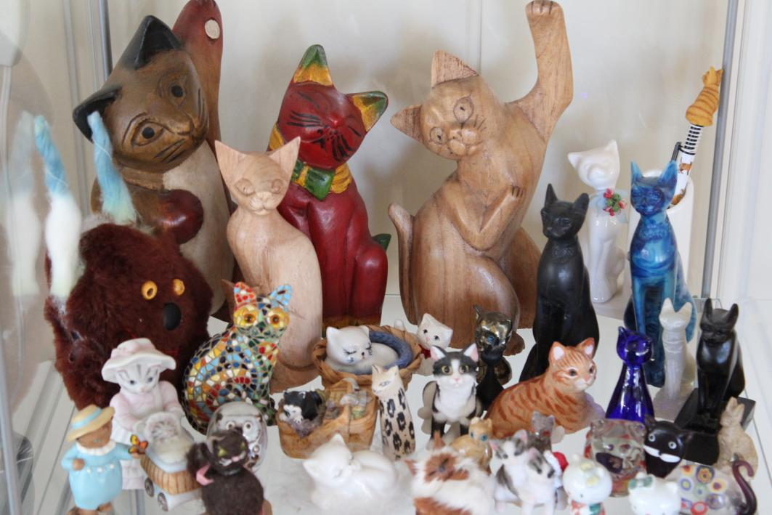
Many collect animal figures
– and cats are among the most popular

Slide 5
Self-reported social attachment to cats among cat owners (scale 1–10)
No. of cat owners
Attachment score
Average: 8.7 on the 1–10 scale, N=395.
(Sandem, 1998, The social bond between cats and humans. MSc thesis, Norwegian University of Life Sciences)

Slide 6
Social attachment to cats by owners – the gender effect (scores on 1–10 scale)
 | N | Mean | Standard deviation | Significance t-test | t
Women | 359 | 8.81 | 1.65 | P<0.01 | -2.60
Men | 39 | 8.08 | 1.87
Male cat | 201 | 8.92 | 1.50 | P<0.05 | 2.27
Female cat | 194 | 8.53 | 1.84
Women with male cat | 171 | 9.04 | 1.44 | P<0.01 | 2.65
Women with female cat | 188 | 8.60 | 1.80
(Sandem, 1998, The social bond between cats and humans. MSc thesis, Norwegian University of Life Sciences)

Slide 7
Reason | No.
Cats are independent | 207
Cats are affectionate | 196
Owner has a special relationship to cats | 183
Cats do not require much work | 170
Cats are good company | 169
Cats are beatiful animals | 111
Cats are calm animals | 92
Cats have personalities | 79
Cats are clean | 77
Cats are fascinating animals | 72
Cats are intelligent | 59
Owner fancies showing cat in cat shows | 56
Cats can function well indoors | 51
Want children to have contact with animals | 49
Owner fancies cat breeding | 46
Cats do well as mouse hunters | 39
Why do owners have a cat as a pet?
(more than one option could be ticked)
(Sandem, 1998, The social bond between cats and humans. MSc thesis, Norwegian University of Life Sciences)

Slide 8
What cat owners like and dislike about cats
Characteristics | No.
Positive characteristics
Interactive behaviour | 487
Personality | 247
Activity level | 207
Negative characteristics
Destructive/aggressive behaviour | 352
Irritating behaviour | 188
Natural behaviours | 90
Problems with using litter box | 88
Fighting with other animals in household | 56
Lack of sociability | 21
(Sandem, 1998, The social bond between cats and humans. MSc thesis, Norwegian University of Life Sciences)

Slide 9
Attachment to various breeds (1–10 scale)
Breed | N | Mean | Standard deviation | Significance
British shorthair | 18 | 9.17 | 1.15 | a*
Sacred birman | 54 | 9.15 | 1.22 | a
Burmese | 16 | 9.00 | 1.15 | ab
Persian | 83 | 8.90 | 1.53 | ab
Siamese | 13 | 8.85 | 1.95 | ab
House cat | 91 | 8.60 | 1.90 | ab
Norwegian forest cat | 57 | 8.54 | 1.86 | ab
Abyssinian | 19 | 8.26 | 1.59 | b
* Breeds with different letters show significant differences.
(Sandem, 1998, The social bond between cats and humans. MSc thesis, Norwegian University of Life Sciences)

Slide 10
Examples of positive effects of animals on humans, including animal-assisted interventions
Children’s psychological development
A comrade for adults
Social contact with elderly in nursing homes
Visiting animals in nursing homes and hospitals
Humans with mental illness, e.g. depression/anxiety
Children with autism
Violent criminals in prison
Occupational therapy for youth with behavioural distrurbances
Green care – farm animals and pets as work training and therapy

Slide 11
More on cats’ behaviour and welfare is found here (in Norwegian)
www.braastad.info – Braastad’s website on ethology, animal welfare, cats and human–animal relationship
www.facebook.com/KattenAtferdVelferd – Facebook (Meta) site for the Norwegian cat book
www.etologi.no – website for the Norwegian Association of Ethologists
www.etologi-dyrevelferd.no – website on ethology and animal welfare for secondary schools
www.animalpickings.com – popular scientific website for the Research Group on Ethology and Animal Environment at the Norwegian University of Life Sciences
Notes:
Trykk Visningsfunksjonen så samme bilde er på PC og lerret!
Trykk deretter lenken.

Slide 12
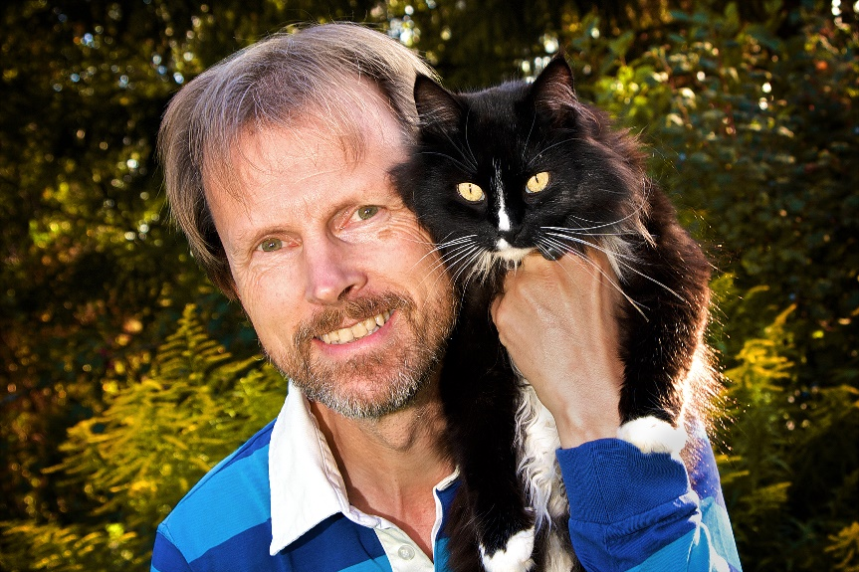
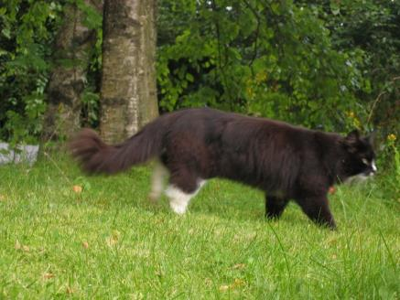
Thank you for listening to Bjarne. He believes that he understands me.
But we have our secrets that no ethologist yet knows about.

