Slide 1
The Cat – Behaviour and Welfare 17. The cat’s toilet preferences
Bjarne O. Braastad
Professor of Ethology
Department of Animal and Aquacultural Sciences,
Norwegian University of Life Sciences, NMBU, Ås, Norway

Slide 2
Refusal to use a cat toilet
May be due to nervousness – punishment is banned.
Is the litter box clean – or perhaps too clean? The cat expects its own odour there.
Is the litter box cleaned with detergents containing ammonia? Use more neutral products.
Are the walls of the litter box high? The cat may feel trapped inside a hooded litter box with a closed flap. Adapt the cat gradually to such a box.
Is the cat litter too coarse? Cats don’t like to eliminate on rocks!
Is the litter box too close to food or the resting place?
Norwegian University of Life Sciences
Notes:
6
6
5
5
5
5
5
Først:
The general behaviour of Siamese and Persian cats in our study were similar to what was earlier reported by Dennis Turner. E.g., we found Siamese cats to be more contact-seeking, staying longer in owner’s lap, using more vocal communication, and be more playful and active than other breeds.
Here I will present some data on the behaviour problems in these breeds and in non-pedigree cats.
The histograms show the percentages of categories 4 and 5 combined on the 5-point scale, that is the behaviour being shown ‘often’ or ‘very often’.
The statistics relate to the whole scale, and are marked by asterisks
for each trait.

Slide 3
No, I don’t like it this way…
Norwegian University of Life Sciences

Slide 4
More on cats’ behaviour and welfare is found here (in Norwegian)
www.braastad.info – Braastad’s website on ethology, animal welfare, cats and human–animal relationship
www.facebook.com/KattenAtferdVelferd – Facebook (Meta) site for the Norwegian cat book
www.etologi.no – website for the Norwegian Association of Ethologists
www.etologi-dyrevelferd.no – website on ethology and animal welfare for secondary schools
www.animalpickings.com – popular scientific website for the Research Group on Ethology and Animal Environment at the Norwegian University of Life Sciences
Notes:
Trykk Visningsfunksjonen så samme bilde er på PC og lerret!
Trykk deretter lenken.

Slide 5
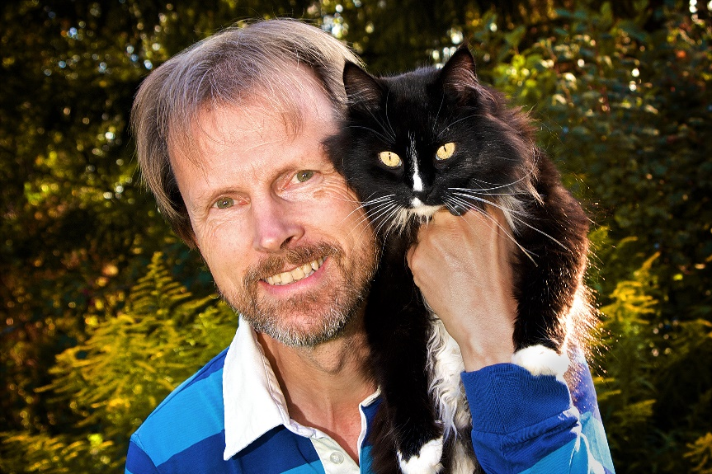
Thank you for listening to Bjarne. He believes that he understands me.
But we have our secrets that no ethologist yet knows about.

