Slide 1
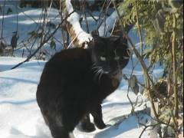
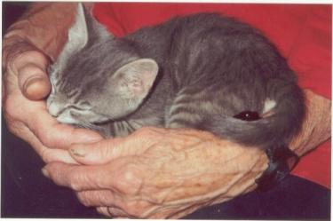
The Cat – Behaviour and Welfare 16. Urine marking in cats
Bjarne O. Braastad
Professor of Ethology
Department of Animal and Aquacultural Sciences,
Norwegian University of Life Sciences, NMBU, Ås, Norway

Slide 2
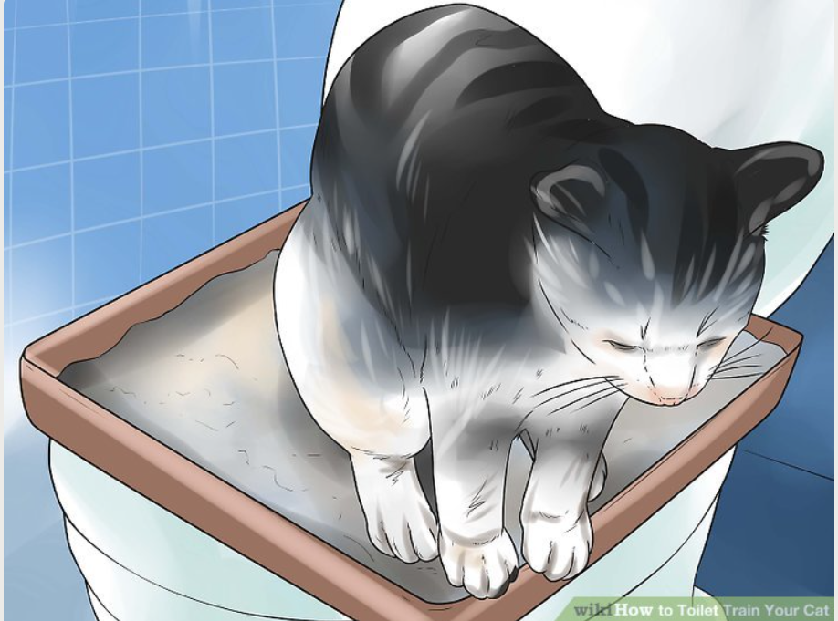
How to toilet-train the kitten
This is rarely a problem.
Kittens should learn this from their mother.
Problems can arise if the kitten loses its mother too early.
Ask the cat breeder what kind of toilet and substrate the kitten is used to.
Use a shaping method to teach the kitten to use the toilet: reward small steps until a complete behaviour is shown. Do not disturb the kitten while it is defecating or urinating.
The cat can be trained to used our WC: https://www.wikihow.com/Toilet-Train-Your-Cat
Norwegian University of Life Sciences
Notes:
6
6
5
5
5
5
5
Først:
The general behaviour of Siamese and Persian cats in our study were similar to what was earlier reported by Dennis Turner. E.g., we found Siamese cats to be more contact-seeking, staying longer in owner’s lap, using more vocal communication, and be more playful and active than other breeds.
Here I will present some data on the behaviour problems in these breeds and in non-pedigree cats.
The histograms show the percentages of categories 4 and 5 combined on the 5-point scale, that is the behaviour being shown ‘often’ or ‘very often’.
The statistics relate to the whole scale, and are marked by asterisks
for each trait.

Slide 3
Cat breed codes in figures
The European Easy-Mind System (EMS) is used as breed codes in the following figures. EMS codes are used internationally by FIFe, the European Cat Fancier Society (Fédération Internationale Féline).
EMS Code | Breed name | No. per breed
ABY | Abyssinian | 21
BEN | Bengal | 18
BRI | Bristish Shorthair | 29
BUR | Burmese | 16
CRX | Cornish Rex | 12
DRX | Devon Rex | 13
HK | Housecat Shorthair (true EMS code is HCS) | 410
HL | Housecat Longhair (true EMS code is HCL) | 287
MAU | Egyptian Mau | 20
MCO | Maine Coon | 80
NFO | Norwegian Forest Cat | 48
ORI | Oriental breeds (Balinese, Oriental Shorthair, Oriental Longhair, Seychellois Shorthair) | 25
PER | Persian | 18
RAG | Ragdoll | 45
SBI | Sacred Birman | 41
SIA | Siamese | 17
SIB | Siberian | 37
Total = 17 |  | N =1137
Notes:
For å se nærmere på raseeffekter ble 17 raser sammenlignet
Antall katter per rase er ganske varierende
Orientalske raser er slått sammen, da de i avlssamenheng er en og same rase. Kattens morfologisketrekk avgjør hvem rasebetegnelse den får. Dette ga også mulighet for inkludere flere av disse rasene i studien, da de enkeltvis bestod av for få individer. Siameseren bl.a. er en rase som hører under orientalske raser, men da Siameseren har blitt studert tidligere valgte vi å se på den som en egen rase.
19 av 22 atferdsegenskaper gi signifikanteffekt av rase.
Jeg har gjort et lite utvalg av atferdsegenskaper som jeg ønsker å presentere for dere fra resultatene:

Slide 4
Urination or spraying outside the cat toilet – independent of breed
Occurrence of the behaviour trait in 17 cat breeds. The Y axis shows score averages (M ± SE) on a 1-5 scale based on owner assessments. 1= Never, 2 = Seldom, 3= Now and then, 4 = Often, 5 = Always. The number above the breed code shows number of cats in the analysis.
mean
(Eriksen, 2014, Behavioural characteristics of pedigree cats in Norway. MSc thesis, Norwegian University of Life Sciences)

Slide 5
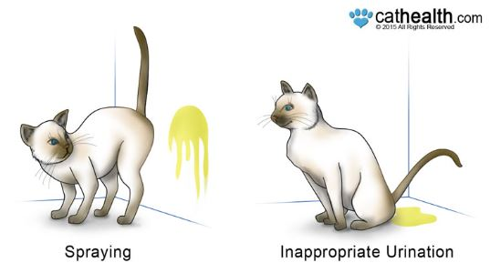
Urine marking and urination/ defecation in wrong places
A veterinarian must check this is not caused by a disease (e.g. feline lower urinary tract diseases)
Important to distinguish between urine marking (spraying) and outside toileting toilet!
Spraying or defecation as marking:
contact marking – calls for owner – often starts when owner is away for a longer time than usual
Strengthening of self-confidence by social problems with other cats, changes in household, or even moved furniture
Norwegian University of Life Sciences
Notes:
6
6
5
5
5
5
5
Først:
The general behaviour of Siamese and Persian cats in our study were similar to what was earlier reported by Dennis Turner. E.g., we found Siamese cats to be more contact-seeking, staying longer in owner’s lap, using more vocal communication, and be more playful and active than other breeds.
Here I will present some data on the behaviour problems in these breeds and in non-pedigree cats.
The histograms show the percentages of categories 4 and 5 combined on the 5-point scale, that is the behaviour being shown ‘often’ or ‘very often’.
The statistics relate to the whole scale, and are marked by asterisks
for each trait.

Slide 6
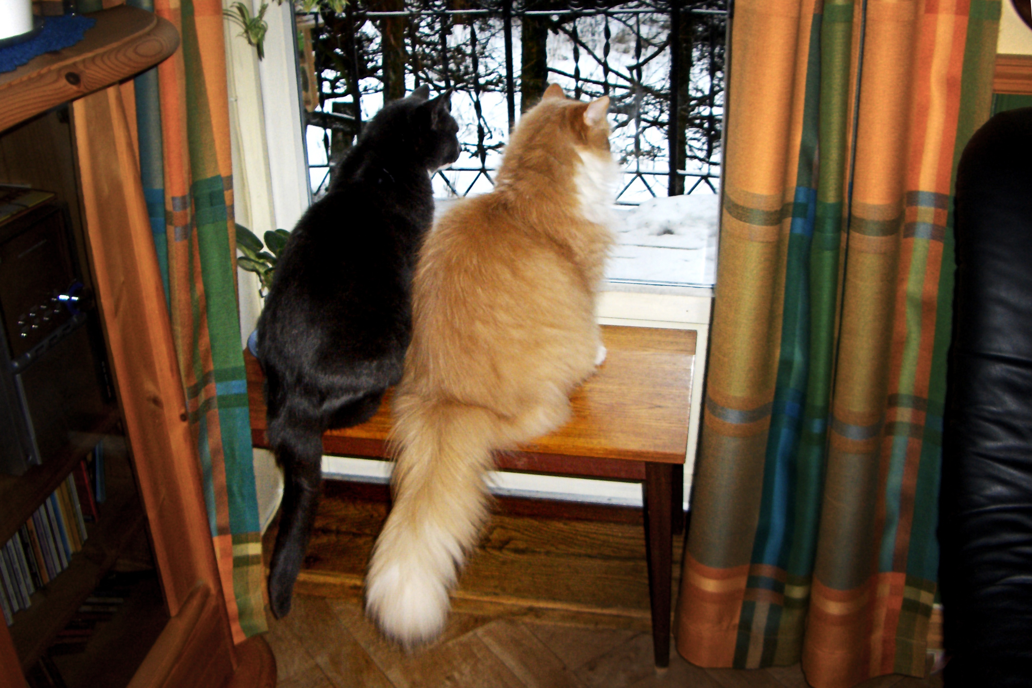
Measures against indoor marking I
Contact marking:
Ignore the cat if it happens when owner is at home.
Contact with food and cuddling on owner’s initiative.
Cats must be habituated to the owner being away for a gradually longer time, to avoid separation anxiety.
Photo: Leif Aslaksen
Norwegian University of Life Sciences
Notes:
6
6
5
5
5
5
5
Først:
The general behaviour of Siamese and Persian cats in our study were similar to what was earlier reported by Dennis Turner. E.g., we found Siamese cats to be more contact-seeking, staying longer in owner’s lap, using more vocal communication, and be more playful and active than other breeds.
Here I will present some data on the behaviour problems in these breeds and in non-pedigree cats.
The histograms show the percentages of categories 4 and 5 combined on the 5-point scale, that is the behaviour being shown ‘often’ or ‘very often’.
The statistics relate to the whole scale, and are marked by asterisks
for each trait.

Slide 7
Measures against indoor marking II
Social insecurity, lack of self-confidence:
Protect the cat from what is threatening – seal cat flap, put food close to cat flap indoors, keep other animals away
Adapt the cat gradually to what is threatening – habituation or desensitization.
Try Feliway Classic®. Don’t wait too long (<2 months). Effects can take time (up to 1 month). May give emotional stabilization by stress. Effect is not guaranteed.
Try Feliway Friends®. This may reduce social conflicts or social anxiety. Effect is not guaranteed.
By stress, try a food that contains increased L-tryptophan, which promotes increased release of serotonin in brain.
Try environmental enrichment with catnip.
Norwegian University of Life Sciences
Notes:
6
6
5
5
5
5
5
Først:
The general behaviour of Siamese and Persian cats in our study were similar to what was earlier reported by Dennis Turner. E.g., we found Siamese cats to be more contact-seeking, staying longer in owner’s lap, using more vocal communication, and be more playful and active than other breeds.
Here I will present some data on the behaviour problems in these breeds and in non-pedigree cats.
The histograms show the percentages of categories 4 and 5 combined on the 5-point scale, that is the behaviour being shown ‘often’ or ‘very often’.
The statistics relate to the whole scale, and are marked by asterisks
for each trait.

Slide 8
More on cats’ behaviour and welfare is found here (in Norwegian)
www.braastad.info – Braastad’s website on ethology, animal welfare, cats and human–animal relationship
www.facebook.com/KattenAtferdVelferd – Facebook (Meta) site for the Norwegian cat book
www.etologi.no – website for the Norwegian Association of Ethologists
www.etologi-dyrevelferd.no – website on ethology and animal welfare for secondary schools
www.animalpickings.com – popular scientific website for the Research Group on Ethology and Animal Environment at the Norwegian University of Life Sciences
Notes:
Trykk Visningsfunksjonen så samme bilde er på PC og lerret!
Trykk deretter lenken.

Slide 9
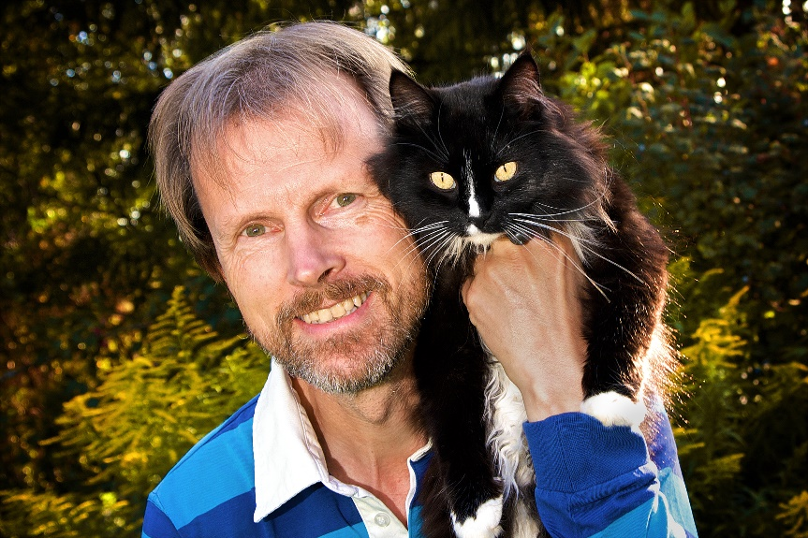
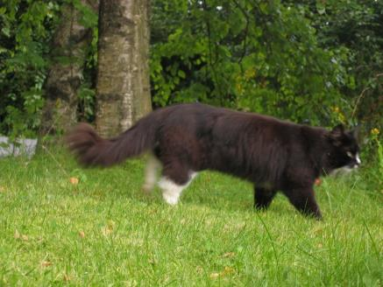
Thank you for listening to Bjarne. He believes that he understands me.
But we have our secrets that no ethologist yet knows about.

