Slide 1
The Cat – Behaviour and Welfare 15. When the cat scratches furniture
Bjarne O. Braastad
Professor of Ethology
Department of Animal and Aquacultural Sciences,
Norwegian University of Life Sciences, NMBU, Ås, Norway

Slide 2
Cat breed codes in figures
The European Easy-Mind System (EMS) is used as breed codes in the following figures. EMS codes are used internationally by FIFe, the European Cat Fancier Society (Fédération Internationale Féline).
EMS Code | Breed name | No. per breed
ABY | Abyssinian | 21
BEN | Bengal | 18
BRI | Bristish Shorthair | 29
BUR | Burmese | 16
CRX | Cornish Rex | 12
DRX | Devon Rex | 13
HK | Housecat Shorthair (true EMS code is HCS) | 410
HL | Housecat Longhair (true EMS code is HCL) | 287
MAU | Egyptian Mau | 20
MCO | Maine Coon | 80
NFO | Norwegian Forest Cat | 48
ORI | Oriental breeds (Balinese, Oriental Shorthair, Oriental Longhair, Seychellois Shorthair) | 25
PER | Persian | 18
RAG | Ragdoll | 45
SBI | Sacred Birman | 41
SIA | Siamese | 17
SIB | Siberian | 37
Total = 17 |  | N =1137
Notes:
For å se nærmere på raseeffekter ble 17 raser sammenlignet
Antall katter per rase er ganske varierende
Orientalske raser er slått sammen, da de i avlssamenheng er en og same rase. Kattens morfologisketrekk avgjør hvem rasebetegnelse den får. Dette ga også mulighet for inkludere flere av disse rasene i studien, da de enkeltvis bestod av for få individer. Siameseren bl.a. er en rase som hører under orientalske raser, men da Siameseren har blitt studert tidligere valgte vi å se på den som en egen rase.
19 av 22 atferdsegenskaper gi signifikanteffekt av rase.
Jeg har gjort et lite utvalg av atferdsegenskaper som jeg ønsker å presentere for dere fra resultatene:

Slide 3
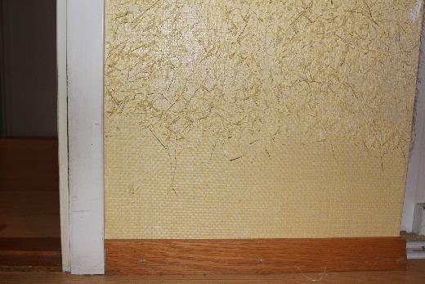
Scratching furniture, curtains, carpets etc.
Occurrence of the behaviour trait in 17 cat breeds. The Y axis shows score averages (M ± SE) on a 1-5 scale based on owner assessments. 1= Never, 2 = Seldom, 3= Now and then, 4 = Often, 5 = Always. The number above the breed code shows number of cats in the analysis.
Becomes reinforced if owner approaches
the cat trains the owner ⇒ must be ignored or mild negative feedback
Provide a scratching post, deposited with catnip. Reward using it.
mean
(Eriksen, 2014, Behavioural characteristics of pedigree cats in Norway. MSc thesis, Norwegian Univeristy of Life Sciences)

Slide 4
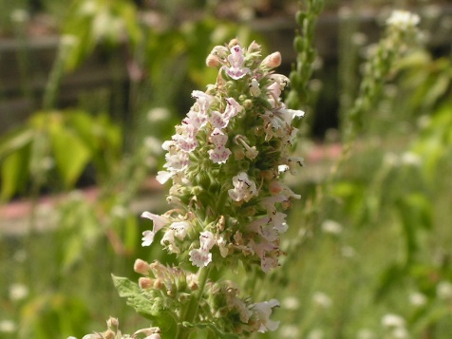
Catnip (Nepeta cataria, environmental enrichment for cats)
Dried leaves or plant oil: increases attention to scratching post or toys
Affects 50–80% of cats (both genders), castrated or intact (the rest passively?)
Does not affect kittens below 2–3 months of age
Individual variation: due to dominant gene
Reactions: sniffs; chews; licks; touches/rubs cheek, chin or body; rolls onto the catnip
More rarely, stretches, drools, jumps, runs or becomes aggressive and
hyperactive
Hallucination or trance
Duration: 5–15 minutes, then non-responsive for 30–60 minutes
Active substance nepetalactone enters via nose to amygdala and hypothalamus
Can react to concentrations as low as 0.01–1.0 x 10⁹.
Harmless, no long-term effects or addiction. Can be habituated if it is given too frequently
Pregnant females: can risk uterus contractions → avoid intake

Slide 5
More on cats’ behaviour and welfare is found here (in Norwegian)
www.braastad.info – Braastad’s website on ethology, animal welfare, cats and human–animal relationship
www.facebook.com/KattenAtferdVelferd – Facebook (Meta) site for the Norwegian cat book
www.etologi.no – website for the Norwegian Association of Ethologists
www.etologi-dyrevelferd.no – website on ethology and animal welfare for secondary schools
www.animalpickings.com – popular scientific website for the Research Group on Ethology and Animal Environment at the Norwegian University of Life Sciences
Notes:
Trykk Visningsfunksjonen så samme bilde er på PC og lerret!
Trykk deretter lenken.

Slide 6
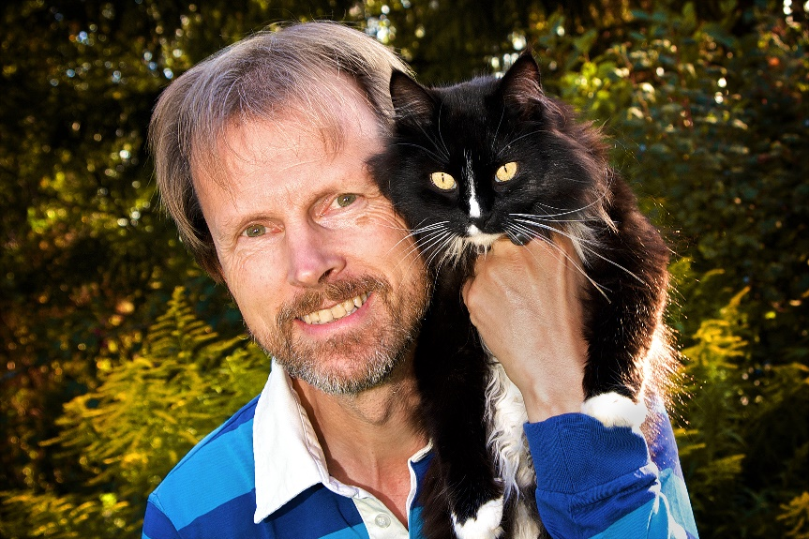
Thank you for listening to Bjarne. He believes that he understands me.
But we have our secrets that no ethologist yet knows about.

