Slide 1
The Cat – Behaviour and Welfare 11. What can we do with homeless cats?
Bjarne O. Braastad
Professor of Ethology
Department of Animal and Aquacultural Sciences,
Norwegian University of Life Sciences, NMBU, Ås, Norway

Slide 2
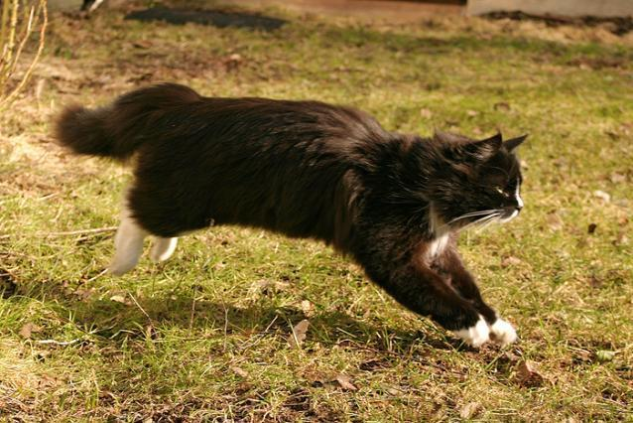
Ethical question:
Has society a moral duty to ensure welfare of domesticated species living ferally, and where individuals are living ferally because:
humans get rid of their animals
animals escape voluntarily
they are descendants of such animals?
Of course, I think of stray cats.

Slide 3
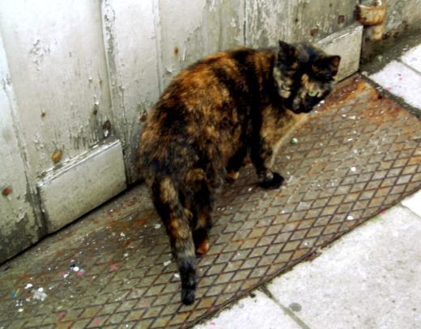
The problem of stray cats
The cat’s status in society has increased during the last decades.
Society has an ethical responsibility for stray cats.
The European Convention for the Protection of Pet Animals (1987) gives obligations to take measures if the number of stray cats becomes problematic.

Slide 4
Norwegian Animal Welfare Act – duty to alert
Ch. 5: Duty to alert (2nd part)
Anyone who becomes aware that a large number of wild or stray animals are exposed to sickness, injury or other abnormal suffering shall, as soon as possible, inform the Food Safety Authority or the police.
This also applies to stray cats.
See: https://www.regjeringen.no/en/dokumenter/animal-welfare-act/id571188/

Slide 5
Norwegian Animal Welfare Act – duty to help
Ch. 4: Duty to help
Anybody who discovers an animal that is obviously sick, injured or helpless shall, as far as possible, help the animal. If it is impossible to provide adequate help, and the animal is domestic or a large wild mammal, the owner or the police shall be alerted immediately.
If it is obvious that the animal will not survive or recover, the person who discovered the animal may kill it at once. However, animals from holdings or large wild mammals shall not be killed if it is possible to alert the owner, a veterinarian or the police within reasonable time.
Necessary expenses for action under this section shall be covered by the state, but the expenses relating to helping domestic animals may be recovered from the animal’s keeper or owner.

Slide 6
Stray cats – solutions
Unacceptable solutions:
Ignore the problem – unethical
Kill captured cats – inefficient, does not reduce population in the long run → immigration because of available territory
There is much experience in various countries with alternative methods:
TNR method = Trap, Neuter, Return
TTVARR method = Trap, Test, Vaccinate, Alter, Rehome or Release (International Cat Care, http://www.icatcare.org)
– effective in many places (www.snip-international.org)
Mandatory ID tag, e.g. microchip
Reproduction control
Limited number of cats allowed per household?
NB: It is difficult to assess whether a captured cat has an owner. In unfamiliar terrain, cats may become quite fearful or anxious.

Slide 7
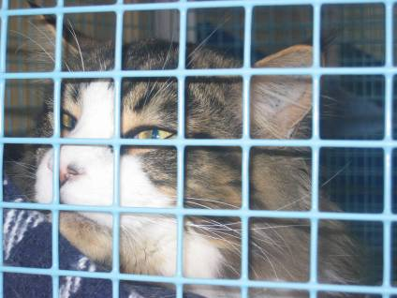
Cat shelters
Norwegian regulations apply to cat shelters.
Functional rather than detailed requirements.
Cats are not required to be kept in cages.
Necessary competence among staff is required.

Slide 8
More on cats’ behaviour and welfare is found here (in Norwegian)
www.braastad.info – Braastad’s website on ethology, animal welfare, cats and human–animal relationship
www.facebook.com/KattenAtferdVelferd – Facebook (Meta) site for the Norwegian cat book
www.etologi.no – website for the Norwegian Association of Ethologists
www.etologi-dyrevelferd.no – website on ethology and animal welfare for secondary schools
www.animalpickings.com – popular scientific website for the Research Group on Ethology and Animal Environment at the Norwegian University of Life Sciences
Notes:
Trykk Visningsfunksjonen så samme bilde er på PC og lerret!
Trykk deretter lenken.

Slide 9
Thank you for listening to Bjarne. He believes that he understands me.
But we have our secrets that no ethologist yet knows about.

