Slide 1
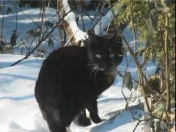
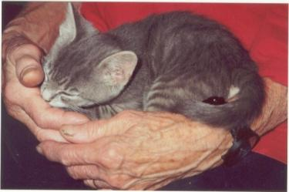
The Cat – Behaviour and Welfare 10. Orientation and navigation in cats
Bjarne O. Braastad
Professor of Ethology
Department of Animal and Aquacultural Sciences,
Norwegian University of Life Sciences, NMBU, Ås, Norway

Slide 2
Behaviour and navigation in unfamiliar terrain Advice when searching for a missing cat

Slide 3
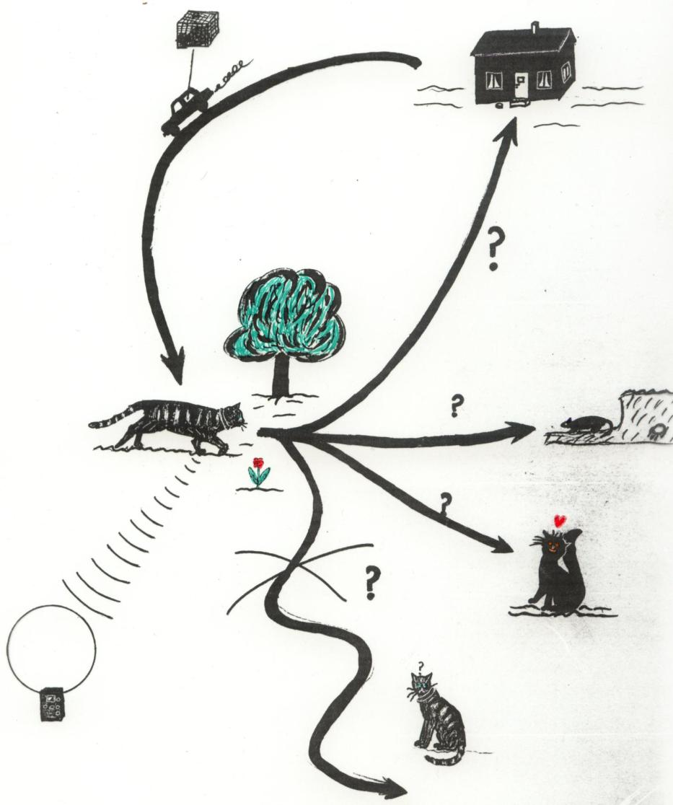
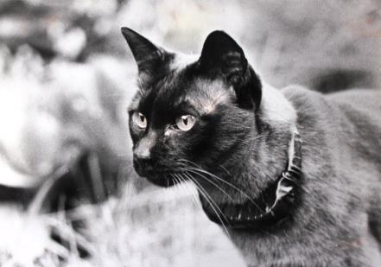
The cat’s behaviour in unfamiliar terrain
(Braastad’s MSc thesis, 1980, University of Trondheim)

Slide 4
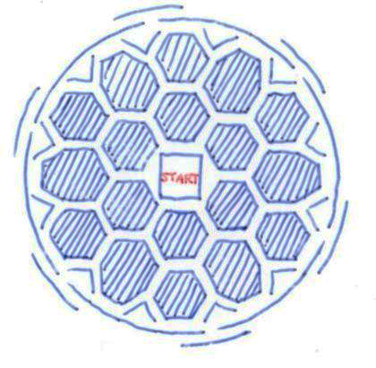
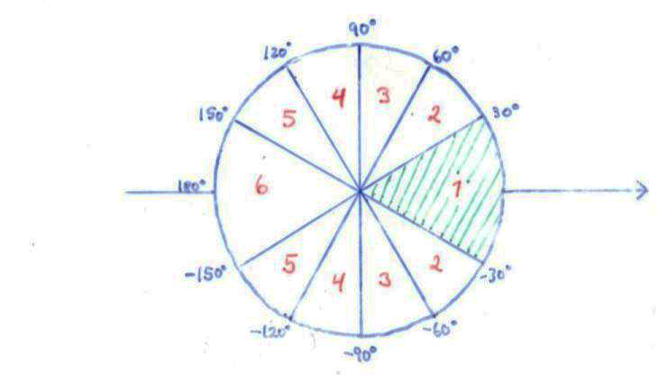
Precht & Lindenlaub, 1954:
Lorry transport in closed box
Radial-symmetric labyrinth with roof, 6 exits with angle of 60 degrees between each
Start box opened
after 1–8 km
drive with many turns
Home direction
21 out of 42 cats exited in the home direction (p<0.001).
(Prect and Lindenlaub, 1954, Ethology 11(3), 485–494)

Slide 5
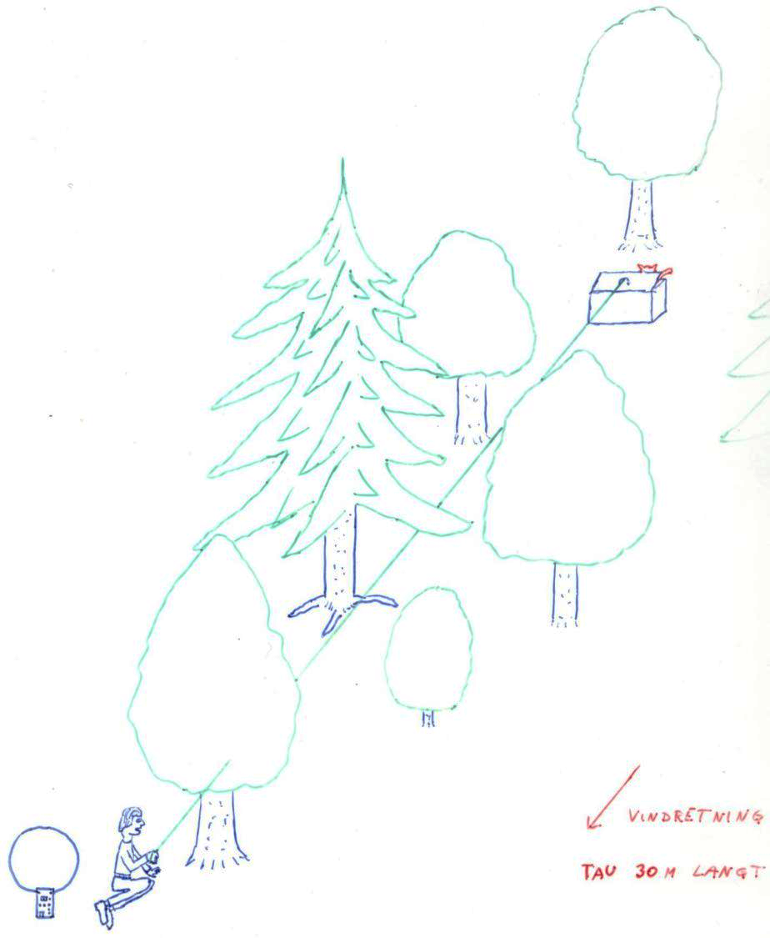
Cats driven by car into forest and released
(Braastad, 1980, MSc thesis, University of Trondheim)
Wind direction
30 m rope from box

Slide 6
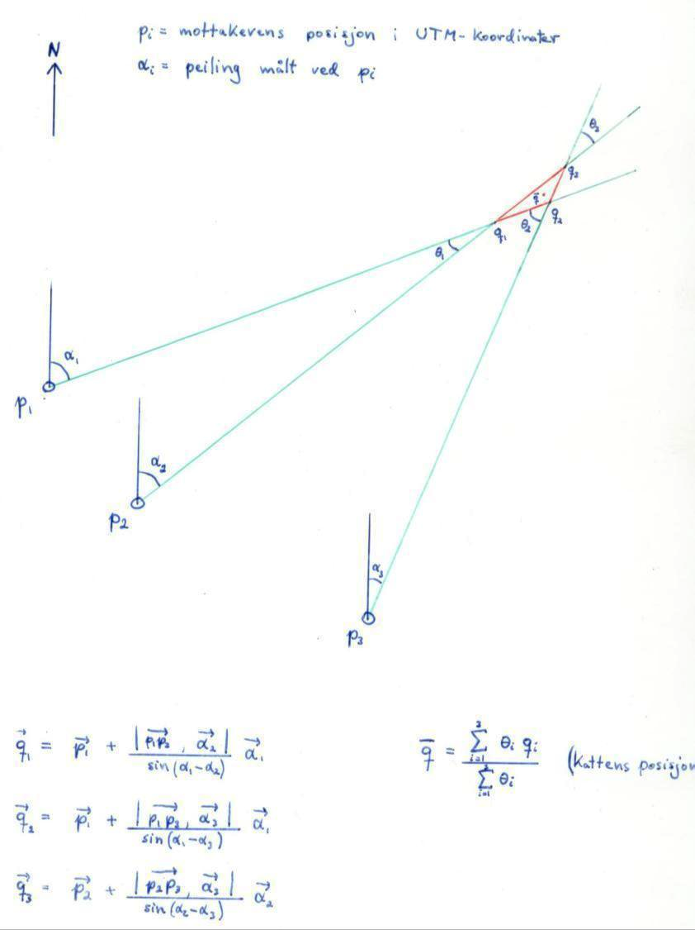
p_{i} = receiver’s position, UTM co-ordinates
α_{i} = angle from north, direction to cat
Position calculated by triangulation of bearings from radio-collared cats, frequency: 27 MHz
Cat’s position in geometrical mid-point of red triangle

Slide 7
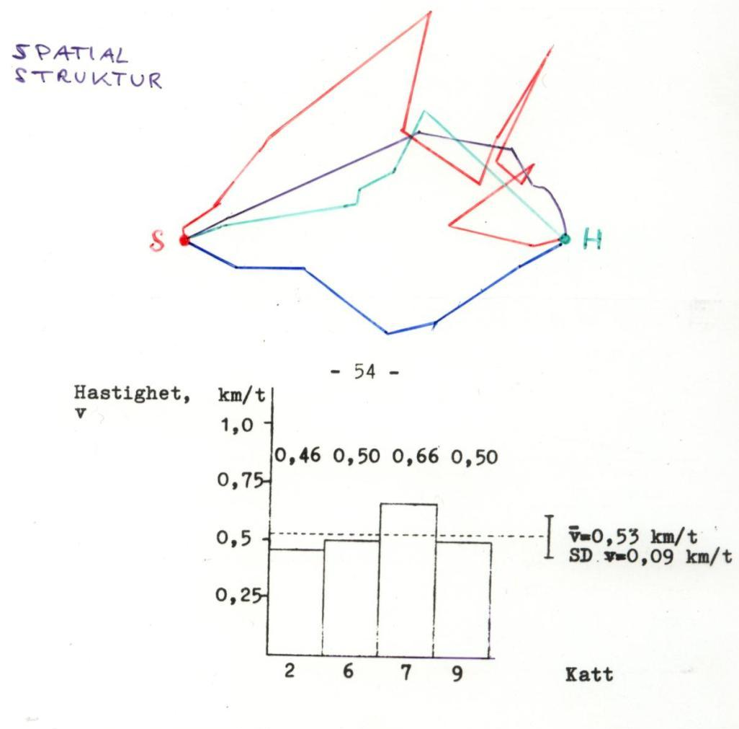
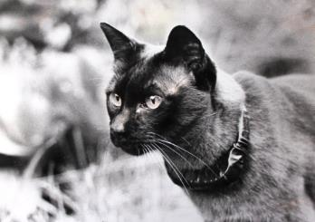
Wandering route and speed
S = start
H = home
Speed (km/h)
Cat ID

Slide 8
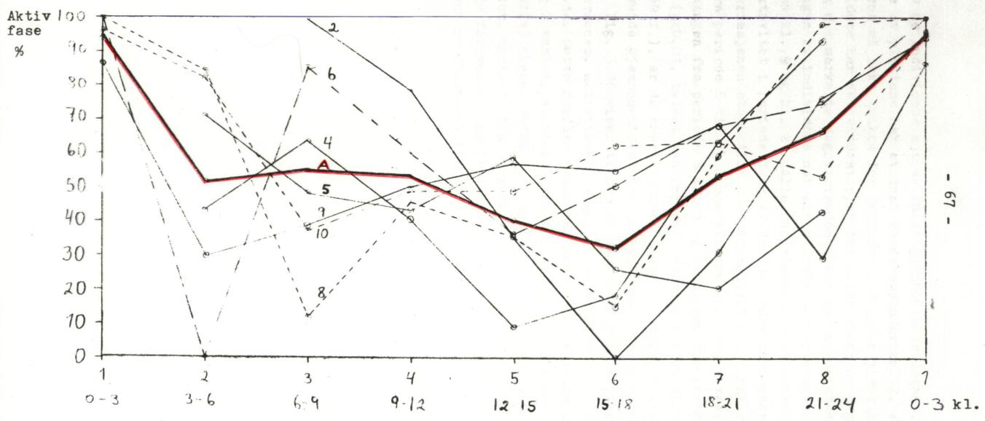
Diurnal rhythm in unfamiliar terrain
Individual rhythms of active behaviour are shown from 00–24 h, as percentage of three-hour period. Red curve: average among the 7 cats.

Slide 9
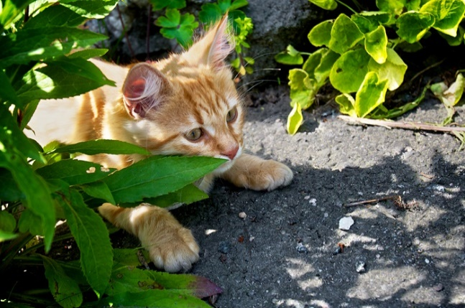
When is the homing ability developed?
It does not appear by itself by 1 year of age, as some believe. It must be developed gradually with experience of wandering outdoors.
The kitten can be let out from about 6 months, with consideration of traffic and other environmental conditions.
Train the cat to walk on a leash, indoors first, then outdoors.
Spend time outdoors with the cat during the first period.
When the cat is released freely, allow it to run into the house if something frightens it.
Train the cat to use a cat flap, if possible.
Give the cat increasing degrees of freedom.
(Photo: Audun Braastad)

Slide 10
How can you find a missing cat?
An adult cat moved ≤2 km away, will have a good chance of returning by itself. Adult males may walk longer than females and adolescents.
If the cat is lost on a holiday or a long way from home, it will most probably stay in the vicinity, within a few hundred metres.
The new home range may gradually increase as time passes.
The cat will frequently hide in dense vegetation/thickets. Search there.
Search in early dawn or twilight. The cat is likely to be active and walk more openly.
If you have indications about its presence, place food there to keep it around until you can catch it.
The cat may not dare to approach you upon calling.
You might need to use a live trap with boiled fish – but with frequent supervision, and it must work properly the first time!

Slide 11
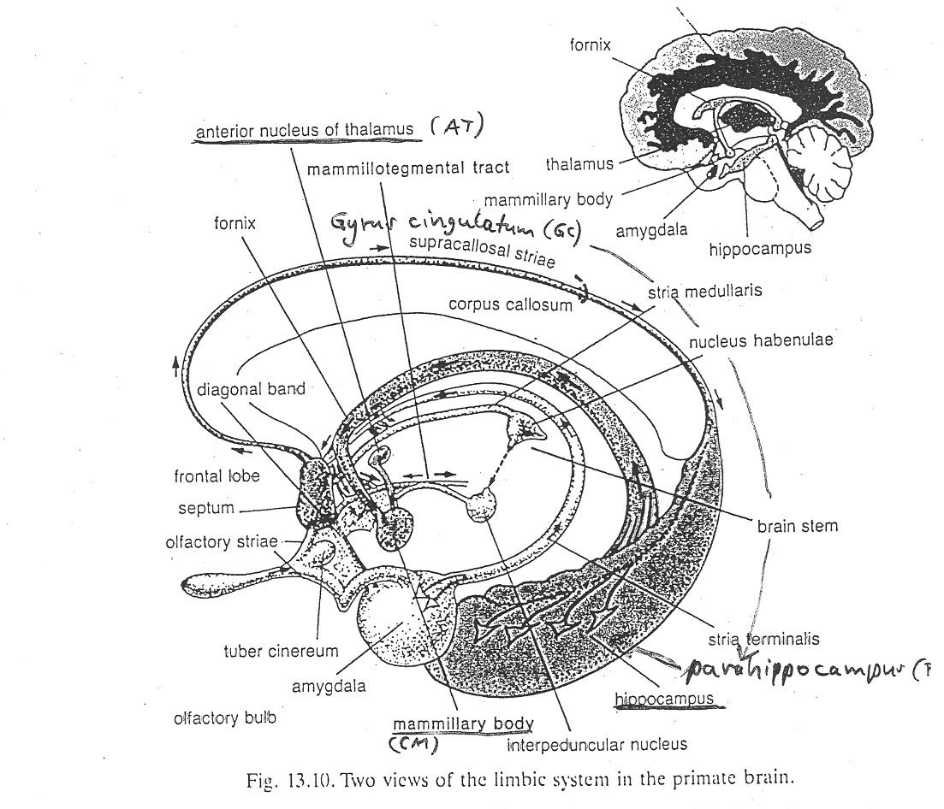
The limbic system of the brain: information flow
(Gray, J.A., 1993, The Psychology of Fear and Stress, 2nd edn, Cambridge University Press, Cambridge, UK)

Slide 12
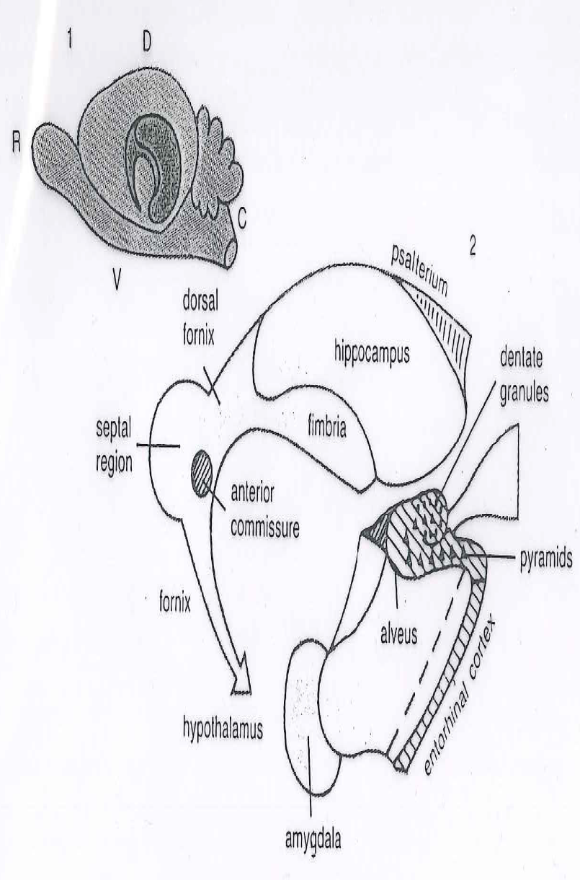
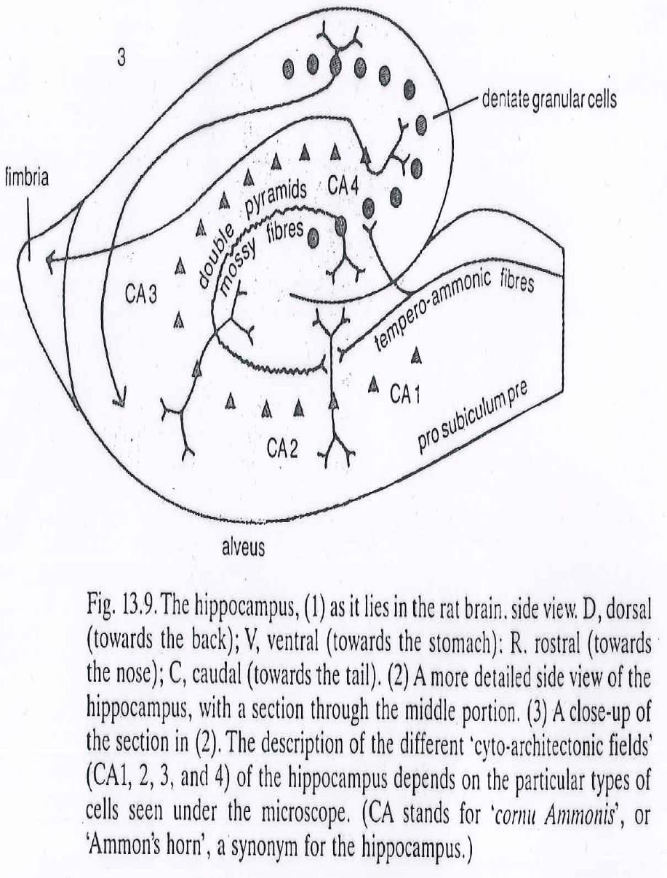
Hippocampus, cross-section
Important area for senses of time and place: entorhinal cortex

Slide 13
More on cats’ behaviour and welfare is found here (in Norwegian)
www.braastad.info – Braastad’s website on ethology, animal welfare, cats and human–animal relationship
www.facebook.com/KattenAtferdVelferd – Facebook (Meta) site for the Norwegian cat book
www.etologi.no – website for the Norwegian Association of Ethologists
www.etologi-dyrevelferd.no – website on ethology and animal welfare for secondary schools
www.animalpickings.com – popular scientific website for the Research Group on Ethology and Animal Environment at the Norwegian University of Life Sciences
Notes:
Trykk Visningsfunksjonen så samme bilde er på PC og lerret!
Trykk deretter lenken.

Slide 14
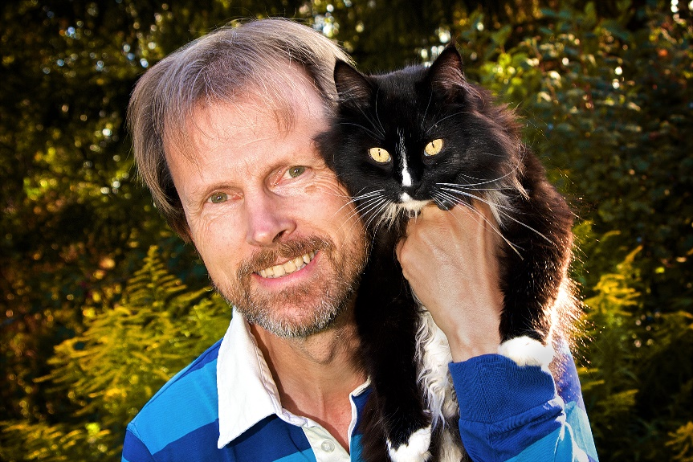
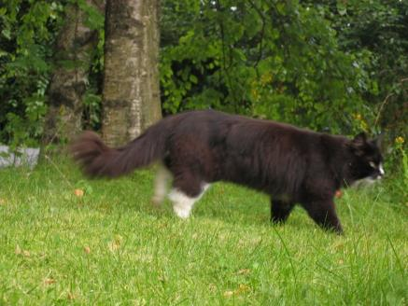
Thank you for listening to Bjarne. He believes that he understands me.
But we have our secrets that no ethologist yet knows about.

