Slide 1
The Cat – Behaviour and Welfare 1. The kitten’s senses
Bjarne O. Braastad
Professor of Ethology
Department of Animal and Aquacultural Sciences,
Norwegian University of Life Sciences, NMBU, Ås, Norway

Slide 2
The kitten’s senses and behavioural development
Skin sense (tactile sense) and smell (olfactory sense) are ready at birth.
Ears are open by 5 days, eyes by 9 days (with variation).
Relationship with the mother is most important for the first weeks.
The kitten becomes more active by 3 weeks.
3–21 weeks: socialization and social play:
socialization: 3–12 weeks; most active 3–7 weeks
social play: learns effect of signals and social responses
learns with whom it can have social contact
humans must be included in socialization or the cat will remain fearful towards them
– varied human contact is important
start: weeks 3–9; most active: weeks 9–14
Notes:
Atferdsutvikling – sosialisering – 12 uker
Sosial struktur – hunner og hanner
Eierløse katter – katters atferd i ukjent terreng
Kommunikasjon – akustisk, visuell, berøring, lukt, mennesker (inkl. Lydfiler)
Atferdsproblemer

Slide 3
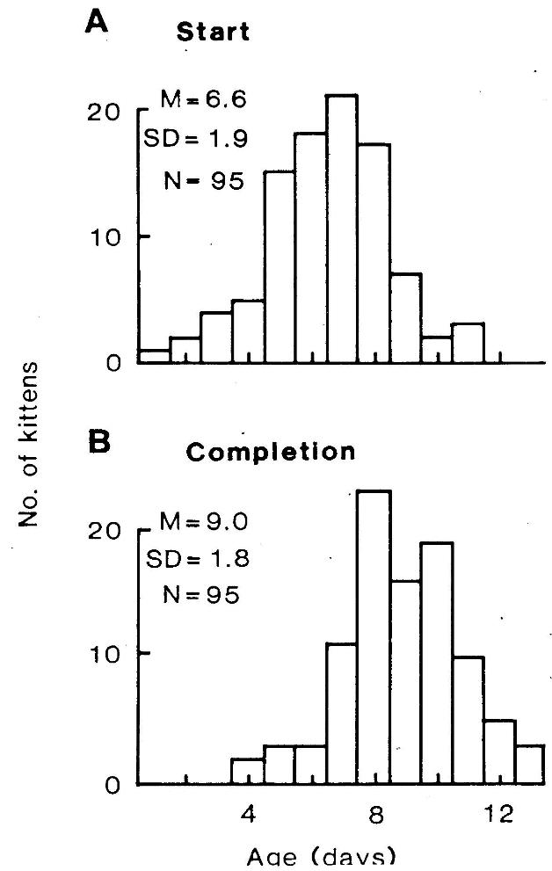
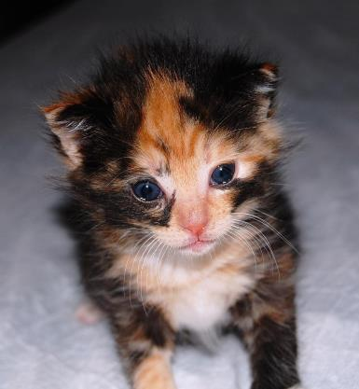
Eye opening in kittens – start and completion
Photo: Linda Iren Jensen
(Braastad & Heggelund, Developmental
Psychobiology 17, 675–681)
Notes:
Atferdsutvikling – sosialisering – 12 uker
Sosial struktur – hunner og hanner
Eierløse katter – katters atferd i ukjent terreng
Kommunikasjon – akustisk, visuell, berøring, lukt, mennesker (inkl. Lydfiler)
Atferdsproblemer

Slide 4
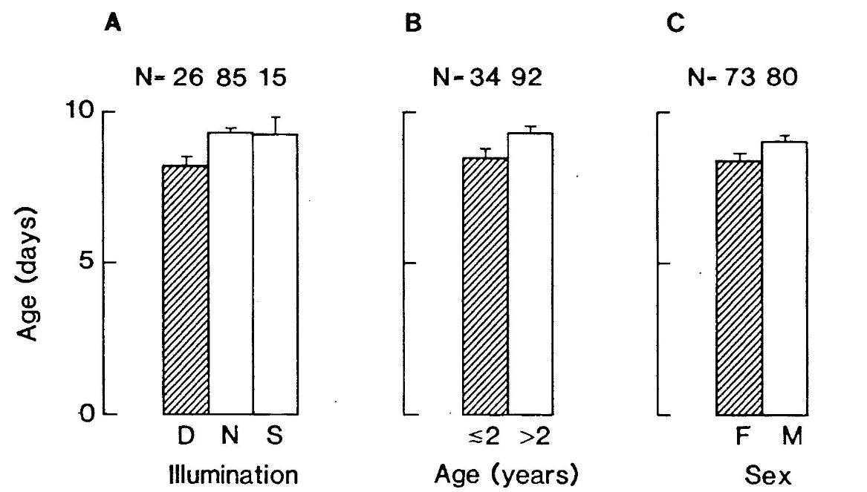
Eye opening in kittens – effects of light, mother’s age and gender (but heredity is most important, shown by paternity)
(Braastad & Heggelund, 1984)
Notes:
Atferdsutvikling – sosialisering – 12 uker
Sosial struktur – hunner og hanner
Eierløse katter – katters atferd i ukjent terreng
Kommunikasjon – akustisk, visuell, berøring, lukt, mennesker (inkl. Lydfiler)
Atferdsproblemer

Slide 5
More on cats’ behaviour and welfare is found here (in Norwegian)
www.braastad.info – Braastad’s website on ethology, animal welfare, cats and human–animal relationship
www.facebook.com/KattenAtferdVelferd – Facebook (Meta) site for the Norwegian cat book
www.etologi.no – website for the Norwegian Association of Ethologists
www.etologi-dyrevelferd.no – website on ethology and animal welfare for secondary schools
www.animalpickings.com – popular scientific website for the Research Group on Ethology and Animal Environment at the Norwegian University of Life Sciences
Notes:
Trykk Visningsfunksjonen så samme bilde er på PC og lerret!
Trykk deretter lenken.

Slide 6
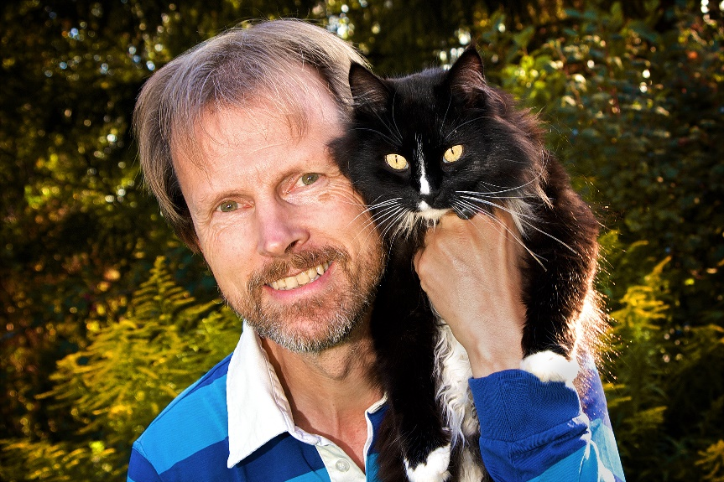
Thank you for listening to Bjarne. He believes that he understands me.
But we have our secrets that no ethologist yet knows about.

