Slide 1
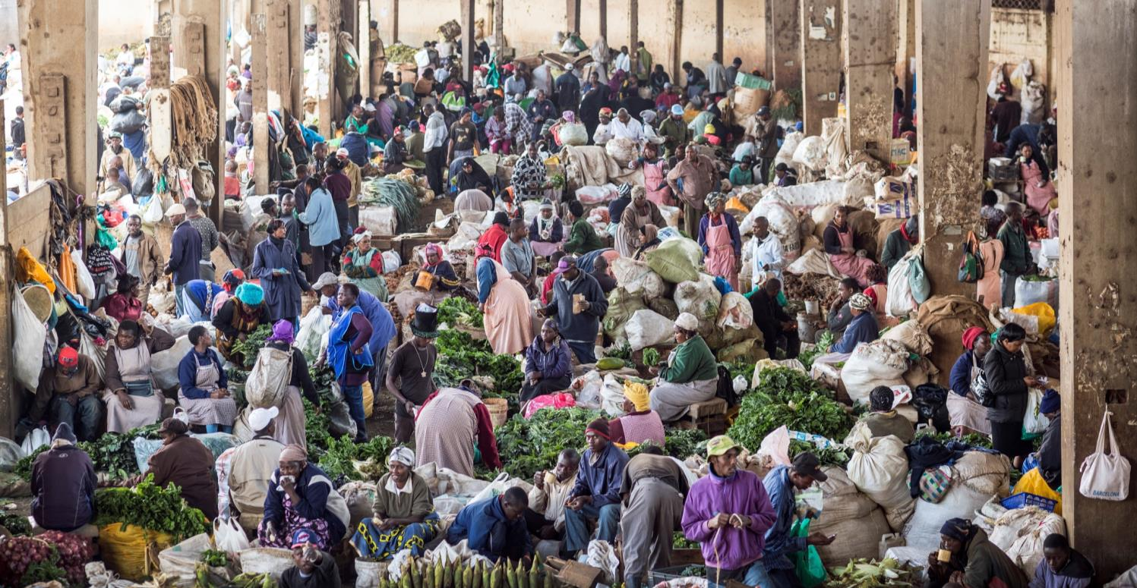
CABI’s role in facilitating trade and market access
Roger Day, African Regional Consultation, October, 2015

Slide 2
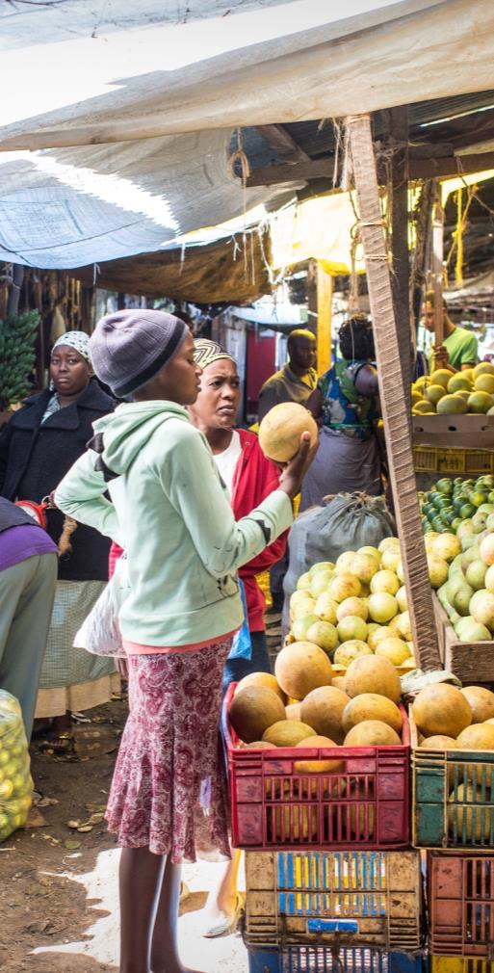
Presentation Outline
  Trade, an engine of development
  Alignment with global and continental priorities
  Challenges and issues
  CABI’s contribution
  Priority areas identified at last Consultation
  What needs to be addressed in CABI’s MTS 2016-2018

Slide 3
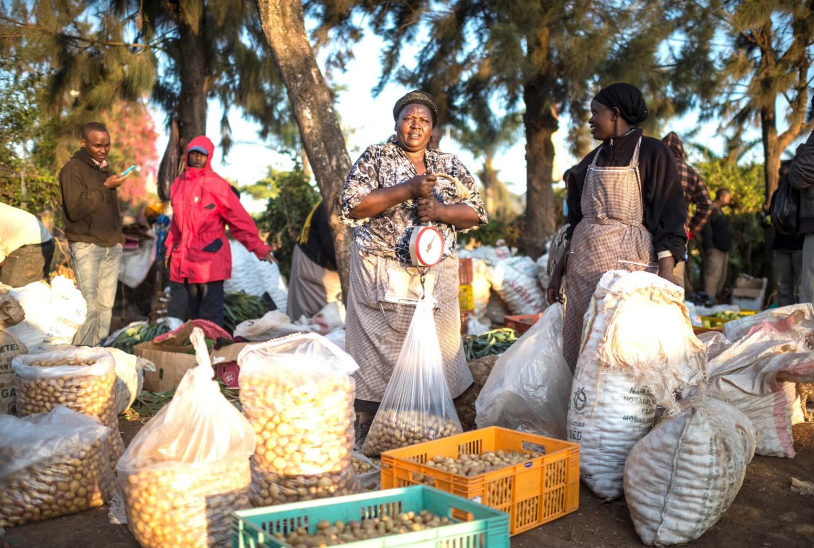
“An ounce of trade can be worth a pound of aid.”
Ban Ki-moon, Secretary-General of the UN

Slide 4
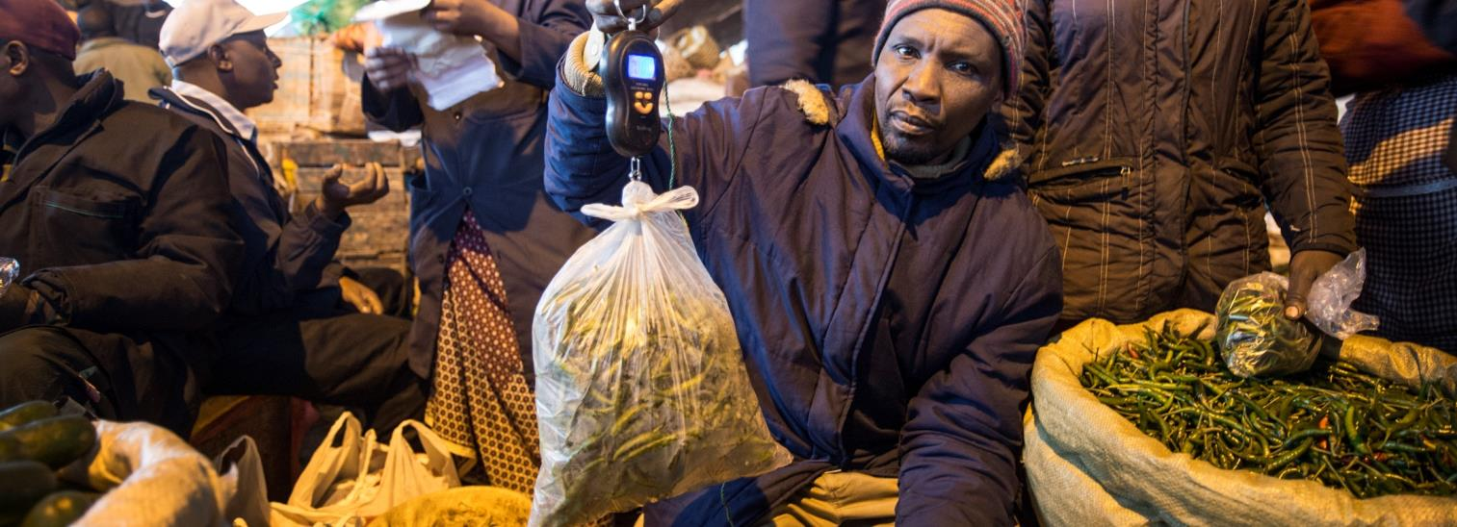
The opportunity:
If the world’s 500 million smallholder farmers
can trade more, better quality produce,
they’ll be able to improve their lives and contribute to the increasing global demand for food.
Notes:
Through greater participation in trade related activities, smallholders are improving their own food security- spreading risks so that they can gain income for improved access to food
Their contribution also help improve the food security of many others- a projected 9 billion people by 2050. Much of that growth in the developing world
Opportunities to link to Plantwise. Greater productivity ( improved management of pests) so losing less and allowing more surpluses to be traded.
Loose less, trade more
Just a few diseases have an annual loss of the equivalent food to feed 400-600 million people

Slide 5

Trade for Development
  Global
  Aid for Trade
  Sustainable Development Goals
  Africa
  Comprehensive Africa Agricultural Development Programme (CAADP)
      Sustaining the CAADP Momentum
  The Malabo Declaration
      Post Malabo Road Map
  Regional and continental free trade areas
  Science Agenda for Agriculture in Africa

Slide 6
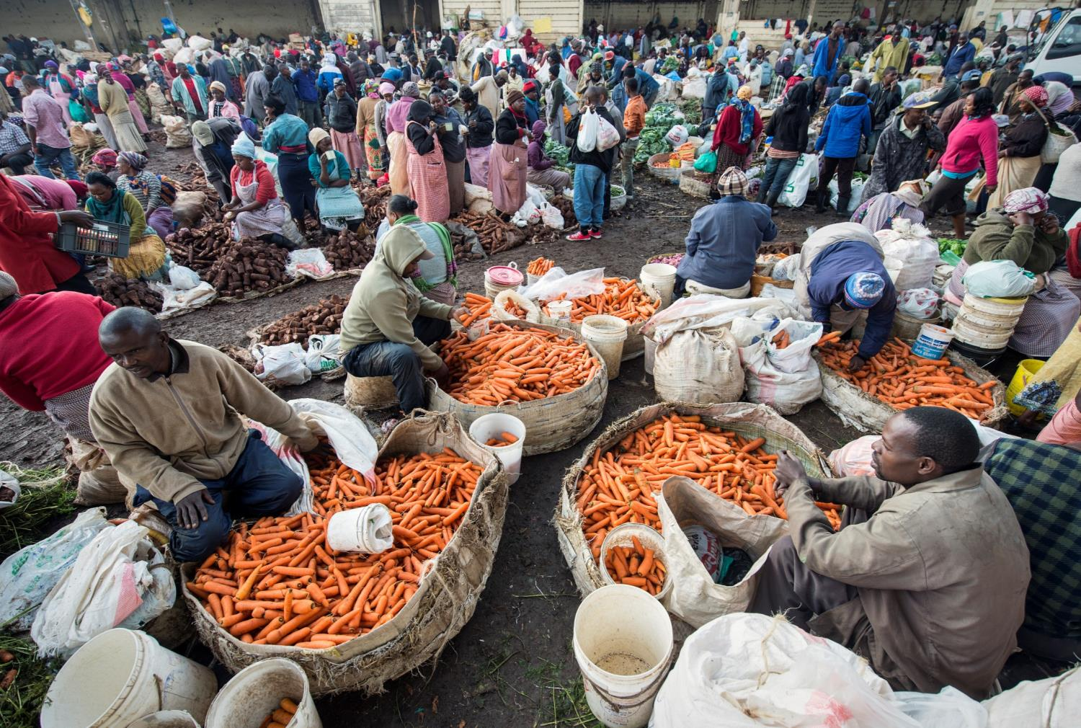
But there are challenges…
“An ounce of trade can be worth a pound of aid.”
Ban Ki-moon, Secretary-General of the UN

Slide 7
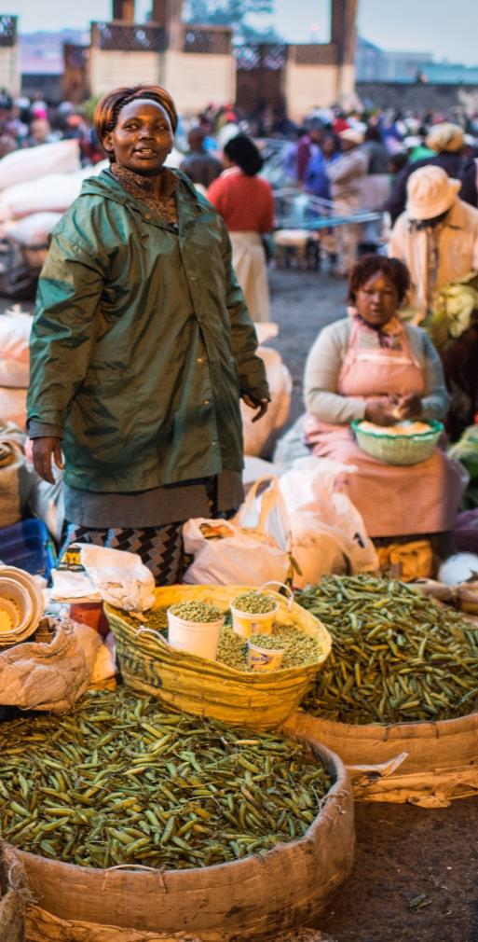
Challenges and Issues
  Quality inputs
  Product quality and safety
  Post harvest, marketing and value addition
  Efficient and effective regulation
  The issues
  Solutions from CABI

Slide 8
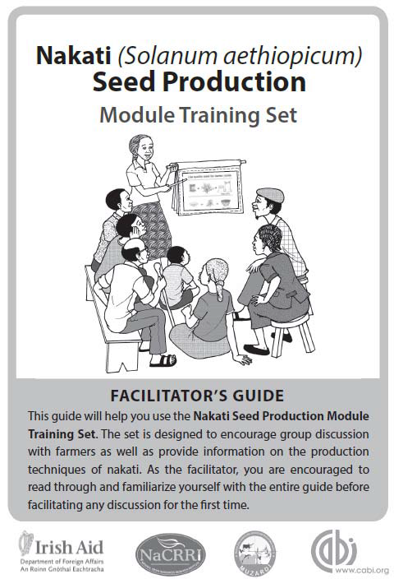
Quality Inputs
  Quality seeds for market-oriented production
      Good seed initiative
  Agrochemicals – fertiliser, pesticides
      ASHC/OFRA
      Promoting FAO’s Code of Conduct (Plantwise)
  Access to credit
      Credit guarantee scheme for coffee growers

Slide 9
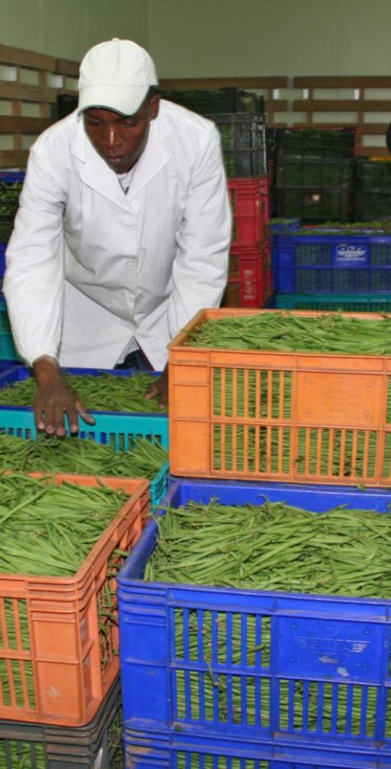
Product Quality and Safety
  Meeting public and private standards
      Ghana horticultural exports project
      Cocoasafe in Asia
  Improving safety of food
      Aflatoxin reduction
      Contaminants in cocoa

Slide 10
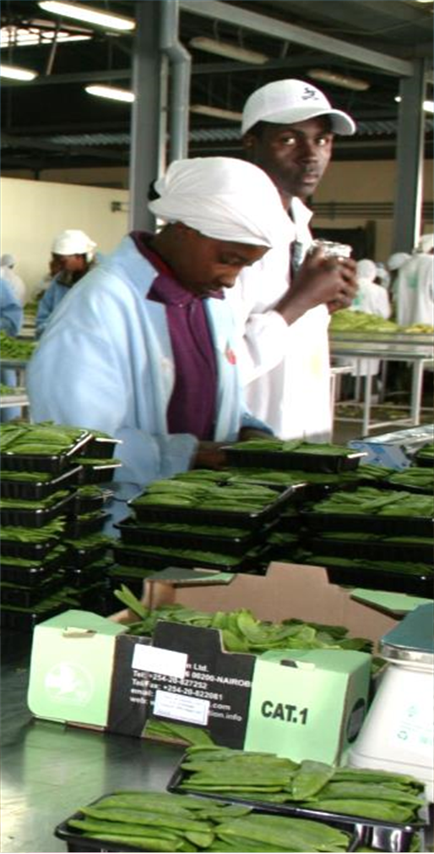
Post Harvest, Marketing and Value Addition
  Information
      Direct to Farm (D2F), Café Movel
  Post-harvest storage
      Biopesticides for stored grain pests
  Producing for higher value markets
      IPM-tomatoes in Tanzania

Slide 11

Efficient and Effective Regulators
  Biosecurity capacity
      Australia-Africa plant biosecurity partnership
      Oil palm biosecurity strategy
  Public-private cooperation
      Uganda floriculture for EU markets
  Implementation of SPS measures
      COMESA “Breaking barriers, facilitating trade”

Slide 12
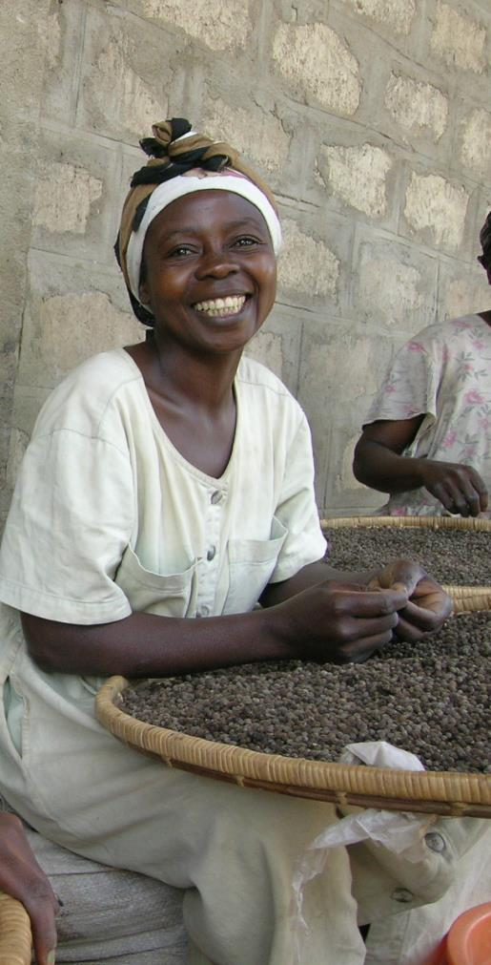
Conclusions
  Trade can help achieve both food security and economic goals
  There are big opportunities, but difficult challenges especially for smallholders
  All of CABI’s themes support trade and market access
  CABI’s expertise needs to be deployed in an integrated way

Slide 13
Notes:
thank you slide
changes only to name, centre & email
Arial24bold, light green
Please let us know if there are any languages you wish to add to this slide
no change to be made to image

