Slide 1
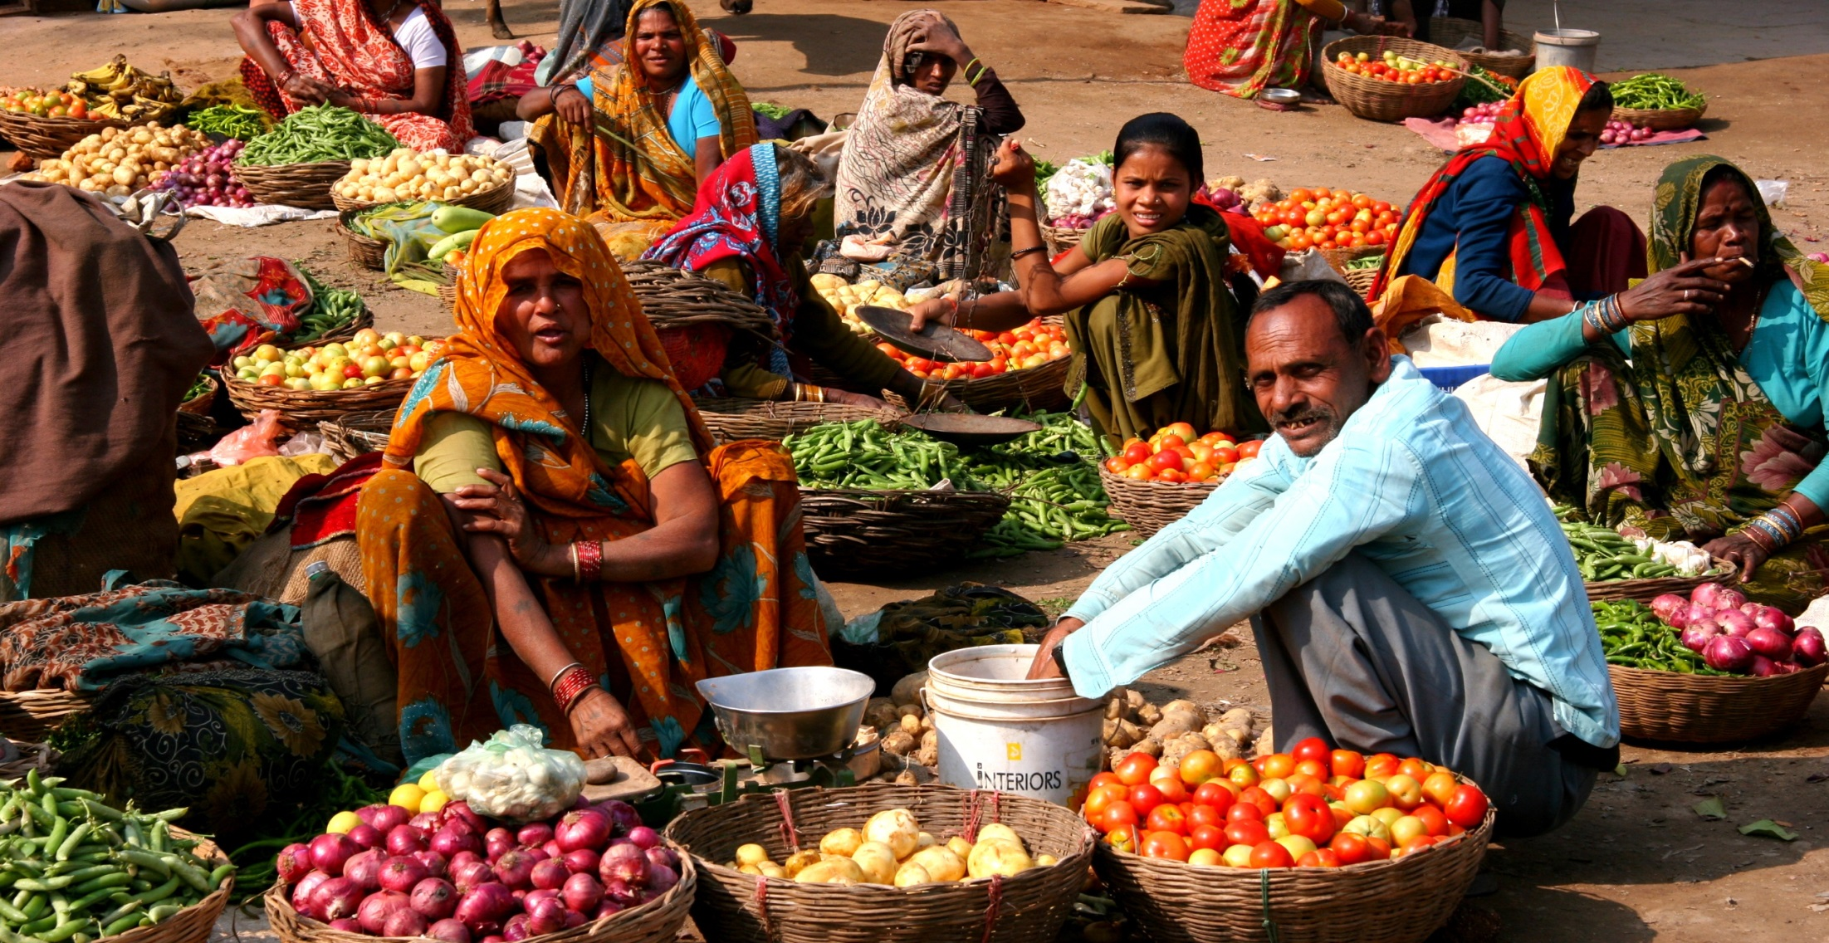
CABI
Going the extra mile
Helping smallholder farmers lose less and grow more
Africa Regional Consultation, October 2015, Trevor Nicholls, CEO

Slide 2
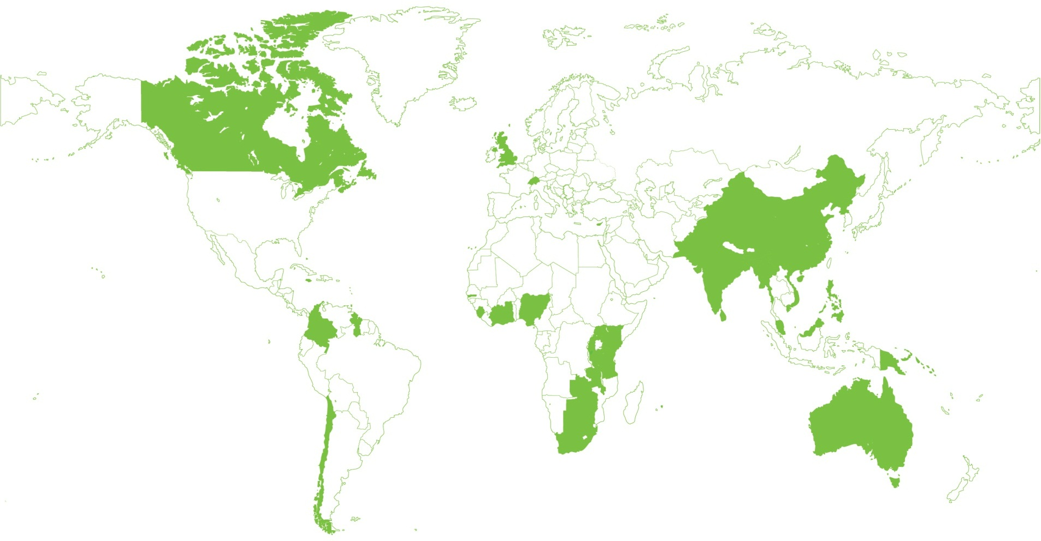
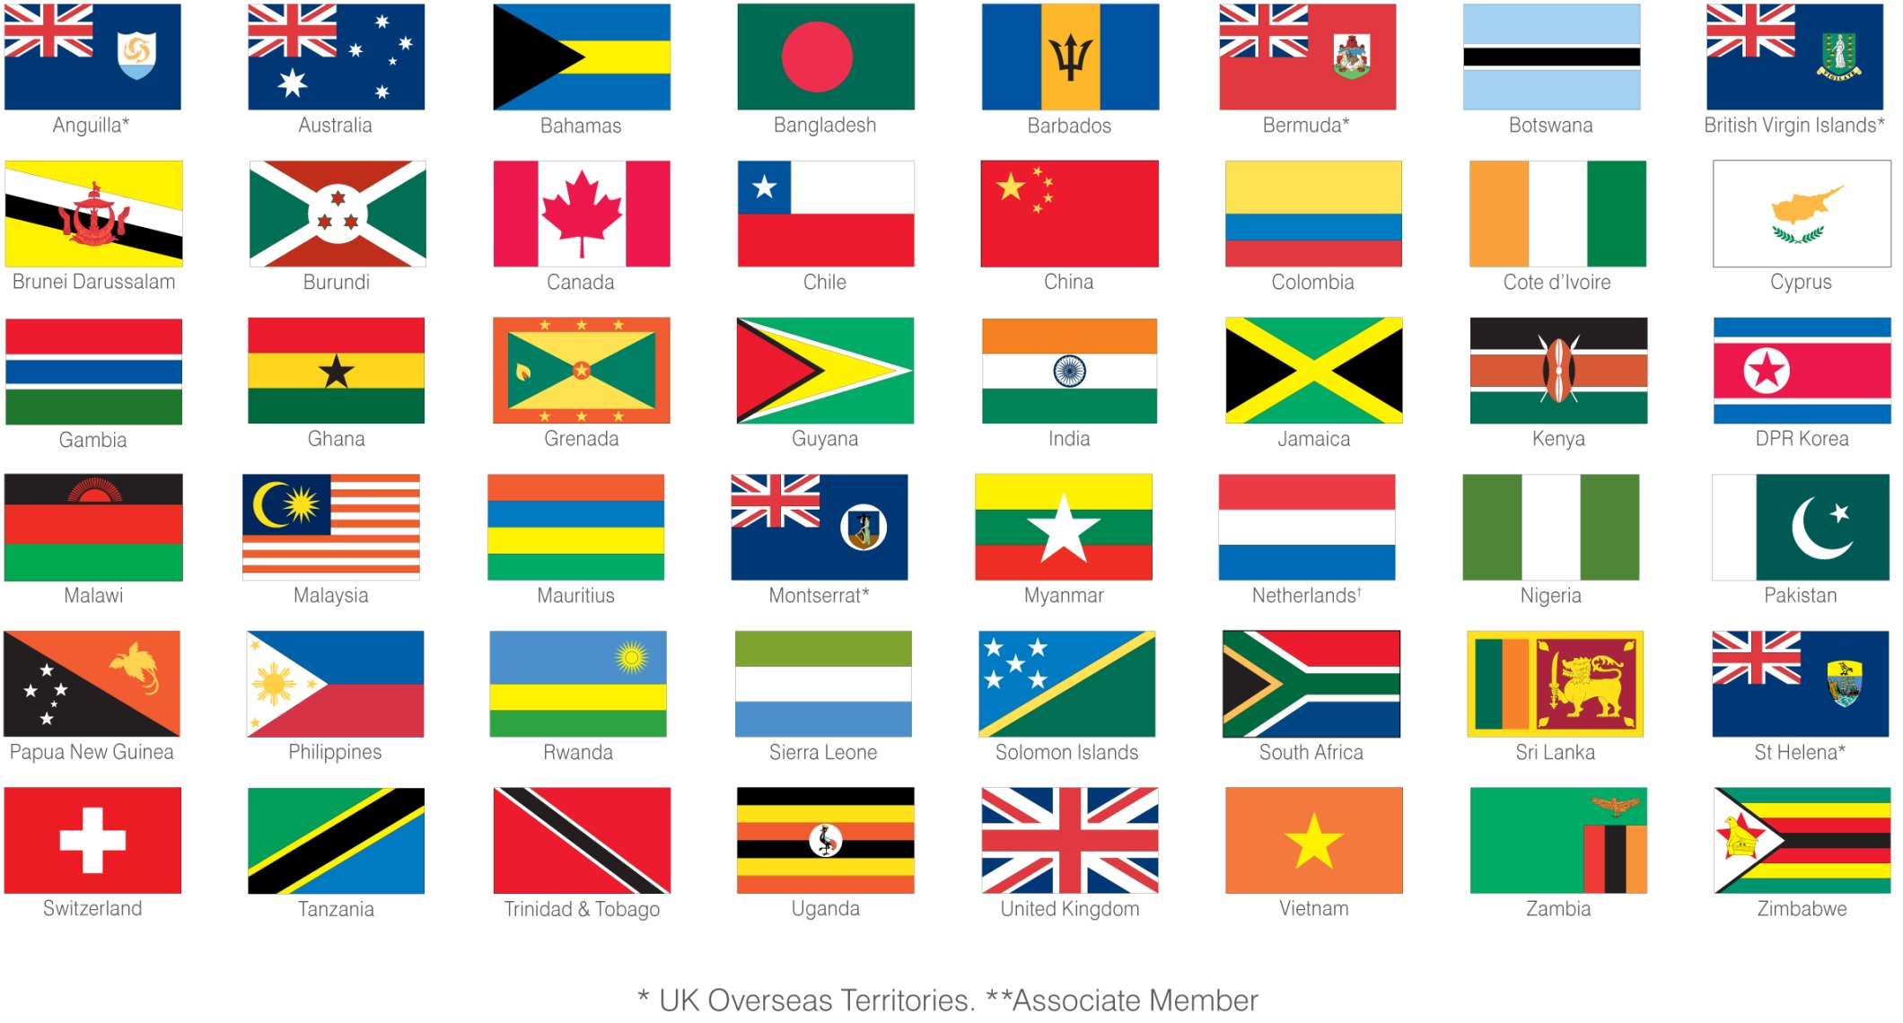
We work on behalf of 48 member countries

Slide 6
By 2050….
There will be nearly 10 billion people on the planet
We will need to produce 60% more food
Over 60% of the population will be living in cities
Nearly 40% of the population will be under 18%
But….
40% of the population will still be working in agriculture
Smallholders and family farms will produce over 70% of world food
Over 1 billion people will still be at risk of malnutrition and hunger
“Increasing smallholder farmers’ productivity and access to markets can have a profound impact on the livelihoods and general prosperity of literally millions of the world’s poor” – World Bank

Slide 7
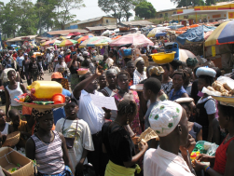


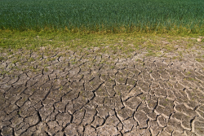
The perfect storm……
Growing world population
Climate change
Dwindling mineral resources
Water shortage

Slide 8
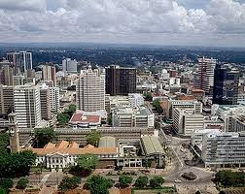
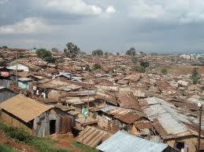
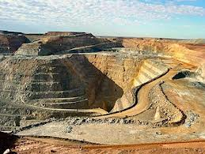
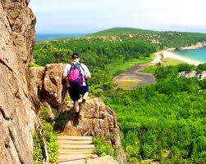

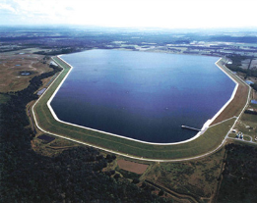
…. in the face of greater competition for land use

Slide 9

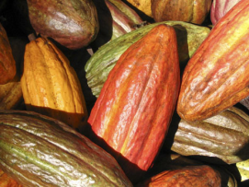
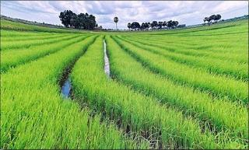
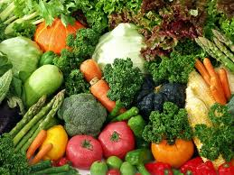
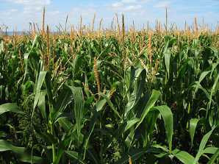
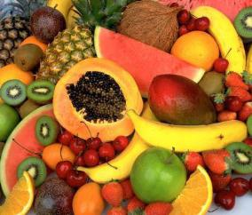
Man cannot live by cereals alone…..

Slide 10
Information and Knowledge are key
Investment in breeding programmes for rice, maize and wheat will not address the problem.
We can make major improvements in food and nutritional security by losing less of what we already produce – without any more land, water or inputs.
Much of the information farmers need is already available but not accessible.

Slide 11
Consolidated priority areas and issues 2012-13
Priority Areas | Priority Issues
Trade and market access and development | SPS compliance; Value-chain focus and postharvest value-addition; GAP and best practices promulgation, and capacity building; Commercialization and contract farming.
Knowledge management, communication and use | Technology transfer (particularly amongst member countries, and south-south); Sharing knowledge amongst stakeholder groups including youth and grassroots (Facebook Agriculture); Mobile advisory services; Improving communications to farmers; Evidence-based policies. Archiving and managing institutional research information.
Plant health | Managing a range of stressors including pests (IPM), water, and soil nutrients; IPM in high value crops; reduction in pesticide inputs; early warning systems for newly emerged/key pests & diseases.
Biodiversity and invasive species management | Invasive management; Capacity building of IS identification and diagnostics; habitat manipulation/agro-biodiversity enrichment Microbial resource collection, characterization and utilization; Development and production of biopesticides, and implications of biopesticides use.
Cross-cutting: Climate smart agriculture Institutional capacity building Publication of, and access to, authoritative information resources

Slide 12
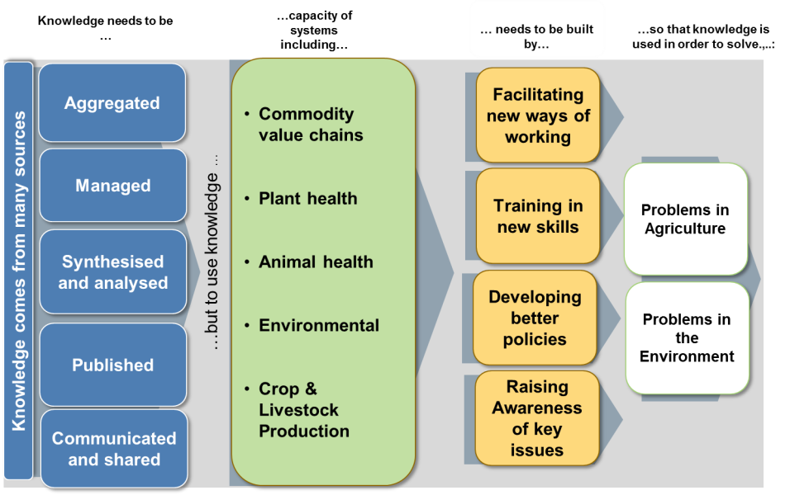
CABI Theory of Change
Knowledge needs to be…
… to build capacity in…
… through …
… in order to solve…

Slide 13
Strategic Goals - Focus on SDG’s 2,12 &15
Greater food and nutrition security
Increased farmer incomes
More sustainable farming practices
Protection of environment and biodiversity

Slide 14
Competencies, Content and Channels
Print
Electronic
Mobile
Video
Clinics
FFS
Personal
Communicating Science to Build Knowledge & Capability
Human
Health
(Nutrition)
Plant Health
Pests & Disease
Seed
Health
Soil
Health
Animal
Health
Environmental
Health
Defensive
Offensive
crops
invasives

Slide 15
Communicating with farmers – greater reach, frequency and impact
Individual
farm visits
Farmer
field schools
Mass
media
Impact
Reach

Slide 16
Communicating with farmers ….. complementary channels for impact
Individual
farm visits
Farmer
field schools
Plant clinics
Mobile
Internet &
Social Media
TV, Radio
Videos
Impact
Reach

Slide 17
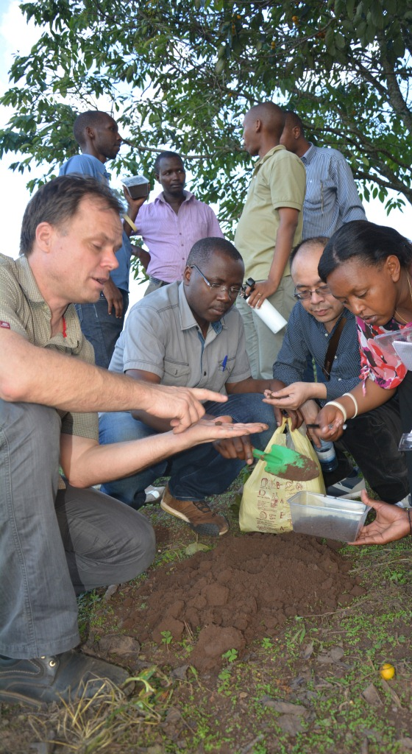
Effective delivery
Information and knowledge needs to be delivered to farmers in ways that are:
Appropriate, relevant and affordable
Timely and understandable
User-centric
Holistic – cover all farm activities, not just one or two crops
Market related – enable farmers to realise the value they create

Slide 18
Creative partnerships for success
Local leaders
(RAB, DPRK)
Technology providers
(CABI, IPP-CAAS, GEI)
Capacity builders
(CABI, Chinese and local scientists)
Farmers
M & E on outcomes, impact, quality control
(CABI, Chinese and local experts)
Dissemination by Agricultural Extension
(CABI, plant doctors, Mass extension campaigns)
Notes:
A trilateral research partnership has been set up to develop and provide smallholder farmers access to an environmentally friendly, biologically-based pest management solution
Soil pest research team, Institute of Plant Protection, Chinese Academy of Agricultural Sciences, Beijing, China
Research group on entomopathogenic beneficial nematodes (basic science, identification, production), Guangdong Entomological Institute, Guangzhou, China
Research stations and extension from Rwanda Agricultural Board, Ministry of Agriculture MINAGRI, Kigali, Butare, Rwanda
Project coordination, communication, management, CABI China
Local project implementation support, socio-economic baselines, CABI Africa
Factory establishment for beneficial nematodes, CABI Switzerland
M and E, CABI UK
Plantwise Rwanda (not officially part of the project, but used for dissemination to farmers)

Slide 19
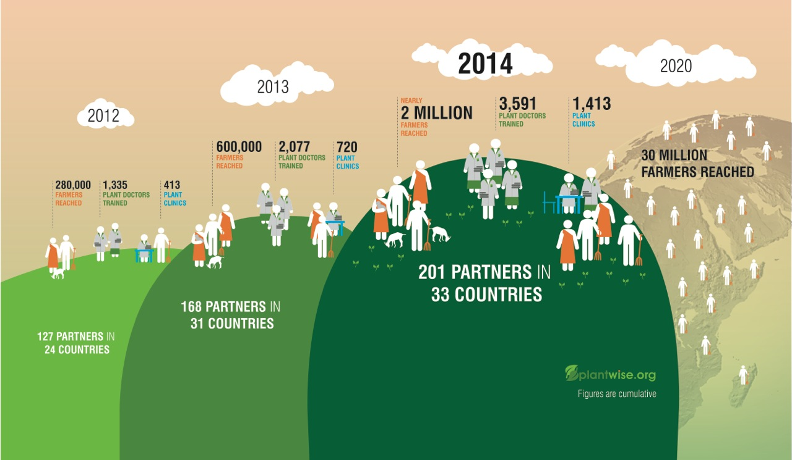
Progress to date

Slide 20
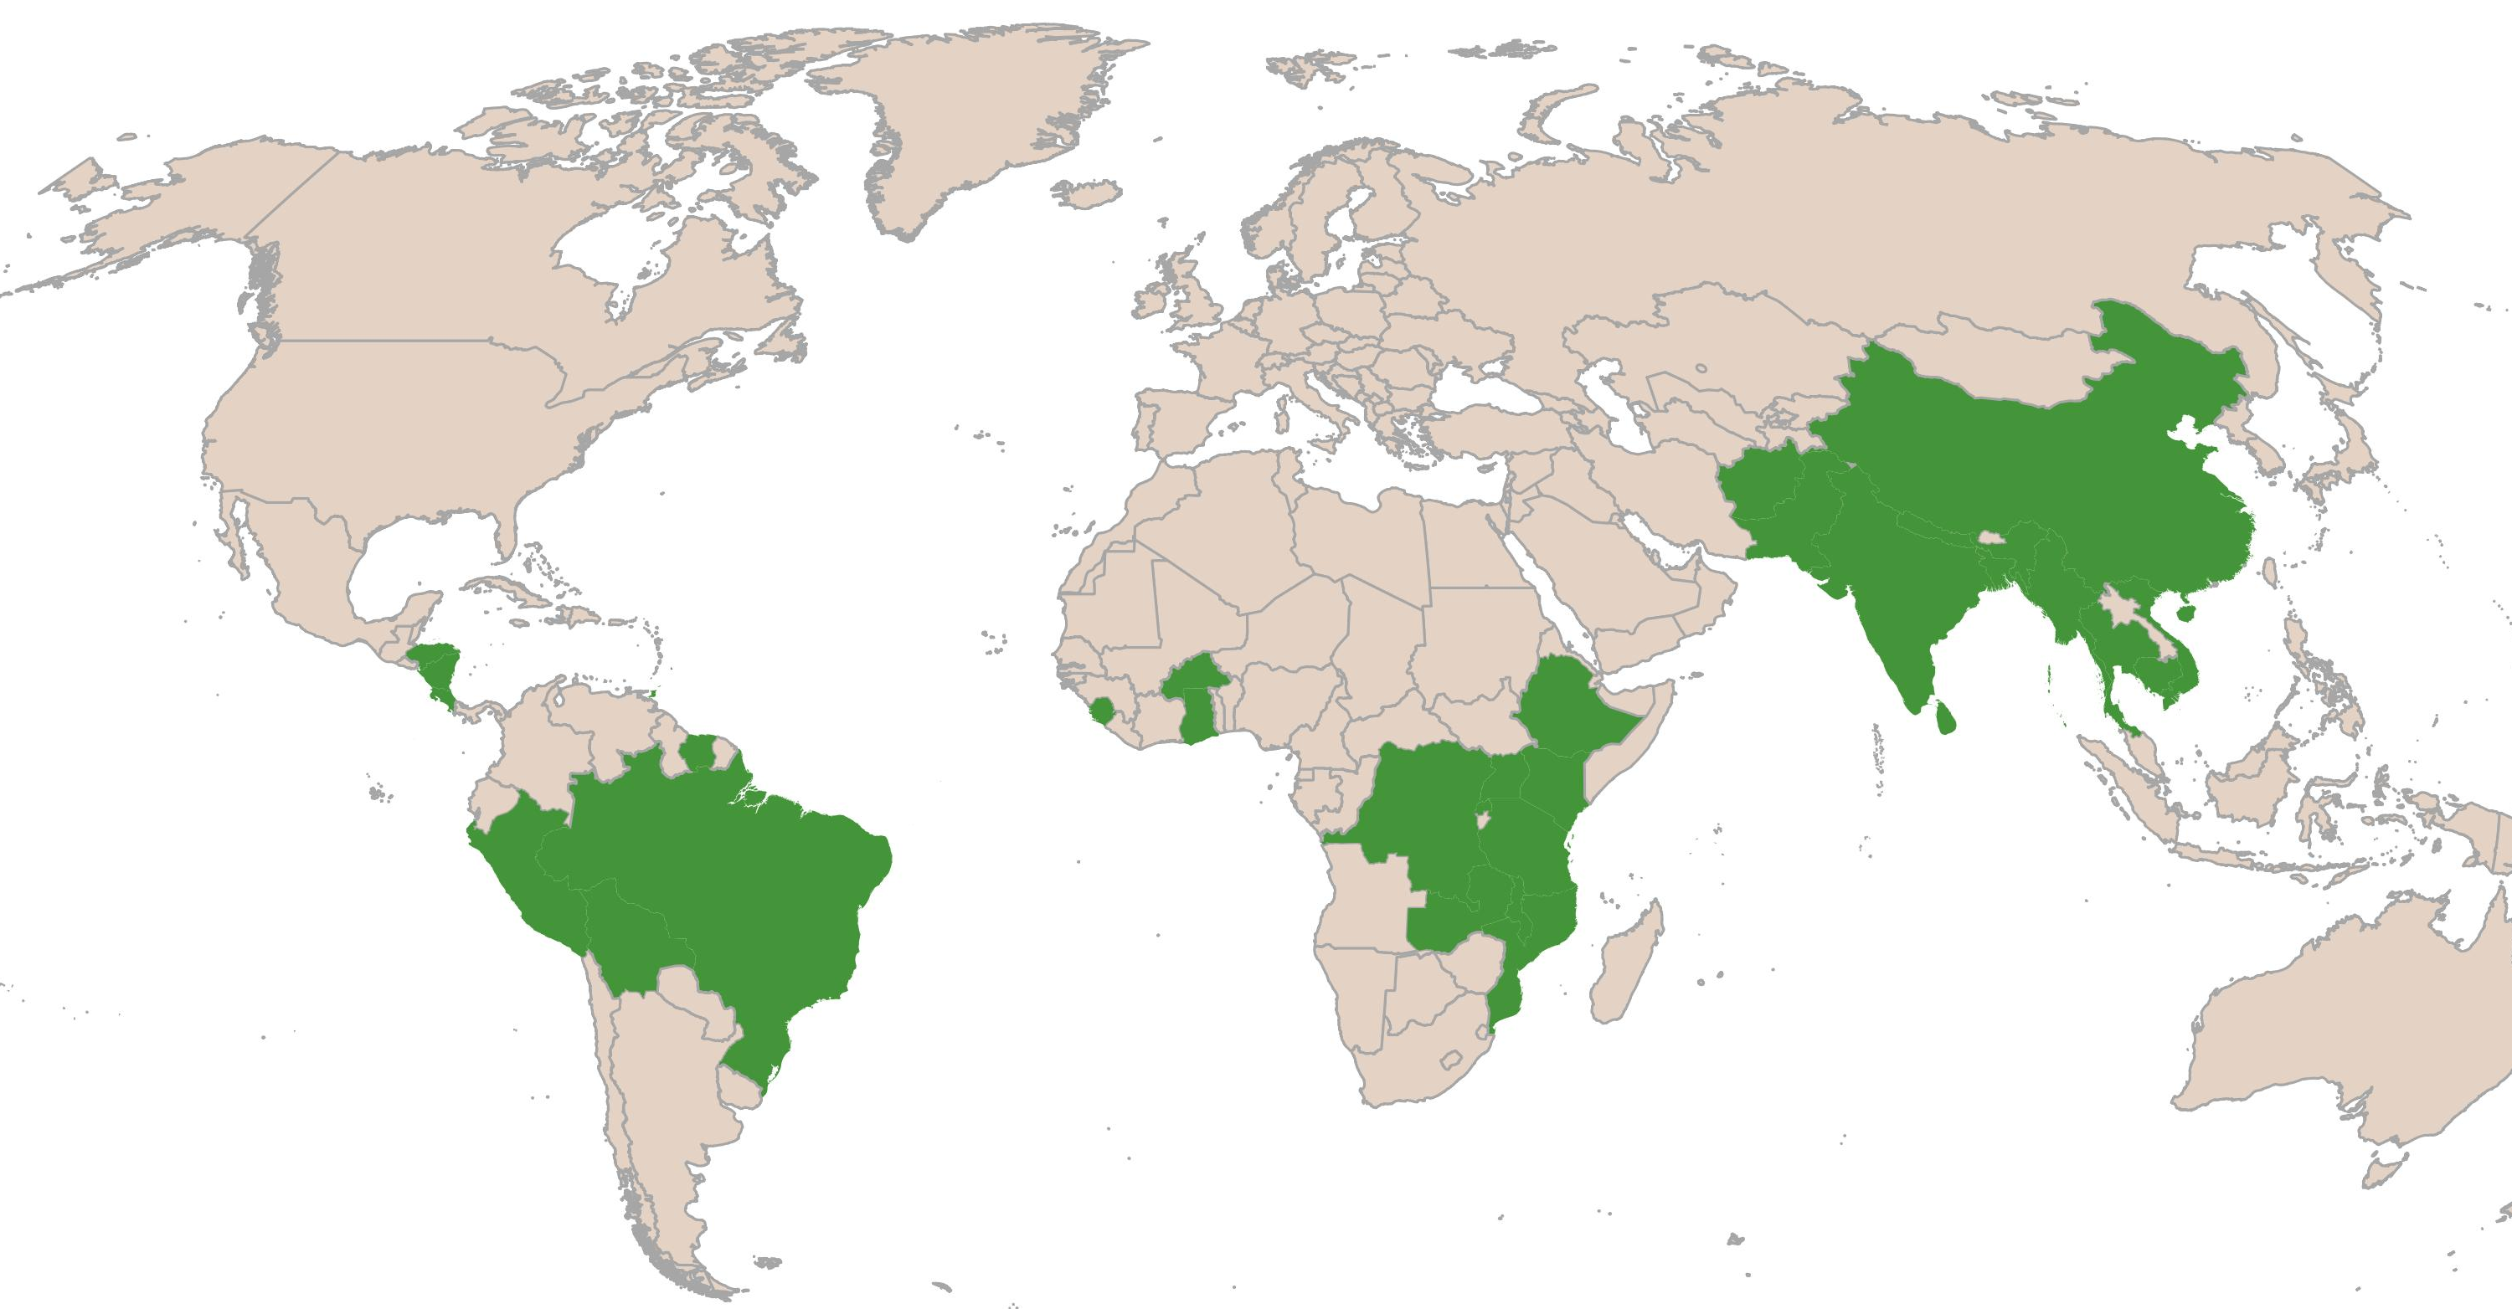
Current Plantwise countries
Central & West Asia
Afghanistan
Pakistan
East Asia
China
Caribbean & Central America
Costa Rica
Honduras
Nicaragua
Barbados
Grenada
Suriname
Trinidad & Tobago
West Africa
Burkina Faso
Ghana
Sierra Leone
South Asia
Bangladesh
India
Nepal
Sri Lanka
Southeast Asia
Cambodia
Myanmar
Thailand
Vietnam
Eastern & Southern Africa
DR Congo
Ethiopia
Kenya
Malawi
Mozambique
Rwanda
Tanzania
Uganda
Zambia
South America
Bolivia
Brazil
Peru

Slide 21

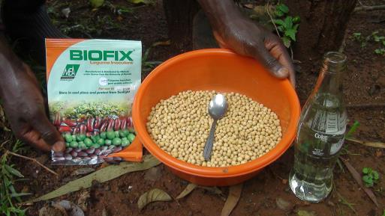
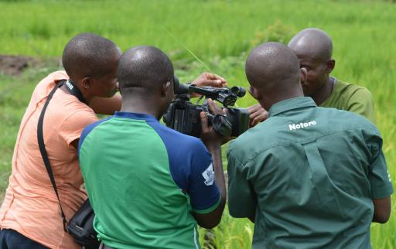
Public and private partners
Private sector (Local SME’s)
Very willing to co-invest in materials production and dissemination that meet their promotional needs
Private sector focused on own products / less likely to welcome creative commons
Have real demand for information products, financial capacity, and the necessary extension networks to reach large number the small-holder farmers (last-mile)
Public sector (National & International)
Limited resources for implementation or materials (Ethiopia a possible exception)
Have a mandate for objective delivery; are trusted and have extensive networks
Inoculant pack inserts for MEA now in use – Kenya , June 2014 now in use
Filming with Notore – Nigeria, March 2014

Slide 22
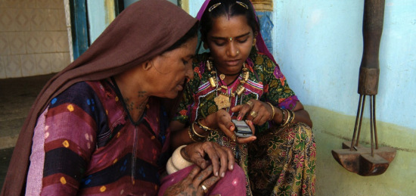
For the Rural Poor, Mobile Phones provide Information, Communication & Entertainment

Slide 23
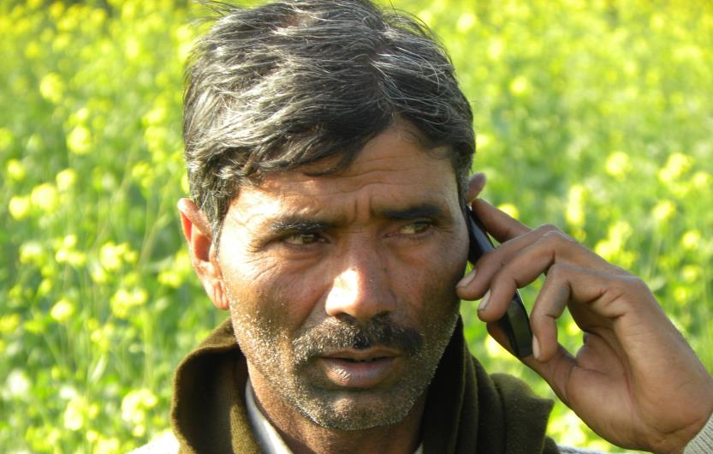
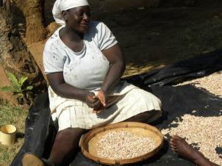
CABI Mobile Experience
IKSL (India)
Partnership with IFFCO & Airtel
Content & QA role
4 million subscribers
GSMA mAgri Program (India)
1.6 million farmers trialled, 350k active subscribers
CABI + ILRI, Digital Green, Handygo
Africa: GSMA mAgri Programme
Airtel in Kenya;
ESOKO in Ghana.
Pakistan:
Delivery of‘New and Emerging Technologies’ grant for mobile agro-advisory services,
CaféMóvel
mExtension for 150,000 coffee growers in India; launched July 2013
Funded by Coffee Board of India, ICO, CFC

Slide 24
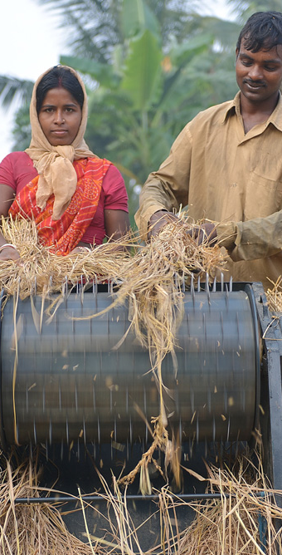
CABI Direct2Farm
Mobile Value Added Service for Agriculture
Provides “actionable information” on agriculture
Repurposed and personalised
Will serve messaging, video, mobile radio
Holistic information brokerage
Real-time information exchange
Value chain focus
Tailor-made to unique user/business needs
Cost effectiveness & scalability
Can be plugged in to existing services
Outreach at scale with minimised costs
Complements conventional agri-extension Complements other CABI activities
Notes:
CABI’s mission is to help farmers solve their problem; with Direct2Farm service, we aim to reach large number of farmers, mainly smallholders, dispersed across land, with high quality information and tailor made knowledge tips, to help them solve problems on crop loss, climatic challenges, and yield improvement. This service, is designed in a way that it does not depend on intermediaries and can establish “Direct Link” between farmers and other stakeholders.

Slide 25
Sustainability challenges
Development Funding
Awareness
Funded Project Mode
Awareness generation
Content Development
Free Trials
Training & Capacity Building
Handholding
Monitoring & Evaluation
Trials
Usage & Engagement
Investment Funding
Benefit Realization
Referrals
Self sustainable Enterprise Mode
Engagement with private business
Business 2Business activity over value chain
Replicable enterprise model
Adoption by entrepreneurs
Revenue
Profit
Upscale
Social Capital

Slide 26
Building alliances to span the value chain
Awareness
Interest
Demand
Action
Goal
Selection Choices
Mix of crops
Crop production techniques
Processing Methods
Post-harvest handling
Spending Decisions
Choice of which foods are bought
Better outcomes for families
Access to inputs
Links to markets
Storage
Food preparation & consumption
Animal care
Method
Knowledge & technology partners
M
Local health workers
M
P
Stakeholders
Field clinics
P
Private sector
M
Notes:
main heading – 32bold green – no more than 2 lines
text – 24/20 dark grey.
if you need smaller than a 20 THERE IS TOO MUCH ON YOUR SLIDE
The “indent” (increase list level) button creates bullets
please do not use the “bullet button”
bullets should not end in punctuation e.g. : or . or ; or …
bullets can end in ! or ?
green may be used to emphasise words
TO ADD MORE SLIDES in Office2007 use the ‘New Slide’ dropdown on the ‘Home’ ribbon

Slide 27










A landscape alliance
An alliance with 9 founding members
Established 2012, launched at GCARD2 in Uruguay
Focused on improving global food security by supporting smallholder agriculture within healthy, sustainable & climate-smart landscapes
Combined turn-over in excess of US$ 200 million p.a.
>60 member countries comprising >70% of world population
On-going R&D activities in all major regions & ecosystem types

Slide 28
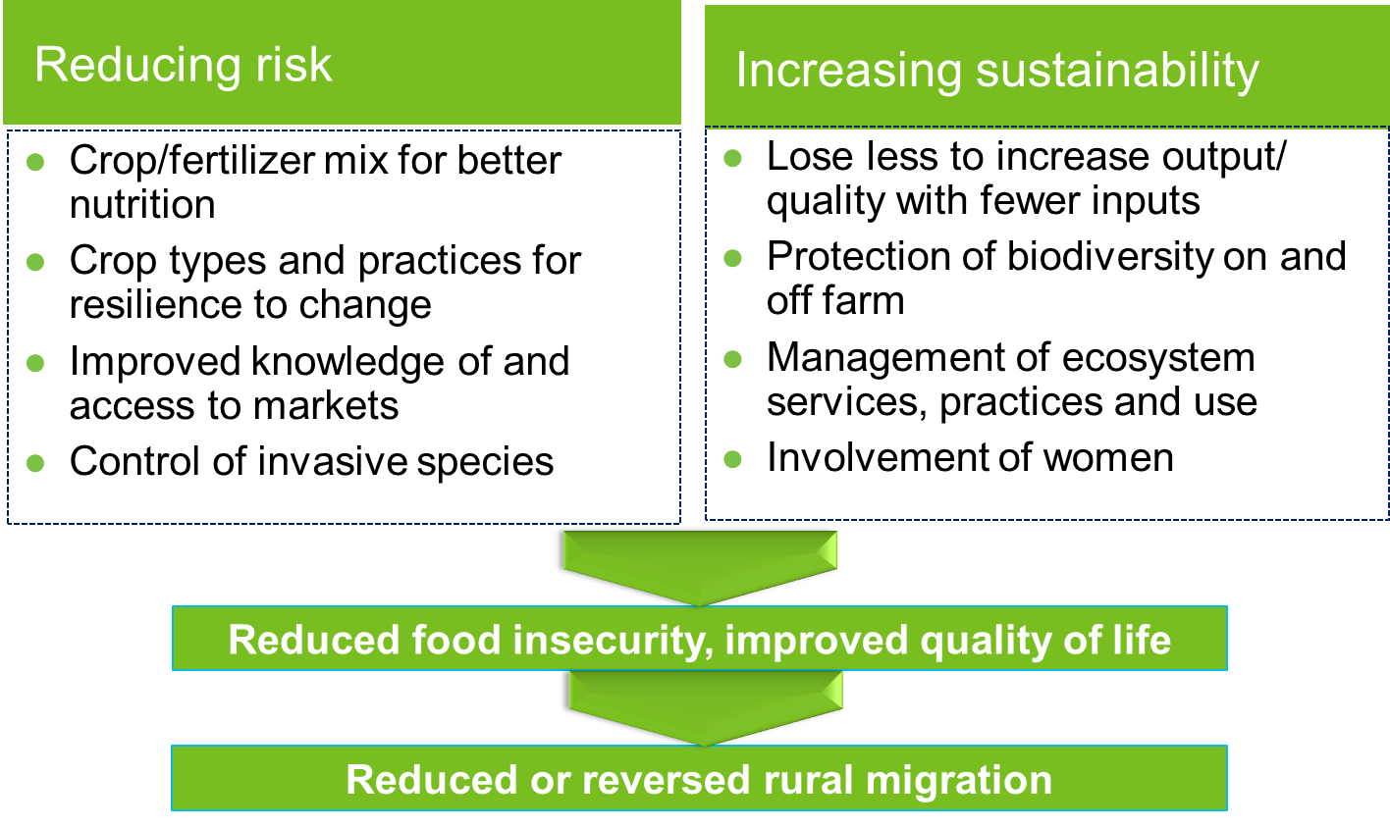
Healthy landscapes –making rural communities more viable

Slide 29
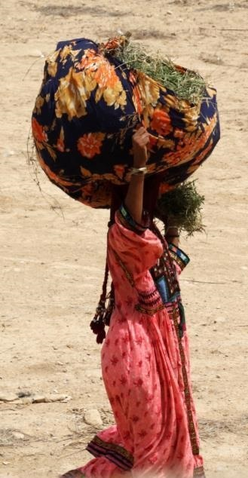
Vision 2020:
to be the place to go for information on agriculture and the environment
CABI to be the domain experts
to be the starting point of every users knowledge discovery journey
to be embedded in a greater part of the users workflow

Slide 30

CABI in 2020 – healthy, sustainable agriculture
Digitally powered
Weeds & Invasives
Nutrition
Soils
Trade and market access
Seeds
& plant health
Gender sensitive
Integrated and sustainable
Mobile/ICT
Climate smart

Slide 31
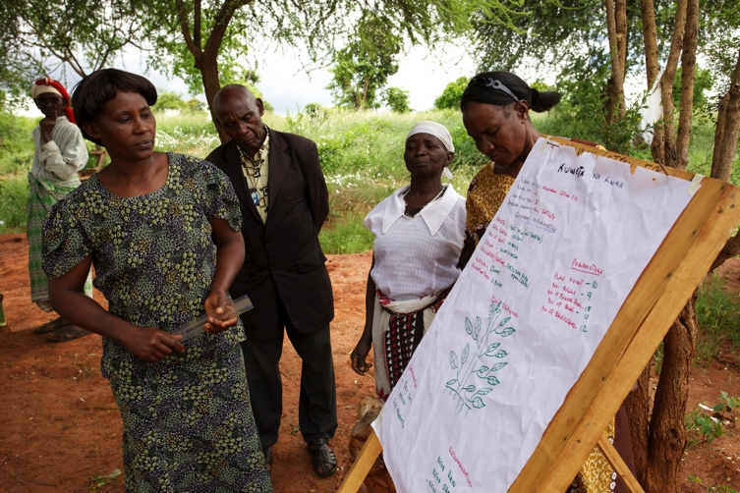
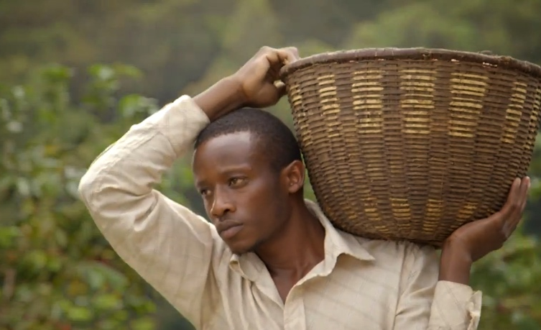
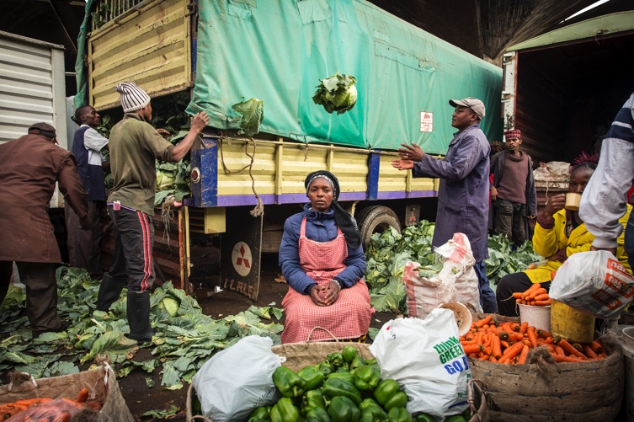
Step change in M & E
Global Director, M&E recruited in Africa with regional support staff
Strategy, systems, and approach now in place
Rigorous framework for projects of value >£250K
Tracking of project implementation: Guided by PRINCE2
Improved M&E within projects: Guided by project log frames
Log frames track progress and milestones at the thematic/programme level
Monitoring Progress towards Medium Term Strategic Goals with CABI-wide KPIs
Annual targets for publications showing impacts at scale :
3 ex-post impact evaluations
6 high quality case studies
2 journal papers published

Slide 32
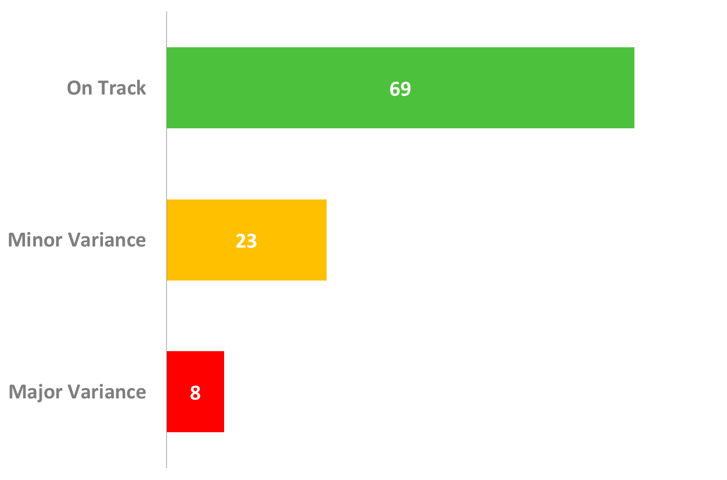
Progress of Medium Term Strategy
% of output indicators
Project delays or lower than expected outputs
Funding constraints
Partner delays
Lack of capacity in country of work
Delayed impact
Delays in Publishing new products due to platform renewal
Instability in countries causing project suspension
Change in donor priorities

Slide 33
Continuing growth, improving efficiency

Slide 34













Key Donors

Slide 35
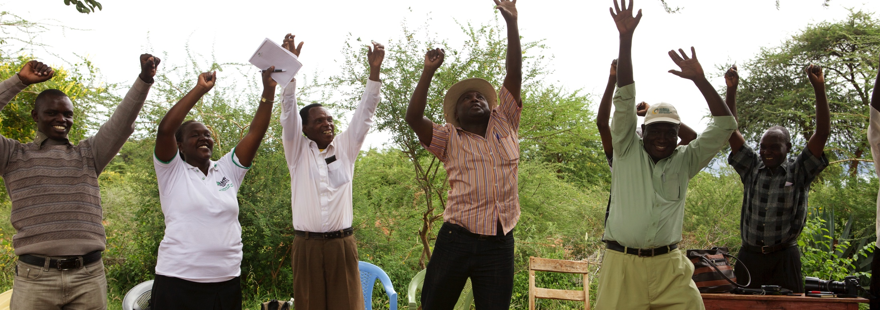
Trevor Nicholls, CEO
t.nicholls@cabi.org
Notes:
thank you slide
changes only to name, centre & email
Arial24bold, light green
Please let us know if there are any languages you wish to add to this slide
no change to be made to image

