Slide 1
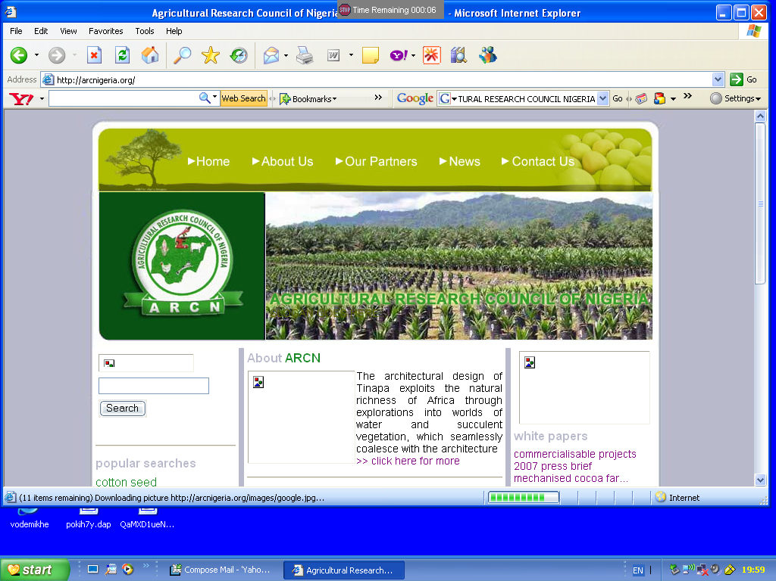
AGRICULTURAL RESEARCH COUNCIL OF NIGERIA
CABI AFRICA MEMBER COUNTRY CONSULTATION
LUSAKA, ZAMBIA
14TH OCTOBER 2015

Slide 2
AGRICULTURAL RESEARCH COUNCIL OF NIGERIA
OVERVIEW OF THE NIGERIAN NATIONAL AGRICULTURAL RESEARCH & EXTENSION SYSTEM
Nigeria has the largest Agricultural Research system in SSA
18 National Agric. Research Institutes, NARIs (15 under the aegis of ARCN)
17 Federal Colleges of Agriculture (11 under ARCN)
19 State Colleges of Agriculture
3 Universities of Agriculture
47 Faculties of Agriculture in both State and Federal Universities
10 Faculties of Veterinary Medicine
5 International Agricultural Research Centers present in Nigeria
(IITA, AfricaRice, ICRISAT, IFPRI and ILRI)
Several Organized Private Sector (OPSs), Non Governmental Organizations (NGOs), Community-Based Organizations (CBOs), Faith-Based Organizations (FBOs)

Slide 3
AGRICULTURAL RESEARCH COUNCIL OF NIGERIA
All NARIs are owned by the FG while each of the 36 states are divided into Extension Zones, Blocks and Cells
The Extension Workers & Subject Matter Specialists (SMSs) of the States Agric. Dev. Projects (ADPs) depend on NARIs for most technologies
Nigeria is divided into 5 Ecological Zones; 5 Regional Coordinating Research Institutes oversee the research need and coordinate farming system research activities of each ecological zone
Research-extension linkages are promoted at regional levels through regional research-extension committees and quarterly technological review meetings involving SMSs
The National Agric. Extension Research & Liaison Service operates through the Programmes of each NARI and NAERLS Regional Offices

Slide 4
AGRICULTURAL RESEARCH COUNCIL OF NIGERIA
NIGERIA’S PAST PARTNERSHIP WITH CABI
Nigeria is one of the founding member of CABI.
In those period, Nigeria has benefited from her partnership with CABI in form of:
Expertise in the control of pre- and post-harvest pests of crops
Environmental sustainability through the use of CABI technologies in the country
Nigerian scientists have benefited from annual capacity development activities of CABI in form of short courses, workshops, seminars, etc.

Slide 5
AGRICULTURAL RESEARCH COUNCIL OF NIGERIA
NIGERIA’S PRESENT PARTNERSHIP WITH CABI
In recent time,
Research organizations in Nigeria have continued to benefit from CABI’s publications
Some project being implemented in Nigeria. These include:
Africa Soil Health Consortium (ASHC): This brings together experts in soil health, and brings communications expertise and experience of working with farmers.
ASHC is being implemented in 5 countries including Nigeria from June 2015 – June 2019.

Slide 6
AGRICULTURAL RESEARCH COUNCIL OF NIGERIA
NIGERIA’S PRESENT PARTNERSHIP WITH CABI CONTD.
Institutionalizing the quality of commercial products:
CABI, working with partners, is supporting increased knowledge and information available to smallholder farmers and decision makers on commercial bio fertilizers and bio pesticides.
This is in order to support uptake and use and support regulatory mechanisms.
Implemented in 6 countries including Nigeria from July 2012 – Dec. 2016.

Slide 7
AGRICULTURAL RESEARCH COUNCIL OF NIGERIA
NIGERIA’S PRESENT PARTNERSHIP WITH CABI CONTD.
mNutrition: Addressing hidden hunger through mobile messaging.
Helping to combat the problem of hidden hunger,
CABI and its partners in the DFID mNutrition initiative are developing content for a mobile phone-based messaging service.
Aimed at increasing knowledge of nutrition and health within communities in 14 countries, including Nigeria.
The project is being implemented from May 2014 – May 2017

Slide 8
AGRICULTURAL RESEARCH COUNCIL OF NIGERIA
NIGERIA’S PRESENT PARTNERSHIP WITH CABI CONTD.
CABI’s Direct2Farm mobile enabled information service.
Provides agro-advisory services across India and Africa
Compliments existing field-based extension services operated by governments and private industry
Nigeria is among the countries to participate in the second phase

Slide 9
AGRICULTURAL RESEARCH COUNCIL OF NIGERIA
NIGERIA’S NATIONAL PRIORITIES IN AGRICULTURE & ENVIRONMENT
1. Nigeria’s Environmental Priority
Reduce Nigeria's vulnerability to the negative impacts of climate change through minimizing risk, improving local and national adaptive capacity and resilience, leveraging new opportunities and facilitating collaboration with the global community

Slide 10
AGRICULTURAL RESEARCH COUNCIL OF NIGERIA
NIGERIA’S NATIONAL PRIORITIES IN AGRIC. & ENVIRONMENT
2. Nigerian Agricultural Policy Focus – Agriculture as a business
Land and agricultural input support
Agricultural Value Chains development - Priority commodities including cocoa, rice, cassava, sorghum, cotton, maize, livestock and fisheries, etc.
Post harvest and processing, marketing and utilization
Agricultural Research and extension system development
Food and nutrition
Climate Resilient agricultural development
Agricultural risk sharing and insurance

Slide 11
AGRICULTURAL RESEARCH COUNCIL OF NIGERIA
NIGERIA’S NATIONAL PRIORITIES IN AGRIC. & ENVIRONMENT
3. Nigeria’s Agricultural Research Focus/Priorities:
Reduce poverty and increase food security by contributing to the establishment of sustainable agricultural growth and development in Nigeria
Development and dissemination of demand-driven agricultural technologies
Establishment of agricultural knowledge management system
Capacity strengthening
Appropriate agricultural policy options, markets and competitiveness
Cross-cutting: Environmental sustainability, gender mainstreaming, pro-poor, pro-health, agricultural innovation systems

Slide 12
AGRICULTURAL RESEARCH COUNCIL OF NIGERIA
NIGERIA’S NATIONAL PRIORITIES IN AGRIC. & ENVIRONMENT
Relationship with the priorities of CABI:
CABI Nigeria
Improving food security -Increase food security
Supporting farmers -Technologies development and dissemination; Capacity strengthening
Protecting biodiversity -Sustainable agricultural growth
Providing information -Knowledge management system

Slide 13
AGRICULTURAL RESEARCH COUNCIL OF NIGERIA
OPPORTUNITIES & MECHANISMS TO FURTHER STRENGTHEN PARTNERSHIP WITH CABI
Areas of CABI’s activities to complement efforts in Nigeria
Providing easy access to plant clinics and diagnostic information
Help Nigerian farmers to improve their crop quality and yield.
‘Good Seed Initiative’
Encouraging higher investment in smallholder farmers
Combating invasives and plant pests
Advising on global trade and quarantine issues
Training farmers on the best methods for harvesting and processing
Advising on good agricultural practice and market access
Ensuring farmers benefit from scientific research interventions
Using ICTs to make information available to support farmers
Production of leading agricultural resources

Slide 14
AGRICULTURAL RESEARCH COUNCIL OF NIGERIA
OPPORTUNITIES & MECHANISMS TO FURTHER STRENGTHEN PARTNERSHIP WITH CABI
Prioritize areas of intervention in the country
Inclusion of more agricultural research institutions in the interventions
Wider circulation of scientific information from CABI in Nigeria
Improving on communication between CABI and Nigeria
Complementing national government research & extension initiatives in the country

Slide 15
AGRICULTURAL RESEARCH COUNCIL OF NIGERIA
OPPORTUNITIES & MECHANISMS TO FURTHER STRENGTHEN PARTNERSHIP WITH CABI
It is important for CABI to adequately inform ARCN of its interventions/initiatives in Nigeria
This would help in tracking the progress of the interventions

