Slide 1
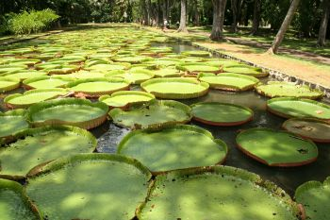
CABI African Member Country Consultation
Mr V Punchoo
Chief Agricultural Officer
Agricultural Services
Ministry of Agro Industry and Food Security
Republic of Mauritius

Slide 2
Mauritian Government Policy
To ensure food security
50% of local agricultural produce organic by 2020
Use of environment friendly techniques for crop protection

Slide 3
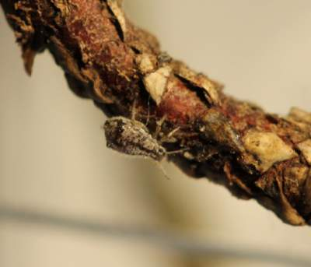
Biological control of the cypress aphid, Cinara cupressivora
In January 1999, the cypress aphid, Cinara cupressivora, was detected in Mauritius.
A major pest of cypress
Pauesia juniperorum introduced from KEFRI, Kenya Forestry Research Institute in 2001 with the support of CABI

Slide 4
Request for microbial identification
Microbial identification of enterobacteria (including symbiotic ones) found in the gut of fruit flies
Capacity building for the identification of viruses in honey bees

Slide 5
Quarantine pests
The tomato leaf miner, Tuta absoluta is present in the African continent and it has now reached Comoros Island.
This pest has not been recorded in Mauritius
Support for the preparation of a preparedness action plan for the eradication of the tomato leaf miner (if it is introduced) is being requested.

Slide 6
Banana Freckle Disease
The banana freckle disease has been detected in Mauritius.
This devastating disease has severely affected banana production in Mauritius.
The support of CABI is being requested to carry out a feasibility study for the eradication of this disease from Mauritius.

Slide 7
Training on molecular identification of pests and diseases
Agricultural crops are damaged by pests and diseases.
Crop losses can be minimized and specific treatments can be tailored to combat specific pathogens if plant diseases are correctly diagnosed and identified early.
The traditional method of identifying plant pathogens is through visual examination. Identification is done after the pest has already caused severe damage to the crop.
Capacity building in the field of molecular identification of plant pests and diseases would enable early identification.
Appropriate control measure is applied at an early stage of pest status. Pest damage is minimised.

Slide 8
Introduction of biological agents
Support is requested for the introduction of biological agents for the control of white flies (Bemisia tabaci) and the hopper attacking okra.

Slide 9
Access to scientific papers and other scientific publications
Free access to scientific papers and other scientific publications is desirable.
This will help us to boost our knowledge
Better implement and monitor projects (biological control of pests, combating invasive species, ..)

Slide 10

Thank you all for your attention

