Slide 1
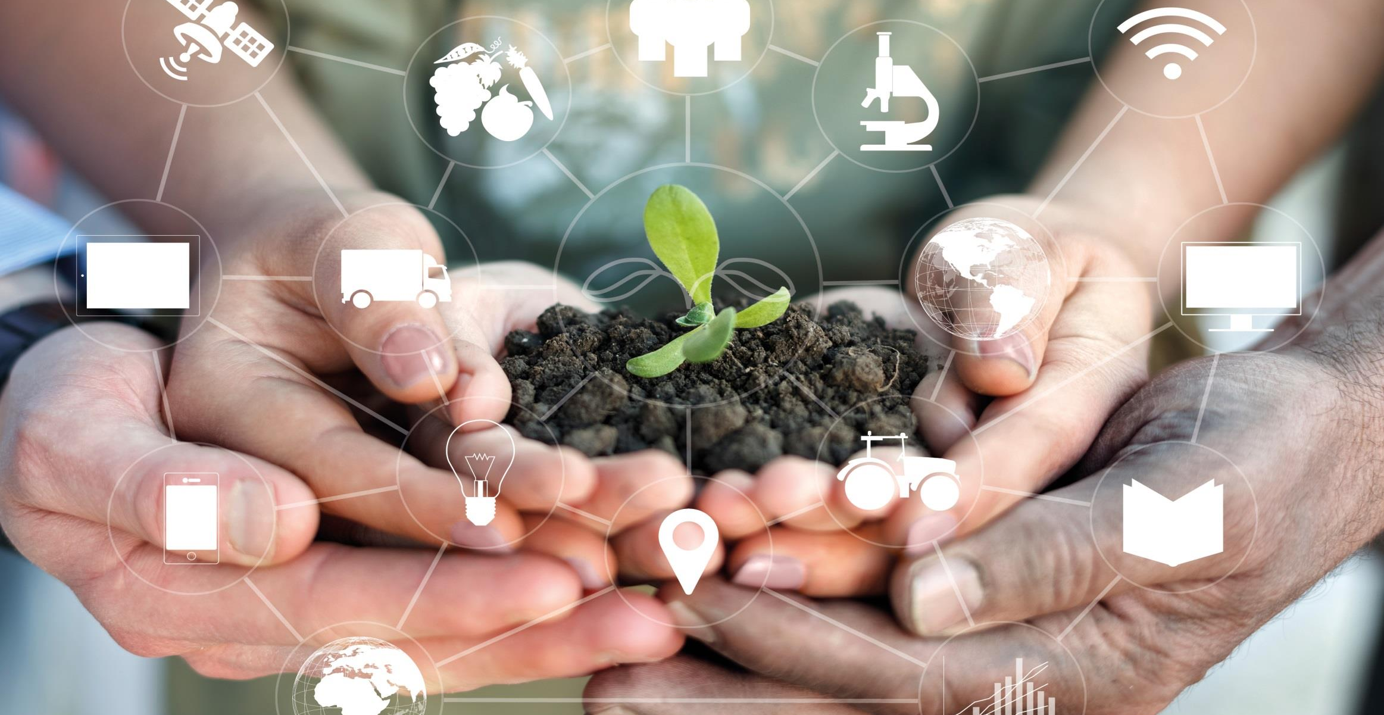
Presentation heading here
2nd line if needed
From policy makers to smallholder farmers
Access to knowledge: Making a difference
Elizabeth Dodsworth
Global Director, Knowledge Management
African Member Countries Regional Consultation
14-16 October 2015

Slide 2
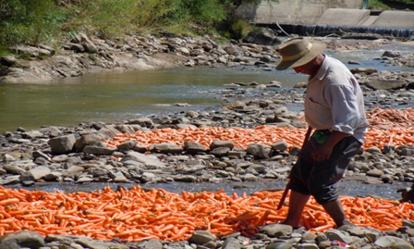

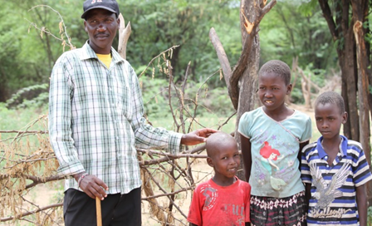
Global Issues
Global demand for food, feed, fibre will double by 2050 as the world's population increases to over 10 billion
  Need to produce 60% more food
Undernutrition is a major challenge to human and economic development. By 2050 over 1 billion people will still be at risk of malnutrition and hunger.
  Undernutrition is associated with one third of all child deaths globally, and 165 million children are stunted

Slide 3
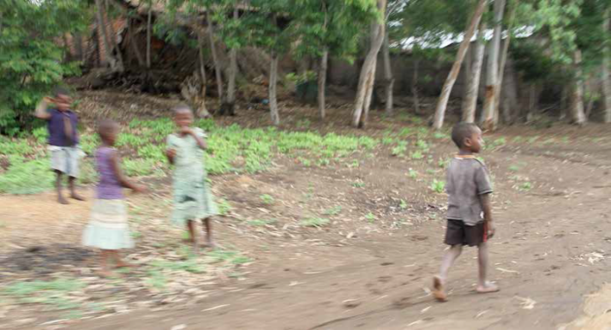
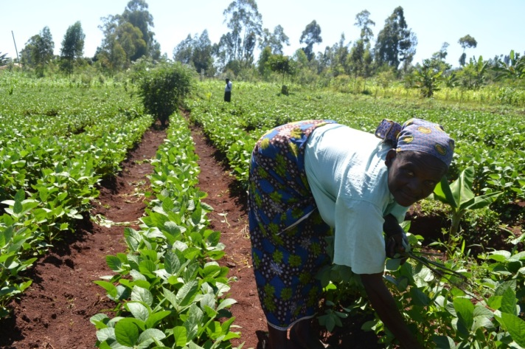
2030 Agenda for Sustainable Development
Goal 2. End hunger, achieve food security and improved nutrition and promote sustainable agriculture
  2.a Increase investment, including through enhanced international cooperation, … agricultural research and extension services, technology development … in order to enhance agricultural productive capacity in developing countries, in particular least developed countries
Goal 17. Strengthen the means of implementation and revitalize the global partnership for sustainable development
  17.6 Enhance North-South, South-South and triangular regional and international cooperation on and access to science, technology and innovation and enhance knowledge sharing on mutually agreed terms, ….
  17.8 …….. and enhance the use of enabling technology, in particular information and communications technology

Slide 4
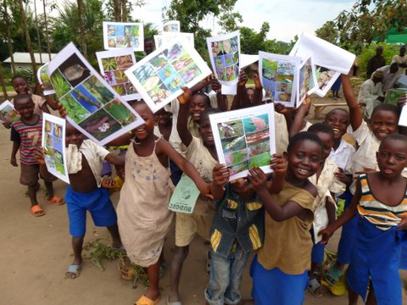
From policy makers to smallholder farmers
information
+
communication
↓
increased knowledge
↓
better decision making
Notes:
Accessing knowledge: making a difference
Access to research findings and technical agricultural information are vital resources for food security, sustainable agriculture and nutrition
Improving nutrition for the poor as a result of behaviour change promoted by accessible mobile-based services delivered at scale through sustainable business models

Slide 5
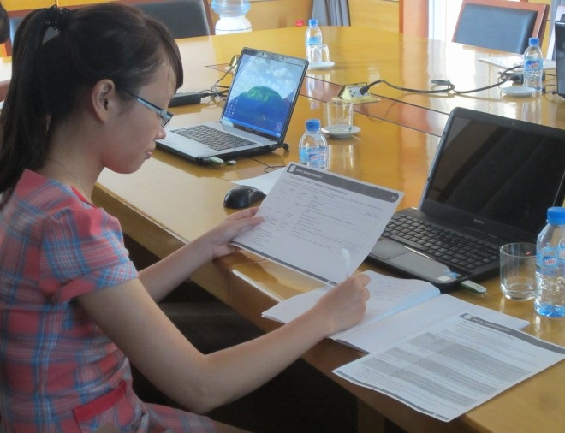
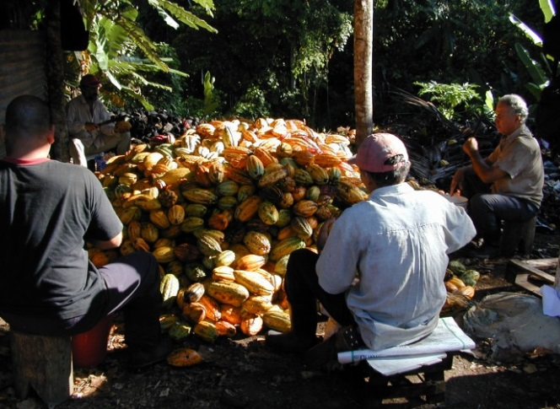
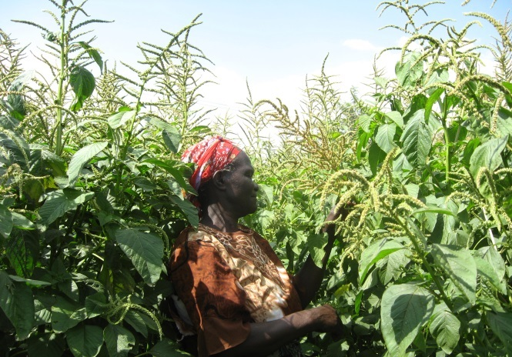
Challenges
Information and data not in public domain
If ‘available’ – often difficult to find
A lot of work needs to be done to make information and data useful
It’s not just yield information and data – but also satellite, meteorology, market prices and value chain information and data
Getting information and data into the hands of communities, particularly women
Encouraging public bodies ( research institutes, governments, NGOs) to make all data behind their research available and easy to access and use
Gathering evidence on where access to information and data have positive impact on food and/or nutrition security
Notes:
Challenges the first part of democratisation is to get access to data.
Much information is simply not in the public domain.
When it is available , information is often difficult to find: specific information and data sets are often buried in big documents, they are unprocessed and fragmented.
A lot of work needs to be done to make it useful and understandable

Slide 6

Introducing GODAN

Slide 7
Global Open Data for
Agriculture and Nutrition
www.GODAN.info
Data anyone can access, use and share
Open Data must:
be accessible, which usually means published on the web
be available in a machine-readable format
have a licence that permits anyone to access, use and share it
Notes:
Data first needs to be available – not necessarily free – but not closed
To be accessible means that it is usually in machine readable code
Data should be in a form that is ‘interoperable’ so that it can be manipulated and aggregated with data from elsewhere to produce results that are of practical use for farmers and consumers
Data can be from records of farmer harvests and land use, satellite data on local weather or even visualizations of crop damage
Data can help inform farmer decisions and work towards food security

Slide 8
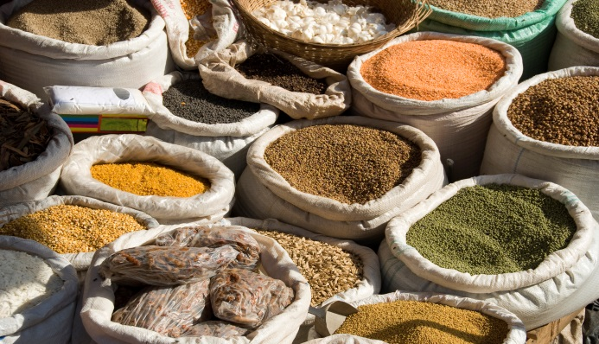


How GODAN came about
2012 G-8 Summit
World leaders commit to “ .. share relevant agricultural data available from G-8 countries with African partners.”
2013 (April) G-8 International Conference on Open Data for Agriculture
2013 (October) Open Government Partnership meeting – GODAN launched
2014 (December) Secretariat launched with 5 year timeline 2015-2019
Notes:
At G8 discussions in 2012 World Leaders committed to share data to achieve food security and meet Sustainable Development Goals to tackle extreme poverty
They held a international conference relating to agriculture in April 2013
This resulted in the launch of GODAN at the Open Government Partnership meeting October 2013
A small secretariat was set up in late 2014 with centres in Wallingford, Wageningen and Rome
This has a 5 year timeline with an Inception Period from January to end of July
The Secretariat has engaged in international events and has held one-to-one meetings with national governments and major organizations
It has an active work programme and is ready to take on the challenges of the years ahead
The aim of the GODAN initiative is to create practical benefit for farmers and consumers worldwide and to create a culture where the default option (why not open data?) is normal
It is important that we engage not only with governments and businesses, but also with developers and the scientific community to enable the data that is opened to be transformed into useful applications that meet the need for food security
This means working with our partners globally to bring people and organizations together
We also need to understand the importance of open data for research – universities will be among the major consumers of open data to create innovation

Slide 9
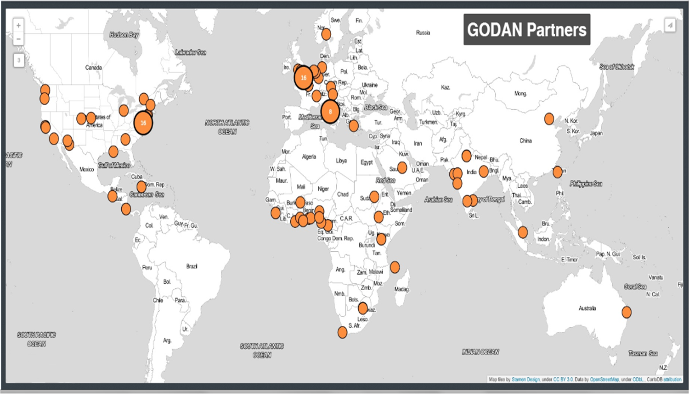
138 partners and growing
Notes:
Core aims and activities
Brings together agriculture, nutrition and open data sectors for:
High level advocacy for GODAN and on the importance of open data across agricultural and nutritional datasets
Harmonize activities with others, share knowledge and lessons and identify evidence of impact of engagement of engagement in agricultural/ nutritional open data activities
Manage a framework of national and international events and dialogues to stimulate end-user engagement with open data and to build the GODAN community of practice

Slide 10

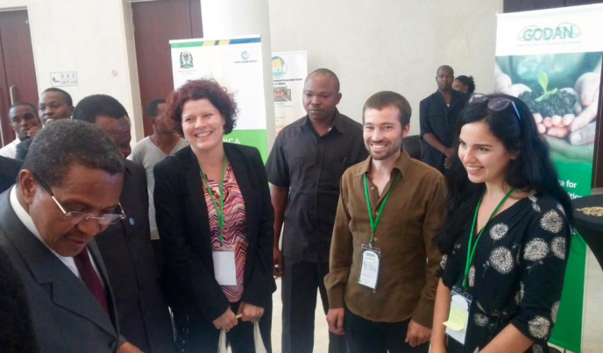
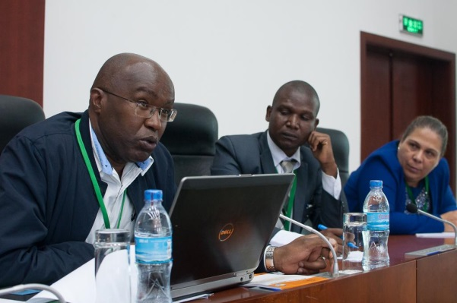
Africa Open Data Conference
President Jakaya Kikwete, Tanzania, attending the Conference
Kiringa Makau, Ministry of Kenya answering questions about agricultural transformation and the role of open data in Kenya
Notes:
Open data in agriculture and nutrition
Will inform understanding the Agriculture and Nutrition Open Data Value Chain
Addresses real-world problems for farmers and consumers
Creates need for data scientists and developers as intermediaries to enable open data to be used
Requires fora to bring together everyone in the data value chain
Identifies universities as real consumers of open data in Agriculture and Nutrition
Open data in agriculture and nutrition
The aim of the GODAN initiative is to create practical benefit for farmers and consumers worldwide and to create a culture where the default option (why not open data?) is normal
It is important that we engage not only with governments and businesses, but also with developers and the scientific community to enable the data that is opened to be transformed into useful applications that meet the need for food security
This means working with our partners globally to bring people and organizations together
We also need to understand the importance of open data for research – universities will be among the major consumers of open data to create innovation
President Jakaya Kikwete, Tanzania, attending the Conference
Kiringa Makau, Ministry of Kenya answering questions about agricultural transformation and the role of open data in Kenya
Africa Open Data Conference

Slide 11

The case for open information and data
Explains why open data is important for agriculture and nutrition
Thirteen use cases show the impact of open data - one of which is Plantwise – ‘Boosting crop yields with a best practice knowledge bank.’
The paper prompts discussion about the issues and the opportunities that can solve problems
Notes:
The paper created tremendous interest at IODC and has been widely shared
It has been downloaded from the GODAN and ODI websites around 4,000 times
The ODI has reprinted the report in hard copy to share at events
GODAN has also reprinted the report twice since the end of May

Slide 12

Join us
  Sign up means you agree to our principles in our Statement of Purpose http://www.godan.info/about/statement-of-purpose/
Easy to complete forms online http://www.godan.info/partners/become-a-godan-partner/
Talk to us about how you can get involved in our events, publications and working groups
Notes:
CABI
Host of the GODAN Secretariat
Supports the GODAN network
Works to enhance community ownership
Supports high level advocacy and awareness
Coordinates working groups
Manages a programme of dialogue and events
Coordinates partner involvement
Shares information and news
A small team, Executive Director, Programme Manager and Communications in Wallingford
Researcher and Partnerships Advisor in Wageningen
Partnerships Development in Rome

Slide 13

Building on D2F – introducing mNutrition
Notes:
Improving nutritional status of women of child bearing age and children under the age of two years can have a profound effect on a child’s ability to grow, learn and rise out of poverty while it also contributes to the overall productivity, economic development and poverty reduction of a country

Slide 14
Challenges
Improving nutritional status of women of child bearing age and children under the age of two years
Reaching women in rural communities with mobile services
Technical assistance to service providers to launch and scale up mNutrition services
Support at national level – for long term sustainability
Effecting behaviour change – diet and agricultural practices

Slide 15
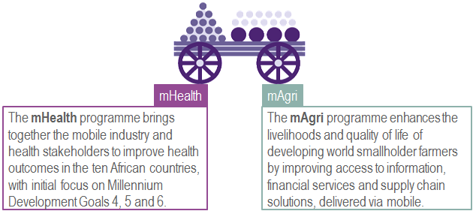
mNutrition initiative
Notes:
The mNutrition initiative builds on the expertise and capacity of two existing platforms:
the mHealth
the mFarmer/mAgri
GSMA brings together mobile network operators, the wider mobile industry and the development community to develop, test and roll-out commercial mobile services for the underserved people in emerging markets.
The overall aim of the mNutrition project is: ‘Improved nutrition for the poor as a result of behavior change promoted by accessible mobile-based services delivered at scale through sustainable business models.’

Slide 16
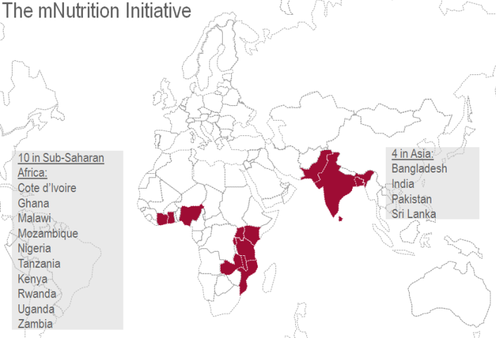
GSM Association and DFID partnership
To develop and scale-up the delivery of nutrition messages through agriculture and health mobile phone platforms.
8 in Sub-Saharan Africa:
Ghana
Malawi
Mozambique
Nigeria
Tanzania
Rwanda
Uganda
Zambia
4 in Asia:
Bangladesh
Pakistan
Sri Lanka
Myanmar
Notes:
Running from May 2014 to May 2017, the project aims to reach at least 3 million people in:
8 countries in Africa
Five New Alliance countries: Ghana, Malawi, Mozambique, Nigeria, Tanzania
Three additional nutrition priority countries: Rwanda, Uganda, Zambia
4 countries in South Asia: Pakistan, Sri Lanka, Bangladesh and Myanmar.

Slide 17




Improving nutritional status of women and children, a multidisciplinary approach:
behaviour change in feeding and dietary practices
referral to and demand creation for nutrition and health services
registration of target population and timely and efficient data surveillance of key nutrition indicators
nutrition-sensitive agriculture practices
increased access to food as a result of improved agricultural production and income
Notes:
behaviour change in feeding and dietary practices
referral to and demand creation for nutrition and health services
registration of target population and timely and efficient data surveillance of key nutrition indicators
nutrition-sensitive agriculture practices including cultivation and consumption of crops with higher nutritional value(s) and improved livestock management and consumption of animal-based products
increased access to food as a result of improved agricultural production and income

Slide 18
Achievements so far
Common framework content
Key nutrition indicators and potential health & agriculture interventions, validated in 12 countries
Nutrition-sensitive agriculture content for mobile Agri services in Ghana and Malawi
Health based nutrition content for mobile Health services in Ghana, Malawi, Nigeria & Tanzania
3 mobile Agri services launched as pilots, together with the first 2 mobile Health services
Linked up with Plantwise country teams in Ghana and Malawi, and using Knowledge Bank content
Notes:
Created a common framework for nutrition sensitive agriculture and health related nutrition content to be applied across all target countries
Completed nutrition landscape analyses and content frameworks in 12 countries to identify key nutrition indicators and potential health & agriculture interventions and validated in country
Developed nutrition-sensitive agriculture content for mobile Agri services in 4 countries (Ghana, Malawi, Sri Lanka & Bangladesh) through local partnerships
Developed health based nutrition content for mobile Health services in 4 countries (Ghana, Malawi, Nigeria & Tanzania) through local partnerships
3 mobile Agri services have launched in pilot scale so far and a 4th will launch imminently, together with the first 2 mobile Health services
Linked up Plantwise country teams with mNutrition implementation teams in all Agri countries (Ghana, Malawi, Sri Lanka, Bangladesh, Pakistan & Myanmar) to work on potential collaborations
Used Plantwise factsheets and pest management decision guides as a source for development of mNutrition country content – supporting the wide dissemination of Plantwise content via mobile
Started development of a Nutrition Knowledge Bank to act as an open source repository of nutrition related factsheets and messages (which can also feed the Plantwise Knowledge Bank)

Slide 19

Going forward
Leveraging CABI’s core competencies in the area of nutrition-sensitive agriculture
Ensuring linkage with core programmes, e.g., Plantwise and Direct2Farm
Leveraging expertise in information management in the new ‘data’ management arena
Working in Member Countries on nutrition-sensitive initiatives
Working with Member Countries on mobile advisory services
Looking forward to more dialogue with Member Countries on how we can encourage, support and partner Member Countries in open data initiatives

Slide 20
Elizabeth Dodsworth
e.dodsworth@cabi.org
Notes:
thank you slide
changes only to name, centre & email
Arial24bold, light green
Please let us know if there are any languages you wish to add to this slide
no change to be made to image

