Slide 1
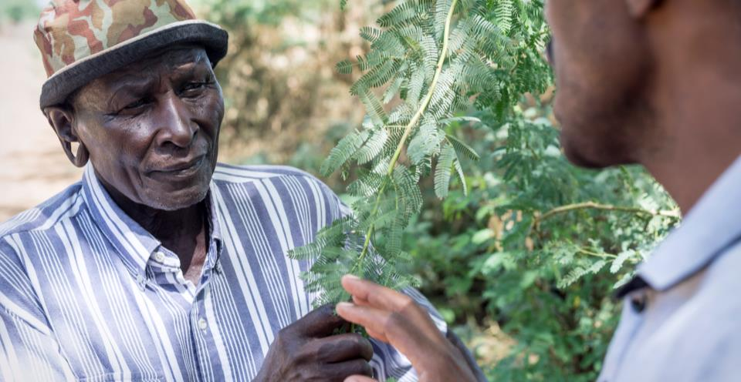
The green wastelands of Africa
Presentation to CABI Regional Consultation
Phil Abrahams, Sean Murphy & Arne Witt
15 October 2015
Notes:
70% of the worlds’ poor live in rural areas

Slide 2
Invasives: Green wastelands
The problem
Displacing people and crops
Affecting food security, livelihoods and health
Borders not respected
Response is often nationally-focussed and not multi-sector
The solution
- Regional coordination of stakeholders to support approaches to:
- Prevent / Detect early and eradicate / Mitigate
The ask
We are seeking your mandate for action
Key elements for a regional Invasive Species Management Strategy, with donor support
How can you help?
What could CABI do to deliver?
‘Plantwise’ partnership approach to implement IPM-/Biocontrol options at scale
Develop tools, policies, etc? What is important for you?
Why does it matter…….?
The problem
Invasive species are displacing people and crops
The solution
Coordination of stakeholders to support IPM-/Biocontrol-based options
The Ask
We are seeking £40m over 5y to roll out such a programme in 10 countries in Africa
What CABI will do to deliver
Orchestrate a 3-stage regional hierarchical management approach, underpinned by in-field tools, policy guidance, an open access invasive species knowledge hub, biocontrol programmes, and community communication & engagement

Slide 3
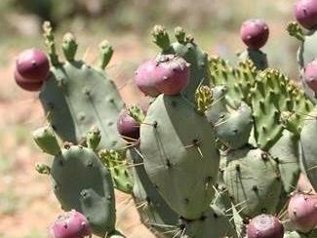
Invasive species
plants, animals, fungi or bacteria that aren’t native
and have negative effects on an economy, environment and health.

Slide 4
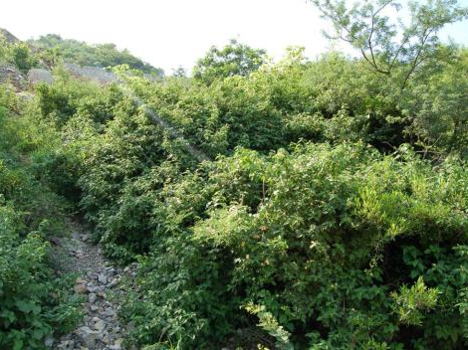
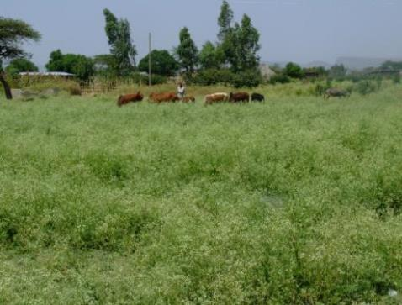
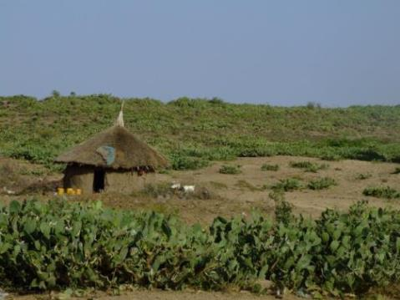
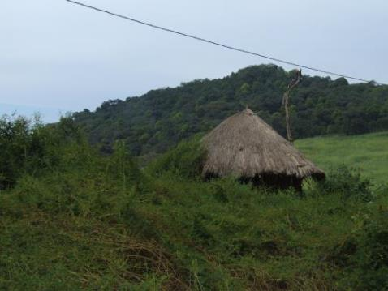
THE PROBLEM
Lantana camara
Parthenium hysterophorus
Opuntia stricta
Mimosa diplotricha

Slide 5
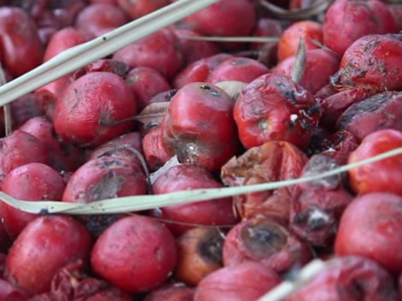
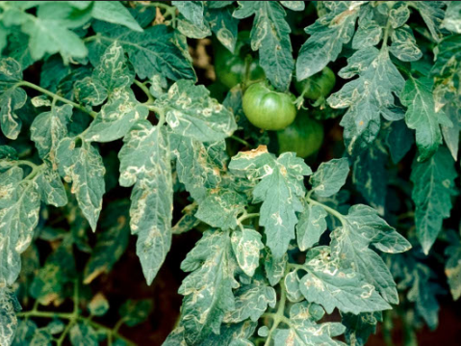
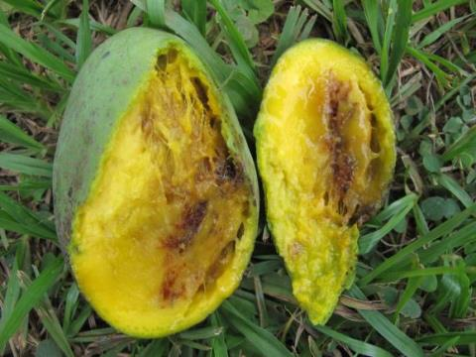
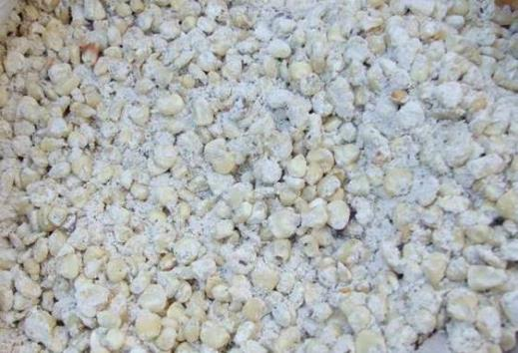
THE PROBLEM
Tuta absoluta on tomato
Liriomyza on tomato
Oriental fruit fly
Larger grain borer on maize

Slide 6

The costs: A global problem…
Loss to the world economy as a result of invasive non-native species is estimated at 5% of annual production
Global costs estimated at > $1.4 trillion
Notes:
Global problem, local ‘tragedy’ local catastrophe
Map of whole world with global figures (1.4 Trillion)
Hilight UK, US and Europe
Pin on map of Africa – go in to Peace’s story (add image of Peace

Slide 7
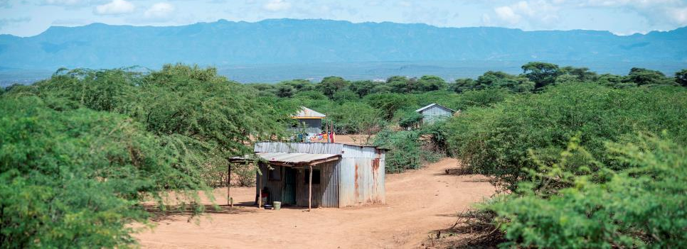
…a local tragedy
Across East Africa, just 8 of the major invasive species cause economic losses of well over $1.5bn a year affecting staple crops such as:
maize and cassava ($979m)
horticulture ($284m)
livestock (>$500m)
The food security and incomes of >26m farming families are being affected in this region alone.
Notes:
Across East Africa, just eight of the major invasive species cause economic losses of well over $1.5bn a year, affecting staple crops such as maize and cassava ($979m), horticulture ($284m), and livestock (>$500m). The food security and incomes of >26m farming families are being affected – for these pests alone, we estimate a 17% loss in potential annual income for those mixed maize system farmers earning under $2/day; furthermore, over 3% of the region’s annual agricultural GDP is lost to just this handful of invasives.

Slide 8
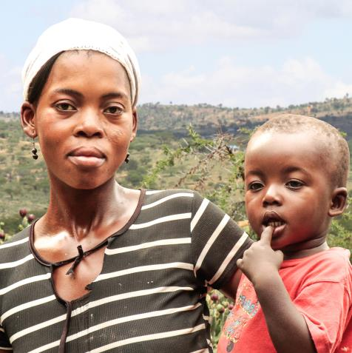
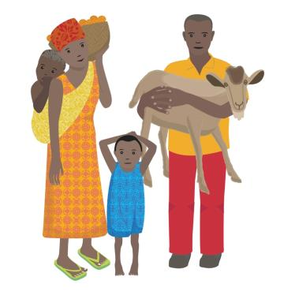
The costs: A global problem, a local tragedy
For people like Peace
Notes:
IS disproportionately affect the poor because they rely on natural resources for livelihoods
Inside cover of brochure (photo of her and child and cartoon character)

Slide 9

Fact:
100 million women in Africa spend 20 billion hours weeding per annum
Fact:
Almost 70% of children need to leave school during peak weeding periods
FACTS:
The weeds are smothering our crops and I have to get my children and friends to help manage them.
Notes:
Weeding and gender/youth
100 million women in Africa spend 20 billion hours weeding per annum
Almost 70% of children need to leave school during peak weeding periods
Weeds cause 10% yield loss in developed but 30% in developing world
Hand weeding is 60% of pre-harvest labour - mostly down to women & children

Slide 10
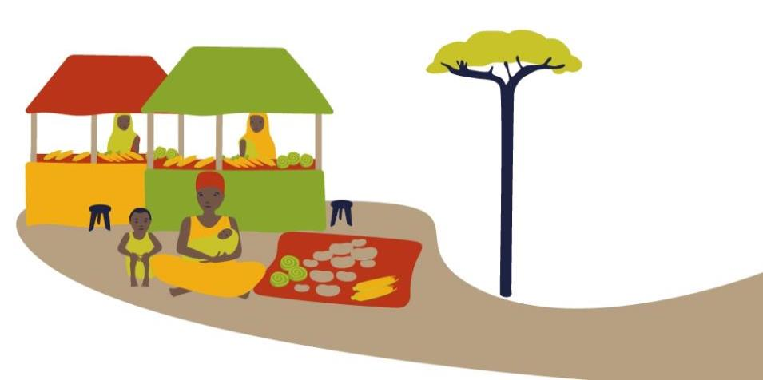

Fact:
Losses caused by invasive species on just 8 staple crops near $12.8 billion per annum
Fact:
Species such as parthenium have been known to cause crop losses of up to 97%
FACTS:
Because we have less to sell, it’s harder to send our children to school and to live well.
Notes:
Weeding and gender/youth
100 million women in Africa spend 20 billion hours weeding per annum
Almost 70% of children need to leave school during peak weeding periods
Weeds cause 10% yield loss in developed but 30% in developing world
Hand weeding is 60% of pre-harvest labour - mostly down to women & children

Slide 11
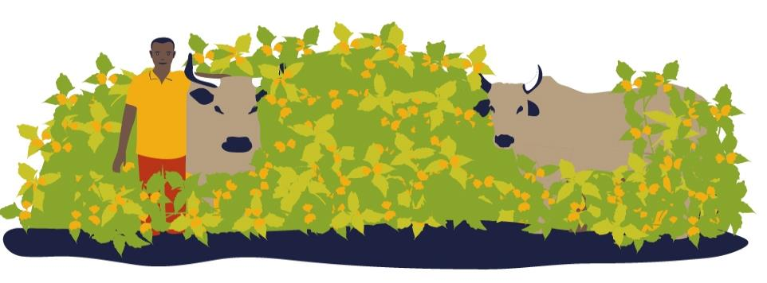
The plants our animals graze on are being choked by weeds. They try and eat them but some of them are poisonous or have thorns.
Fact:
71% of South Africa’s natural grazing would be lost if alien invasive weeds were not managed
FACTS:
Fact:
Livestock accounts for 30% of Africa’s agricultural GDP
Notes:
Livestock and grazing land
Livestock accounts for 30% of Africa’s agricultural GDP
In South Africa – study showed 71% of natural grazing would be lost if alien invasive weeds were not managed

Slide 12
Invasive species can be:
The solution
prevented
identified before they establish
controlled
Notes:
With existing technologies and a systematic approach – the green desert can be turned back.
Incomes can be improved, land can be reclaimed.
Interventions on IS are almost always beneficial with activities like bc giving cost: benefit ratios of >1:250

Slide 13
CABI’s vision
To stop the world’s worst
invasive species
undermining the livelihoods
of 50 million farming families
Notes:
In Ethiopia as one example 11% of the approx pop of 85 million are reliant on pastoralism (nearly 9 ½ million)
In Ethiopia 1 of the 2 major invasives is prosopis which has invaded 700,000 hectares of prime grazing and is still expanding its range
In East and Southern Africa nearly 50% of the cultivated area of major staple crops is devoted to maize. Over 60 million people constitute the farming population of this area.

Slide 14
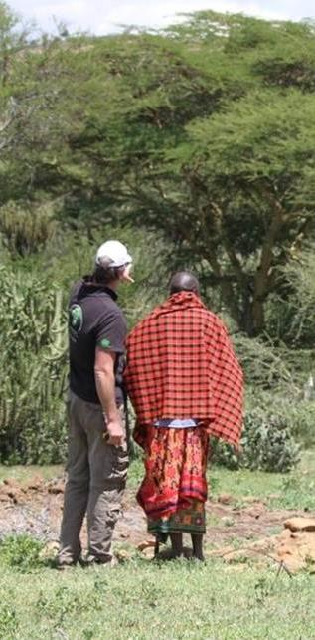
Why CABI?
Cassava mealybug threatened the food security of >200 million in Africa. Biocontrol reduced mealybug by 95%. Cost:benefit 1:149
Mango mealybug control in West & Central Africa increasing fruit production by 142% with cost:benefit 1:145
Orthezia control in St Helena saving an endemic tree from extinction
Rubbervine control in Australia saving a world heritage ecosystem cost:benefit 1:108
Recent series of GEF funded projects in South East Asia, Caribbean and East Africa
Notes:
African farmer’s cassava crops protected
Phenacoccus manihoti, cassava mealybug attacked African cassava crops, causing crop losses of up to 80%. It quickly spread and threatened the food security of over 200 million people. A parasitic wasp, Anagyrus lopezi, was introduced to control the mealybug in 1981 and by 1990 the population of mealybug had been reduced by 95%.
An economic analysis of the programme showed that benefits to all 27 African countries involved, accumulated over 40 years, amounted to US$9.4 billion, with an annual gain of US$235 million and a benefit-cost ratio of 149:1

Slide 15
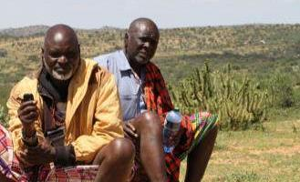
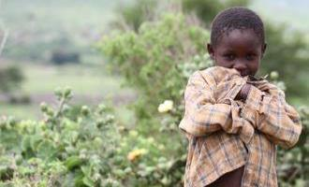
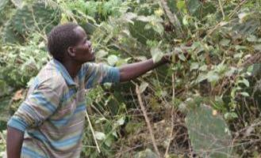
10 invasives / 10 countries
We propose seeking donor investment to improve livelihoods by implementing a programme which will:
Develop national and regional linkages to facilitate a systematic approach to Invasive species management
Create and share knowledge to enable countries to identify, prevent and manage threats
Develop best management plans to address 10 of the world’s worst invasives (Phase I)
Notes:
CABI will act as a convening force which coordinates the currently disconnected activities of government ministries, NGOs, farmer groups, private sector, public extension and research bodies.
Information tools for in-field identification, multimedia advisory messages to help land managers and farmers, open access distribution data and control options, policy inputs and even roll-out programmes for IPM and classical biocontrol, are just some of the portfolio of CABI activities to help accelerate the necessary response to these new green deserts.

Slide 16
CABI Invasive Species Strategy:
Building the case
Engage with Member Countries to secure your mandate and active support – starts today!
Convene stakeholders to agree action plans
Evidence: quantify the spread and impact
Assign institutional roles and responsibilities to ensure a systematic approach to invasive species management (at a national and regional level)
Utilise the proven Plantwise approach

Slide 17
CABI Invasive Species Strategy:
Action plan, stage 1 – Prevention
Define key users and stakeholders (Institutions, front-line personnel)
What are their needs-gaps, and skillsets?
What tools should CABI develop in support?
How can they be coordinated regionally to stop invasive pests from arriving?

Slide 18
The action plan, stage 2: Early detection and eradication Providing a system which enables detection and rapid response to new invaders, e.g.
Sentinel systems: Plantwise, plus other national mechanisms?
Mobile messages to raise awareness
Extension materials and support
Consultancy and networks: Role for a CABI centre of excellence?
Image bank, for in-field identifications
Crowd sourcing as method of local reporting

Slide 19
The action plan, stage 3: Mitigation Controlling established invasives, e.g.
Discussion documents outlining control options: costs, risks and benefits, drawing on case studies from elsewhere
Consultancy service to roll out implementation of selected management strategies
Information materials to support implementation of appropriate controls

Slide 20

A global programme…

Slide 21
Focussing on 10 of Africa’s worst (phase 1)
Proposed Species | Type
Prosopis spp. | Plant
Mimosa spp. | Plant
Opuntia spp. | Plant
Parthenium hysterophorus | Plant
Lantana camara | Plant
Tuta absoluta | Insect
Liriomyza | Insect
Larger Grain Borer | Insect
Oriental fruit fly | Insect
Maize lethal necrosis | Disease
Notes:
Background info on the invasives:
Mimosa pigra is a small prickly shrub that invades wetlands and rice fields in many parts of the world. Infestations increase cultivation expenses for soil preparation, and the labour required to remove the invasive plant before cultivation. In some areas, this expense is so much greater than the income of agricultural products that local people cease to crop part of or all of their land
Mimosa diplotricha is a small scrambling shrub that forms impenetrable spiny thickets and invades highly disturbed sites, especially agricultural systems. The prickly thorns make weeding and harvesting crops very difficult resulting in increased production and management costs as well as reduced yields and productivity. M. diplotricha has also been observed to reduce foliage quality and quantity in grazing areas and containing mimosin it is toxic to herbivores. The plant is recognised as a serious weed of crops in the Pacific Islands, Asia and some African countries were it causes serious problems in coconut, oil palm, tea and rubber plantations, sugarcane and pineapple fields, croplands (cassava, tomatoes, upland rice, soybeans, maize and peanuts) and pasturelands. Many farmers usually avoid infested land.
Parthenium hysterophorus causes severe crop losses primarily due to its allelopathic effects followed by its ability to outcompete crops for nutrients and moisture. The pollen inhibits fruit setting in crops including tomato, brinjal, beans, capsicum, and maize. In India, where Parthenium has invaded 14.25 million hectares of farmland alone, yield losses of up to 40% in agricultural crops and reduced forage production by up to 90% has been reported in several crops. In Ethiopia, when Parthenium was left uncontrolled reductions of between 40% and 97% in yields of Sorghum bicolor grain have been reported.
Lantana camera has been introduced widely since the 1800s as an ornamental, often used as a hedge plant, and has become widespread in Australia, India and South Africa, infesting millions of hectares of land, including agricultural crops. Lantana poses human health risks since the dense thickets provide breeding grounds tsetse flies (vectors of trypanosomosis), and potentially also rats, wild pigs and other insect pests . The fruits, if eaten by children can cause severe toxicity and even death, and its woody stem and higher lignin content pose fire hazards, increasing fire frequency.
In Ghana, Chromolaena odorata has contributed to households being driven into increasingly marginal positions, and have forced poor smallholders to move their farming activities further upslope, perpetuating land disturbance and facilitating spread of the invasive plant (Robbins, 2004). Timorese semi-subsistence agriculturalists are severely affected by C. odorata resulting in a significant loss of feed stocks for cattle herds which represent the primary source of family wealth.
In Africa, the larger grain borer (LGB) is a devastating post-harvest storage insect pest of maize and cassava, which are staple food crops. In small-scale farming systems levels of grain weight loss significantly increased after the invasion of LGB - from about 9% up to over 60%. The storage period for the harvest was also reduced; thus storage losses due to LGB threaten the livelihoods of farmers across Africa.
Of additional concern in some regions such as sub-Saharan Africa and tropical Asia is the amount of grazing land that pastoralists lose to invasive weeds such as parthenium, opuntia, lantana, chromolaena, and mimosa species; for example, parthenium can cause a loss of up to 90% of carrying capacity. They displace valuable pasture species and can grow so densely that they inhibit/prevent the movement of people and animals. These biological invasions also have a direct effect on the health of livestock, with lantana, parthenium, chromolaena and other invasive plants being toxic to livestock.
Tuta absoluta
The high biotic potential of Tuta absoluta shows that this invasive species is a major threat to tomato production in Africa, Asia and the Pacific islands and will have a major impact on the livelihoods of smallholders and agribusinesses in these regions’.

Slide 22
Starting the debate
To discuss: What are the key issues to address: What are the gaps, nationally and regionally, and which Invasives are your main concern?
To agree: How can we work together to have an impact?
Up next: How have invasive species impacted us?

Slide 23
Phil Abrahams, CABI-UK
p.abrahams@cabi.org
Notes:
thank you slide
changes only to name, centre & email
Arial24bold, light green
Please let us know if there are any languages you wish to add to this slide
no change to be made to image

