Slide 1
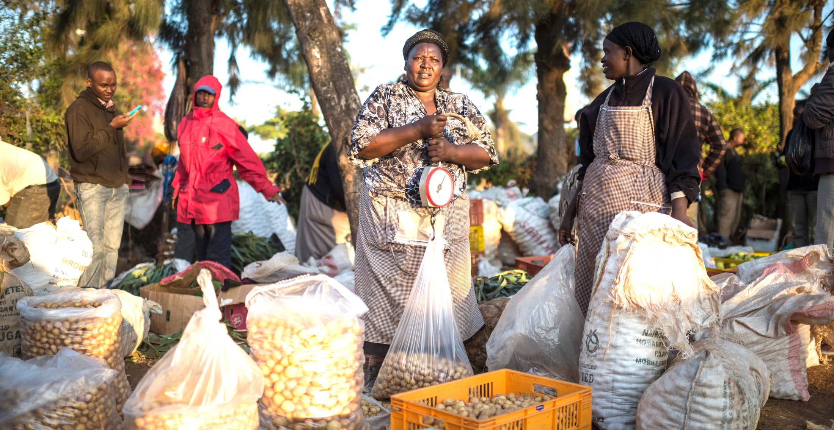
Introduction
African Member Countries Regional Consultation
14-16 October 2015, Lusaka, Zambia
Session 2: Reviewing and Identifying Priorities of Member Countries
George Oduor, Deputy Director (Research), CABI Africa
Notes:
Main title slide to be used at start of presentation- Arial36bold white
may vary depending on heading between min=32pt, max=40pt
Subtitle - Arial28bold white
Credits – Arial14light green, can include:
Data collected by [Add names of contributors and production team & REMOVE THE BRACKETS]
Analysis and compilation by [Add names of contributors & REMOVE THE BRACKETS]
or Presenter’s name, date, event
You may insert your own picture (Click icon to add picture). No line bordering picture.
Portfolio link http://portfolio:8090, enter your usual network username and password
TO ADD MORE SLIDES in Office2007 use the ‘New Slide’ dropdown on the ‘Home’ ribbon

Slide 2
Consolidated priority areas and issues 2012-13
Priority Areas | Priority Issues
Trade and market access and development | SPS compliance; Value-chain focus and postharvest value-addition; GAP and best practices promulgation, and capacity building; Commercialization and contract farming.
Knowledge management, communication and use | Technology transfer (particularly amongst member countries, and south-south); Sharing knowledge amongst stakeholder groups including youth and grassroots (Facebook Agriculture); Mobile advisory services; Improving communications to farmers; Evidence-based policies. Archiving and managing institutional research information.
Plant health | Managing a range of stressors including pests (IPM), water, and soil nutrients; IPM in high value crops; reduction in pesticide inputs; early warning systems for newly emerged/key pests & diseases.
Biodiversity and invasive species management | Invasive management; Capacity building of IS identification and diagnostics; habitat manipulation/agro-biodiversity enrichment Microbial resource collection, characterization and utilization; Development and production of biopesticides, and implications of biopesticides use.
Cross-cutting: Climate smart agriculture Institutional capacity building Publication of, and access to, authoritative information resources

Slide 3
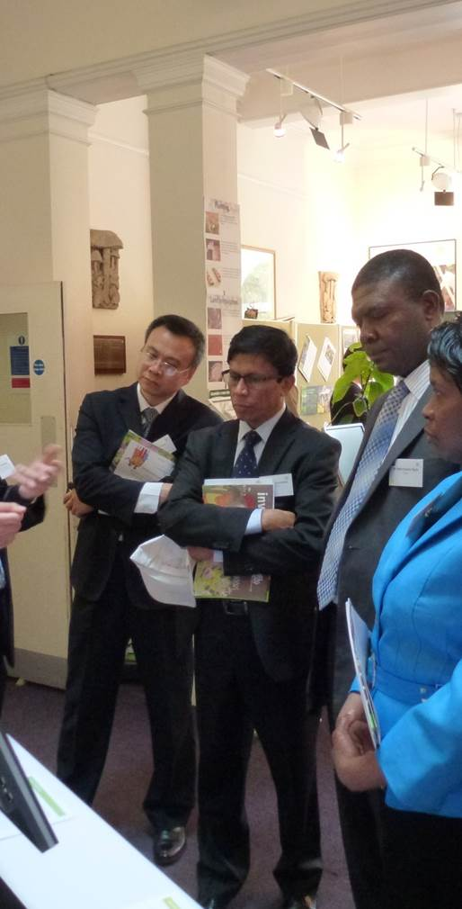
CABI’s response and thematic strategies
The 2012/13 Consultations have guided
the revision of CABI Medium Term Strategy 2014-16 and Vision 2020
the development of a joint CABI-member countries strategic framework for the next 3-5 years
CABI has already developed significant portfolios of current and future initiatives in addressing the 7 priority areas
e.g. an expanded Plantwise programme, further development of mobile agro-advisory services, Invasive Species livelihood programme, and fine tuned thematic strategies
Notes:
image & content
main title - Arial26bold Grey-80%- max 2 lines
subtitle - 18bold Grey-80%- max 2 lines
body text black- may vary depending on heading between min=18pt, max=24pt
This slide is to describe the work of a project, product, department or team.
You may insert your own picture (Click icon to add picture). No line bordering picture.
Portfolio link http://portfolio:8090, enter your usual network username and password
TO ADD MORE SLIDES in Office2007 use the ‘New Slide’ dropdown on the ‘Home’ ribbon

Slide 4

Aims and objectives of Regional Consultations 2015-16
As previously, to align CABI’s work more effectively with national and regional needs and develop mutually agreed plans for appropriately funded and resourced programmes
Specifically:-
Conduct a systematic and focused review of progress achieved in the 7 priority areas identified in 2012-2013, and their continued relevance
Identify new emerging regional priorities
Agree on action plans by linking regional priorities with CABI’s capabilities and strategies and identifying synergies among partners
Notes:
image & content
main title - Arial26bold Grey-80%- max 2 lines
subtitle - 18bold Grey-80%- max 2 lines
body text black- may vary depending on heading between min=18pt, max=24pt
This slide is to describe the work of a project, product, department or team.
You may insert your own picture (Click icon to add picture). No line bordering picture.
Portfolio link http://portfolio:8090, enter your usual network username and password
TO ADD MORE SLIDES in Office2007 use the ‘New Slide’ dropdown on the ‘Home’ ribbon

Slide 5

Systematic and focused review of progress achieved
The review done or to be done through
Survey on CABI’s delivery (carried out in August/September 2015)
Compilation and circulation of the summary list of initiatives and projects in addressing the 7 priority areas (August/September 2015)
Compilation and circulation of Project Dossier
CABI CEO’s presentation to update on the overall progress
Regional Director’s review on the progress in the Region
Other presenters’ reviews on progress in specific issues
Notes:
image & content
main title - Arial26bold Grey-80%- max 2 lines
subtitle - 18bold Grey-80%- max 2 lines
body text black- may vary depending on heading between min=18pt, max=24pt
This slide is to describe the work of a project, product, department or team.
You may insert your own picture (Click icon to add picture). No line bordering picture.
Portfolio link http://portfolio:8090, enter your usual network username and password
TO ADD MORE SLIDES in Office2007 use the ‘New Slide’ dropdown on the ‘Home’ ribbon

Slide 6
CABI Member Country survey
17 respondents
to the survey of
48 Member Countries

Slide 7
Notes:
You may insert your own picture (Click icon to add picture). No line bordering picture.
Portfolio link http://portfolio:8090, enter your usual network username and password

Slide 8

Some of the most important/urgent agricultural and environmental issues your country is facing

Slide 9
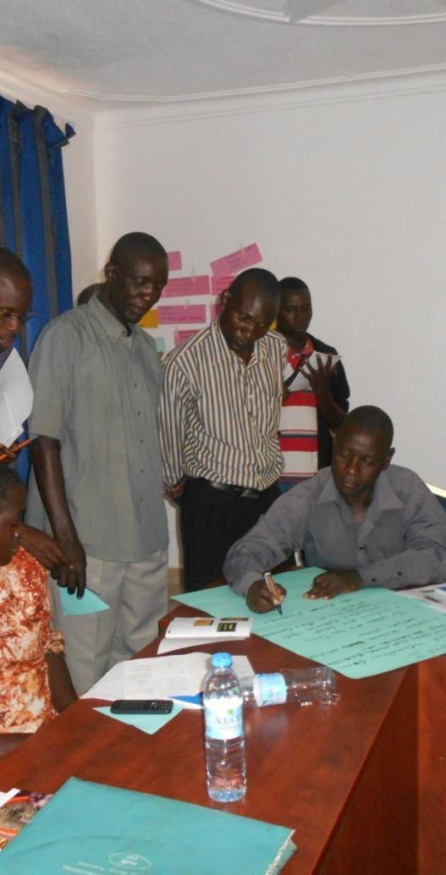
Specific objectives of Session 2
Review the continued relevance of 7 priority areas identified in 2012-2013
Identify new emerging regional priorities
Agree on sub-regional and regional priority areas and issues
Through sub-regional break-out group and plenary discussions
Notes:
image & content
main title - Arial26bold Grey-80%- max 2 lines
subtitle - 18bold Grey-80%- max 2 lines
body text black- may vary depending on heading between min=18pt, max=24pt
This slide is to describe the work of a project, product, department or team.
You may insert your own picture (Click icon to add picture). No line bordering picture.
Portfolio link http://portfolio:8090, enter your usual network username and password
TO ADD MORE SLIDES in Office2007 use the ‘New Slide’ dropdown on the ‘Home’ ribbon

Slide 10
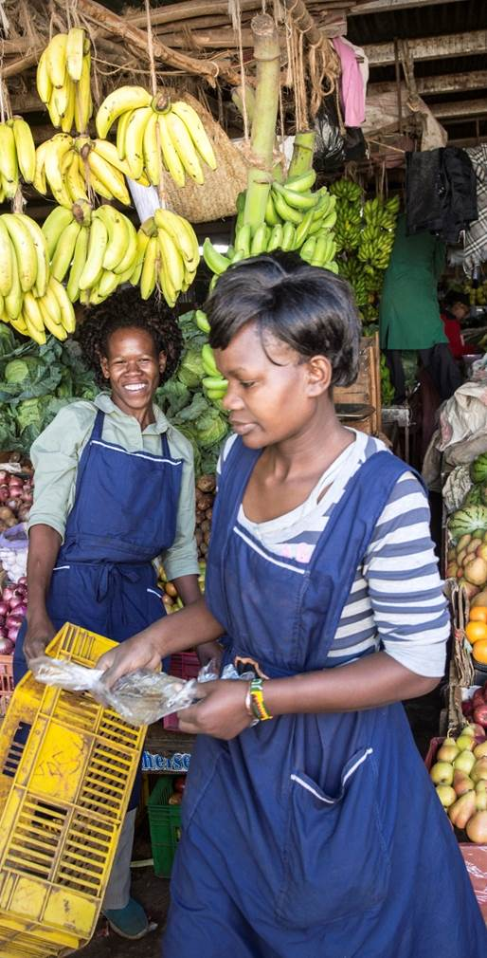
Suggested Steps for Discussions
Break-out Discussions
Step 1: Review and agree on the continued relevance of 7 priority areas and issues identified in 2012-2013
Step 2: Articulate top 3 new emerging national priority areas by each member country
Step 3: Discuss and agree on top 3 new emerging sub-regional priority areas
Step 4: Discuss and agree on specific issues of each of these 3 priority areas
Step 5: Integrate both previous relevant and new emerging sub-regional priority areas/issues into “Sub-regional priority areas/issues 2015”

Slide 11
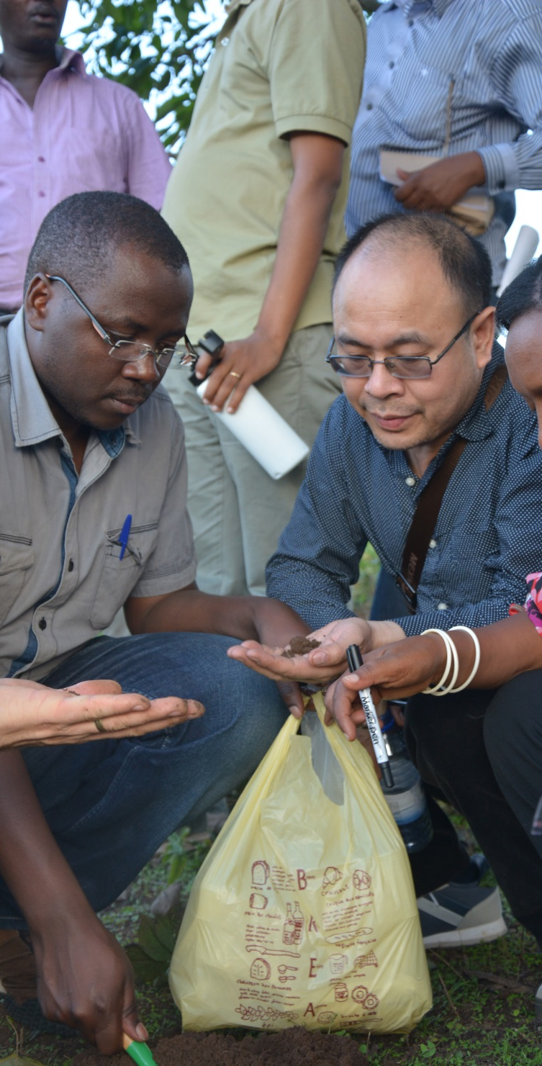
Suggested Steps for Discussions
Plenary Discussions
Step 6: Discuss and agree on “Regional Priority Areas and Issues” after reporting back

Slide 12
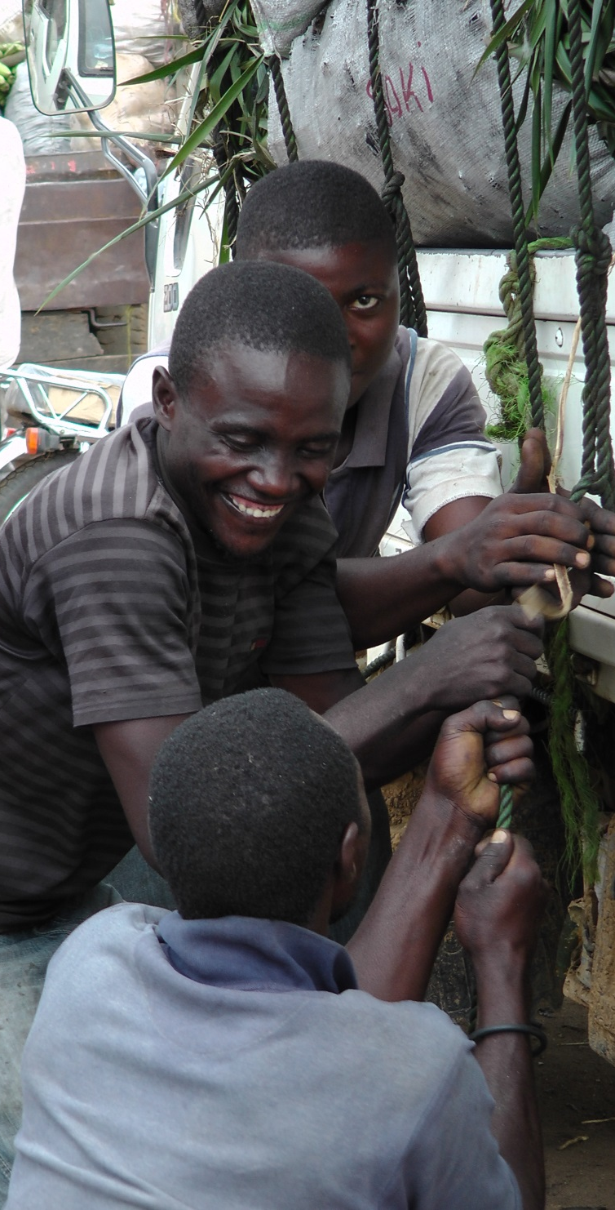
Break-out Groups
Eastern Africa: Burundi, Ethiopia, Kenya, Tanzania, Rwanda and Uganda plus partners (Morris Akiri and Dannie Romney)
Southern Africa: Botswana, Malawi, Mauritius, South Africa, Zambia and Zimbabwe plus partners (Roger Day and Elizabeth Dodsworth)
Western Africa: Cameroon, Cote d’Ivoire, Gambia, Ghana, Nigeria and Sierra Leone plus partners (George Oduor and Victor Clottey)
Notes:
image & content
main title - Arial26bold Grey-80%- max 2 lines
subtitle - 18bold Grey-80%- max 2 lines
body text black- may vary depending on heading between min=18pt, max=24pt
This slide is to describe the work of a project, product, department or team.
You may insert your own picture (Click icon to add picture). No line bordering picture.
Portfolio link http://portfolio:8090, enter your usual network username and password
TO ADD MORE SLIDES in Office2007 use the ‘New Slide’ dropdown on the ‘Home’ ribbon

Slide 13
George Oduor, Africa
g.oduor@cabi.org
Notes:
thank you slide
changes only to name, centre & email
Arial24bold, light green
Please let us know if there are any languages you wish to add to this slide
no change to be made to image

