Slide 1
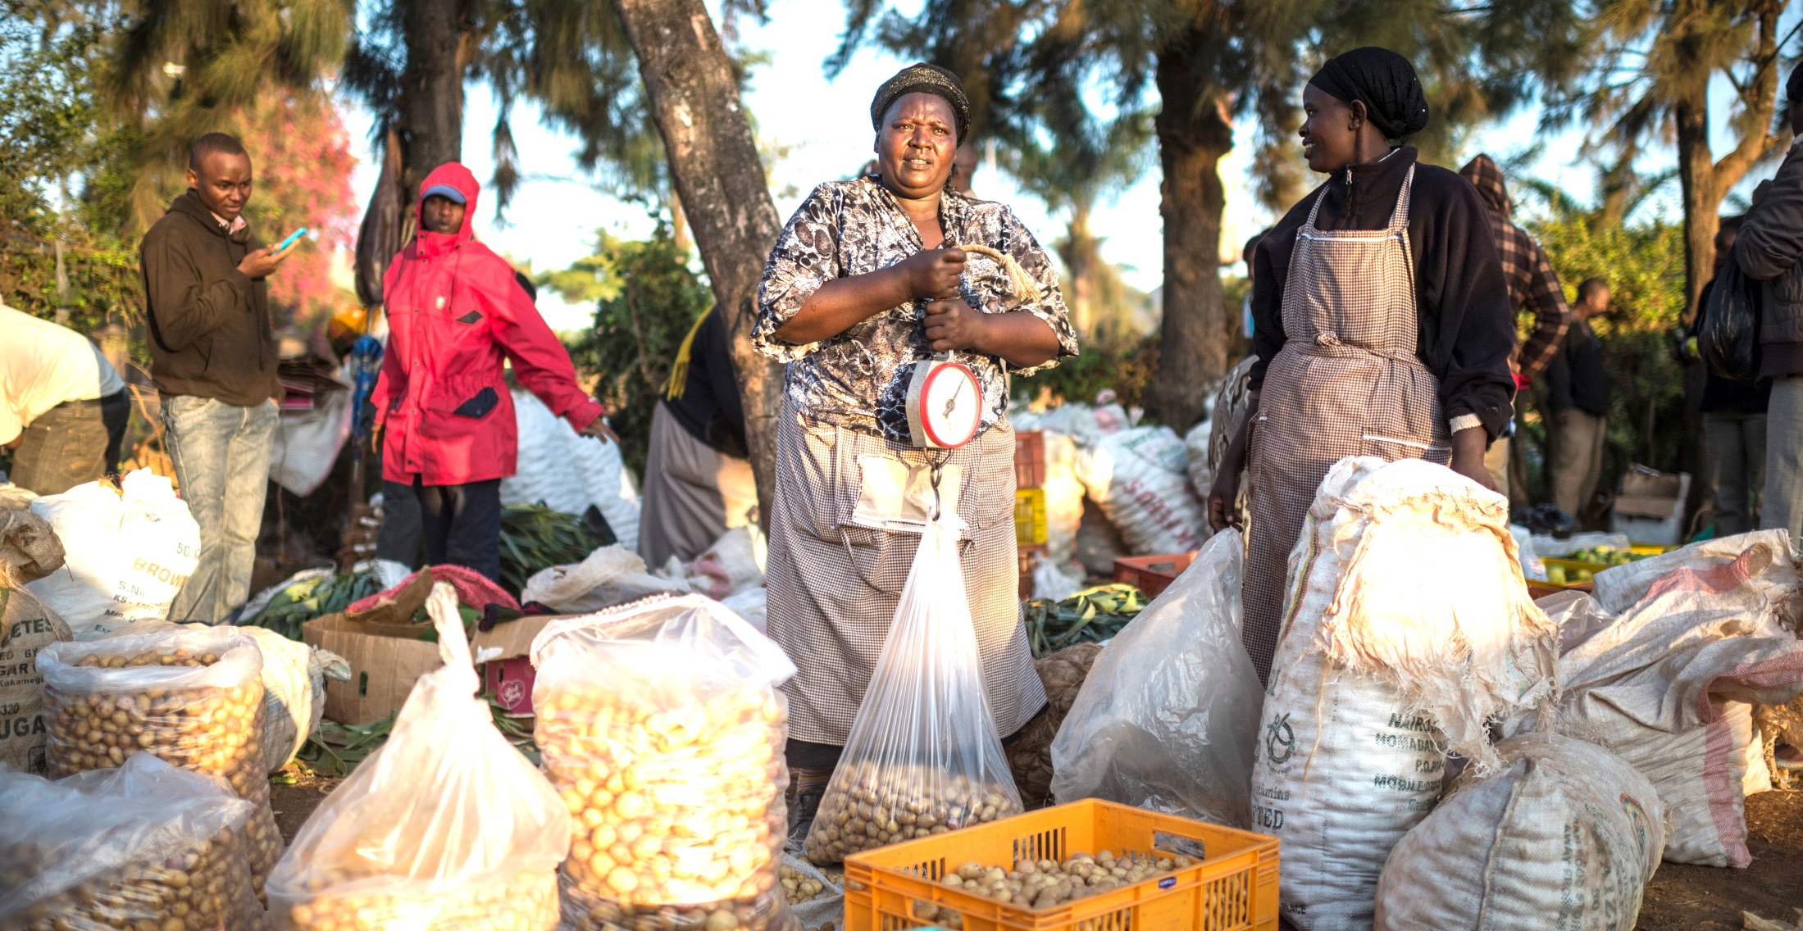
Session 3: Introduction
Objectives of the Day
African Member Countries Regional Consultation
14-16 October 2015, Lusaka, Zambia
Session 3: Prioritising Key Regional Issues
Morris Akiri, Regional Director, CABI Africa
Notes:
Main title slide to be used at start of presentation- Arial36bold white
may vary depending on heading between min=32pt, max=40pt
Subtitle - Arial28bold white
Credits – Arial14light green, can include:
Data collected by [Add names of contributors and production team & REMOVE THE BRACKETS]
Analysis and compilation by [Add names of contributors & REMOVE THE BRACKETS]
or Presenter’s name, date, event
You may insert your own picture (Click icon to add picture). No line bordering picture.
Portfolio link http://portfolio:8090, enter your usual network username and password
TO ADD MORE SLIDES in Office2007 use the ‘New Slide’ dropdown on the ‘Home’ ribbon

Slide 2
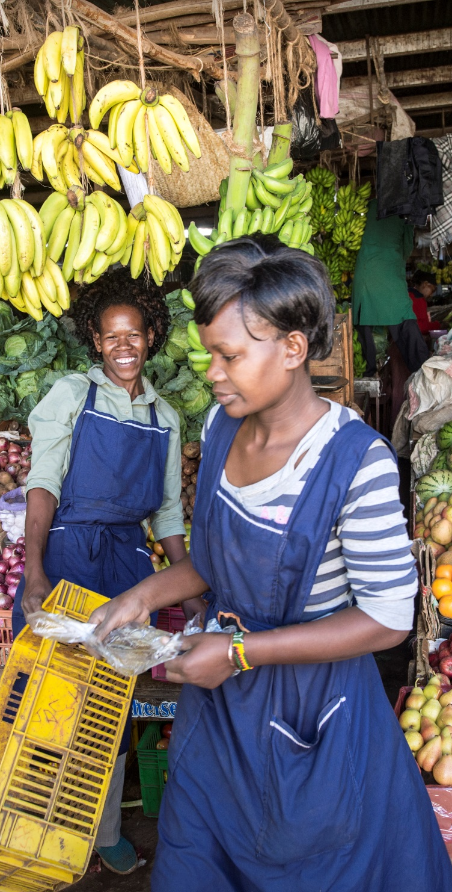
Objectives of the Day – Session 3
Highlight issues of select key CABI strategic areas
Focus on Invasive species – the livelihoods threat facing Africa through a special session
Discuss the importance of these highlighted issues to member countries, and challenges faced
Match regional priorities with CABI’s capabilities and strategies
Identify what kind of support member countries can provide in order to develop further joint initiatives and projects in relation to these issues
Notes:
image & content
main title - Arial26bold Grey-80%- max 2 lines
subtitle - 18bold Grey-80%- max 2 lines
body text black- may vary depending on heading between min=18pt, max=24pt
This slide is to describe the work of a project, product, department or team.
You may insert your own picture (Click icon to add picture). No line bordering picture.
Portfolio link http://portfolio:8090, enter your usual network username and password
TO ADD MORE SLIDES in Office2007 use the ‘New Slide’ dropdown on the ‘Home’ ribbon

Slide 3
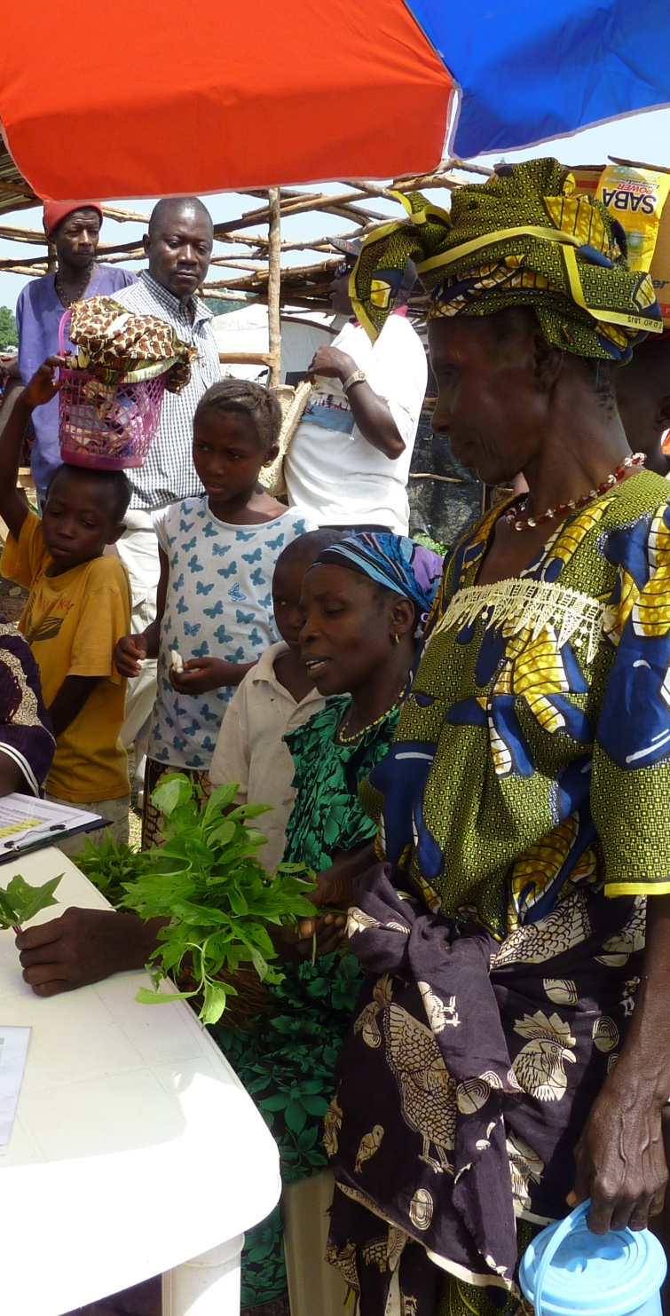
Issues of select
key CABI strategic areas
Open data and mobile information delivery
Plantwise - issues in relation to Plant Health system development, Knowledge Bank and M&E of the Plantwise
CABI's role in facilitating trade and market access
CABI’s Policy on Access and Benefit Sharing Compliance under the Nagoya Protocol
Invasive species – the livelihoods threat facing Africa
Notes:
image & content
main title - Arial26bold Grey-80%- max 2 lines
subtitle - 18bold Grey-80%- max 2 lines
body text black- may vary depending on heading between min=18pt, max=24pt
This slide is to describe the work of a project, product, department or team.
You may insert your own picture (Click icon to add picture). No line bordering picture.
Portfolio link http://portfolio:8090, enter your usual network username and password
TO ADD MORE SLIDES in Office2007 use the ‘New Slide’ dropdown on the ‘Home’ ribbon

Slide 4
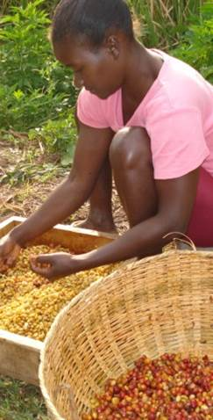
Have countries got objections to CABI’s Policy?
Are there specific contacts in your countries other than yourselves that CABI must negotiate with?
Are there specific protocols or procedures that countries want addressing in CABI’s best practice?
What changes to the procedures and practices need to be made for your country to adopt CABI’s policy at the 2016 CABI Review Conference?
Plenary discussions on CABI CBD and ABS Policy
Notes:
image & content
main title - Arial26bold Grey-80%- max 2 lines
subtitle - 18bold Grey-80%- max 2 lines
body text black- may vary depending on heading between min=18pt, max=24pt
This slide is to describe the work of a project, product, department or team.
You may insert your own picture (Click icon to add picture). No line bordering picture.
Portfolio link http://portfolio:8090, enter your usual network username and password
TO ADD MORE SLIDES in Office2007 use the ‘New Slide’ dropdown on the ‘Home’ ribbon

Slide 5
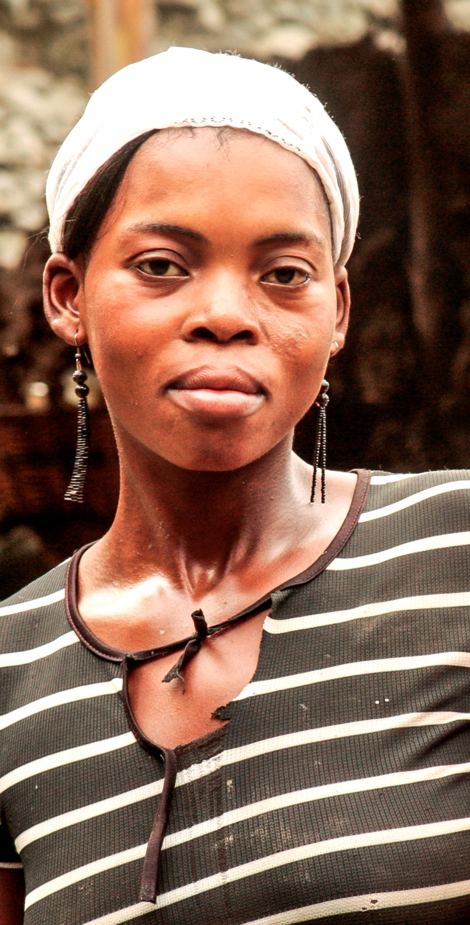
Invasive species – the livelihoods threat facing Africa
This special session on invasive species aims to address the following overarching objectives:
Discuss and review the impact of invasive species on livelihoods in Africa
Identify where gaps lie in current action plans and what can be done collectively to address the issues
Identifying partnerships and next steps for addressing invasive species at a regional level.
Notes:
image & content
main title - Arial26bold Grey-80%- max 2 lines
subtitle - 18bold Grey-80%- max 2 lines
body text black- may vary depending on heading between min=18pt, max=24pt
This slide is to describe the work of a project, product, department or team.
You may insert your own picture (Click icon to add picture). No line bordering picture.
Portfolio link http://portfolio:8090, enter your usual network username and password
TO ADD MORE SLIDES in Office2007 use the ‘New Slide’ dropdown on the ‘Home’ ribbon

Slide 6
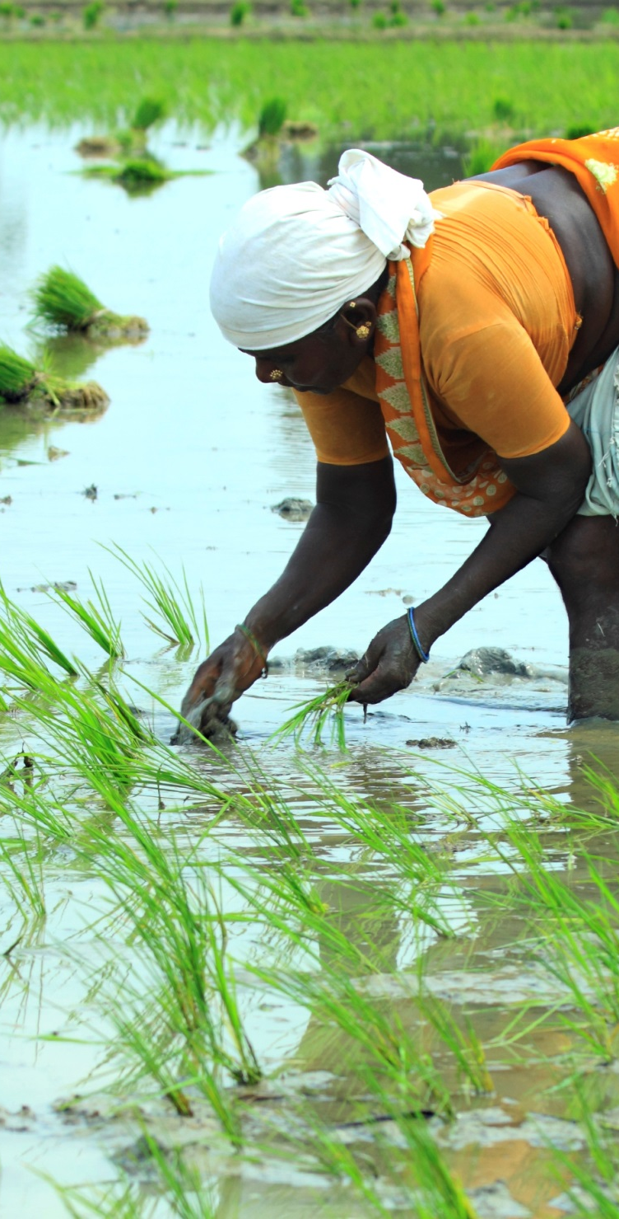
Break-out Discussions 2: Key Invasive Issues
Random selection
Group 1:
(Roger Day and Carol McNamara)
Group 2:
(Babar Bajwa and Dannie Romney)
Group 3:
(Victor Clottey and Phil Abrahams )
Notes:
image & content
main title - Arial26bold Grey-80%- max 2 lines
subtitle - 18bold Grey-80%- max 2 lines
body text black- may vary depending on heading between min=18pt, max=24pt
This slide is to describe the work of a project, product, department or team.
You may insert your own picture (Click icon to add picture). No line bordering picture.
Portfolio link http://portfolio:8090, enter your usual network username and password
TO ADD MORE SLIDES in Office2007 use the ‘New Slide’ dropdown on the ‘Home’ ribbon

Slide 7
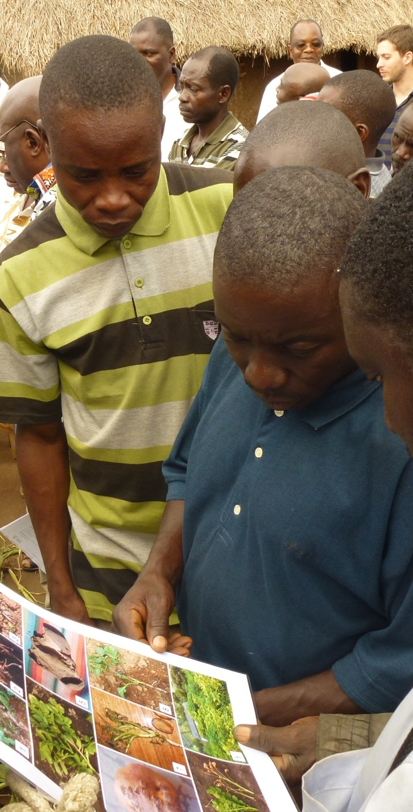
Break-out Discussions 3: Other highlighted issues
Group 1: Open data and mobile information delivery
Gambia, Kenya, Mauritius, Nigeria, South Africa, Uganda, Agricultural Research Council of South Africa, FAO and ZARI plus other local partners (Elizabeth Dodsworth and Dannie Romney)
Group 2: Issues in relation to Plant Health system development, Knowledge Bank and M&E
Ghana, Malawi, Sierra Leone, Tanzania, Rwanda, Zambia, Self Help Africa and PW National Data Coordinator for Zambia plus local partners (Washington Otieno and Victor Clottey)
Group 3: CABI's role in facilitating trade and market access
Botswana, Burundi, Cameroon Cote d’Ivoire, Ethiopia, Zimbabwe, AfDB, COMESA plus local partners (Roger Day and George Oduor)
Notes:
image & content
main title - Arial26bold Grey-80%- max 2 lines
subtitle - 18bold Grey-80%- max 2 lines
body text black- may vary depending on heading between min=18pt, max=24pt
This slide is to describe the work of a project, product, department or team.
You may insert your own picture (Click icon to add picture). No line bordering picture.
Portfolio link http://portfolio:8090, enter your usual network username and password
TO ADD MORE SLIDES in Office2007 use the ‘New Slide’ dropdown on the ‘Home’ ribbon

Slide 8
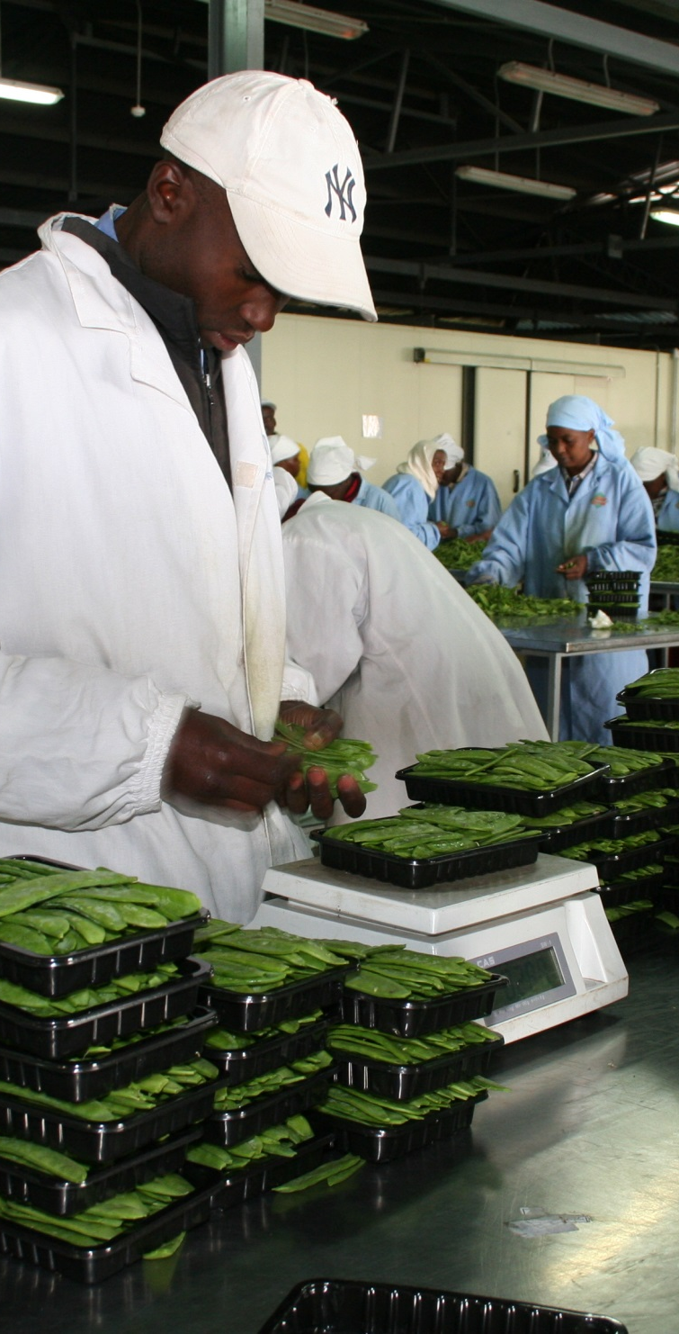
Suggested Steps for Break Out Discussions 3 (continued from Session 2)
Step 7: Discuss specific questions on highlighted issues of select CABI strategy areas, and modify “Regional Priority Areas and Issues” after matching CABI’s capabilities and strategies
Step 8: Agreed on “Regional Priority Areas and Issues for Action” and develop recommendations and action plans
Session 4 (Day 3)- Plenary Discussions
Step 9: Discuss and agree on “Regional Priority Areas and Issues for Action” and “recommendations and action plans” by all member countries and partners present

Slide 9
Akiri Morris, Africa
m.akiri@cabi.org
Notes:
thank you slide
changes only to name, centre & email
Arial24bold, light green
Please let us know if there are any languages you wish to add to this slide
no change to be made to image

