Slide 1

COMESA In partnership with CABI Martha Byanyima SPS Expert

Slide 2
COMESA
COMESA is constituted by 19 MS
FTA Established in 2000
Trade increase from $3.1bn to $19.3bn in 2012
Liberalisation and tariff reduction to facilitate free movement of goods and services including simplified regime for small traders
Based on regional trade policy instruments agreed and implemented by all MS e.g. SPS Regns
Working towards customs union and a common external tariff
Largest FTA, common market and investment area

Slide 3
COMESA
COMESA/EAC/SADC Tripartite FTA
Launched 2015
27 Member states – half of AU membership
GDP $1.3tn, population 565m
Only 14% of intra tripartite trade is from within
Implementation road map, including infrastructure development on trade corridors, tariff negotiations, SPS/TBT harmonization and elimination of NTBs

Slide 4
COMESA
COMESA SPS Strategy is anchored on the COMESA MTSP Priority areas, (i) liberalization and (ii) boosting SMEs productive capacities and (iii) Annexes 9 and 10 of the Tripartite FTA Agreement
Our mandate – make the FTA functional, create an SPS regulatory environment that connects supply chains and makes it easy for industry and SMEs to access regional and global markets
Contribute to the CADDP and Malabo Goals on (i) Tripling intra Africa Trade and (ii) creating a functional Continental FTA

Slide 5
Partnership with CABI – responding to RI challenges
Institutional capacity building , harmonizing the SPS regulatory environment
Implemented a number of training programmes
The Australia/Africa Plant Biosecurity initiative
The COMESA/STDF SPS and trade facilitation programme
2 . The Market Access Prioritization tool to increase investments in SPS capacity
Building consensus on priorities to unlock MS trade potential
Improving collaboration/synergies synergies between public agencies and ministries
Improving public-private sector collaboration on investing in SPS capacity
3. Review of the COMESA SPS Strategy

Slide 6
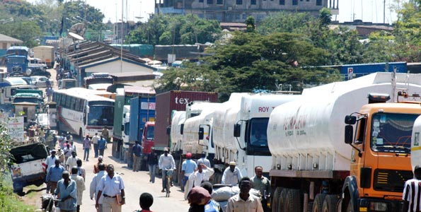
Trade Facilitation Agreement (TFA) & SPS Agreement

Slide 7
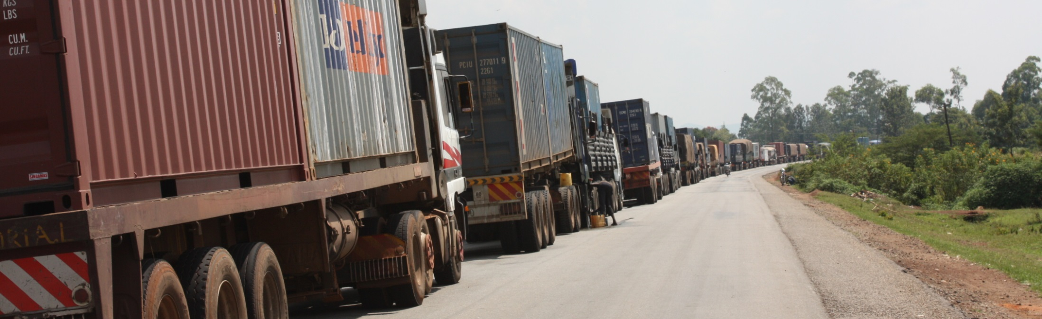
Trade Facilitation
Simplifying trade procedures
Facilitate the movement, release and clearance of goods
How procedures and controls governing the movement of goods across borders can be improved to reduce associated cost and maximise efficiency while safeguarding legitimate PH regulatory objectives

Slide 8
The cost of trade
Barka, 2012

Slide 9
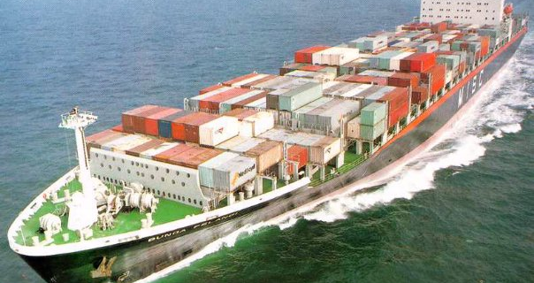
Current SPS Logical Framework
SPS Strategy Meeting, 22-23 June 2015 Kigali, Rwanda

Slide 10
Goal and Purpose
Goal (Overall Objective)
Reduced poverty and increased food security within the COMESA, Tripartite and AU frameworks
Purpose (Specific Objective)
Enhanced SPS capacity of the public and private sector to gain and maintain regional and international market access for food and agricultural products
Indicators: Capacity assessments; rejections/non compliance; increased trade flows

Slide 11
Expected Results
Regional leadership, coordination and collaboration on SPS issues
Private sector driven common certification schemes/protocols and standards in use
Monitoring, surveillance, diagnostic and emergency response systems established for priority SPS risks
Improved decision making using accurate and up-to-date SPS information

Slide 12
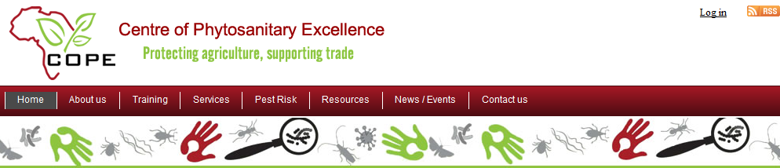
1. Leadership, coordination, collaboration
Establish COMESA/Tripartite SPS coordination mechanisms
Set up regional centres of SPS excellence
Coordinate/support regional participation in international SPS bodies
Assess and monitor regional SPS status

Slide 13
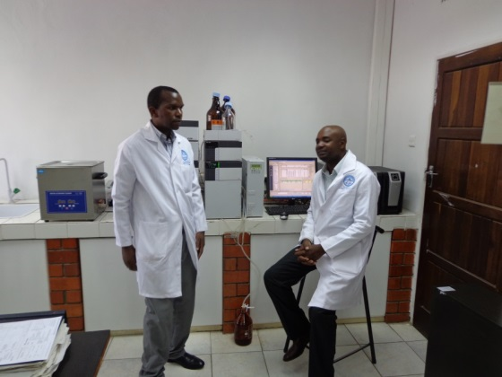
2. Private-sector driven schemes
Set up mechanisms for prioritising, developing, approving common certification schemes
Develop and implement common certification, inspection and mutual recognition schemes

Slide 14


3. Monitoring & response systems
Set up and implement surveillance systems
Develop and test emergency response plans
Set up monitoring and traceability systems

Slide 15
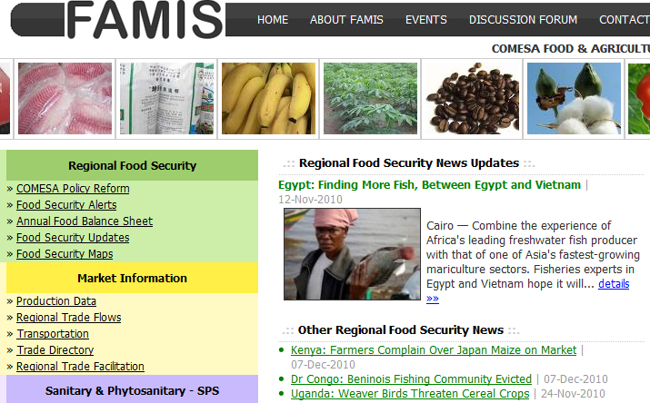
4. SPS information and communication
Establish national communication systems
Set up SPS web portal
Support international SPS communication

Slide 16
Thank You

