Slide 1
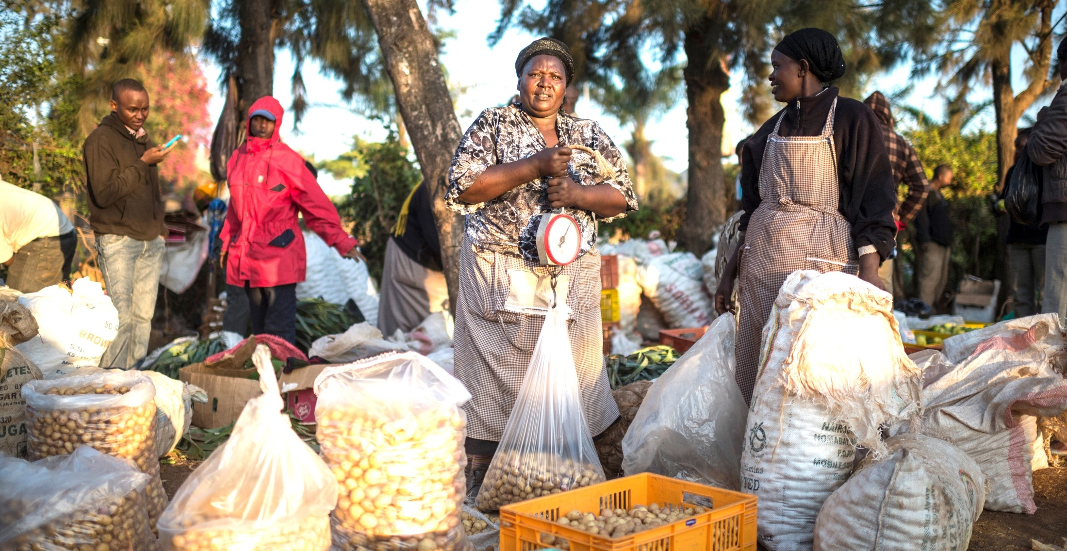
Concluding Remarks
Session 5: Conclusions
Dr Trevor Nicholls, CEO, CABI
African Member Countries Regional Consultation
Lusaka, Zambia, 14-16 October 2015
Notes:
Main title slide to be used at start of presentation- Arial36bold white
may vary depending on heading between min=32pt, max=40pt
Subtitle - Arial28bold white
Credits – Arial14light green, can include:
Data collected by [Add names of contributors and production team & REMOVE THE BRACKETS]
Analysis and compilation by [Add names of contributors & REMOVE THE BRACKETS]
or Presenter’s name, date, event
You may insert your own picture (Click icon to add picture). No line bordering picture.
Portfolio link http://portfolio:8090, enter your usual network username and password
TO ADD MORE SLIDES in Office2007 use the ‘New Slide’ dropdown on the ‘Home’ ribbon

Slide 2
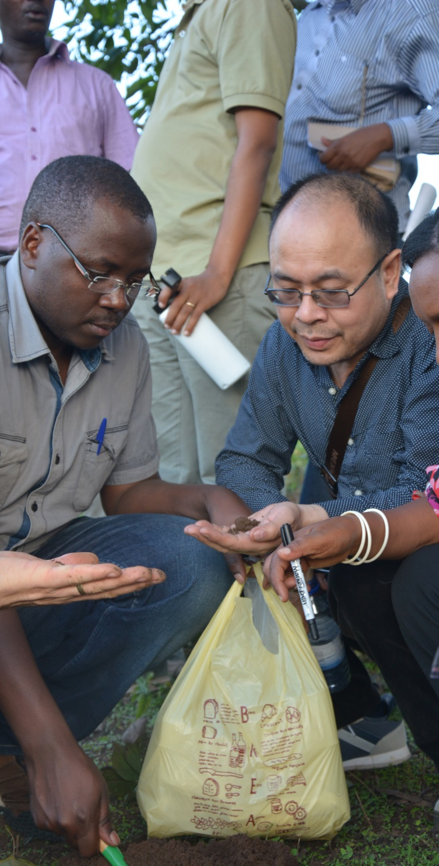
The following objectives have been met thanks to useful input from all of you
To review the progress made and the continued relevance of the priority areas and issues identified in 2012
To identify new emerging national, sub-regional and regional priorities influencing and impacting on sustainable development in the region
To share country and regional experiences and views
To develop regional plans by linking regional priorities with CABI’s capabilities and strategies, and identify synergies among partners
Notes:
image & content
main title - Arial26bold Grey-80%- max 2 lines
subtitle - 18bold Grey-80%- max 2 lines
body text black- may vary depending on heading between min=18pt, max=24pt
This slide is to describe the work of a project, product, department or team.
You may insert your own picture (Click icon to add picture). No line bordering picture.
Portfolio link http://portfolio:8090, enter your usual network username and password
TO ADD MORE SLIDES in Office2007 use the ‘New Slide’ dropdown on the ‘Home’ ribbon

Slide 3
Main outcomes: consolidated Regional Priority Areas and Issues
New Priority Areas | Priority Issues
Trade and market access and development | SPS compliance; Value-chain focus and postharvest value-addition; GAP and best practices promulgation, and capacity building; Commercialization and contract farming; Quality control of agricultural inputs (fake seed and other agro-inputs); Access to local and regional input and output markets; Labour saving technologies for efficient (cost effective) production; Organising farmers into business organisations; Access to information (markets, prices, & regulations, etc.); Access to affordable credit; Risk management (price fluctuation, etc.)
Knowledge management, communication and use | Technology transfer (particularly amongst member countries, and south-south); Sharing knowledge amongst stakeholder groups including men and women, youth and grassroots (using social media to reach these communities); Mobile advisory services; Mass communication and linking multiple stakeholders using mixed communication methods; Improving communications to farmers; Evidence-based policies. Alternative uses of ICT applications – e.g. e-M&E; e-statistics; e-vouchers; Scaling up and out; Archiving and managing institutional research, government and others information; Open data; Private public partnerships to address pests and diseases. Publication of, and access to, authoritative information resources
Plant and Animal Health | Improved genetic materials; Range management; Managing a range of stressors including pests (IPM), water, and soil nutrients; IPM in high value crops; Reduction in pesticide use; Early warning systems for newly emerged/key pests & diseases & approaches to respond to emerging pests; Biotechnology applications for pests and diseases; Zoonotic diseases; Safe use of (veterinary) drugs; Improved diagnostic skills and infrastructure.

Slide 4
Main outcomes: Consolidated Regional Priority Areas and Issues
New Priority Areas | Priority Issues
Invasive species management | Invasive management including aquatic environments and those affecting agriculture; Mapping and distribution of invasives; Capacity building of IS identification and diagnostics.
Biodiversity and ecosystem management | Habitat manipulation/agro-biodiversity enrichment; Microbial resource collection, characterization and utilization; Development and production of biopesticides, and implications of biopesticides use; Composting and waste management. Water management.
Nutrition sensitive agriculture | Awareness-raising of nutrition amongst population; Use of indigenous crops – for nutrition – also to provide nutricals Food safety; (Bio)fortification; Food preparation; Food/diet diversification (micronutrients); Storage, post harvest, processing & preservation.
Seed Systems | Neglected crops and OPVs; Improving self-saved seed (ITK); Regulatory and legislative environment; linking formal and informal sectors; Plant Genetic Resources (PGR)
Cross-cutting: Climate smart agriculture – including modeling crop, pest and beneficial organisms’ distribution & management (climate change adaptation and mitigation) Capacity building and governance (M&E, Gender and youth in Agriculture, inclusivity of minority groups). Coordination, project management. Laboratory practices and accreditation; Legislation (e.g. IPR issues); institutional capacity building

Slide 5
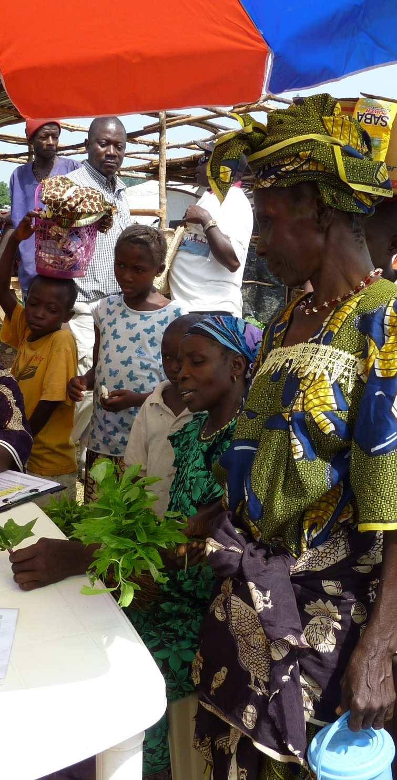
What happens next?
The outcomes from the Regional Consultation
will
influence the revision of the CABI Medium Term Strategy 2016-18 and Vision 2020
be fed into the bigger CABI Review Conference 2016, which is scheduled for late July 2016
facilitate implementation of agreed joint initiatives with member countries
Encourage member country representatives, who unanimously agreed on CABI’s policy on access and benefit sharing in principal at the meeting to seek approvals from relevant national authorities before CABI Review Conference in late July 2016
And lastly, commence the establishment of CABI Southern Africa Centre
Notes:
image & content
main title - Arial26bold Grey-80%- max 2 lines
subtitle - 18bold Grey-80%- max 2 lines
body text black- may vary depending on heading between min=18pt, max=24pt
This slide is to describe the work of a project, product, department or team.
You may insert your own picture (Click icon to add picture). No line bordering picture.
Portfolio link http://portfolio:8090, enter your usual network username and password
TO ADD MORE SLIDES in Office2007 use the ‘New Slide’ dropdown on the ‘Home’ ribbon

Slide 6

Trevor Nicholls, CEO
t.nicholls@cabi.org
Notes:
thank you slide
changes only to name, centre & email
Arial24bold, light green
Please let us know if there are any languages you wish to add to this slide
no change to be made to image

