Slide 1

Break- out Discussions 2 (Session 3)
Key Invasive Issues
African Member Countries Regional Consultation
Lusaka, Zambia, 14-16 October 2015
Notes:
Main title slide to be used at start of presentation- Arial36bold white
may vary depending on heading between min=32pt, max=40pt
Subtitle - Arial28bold white
Credits – Arial14light green, can include:
Data collected by [Add names of contributors and production team & REMOVE THE BRACKETS]
Analysis and compilation by [Add names of contributors & REMOVE THE BRACKETS]
or Presenter’s name, date, event
You may insert your own picture (Click icon to add picture). No line bordering picture.
Portfolio link http://portfolio:8090, enter your usual network username and password
TO ADD MORE SLIDES in Office2007 use the ‘New Slide’ dropdown on the ‘Home’ ribbon

Slide 2
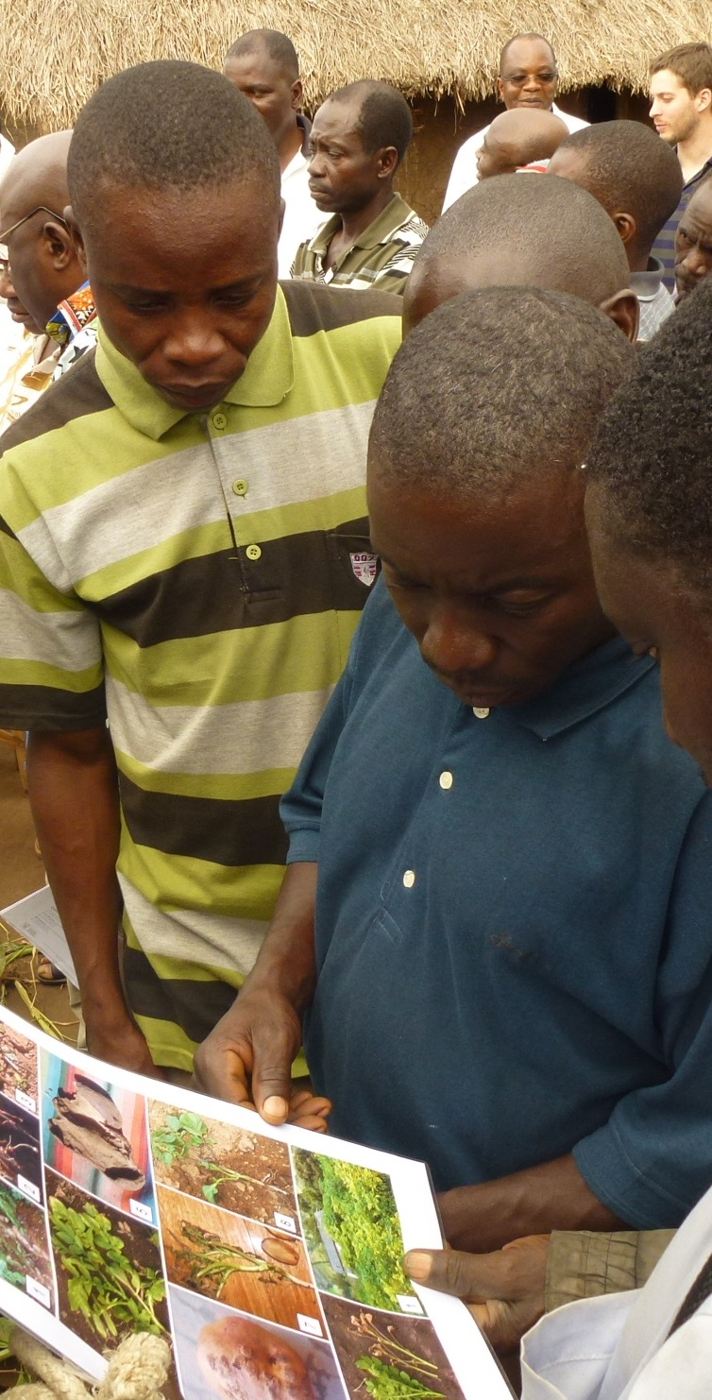
Break-out Groups for Invasives
Random selection
Group 1:
(Roger Day and Carol McNamara)
Group 2:
(Babar Bajwa and Dannie Romney)
Group 3:
(Victor Clottey and Phil Abrahams )
Notes:
image & content
main title - Arial26bold Grey-80%- max 2 lines
subtitle - 18bold Grey-80%- max 2 lines
body text black- may vary depending on heading between min=18pt, max=24pt
This slide is to describe the work of a project, product, department or team.
You may insert your own picture (Click icon to add picture). No line bordering picture.
Portfolio link http://portfolio:8090, enter your usual network username and password
TO ADD MORE SLIDES in Office2007 use the ‘New Slide’ dropdown on the ‘Home’ ribbon

Slide 3

Discussion on key invasives issues
Are invasives an issue? Who is affected and who are the main stakeholders? Why are invasives an issue and what are the gaps nationally, regionally and globally? Which species are causing the biggest problems?
What should we do collectively to address the issues and how will we achieve this?
What partnerships are needed to address invasives?

Slide 4
Consolidated Priority Areas and Issues 2015 - Regional (to modify the table accordingly)
Priority Areas | Priority Issues
Trade and market access and development | SPS compliance; Value-chain focus and postharvest value-addition; GAP and best practices promulgation, and capacity building; Commercialization and contract farming.
Knowledge management, communication and use | Technology transfer (particularly amongst member countries, and south-south); Sharing knowledge amongst stakeholder groups including youth and grassroots (Facebook Agriculture); Mobile advisory services; Improving communications to farmers; Evidence-based policies. Archiving and managing institutional research information.
Plant health | Managing a range of stressors including pests (IPM), water, and soil nutrients; IPM in high value crops; reduction in pesticide inputs; early warning systems for newly emerged/key pests & diseases.
Biodiversity and invasive species management | Invasive management; Capacity building of IS identification and diagnostics; habitat manipulation/agro-biodiversity enrichment Microbial resource collection, characterization and utilization; Development and production of biopesticides, and implications of biopesticides use.
Cross-cutting: Climate smart agriculture Institutional capacity building Publication of, and access to, authoritative information resources

Slide 5
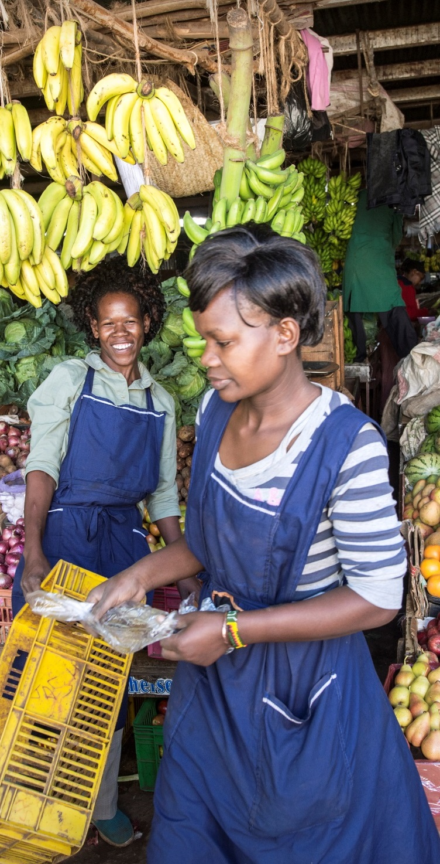
Specific Objectives
Develop recommendations and action plans of agreed “Priority Areas/Issues for Action” for going forward
Notes:
image & content
main title - Arial26bold Grey-80%- max 2 lines
subtitle - 18bold Grey-80%- max 2 lines
body text black- may vary depending on heading between min=18pt, max=24pt
This slide is to describe the work of a project, product, department or team.
You may insert your own picture (Click icon to add picture). No line bordering picture.
Portfolio link http://portfolio:8090, enter your usual network username and password
TO ADD MORE SLIDES in Office2007 use the ‘New Slide’ dropdown on the ‘Home’ ribbon

Slide 6

Discussion Topics
What do you think should be the top 1-2 “Priority Issues for Action”?
What specific activities (e.g. initiatives, programmes and projects) should be included for each agreed “Priority Issues for Action”
What timeframe should be set?
What resources/funding are required and where can they be sourced?
Who should be the partners for these activities?
How should CABI’s Medium-term Strategy address these priority areas, issues and activities?
Notes:
image & content
main title - Arial26bold Grey-80%- max 2 lines
subtitle - 18bold Grey-80%- max 2 lines
body text black- may vary depending on heading between min=18pt, max=24pt
This slide is to describe the work of a project, product, department or team.
You may insert your own picture (Click icon to add picture). No line bordering picture.
Portfolio link http://portfolio:8090, enter your usual network username and password
TO ADD MORE SLIDES in Office2007 use the ‘New Slide’ dropdown on the ‘Home’ ribbon

Slide 7
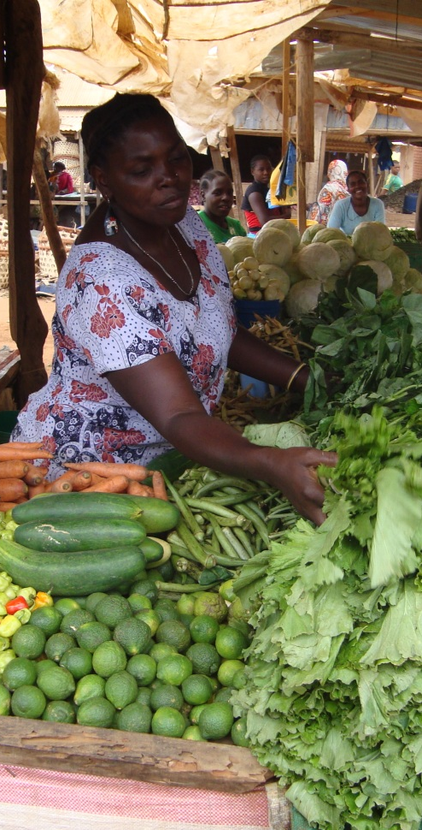
Agreed Priority Areas and Issues for Action by groups
No.1
No. 2
No. 3
Notes:
image & content
main title - Arial26bold Grey-80%- max 2 lines
subtitle - 18bold Grey-80%- max 2 lines
body text black- may vary depending on heading between min=18pt, max=24pt
This slide is to describe the work of a project, product, department or team.
You may insert your own picture (Click icon to add picture). No line bordering picture.
Portfolio link http://portfolio:8090, enter your usual network username and password
TO ADD MORE SLIDES in Office2007 use the ‘New Slide’ dropdown on the ‘Home’ ribbon

Slide 8
Action Plans (1)
Priority Area For Action
Priority Issues
Specific activities
Timeframe
Resources/funding
Partners
Recommendations for CABI MTS

Slide 9
Action Plans (2)
Priority Area For Action
Priority Issues
Specific activities
Timeframe
Resources/funding
Partners
Recommendations for CABI MTS

Slide 10
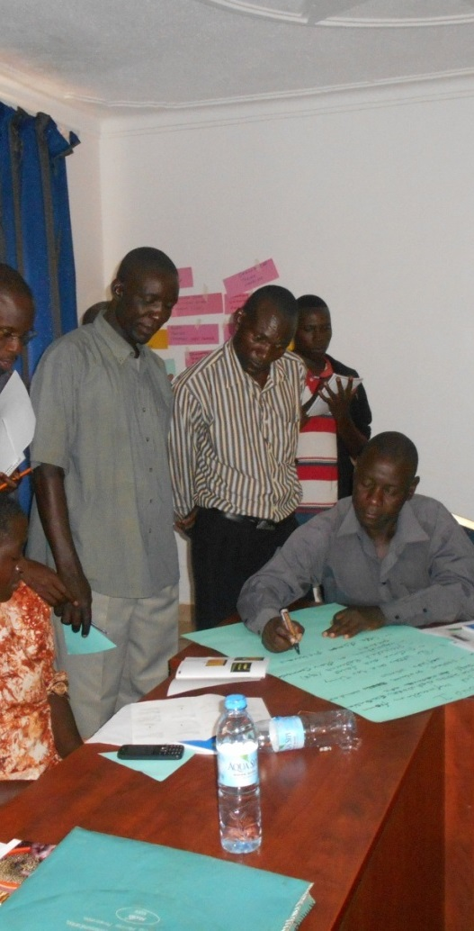
Recommendations for CABI’s Medium-term Strategy 2016-18 in relation to these issues
No.1
No. 2
No. 3
No. 4
Notes:
image & content
main title - Arial26bold Grey-80%- max 2 lines
subtitle - 18bold Grey-80%- max 2 lines
body text black- may vary depending on heading between min=18pt, max=24pt
This slide is to describe the work of a project, product, department or team.
You may insert your own picture (Click icon to add picture). No line bordering picture.
Portfolio link http://portfolio:8090, enter your usual network username and password
TO ADD MORE SLIDES in Office2007 use the ‘New Slide’ dropdown on the ‘Home’ ribbon

Slide 11
Notes:
thank you slide
changes only to name, centre & email
Arial24bold, light green
Please let us know if there are any languages you wish to add to this slide
no change to be made to image

