Slide 2
Chapter 8
Cruise Ships

Slide 3
Cruise Ships
cruise ship: a passenger ship intended to provide passengers with a full tourist experience. All passengers have cabins. Facilities for entertainment aboard are included (Glossary of Transport Statistics, 2009)
cruise product
complex package of transportation, accommodation and leisure facilities on board
itinerary of several destinations to be visited
overall experience is of primary importance
transportation itself plays only a secondary role

Slide 4
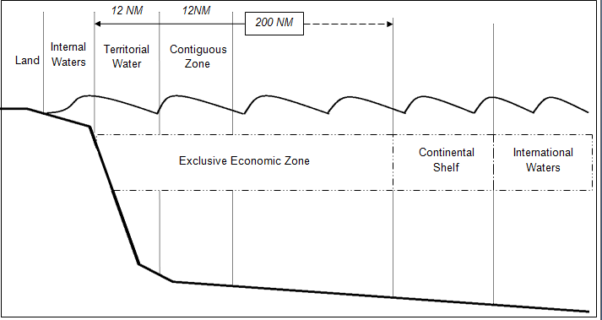
Institutional Framework
IMO = International body responsible for maritime affairs
Treaty - UNCLOS maritime zones
Source : Adapted from The United Nations Convention on the Law of the Sea, 1998

Slide 5
Demand
fastest growing segment within the leisure travel market
average annual passenger growth rate: approx. 7.5%
between 1980 and 2012: 225 million passengers
International demand (numbers of passengers in millions)
Source: Adapted from G.P. Wild, 2012

Slide 6
Supply
Vessel ownership
Ship owner
Financing company
Independent shipping company
Management
Leasing
Charter
Power of disposition
Shipping company
Charter, General sales agent, Commission sales agreements
Charter, General sales agent, Commission sales agreements
Cruise sales
Charter
Tour operator
Broker of the ships
Cruise sales
Cruise sales
Cruise sales
Cruise customer
Uncommon operating model
Common operating model
Source: Adapted from Gross, 2011

Slide 7
Supply
Market shares of the major cruise shipping companies in 2010 (percentage share of berths)
Source: ISL, 2012; ships of 1000 gt and over

Slide 8
Supply
Passenger capacity of world active cruise fleet 1990–2012
Source: ISL, 2012; ships of 1000 gt and over

Slide 9
Supply
World passenger and cargo passenger fleet: average size development 1991-2012
Source: ISL, 2012

