Slide 2
Chapter 3
Travel Intermediaries and Information Technology

Slide 3
Chapter 3 Learning Objectives
After studying this chapter you should be able to:
Explain the evolution, role and features of Global Distribution Systems (GDSs) as travel intermediaries;
Analyze the challenges faced by GDSs as a result of technological change and innovation;
Explain how traditional travel retailers use IT;
Explain how IT has led to disintermediation and evaluate how this has impacted travel intermediaries;
Describe and critically evaluate the different types of online travel intermediaries that have developed as a result of IT; and
Explain how tour operators can use IT to improve productivity and competitiveness.

Slide 4
Key Concepts
Computer reservation systems(CRSs)
Global Distribution Systems (GDSs)
GDS New Entrants (GNEs)
New Distribution Capability (NDC)
Tour operators
Tour wholesalers
Travel retailers
Travel management company (TMC)
Online travel agents (OTAs)
Channel Managers

Slide 5
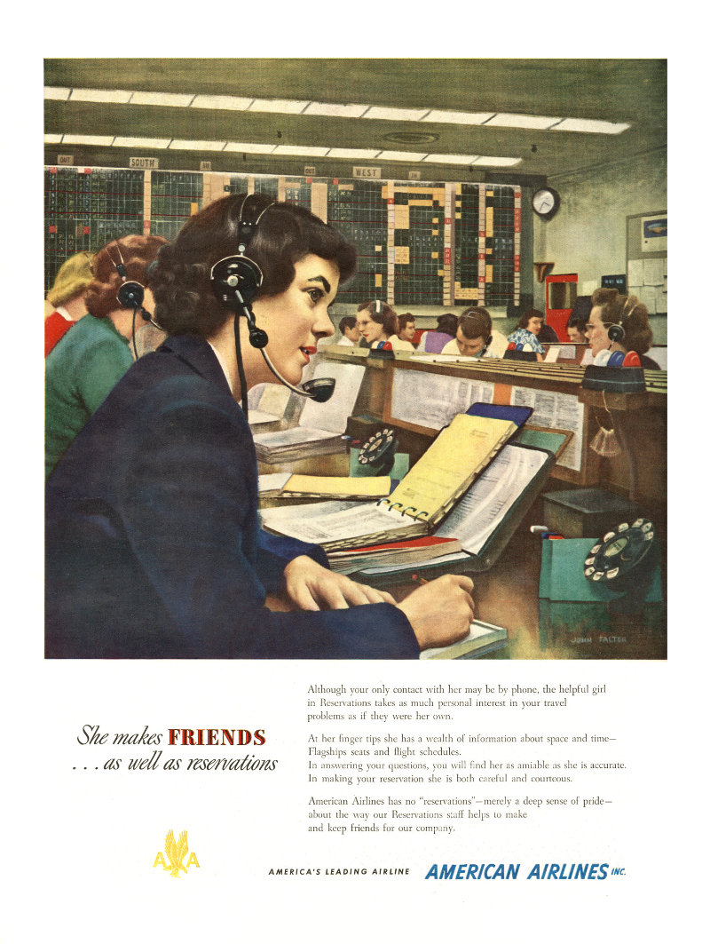
Source: American Airlines

Slide 6
1960
IBM, AA
1960
SABRE
1964
1964
IBM
SABRE
PARS
1968
DL
DATAS
1971
TW, NW
1971
UA
1970
PARS
APOLLO
1976
BA, BR, CCL
TRAVICOM
1980
1982
DL
1982
CO
DATAS II
BA, KL, OS, AZ, SR, OA, SN, TP, EI, Covia
SYSTEM ONE
1988
SQ, CX
1986
1987
AF, IB. LH, SK
COVIA
1987
ABACUS
1990
DL, TW, NW
GALILEO
AMADEUS
1990
WORLDSPAN
1993
GALILEO INT. APOLLO, GALILEO
1995
1998
AMADEUS
SABRE/ABACUS
2000
2006
2010
SABRE/ABACUS
TRAVELPORT APOLLO, GALILEO, WORLDSPAN
AMADEUS
FIGURE 3.2 The evolution of major global distribution systems.

Slide 7
Characteristics of Major GDSs
GDS | Founded | Founders | Market Share | Locations
Sabre | 1960 | American Airlines | 30% | 56,000 travel agency locations. Global presence, strong in US & Asia Pacific
Amadeus | 1987 | Air France, Lufthansa, Iberia & SAS | 39% | 104,000 travel agency locations. Mainly Western Europe, Middle East & Asia Pacific
Abacus | 1988 | Singapore Airlines & Cathay Pacific | 5% | 20,000 travel agency locations. Mainly Asia-Pacific
Travelport | 2006 | Merger of Galileo & Worldspan | 26% | 67,000 travel agency locations. Global presence, strong in US & Western Europe
Worldspan | 1990 | United Airlines
Galileo | 1987 | Nine major European airlines
Apollo | 1971 | Delta, TWA & NW Airlines

Slide 8
Core GDS Functions
Availability
Booking requests
Passenger information
Rates and conditions
E-ticketing & itinerary management
Core GDS functions

Slide 9
Secondary GDS Functions
Booking ancillary services
Secondary GDS Functions
Passenger document requirements
Integrated travel management
Decision support systems
Financial management
E-commerce tools
Corporate travel management
Communication & scheduling

Slide 10
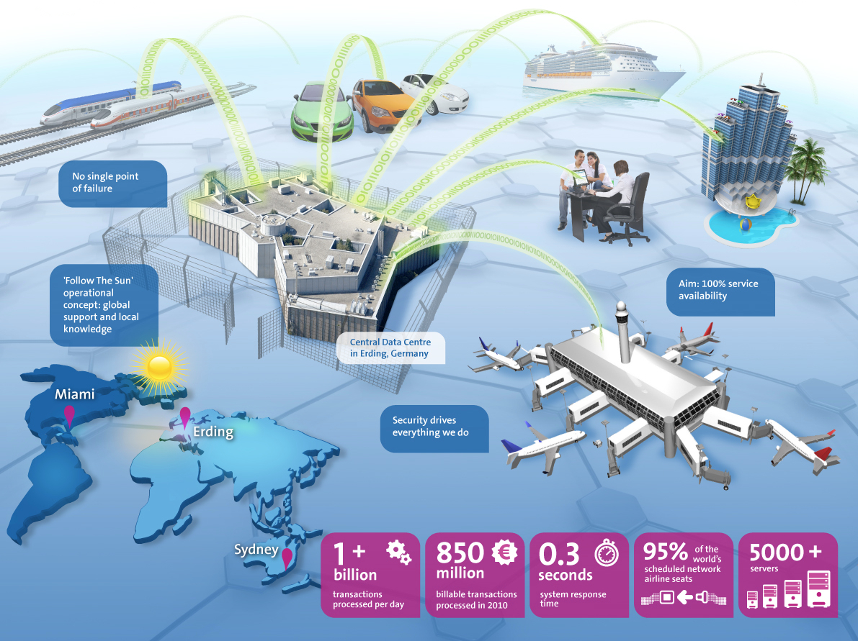
Industry Insights: Amadeus Data Centre
Source: Amadeus, 2014

Slide 11
FIGURE 3.4 Traditional GDS “Green Screen” command line display.
112MAYLCAATH«
12MAY TUE LCA/Z‡2 ATH/‡0
1CY 322 J7 C7 D7 I7 Z4 Y7*LCAATH 0700 0845 319 S 0 123 DCA /E
B7 N7 S7 M7 T7 W7 L7 X7
2A3 903 C4 D4 Z0 A0 I0 J0*LCAATH 0830 1010 321 B 0 DC /E
Y4 B4 M4 K4 W4 S4 H4 L4

Slide 12
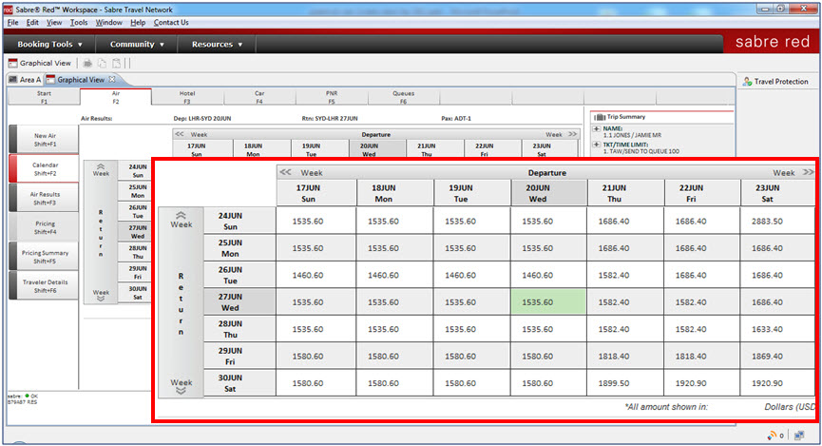
FIGURE 3.5 Sabre Red Graphical Workspace.
Source: Sabre Holdings, 2014

Slide 13
OTA Web GUI
API
API
Suppliers
API
GDS
Agent GUI
FIGURE 3.6 GDS interfaces.

Slide 14
SWOT Analysis of GDSs
 | Positive | Negative
Internal | Strengths Market power Homogenized content Interline bookings Back-office integration Client loyalty | Weaknesses Legacy-based systems Connectivity Pricing innovation
External | Opportunities New suppliers New clients Dynamic packaging Interoperability | Threats GDS New Entrants (GNEs) Open systems Direct bookings

Slide 15
GDS Trends
Diversifying IT solutions
Consolidation
Connectivity and interoperability
Transparency
Personalization
Social, Local and Mobile (SoLoMo)

Slide 16
Tour Operator Use of IT
Package creation
Tour package distribution
Reservations and customer management

Slide 17
Traditional Travel Retailers
Front-office systems
Back-office systems
Accounting systems
Human resource systems
Customer relationship management (CRM)
Communication
Commission tracking
Transaction settlement

Slide 18
Enterprise Resource Planning (ERP) Systems
Back office functions can be integrated into cross-functional systems known as Enterprise Resource Planning (ERP) systems.
Benefits:
Productivity
Reporting
Customer satisfaction
Forecasting

Slide 19
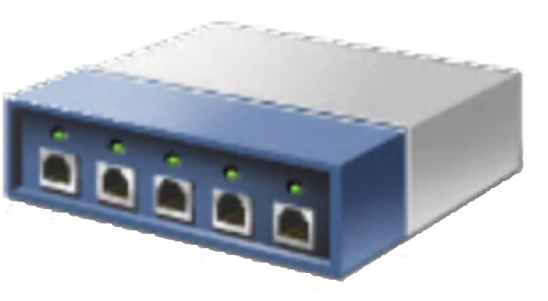
Internet
GDS
Remote users
Modem
VPN client
ISP
VPN/
firewall
Modem
Suppliers
Hub/switch
Server
Router
Wireless devices
Printer | fax |
scanner
Workstations
FIGURE 3.7 Simple travel retailer hardware and network.

Slide 20
Travel Retail Hardware and Networks
Key Terms
Local area network (LAN)
Intranet
Extranet
Virtual private network (VPN)
Firewall

Slide 21
SWOT Analysis of Traditional Retailers
 | Positive | Negative
Internal | Strengths Time and cost Expertise Security Value adding Personalization Special needs | Weaknesses Cost Bias and errors Less choice and transparency Less control High fixed costs Limited opening hours
External | Opportunities Emerging markets Hybrid models Consolidation | Threats Decommissioning Digital competitors Public perceptions Failure to attract talent Lack of investment

Slide 22
Travel Management Companies (TMCs)
Unique characteristics
Contracts and preferred suppliers
Travel policy compliance
Employee productivity
Risk management
Travel expense management

Slide 23
Types of Online Travel Intermediaries
Online travel agents (OTAs)
Online intermediaries
Metasearch engines
Aggregators
Trip planning sites
Affiliates
Group buying sites
Opaque sites
Product review sites

Slide 24
Online Travel Intermediaries
IT Innovations
The Matrix Display
Search filters
Opaque pricing
Dynamic packaging
Flexible date search
Alternative airport search
Low-fare notifications
Mapping
Semantic search

Slide 25
SWOT analysis of online travel intermediaries
 | Positive | Negative
Internal | Strengths Low entry costs and investment Pricing and convenience Customization Choice and control Instantaneous Comparison Flexibility Multimedia | Weaknesses Lack of transparency Cancellation and changes Security Time consuming Limited advice Support (general and special needs) Lack of expertise
External | Opportunities Social Mobile Integration Innovation | Threats Competition Direct bookings

Slide 26
Discussion Questions
What is the difference between a GDS and a GNE? Visit the GDS and GNE websites to help you answer this question. Do you think GNEs are a threat to the GDSs? Justify your answer.
You have started your own small travel retail business. Which GDS would you choose and why?
What is the role of traditional intermediaries in the travel distribution system and are they still needed? How might traditional intermediaries use IT to compete against the innovative features offered by OTAs?
Watch the following video about IATAs New Distribution Capability: http://youtu.be/lW-fIRooeVc. What impact is this IT development likely to have in travel intermediaries?
What is disintermediation and how has it impacted the different types of travel intermediaries described in this chapter? Do you think some of the intermediaries discussed in this chapter are likely to disappear in the next 10 years? Which and why? What role has IT played in this process

Slide 27
Discussion Questions
This chapter provides SWOT Analyses for the GDSs, traditional travel retailers and OTAs. Use the information in this chapter along with your own research to conduct a similar SWOT analysis of TMCs. What do you think the future looks like for TMCs?
Visit two metasearch engines (e.g. Hipmunk, Room77, Skyscanner, Trivago, Kayak) and search for a return flight and hotel to a destination of your choice. Compare and contrast the two sites by identifying the strengths and weaknesses of each. Do they offer different features? Which features do you like the most? What ITs are used to improve the search experience?
Group buying sites and opaque pricing sites have attracted some media controversy. Find some press stories about these types of OTAs and use them to identify the key consumer issues that have generated negative publicity. How can these OTAs overcome these challenges?

Slide 28
Useful Websites
 | Expedia http://www.expedia.com/ |  | Priceline http://www.priceline.com/
 | Sabre Holdings http://www.sabre.com/ |  | Kayak http://www.kayak.com/
 | Travelocity http://www.travelocity.com/ |  | TUI http://www.tui-group.com/en/
 | lastminute.com http://www.lastminute.com/

Slide 29
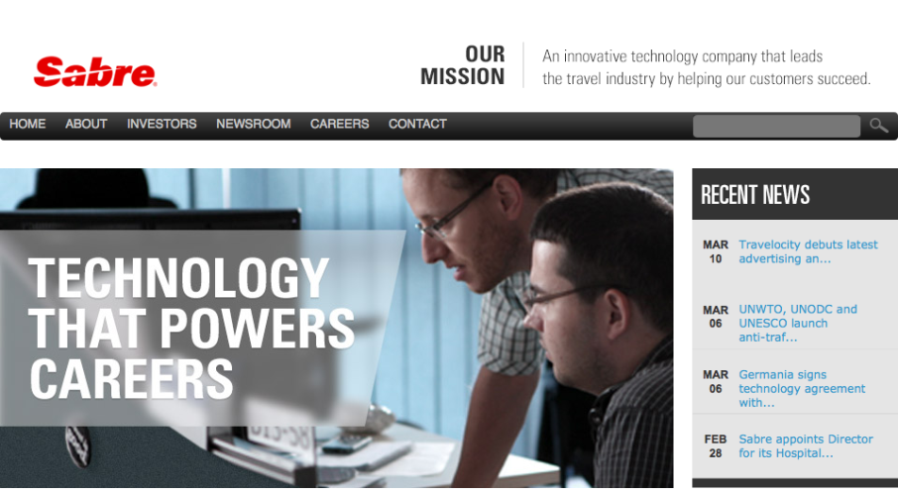
Case Study Sabre Holdings
Founded by partnership between American Airlines and IBM in 1953.
SABRE was the first private real-time online transaction system.
9000 employees in 59 countries.
Diversified beyond GDS to become a travel technology company offering a range of IT solutions for airlines, airports, travel intermediaries, hotels, car rental providers, rail providers and tour operators.
Four business units:
Sabre Travel Network
Sabre Airline Solutions
Sabre Hospitality Solutions
Travelocity

