Slide 1
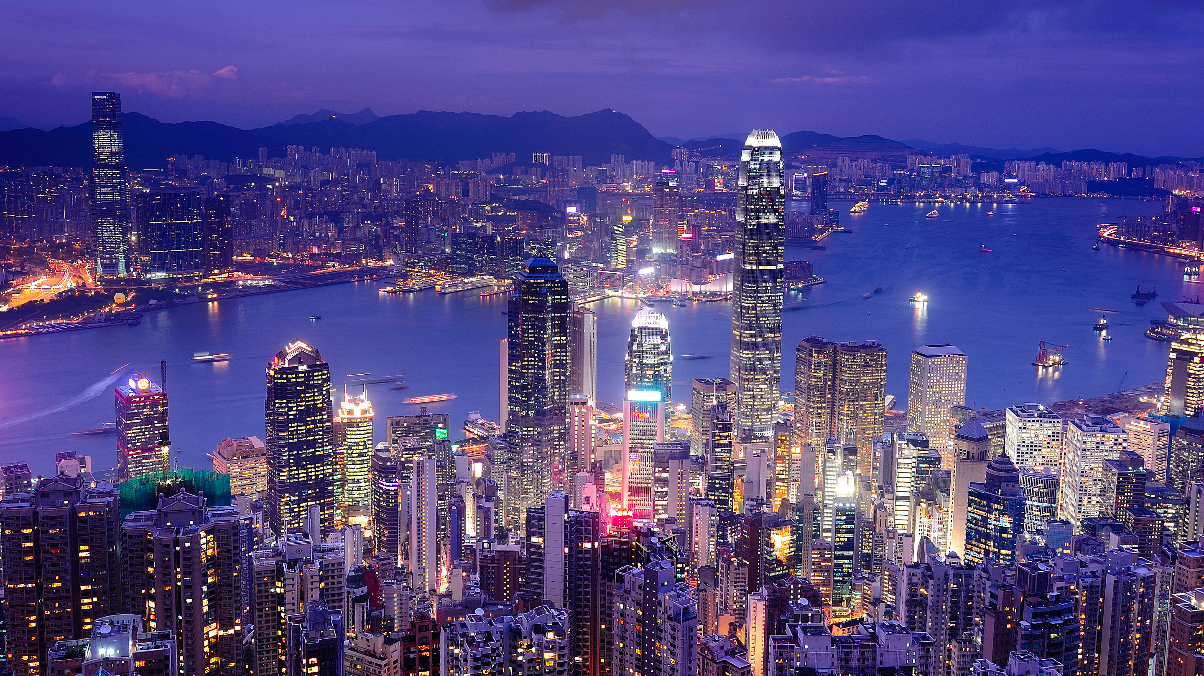
TOURISM
PETER ROBINSON MICHAEL LÜCK STEPHEN L. J. SMITH

Slide 2
5
Road and Rail Transportation

Slide 3
Learning Objectives
To understand the scope and variety of modes of overland forms of transport
To explore the importance of land-based modes of transport for tourism
To understand various marketing and operating strategies for overland transport organizations

Slide 4
Historical Trends
The Railway Age
The Age of Protection
The Age of Administrative Planning
The Age of Contestability

Slide 5
The Bicycle
Categories
  Infrequent leisure cyclists
  Occasional leisure cyclists
  Frequent leisure cyclists
  Cycling enthusiasts
Tracks and trail systems

Slide 6
The Private Car
History (Ford Model T)
Reasons for popularity
  Low cost, especially when shared
  Convenience
  Flexibility in departure times, routings, stops
  Enhanced experience
  Easier luggage transportation
  Guaranteed transportation at destination

Slide 7
Categories
Rental cars
Taxi
Motorhome/RV/caravan

Slide 8
Rental Cars
History
  1912: Sixt
  1918: Jacobs
Focus
  Dominated by business travel
  Leisure/tourist rentals growing rapidly

Slide 9
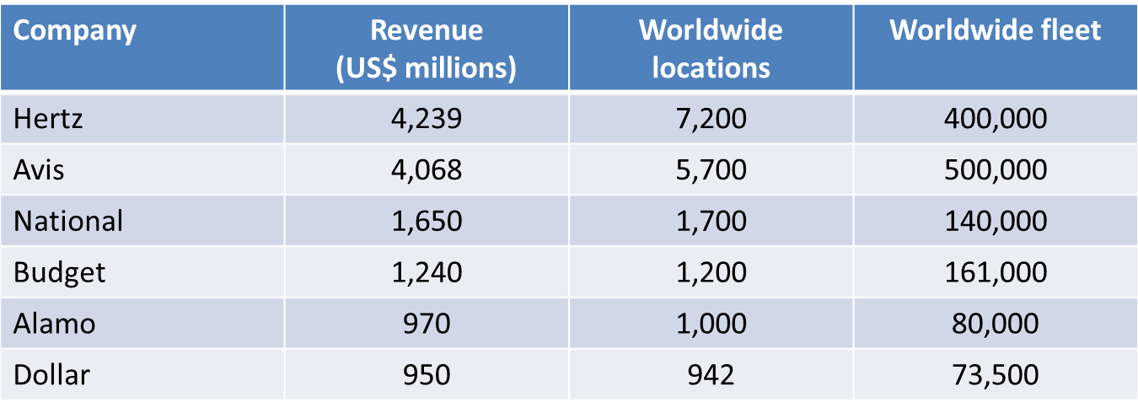
Major Car Rental Companies

Slide 10
Bus and Coach Travel
History
  1662: Blaise Pascal
  Late 19th/early 20th century: self-propelled motorcoaches
Regulation
  USA/UK – similar to air traffic

Slide 11
Categories
Sightseeing tours
Packaged tours
Urban tours
Express bus services
  Hop-on-hop-off
Urban commuter services
Airport shuttles
Charter services
Specialist services

Slide 12
The Railway
History
  1550: ‘wagonways’ on wooden rails
  1804: first steam engine railway in Wales (iron)
  1825: first passenger rail service in England
  1829: first passenger rail service in the USA

Slide 13
Passenger Rail Services Today
Routes
Types
  High-speed trains (TGV, Shinkansen, ICE)
  Heritage trains
  Commuter trains
  Underground trains
  Maglev (Magnetic Levitation)
  Cable cars

