Slide 1
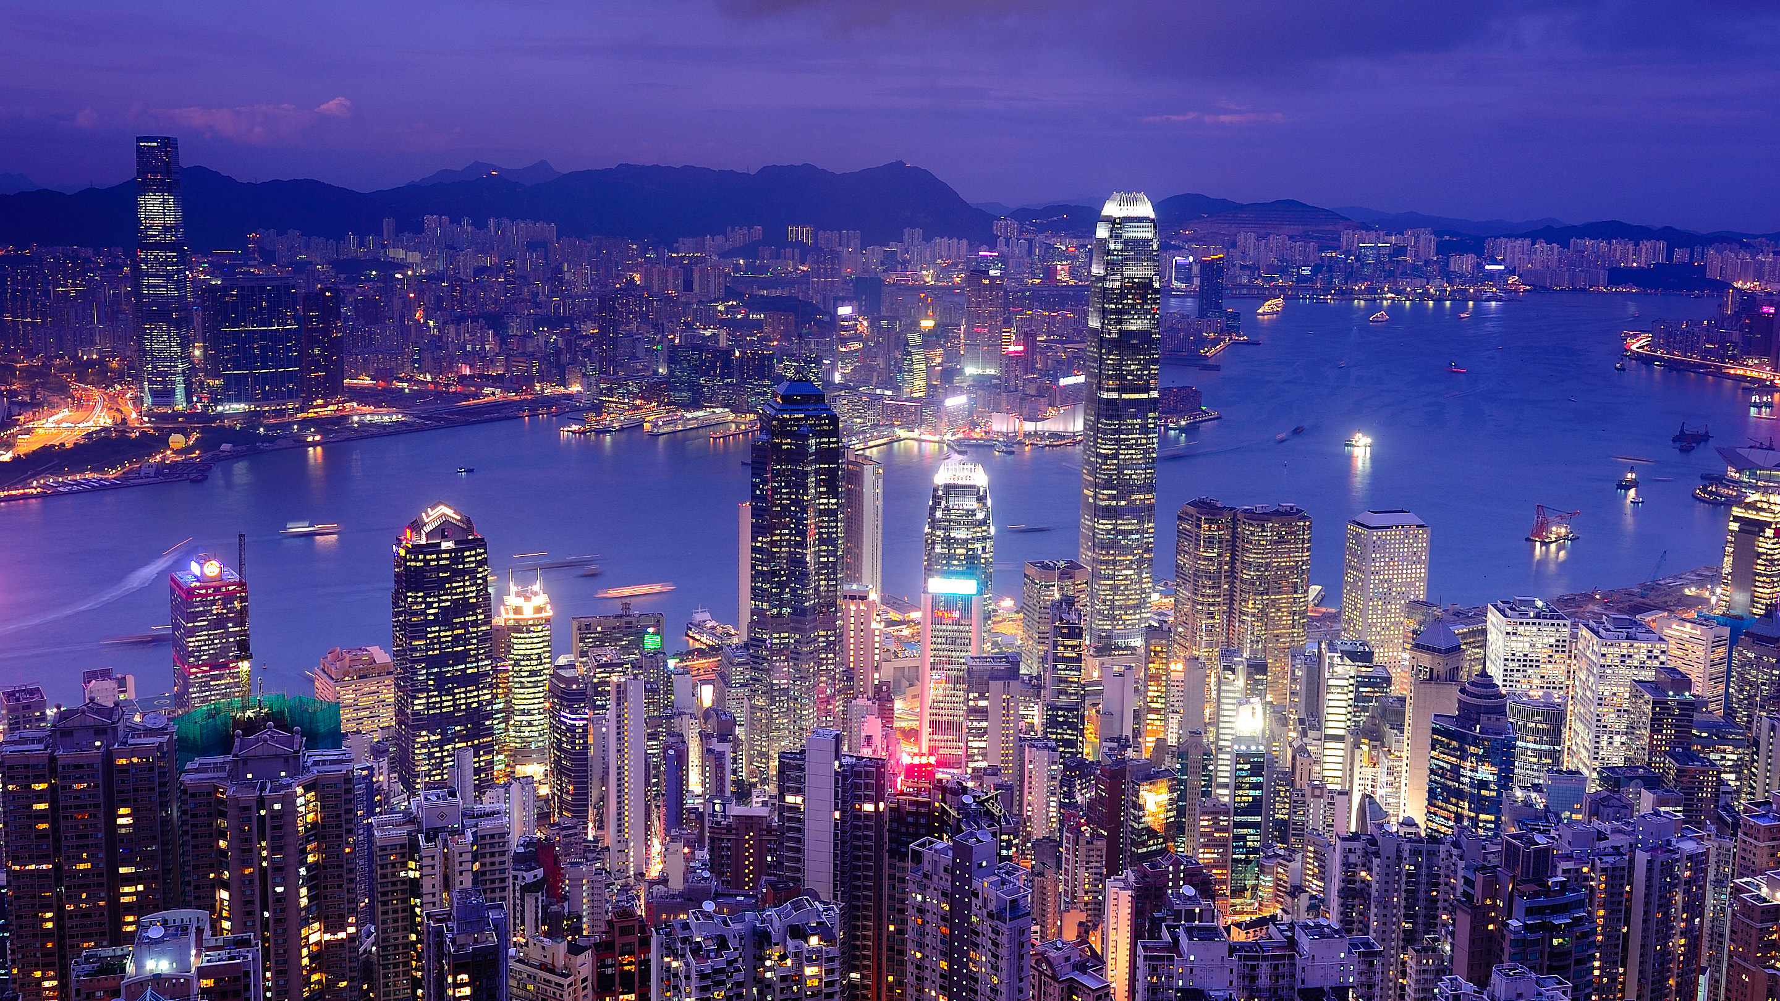
TOURISM
PETER ROBINSON MICHAEL LÜCK STEPHEN L. J. SMITH

Slide 2
2
The Economics of Tourism

Slide 3
Learning Objectives
To define the nature of economics
To understand key concepts from micro- and macro-economics relevant to tourism
To describe the nature of tourism industries and commodities
To appreciate the contributions of tourism to an economy
To understand the nature and use of Tourism Satellite Accounts

Slide 4
Scope of Economics
Fundamentally
  Measurement and understanding of decisions about the use and allocation of scarce resources
  Scarce resources: resources for which potential uses are greater than supply
  Thus, choices must be made about which uses to support

Slide 5
Scope of Economics
Two branches
  Macro: functioning of large-scale economic systems such as labour markets, the effects of inflation and governmental economic policies
  Micro: valuation, pricing, and decision-making by individuals, families and businesses

Slide 6
Key Macro-economic Concepts
Industry
  A group of businesses producing essentially the same product using the same technology
  A hierarchical concept: can refer to a general type of business such as ‘accommodation’ or to specific forms such as hotels, motels, resorts
  New industries emerge over time and old ones may disappear

Slide 7
Key Macro-economic Concepts
Industry
  Defined by ‘characteristic commodity’ – the product that describes core activity
  Industries are classified by a nation’s Standard Industrial Classification System (SIC)
  Characteristic commodities are identified by the Central Product Classification System (CPC) – tied to the SIC

Slide 8
Key Macro-economic Concepts
Industry
  SIC and CPC used to construct a nation’s System of National Accounts (SNA)
    Measures size of all industries, interconnections, inputs and outputs
  Key output of SNA is the Gross Domestic Product (GDP) – a measure of the combined output of all industries in a nation
    A fundamental tool for shaping national economic policies

Slide 9
The Challenge of Tourism
Tourism is a major economic activity in many nations but …
  Is not an industry in the sense that the SNA uses the term
There are tourism industries – just not a single, all-encompassing tourism industry
  What is a characteristic commodity of a tourism industry?

Slide 10
Tourism Commodities
A ‘characteristic commodity’ of a tourism industry is any service or good that earns a significant portion of total revenues from persons engaged in tourism
  ‘Significant portion’ is a matter of judgement
This is called a ‘tourism commodity’
  e.g. hotel accommodations, passenger air service, restaurant meals
  Based on classifications in the CPC

Slide 11
The Challenges of Tourism
Tourism commodities are also purchased by people not engage in tourism: e.g. restaurant meals
Tourism commodities are also produced by non-tourism businesses: e.g. some department stores offer travel agency services

Slide 12
The Challenges of Tourism
Some tourism commodities are purchased frequently by people not engaged in tourism, e.g. insurance (for flight cancellations or illness), or clothing (purchased as a souvenir)
  These are not tourist commodities because most are purchased by non-tourists

Slide 13
The Challenges of Tourism
Some tourism industries sell non-tourism commodities: e.g. laundry services or telecommunication services offered by hotels
To measure tourism: count the value of all transactions that are legitimately tourism but not those that are not

Slide 14
Tourism Satellite Accounts
Designed to model tourism as an industry (even though it is not an industry)
Set up as an extension – ‘satellite’ – of a nation’s SNA
Measures tourism’s contribution to an economy but does not provide a full measure of economic impact of tourism

Slide 15
Economic Impact
Measures the changes in an economy as tourism increases or decreases
Three basic types
  Direct: magnitude of visitor spending
  Indirect: magnitude of tourism businesses purchasing supplies and services from other businesses
  Induced: impact of employee spending in community
Employment impact: jobs created by tourism

Slide 16
Economic Impact
Other measures
Employment impact: job creation driven by tourism
Employment income: wages and salaries provided by tourism
Tourism value-added: the value of tourism goods and services produced in a community, minus the wages, salaries and benefits paid by the employer

Slide 17
Economic Impact
Other measures
  Wealth
    Wages and salaries provided by tourism
    Increase in property values
    Investment income generated through tourism
  Multipliers
    Measure of overall increase in wealth arising from visitor expenditures; associated with economic impact
    Several types, each must be used and interpreted with caution

Slide 18
Economic Impact
Other measures
  Government revenues
    Sales taxes or value-added taxes
    Excise taxes
    Property taxes
    Income taxes
    Business licensing fees
    Fees for visas and passports
    Admission fees from government tourist attractions such as museums and parks

Slide 19
Key Micro-economic Concepts
Value
  Exchange
  Intrinsic
  Existence
  Option
Assets
  Tangible versus intangible
  Constructed versus natural

Slide 20
Key Micro-economic Concepts
Consumer surplus
Opportunity costs
Economic rent
Public goods
  Competitive versus non-competitive
Merit goods
Taxation

