Slide 1

TOURISM
PETER ROBINSON MICHAEL LÜCK STEPHEN L. J. SMITH

Slide 2
1
An Introduction to Tourism

Slide 3
Learning Objectives
To be able to describe the evolution of tourism over time generally as well as historically in selected countries
To be able to define tourism
To summarize the ‘tourism system’ and the key players and components in contemporary tourism

Slide 4
History of Tourism
Tourism has its roots in ancient history
  Sumeria
  Egypt
  Greece
  Rome
  Polynesia

Slide 5
History of Tourism
China
  Zheng He, between 1405 and 1433
Morocco
  Ibn Battuta,14th century
Venice
  Marco Polo, 14th century
Europe
  The ‘Grand Tour’, 17th to 19th centuries

Slide 6
Tourism in Other Lands
Africa
  Egypt: pyramids, Red Sea resorts
  Ecotourism, national parks, wildlife
  Culture and history
Asia
  Very large geography
  Very diverse climate, cultures, attractions, activities

Slide 7
Tourism in Other Lands
Australasia
  Australia, New Zealand, Pacific microstates
  Generally, long distances from key markets
  Resorts and beaches, ecotourism, cultural tourism, culinary tourism
  Air transportation critical

Slide 8
Tourism in Other Lands
Europe
  Long history of tourism
  Cultural tourism, spas/health tourism, culinary tourism, resorts (especially around Mediterranean), sport tourism
  ‘Invented’ mass tourism
  Major market for both outbound and inbound tourism
  Air, rail, private automobile travel important

Slide 9
Tourism in Other Lands
North America
  Canada: best known for environmental-based tourism
  USA: leading origin and destination in the world
  National parks
  Innovations in theme parks
  Innovations in financial services for travellers (credit cards)
  Private car is paramount

Slide 10
Tourism in Other Lands
South America
  Brazil: carnival, host to Olympics, rainforests, ecotourism
  Peru: archaeology
  Chile: wines, cuisine, diverse geography
  Argentina: wines, colonial history, beaches

Slide 11
Characterizing Tourism
Numerous definitions
  Related to hospitality
  Includes both leisure and business travel
Distinctive qualities
  Intangible
  Heterogeneous
  Services consumed on-site ‘in situ’
  Perishable
  Experience-centred

Slide 12
Characterizing Tourism
Tourism system
  Combines origin, destination and travel between them
  Sets various tourism industries into context: accommodation, food services, attractions, travel services, etc.
  A tourism experience is the sum of all the parts of the systems

Slide 13
Characterizing Tourism
The UNWTO definition
  Activities engaged in by persons temporarily away from their usual environment for not more than 12 months for a wide range of purposes, excluding travel to earn income

Slide 14
Characterizing Tourism
Forms of tourism
  Domestic: travel in one’s country of residence
  Inbound: visitors coming from another country
  Outbound: residents leaving to visit another country
  National: travel by residents of a country, whether in their own country or to another country
  Internal: all travel within a country regardless of whether by residents or visitors to that country
  International: travel that involves visitors crossing an international boundary

Slide 15
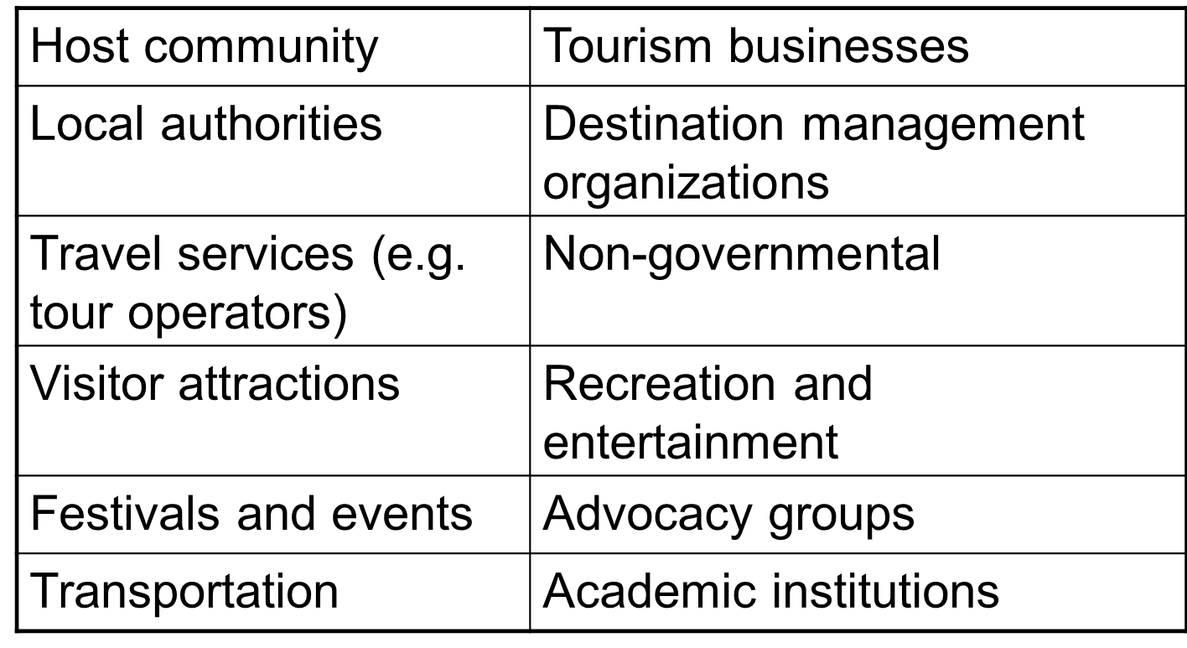
Tourism Organizations

Slide 16
The Study of Tourism
Emerged in colleges and universities in the 1970s
Originally a topic in social sciences; now a topic in its own right
Related to hospitality but distinct
‘Front of house’ versus ‘back of house’
An emerging, evolving field of study
Draws on numerous other fields

