Slide 1
The Business of Plant Breeding:
Market-led approaches to new variety design in Africa
Chapter 2
Visioning and Foresight for Setting Breeding Goals
Nasser Yao, Appolinaire Djikeng and Jonathan Shoham

Slide 2
Chapter 2 Visioning and Foresight for Setting Breeding Goals
Nasser Yao*, Appolinaire Djikeng* and
Jonathan Shoham**
*Biosciences for Eastern and Central Africa (BecA) - International Livestock Research Institute
** Syngenta Foundation for Sustainable Agriculture,
WRO-1002.11.54, P.O. Box 4002, Basel, Switzerland.

Slide 3
Chapter 2 Objectives
To empower plant breeders and R&D leaders to consider future agricultural landscapes in Africa.
2. To equip breeders with methodologies to design new varieties that will remain relevant and satisfy market demands over time.
3. To identify drivers that may affect whether farmers adopt new varieties in the future.

Slide 4
Chapter 2 Contents
Introduction
2. African Agricultural Outlook, Challenges and Policy
3. Visioning and Foresight, using STEEP Analysis and Scenario Creation
4. Integrating Foresight into New Variety Design
5. Risk Management

Slide 5
1. Introduction
Group Discussion
What is your time frame to create and release a new variety?
How do you forecast the future demand of your varieties?

Slide 6
2. African Agricultural Outlook, Challenges and Policy

Slide 7
Africa at a Glance: Agricultural landscape
Food supply vs. demand
Demand growth is fastest in the world
SSA population c. 800 million
220 million undernourished
Mean population growth in SSA is c. 3% (-ve Europe, 0.5% Rest of the World)
Population size expected to double in 35 years
Population growth is double in urban vs. rural areas
Demand

Slide 8
Africa at a Glance: Highest Rate of Population Growth
1.0
4.2
0.7
0.6
0.3
Total population billion (2010)
Source: UNFPA

Slide 9
Africa at a Glance: High GDP per Capita Growth: 2004 – 13
4%
5%
9%
3%
4%
5%
7%
4%
5%
5%
3%
6%
3%
4%
5%
8%
3%
6%
1%
2%
3%
5%
7%
6%
2%
3%
10%
2%
2%
0%
6%
Source: World Development Indicators (World Bank); SFSA analysis

Slide 10
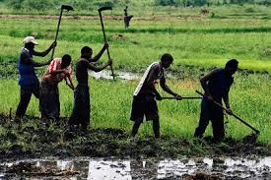
Challenges of SSA Agriculture: Low Productivity in Smallholder Farming
Tonne/ha (2014)
Source:
PSD (USDA)

Slide 11
Reasons for the Low Productivity
Input market constraints
Seed laws/industry
Local fertilizer industry
Distribution system
Credit availability
WEAK PRIVATE SECTOR
Poor access to markets (lack of access to resources/inputs)
Rapid urbanization growth (lack of access to land, degradation of natural resources)
Low investment in agricultural research, training and extension services
Agricultural constraints
Infrastructure; land rights
African crop diversity/uniqueness
Lack of extension/various farming systems
Lack of storage
Overall constraints
War; corruption; governance; education; lack of country economies of scale
Low inter-regional trade
Highest Tariffs
Source:
J L Shoham

Slide 12
However we are now in a period of renewing optimism….
..And it is possible for Africa to feed itself and generate income..
Uganda: Growing apples, displacing imports
Zambia: Increase of cotton production
Kenya: Flower exports surpassed coffee exports
Ethiopia: Beans and coffee from local cooperatives responding well to international markets
DRC: Post-conflict areas relying on cavies for nutrition and growth

Slide 13
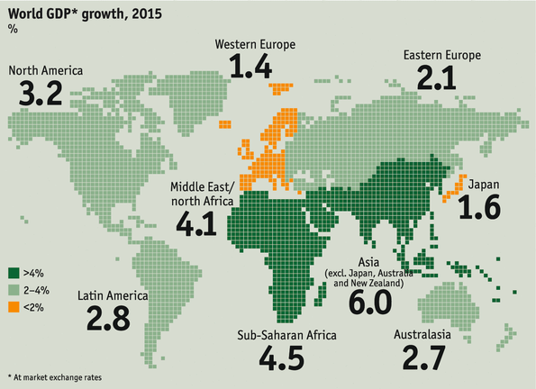
Optimism in African Agriculture Exists..
GDP growth forecasts for 2015: Africa and Asia leading
4.5
…through significant agricultural transformation
Source: ‘The World in 2015’, The Economist

Slide 14
Strategies for Transforming African Agriculture
Improving agricultural productivity
Availability and widespread use of quality farm inputs and technologies, including crop biotechnologies
Facilitating growth in agricultural markets and trade
Investing in public infrastructure for agricultural growth
Reducing rural vulnerability and insecurity
Improving agricultural policy and institutions
Foresight and visioning to meet market/consumers’ demands
Notes:
Introduction to unit 2 is very long

Slide 15
Global Seed Companies in Africa
 | DuPont Pioneer | Monsanto | Vilmorin | Seed Co | Syngenta | Others
Southern
South Africa | ✓ | ✓ | ✓ | ✓ | ✓
Zambia | ✓ | ✓ | ✓ | ✓ | ✓
Zimbabwe | ✓ | ✓
Malawi | ✓ | ✓ |  | ✓
Others | Lesotho, Botswana, Angola |  |  | Angola, Botswana, Swaziland |  | Angola/Baddar
Eastern
Kenya | ✓ | ✓ | ✓ | ✓ | ✓
Tanzania | ✓ |  |  | ✓
Uganda | ✓
Ethiopia | ✓ |  |  | ✓
Mozambique | Setting up |  |  | ✓
Others |  |  |  | Rwanda
North
Morocco |  |  | ✓
Tunisia | ✓ |  |  |  |  | Baddar
Egypt | ✓
Algeria |  | ✓ |  |  |  | Baddar
Libya | ✓
West
Nigeria | Setting up |  |  | ✓ |  | Baddar
Ghana | ✓ |  |  | ✓
Senegal |  |  |  |  |  | Baddar
Others |  | Burkina Faso |  | DRC |  | Baddar: Benin /BF /Cameroon/Chad/Cote D’Ivoire/ Guinea/Mali
# Countries | 15 | <10 | NA | 15 | NA | Baddar: 15 Bayer: 8
Source: Commercial Seed Market in Africa, J L Shoham, Informa, 2014
Notes:
There is also increasing investment in the African seed sector [Slide 31] by both global R&D-based see companies

Slide 16
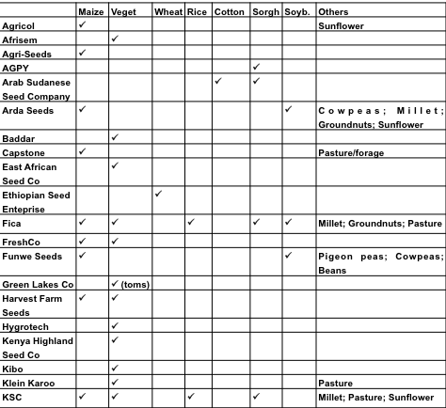
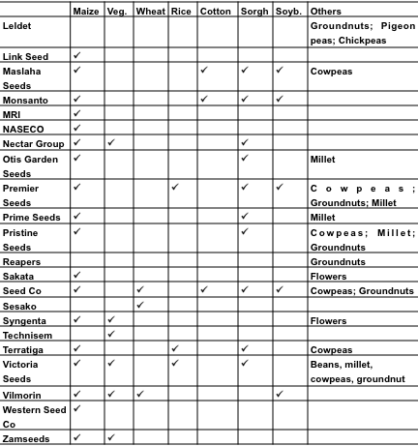
African seed companies and crops portfolio
Source: Commercial Seed Market in Africa, J L Shoham, Informa, 2014
Notes:
There is also increasing investment in the African seed sector [Slide 31] by both global R&D-based see companies [Slides 32-34] and local African copmaines [Slides 35-36]

Slide 17
3. Visioning and foresight using STEEP analysis and scenario creation

Slide 18
3. Visioning and foresight using STEEP analysis and scenario creation
How accurately can we predict the future?
Too many factors and interactions to consider?
Focus on key drivers of change
Construct a range of possible future scenarios
What actually happens is more likely a ‘hybrid’
Test strategies for robustness against these scenarios

Slide 19
STEEP: Useful Framework for Identifying Drivers of Change
Identify the drivers of change by type
Social
Technological
Economic
Environmental
Political/Policy

Slide 20
STEEP Analysis and Scenario Creation
STEP 1 – Identify key drivers of change and assess their predictability
STEP 2 – Access reliable information sources
STEP 3 – Scenario creation using unpredictable drivers (‘splitting factors’)
STEP 4 – Variety specification validation
Notes:
Splitting factors – genome editing to replace a gmo

Slide 21
Social Drivers
Driver | Impact | Predictability | Source
Population growth | Total demand | High | UN data
Urbanization | Dietary habits and tastes | High | UN data
GM accept-ability and regulation | Technical possibilities | Low | IFPRI, ISAAA, News media
Notes:
Attitudes towards GM crops, which are not, also come under this category [Slide 19]

Slide 22
Technological drivers
Driver | Impact | Predict
Biotechnology | Genetic variance, speed and cost | Low
High throughput phenotyping | Selection intensity, number of years per breeding cycle | Low
High throughput genotyping | Selection accuracy, breeding speed and cost | High
Pre-Breeding | Breeding possibilities | Low
Core Breeding | Breeding possibilities | Low
Post Breeding | Breeding possibilities | Low
Big Informatics data | Data management and analysis | Low
Notes:
Technological drivers are those which you will be very familiar with: Speed of the breeding cycle, change in breeding direction (advances in biotechnology, sequencing etc).[Slide 20] ] Amount of data: biology, genetics, molecular, environement and bioinformatics: ‘Big data’ in agriculture also comes under this category. They heavily impact the supply side of the equation d for both crops and seeds. These drivers are far from predictable depending on they do on scientific innovation [Slide 21]

Slide 23
Economic Drivers
Driver | Impact | Predict. | Source
GDP/capita | Food consumption patterns | High | World Bank FAO Food Balance Sheets
Food industry /retailer development | Demand for improved seeds, AMC’s, Scope for PPP’s | Medium | Reardon (2011)
Seed company developments | Seed improvement | Medium | Informa (2014)
Dealer network | Accessibility of seeds | Low | AGRA (2013)
Notes:
Economic drivers cover such things as crop prices, GDP per capita, and investment in the food chain, whether in the seed sector itself, or downstream in the processing and retial sectors [Slide 22]. These heavily influence the demand side for crops and the supply side for seeds.
Some of these drivers, such as the GDP-related ones, are predictable. Others, such as the development of infrastructure and the agro-dealer network, less so [Slide 37]

Slide 24
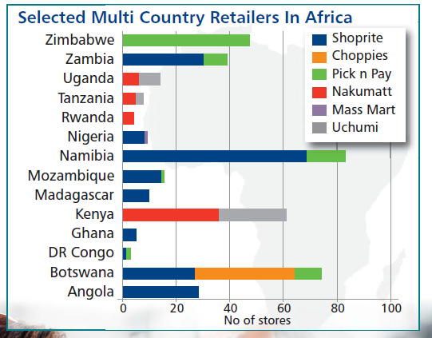
Selected Multi-Country Retailers in Africa
Source: Promar, Insight, June 2014

Slide 25
Environmental Drivers
Driver | Impact | Predict. | Source/ Milestones
Climate change | Crop yields Agronomic traits Extreme events | Low | IPCC/Paris 2015
Certification schemes | Traceability Food safety Export market access | Medium
Pest incidence | Crops yields and quality | Low | CABI Plantwise
Notes:
Environmental drivers relate to climate change and pest incidence and very much affect the supply side and include Global warming and change Extremes: droughts and floods, Carbon credits for agriculture, Pest and disease incidence and Certification schemes
At the moment, despite the considerable efforts being made to better understand and model these (here there is a link to ‘Big data’) these remain unpredictable [Slide 39].

Slide 26
Political Drivers
Driver | Impact | Predictability | Source
National seed laws | IP protection Private sector investments | Low | SeedQuest
Regional seed/variety harmonization schemes | Development costs, speed of variety release | Low | COMESA, ECA, ECOWAS SADC
Ag policies (CAADP) | Investment focus | Low | CAADP web site
Nutrition policies | Consumer traits | Medium | IFPRI
Notes:
Political drivers [Slide 41] embrace seed regulations [Slide 42], agricultural subsidies and tariffs, which impact both supply and demand for crops, and trade-related developments such as regional trade agreements [Slide 43]. Political drivers are inherently unpredictable [Slide 44]

Slide 27
Seed Harmonization Schemes
Regional grouping | Status
SADC (Southern Africa) | MoU signed 2013 It is now for individual countries to join up
COMESA (Eastern and Southern Africa) | Draft COMESA Seed Trade Harmonization regulations adopted Sept 2013
EAC (East Africa) | 2-year project started Oct 2013
ECOWAS (West Africa) | Seed Regulation adopted in 2008 but not yet implemented in most countries
Source: Commercial Seed Market in Africa, J L Shoham, Informa, 2014

Slide 28
Group Exercise
What is your time frame to create and release a new variety ?
Identify drivers of change that could affect your variety designs on this time frame
Which drivers are unpredictable?
What different agriculture scenarios could there be?
How could the various scenarios affect the need for plant breeding and new variety designs?

Slide 29
4. Integrating Foresight into Variety Design

Slide 30
Integrating foresight into new variety design
Foresight methods are used to review existing variety designs or as a starting point to create new designs.
Every trait characteristic in each product profile should be analysed and a decision taken if the trait and benchmark is likely to remain relevant over the time required for variety development.

Slide 31
Risk management
Risk analysis and mitigation is essential for testing long-term viability of demand-led designs
Decision points are required in the stage plan and risk spreading considered
e.g. benefits and costs of maintaining many biologically diverse germplasm lines

Slide 32
What Next?
Having analysed the drivers and identified the ‘splitting factors’:
Construct 2—4 scenarios around ‘splitting factors’
Test your breeding strategies against these scenarios
Identify signposts and put in place indicators
Review and amend variety designs and plant breeding targets
Notes:
Having been through the above process of identifying the drivers and analysing their predictability you are now in a position to construct your scenarios [Slide 46]

Slide 33
The Business of Plant Breeding:
Market-led approaches to new variety design in Africa
Chapter 2
Visioning and Foresight for Setting Breeding Goals
Nasser Yao, Appolinaire Djikeng and Jonathan Shoham

